Slide 1

The Materials Commons A Novel Information Repository and Collaboration Platform for the Materials Community
Staff: Glenn Tarcea, Sravya Tamma,
Domain Scientists: Brian Puchala, Emmanuelle Marquis and John Allison
Information Scientists: Margaret Hedstrom (SI) and
H.V. Jagadish (CSE)
The University of Michigan

Slide 2

PRISMS Overarching Vision Enable accelerated predictive materials science.
Collaboration
Experimental & Simulation Information
Seamless, Continuous Workflow
Provenance Tracking
Accelerate model building and validation
Integrated
Science
PRISMS
Computational
Tools
The Materials
Commons

Slide 3
The Materials Commons - Goals
Notes:
Goals:
Store materials data
Experimental and computational
Including provenance
Collaborate and share data
Facilitate large team integration
Integrate experiments, computation, and theory
Search and use data
Find, synthesize, visualize, analyze, explain
Parameterize constitutive and process models
Seamless part of the scientific workflow

Slide 4
The Materials Commons
The Materials Commons consists of:
2 full time professional staff
>25 PRISMS faculty and grad students as users.
A 390 TB Isilon storage cluster data repository
A website for uploading and downloading data, adding provenance, sharing and searching for data
An application installed on your computer for uploading and downloading data
A REST based API to access and extend the capabilities of the repository
Interacting with NIST, Globus, USAF ICE et al, (and you?) to share best practices, schemas, etc.
Scheduled for PRISMS Community use in Summer 2015.
Notes:
Discuss data protection
Small team requires us to constantly prioritize

Slide 5
Features
File versioning
History change tracking (Provenance, Samples, Files, Attributes and Measurements)
Link your data together
Processes to samples
Samples to files
Rich data model
REST API
Bulk Upload
Collaboration within projects
Real time indexing and searching
Online User Guide
All code has been open sourced (MIT License)
https://github.com/materials-commons

Slide 6
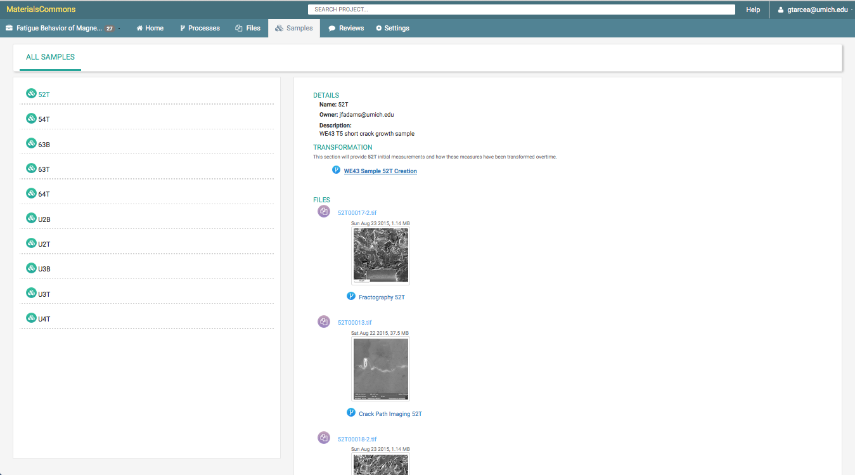
Linking Samples to Processes and Files
Samples page shows you all relationships. You can
create complex relationships that model your
work flow.

Slide 7
Challenges
Workflow capture in a data model
Translating a complicated model into an easy to use UI
Reducing friction/needless steps in the UI
How to easily enter property measurements into the system to enable more powerful features
Data entry twice
Different file formats
Some are proprietary
Different representations in Excel
Asking users to enter their data in after they have already captured it (extra steps)
What should you be able to do with data once it has been entered
Design flexibility to capture different workflow and provenance needs
Updating existing projects and data as data capture improves

Slide 8
Materials Commons Technologies
API/REST Services are all JSON based
JSON Document store on backend (RethinkDB)
Website written using AngularJS
Backend is a mix of Python, Go and Node
Elasticsearch for document indexing
Enhanced FlowJS protocol for all file transfers
Docker Containers for select services

Slide 9
Block Architecture Diagram
HTTPS
HTTP
NGINX
SSL
Reverse
Proxy
Website
Shared Service Access
JSON
API
Services
Web Service
User
Elasticsearch
Cluster
Scripts
Database Cluster
JSON/
FlowJS
Data
Services
Data Upload
Data Loader
Services

Slide 10
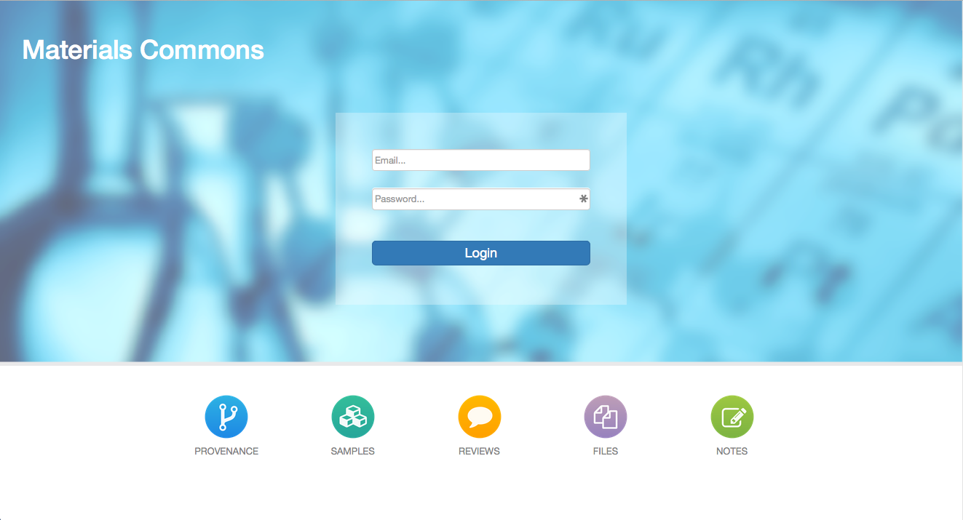
The Materials Commons: https://materialscommons.org
Splash page outlines the prominent features

Slide 11
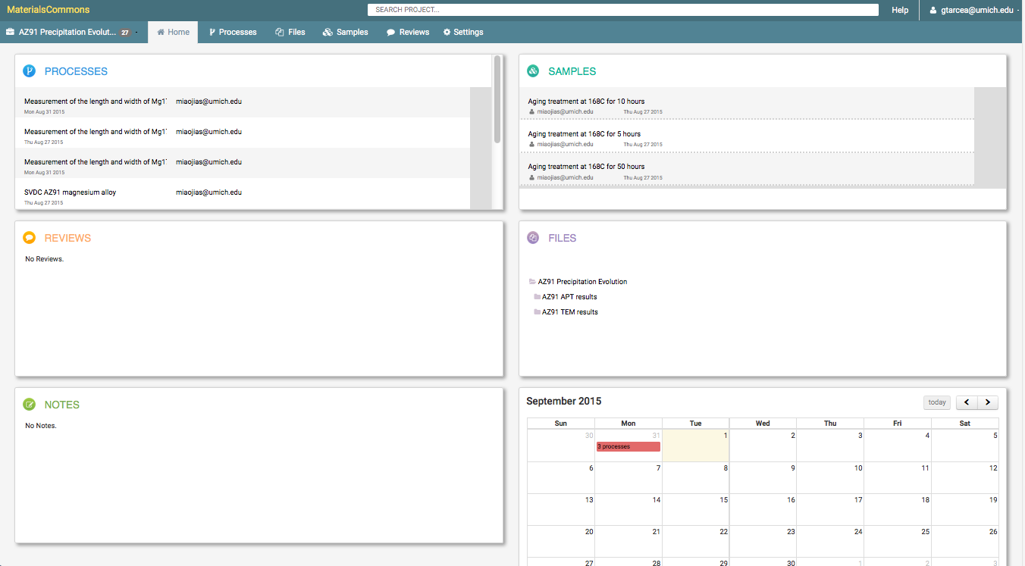
Project Dashboard
Dashboard gives you an overview of your project
Notes:
Gives you access to all objects in system
Search bar allows you to quickly find items of interest
Calendar gives you a chronological view of your project

Slide 12
The Materials Commons - Workflow
Workflow for Materials Commons:
Create a project or use an existing one
Create Samples
Upload files and data
Attach Provenance
Collaborate
Exploration and Notes
Analysis
Coming Soon:
Assign a persistent identifier (e.g. DOI)
Publish data for public sharing
Notes:
This is a general flow
You can do steps in different order
This is a general guide to how we approach Materials Commons features

Slide 13
Today: Single Project Organization
File
Process
Sample
Text
Sample Attributes
Project
Primary objects in the system are:
Processes
Files
Samples
Organized into Projects
With permission, all objects can be shared between multiple Projects (Coming Soon)
Have an associated directory tree containing Files
Notes:
Projects are a logical boundary
Capture everything related to a particular project
Share within a project
We are working towards cross project sharing

Slide 14
Next: Shared Project Organization
DFT
File
StatisticalMechanics
Process
Sample
Text
Sample Attributes
Project
Dislocation Dynamics
Primary objects in the system are:
Processes
Files
Samples
Organized into Projects
With permission, all objects can be shared between multiple Projects
Have an associated directory tree containing Files
Phase Field
Crystal Plasticity
Notes:
Start sharing data, provenance, samples, anything across projects
Enables better modeling of how people work
Hand off becomes possible
Cross project search makes it easier to find your data
Eliminate data silos

Slide 15
Provenance
Provenance is the history of data
In Materials Commons we use the term “Process” to describe what you did with your data.
For example if you took measurements on an SEM then you would use our SEM process.
Using Processes you describe each of your steps and the data you collected or the changes you made.

Slide 16
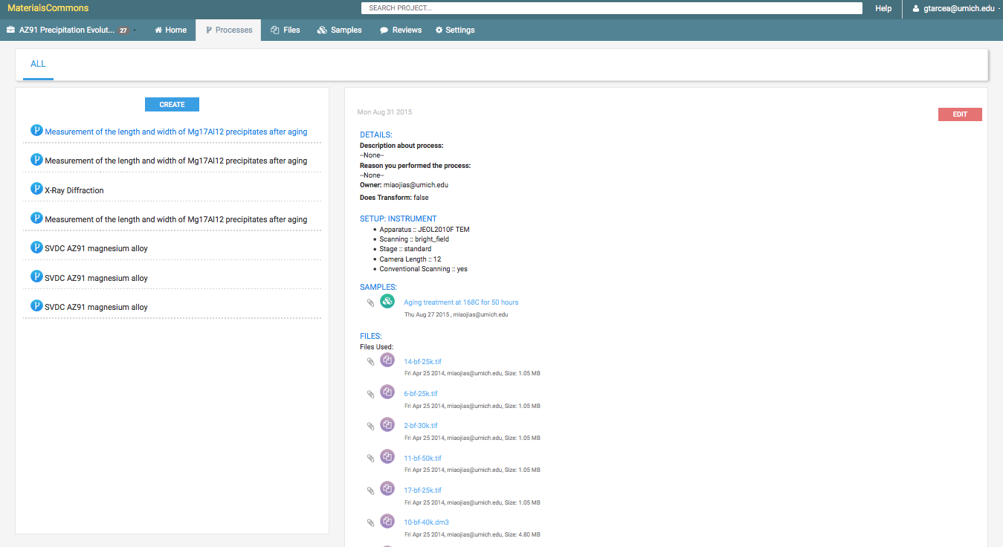
Processes Page
Process Details
Process List

Slide 17
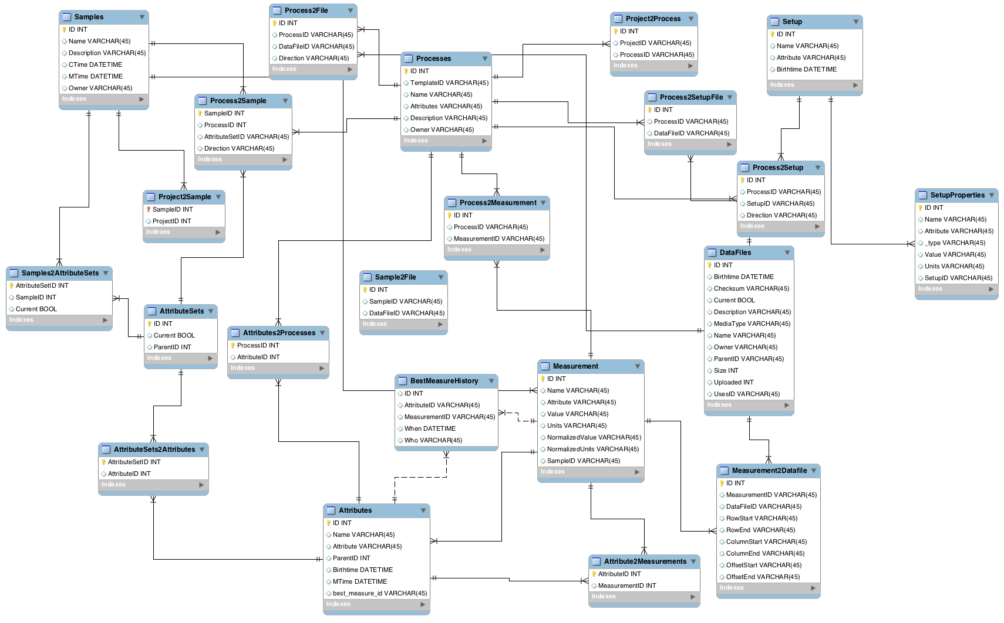
Provenance Model
Provenance:
The attribute A,
of sample S,
is value V,
as determined by process P.
Notes:
Rich data model
Data model is structured on these guiding principles/representation: The attribute A….

Slide 18
Definitions
Process
Measures or changes samples and data
Changing a sample is known as a “transformation”. Examples: Heat Treatment, Sectioning, Cogging
Sample
The object to measure or change
Attribute
What we are measuring. Examples: Length, composition, particle size distribution

Slide 19
The Materials Commons – Provenance & Data Model
Sample
Supplier
Composition
Geometry
Treatment
File
Process
Treatment
Sample
Sample Attributes
Sample
Text
Sectioning
Sample
Sample
Sample
Sample
Sample
Sample
Location
Orientation
Optical
SEM
TEM
Machining
Images
Measurements
Sample
Sample
Sample
Grain size
Morphology
Ppt. size
Grain orientation
Ppt. chemistry
Fatigue
Fatigue
Fatigue
N_{f} vs. Δε
N_{f} vs. Δε
Sample
N_{f} vs. Δε
Analysis
SEM
Images
Measurements
Crack location
Notes:
Review the data model mapping again

Slide 20
Materials Commons: Provenance Entry
Sample attributes name the types of data and describe how the data is stored
Composition, tensile yield strength, etc.
Process templates specify what provenance information must / should / can be given.
Examples types: APT, SEM, Fatigue Test, Monte Carlo Calculation, Continuum Plasticity Calculation, etc.
Instrument settings, process conditions, simulation or analysis input files, output data files, etc.
We develop templates with our users
Templates also provide a dictionary of search terms

Slide 21
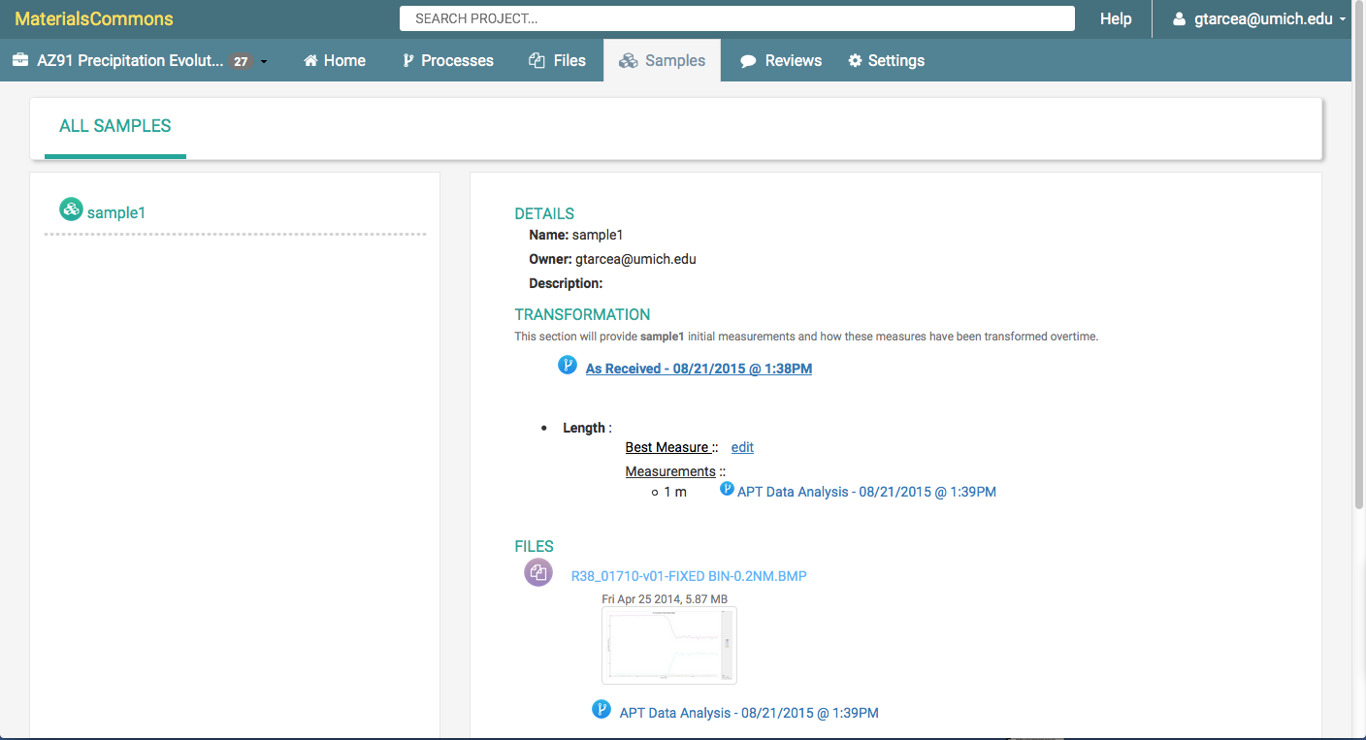
Materials Commons Sample View
View sample details including attribute changes across transformation processes

Slide 22
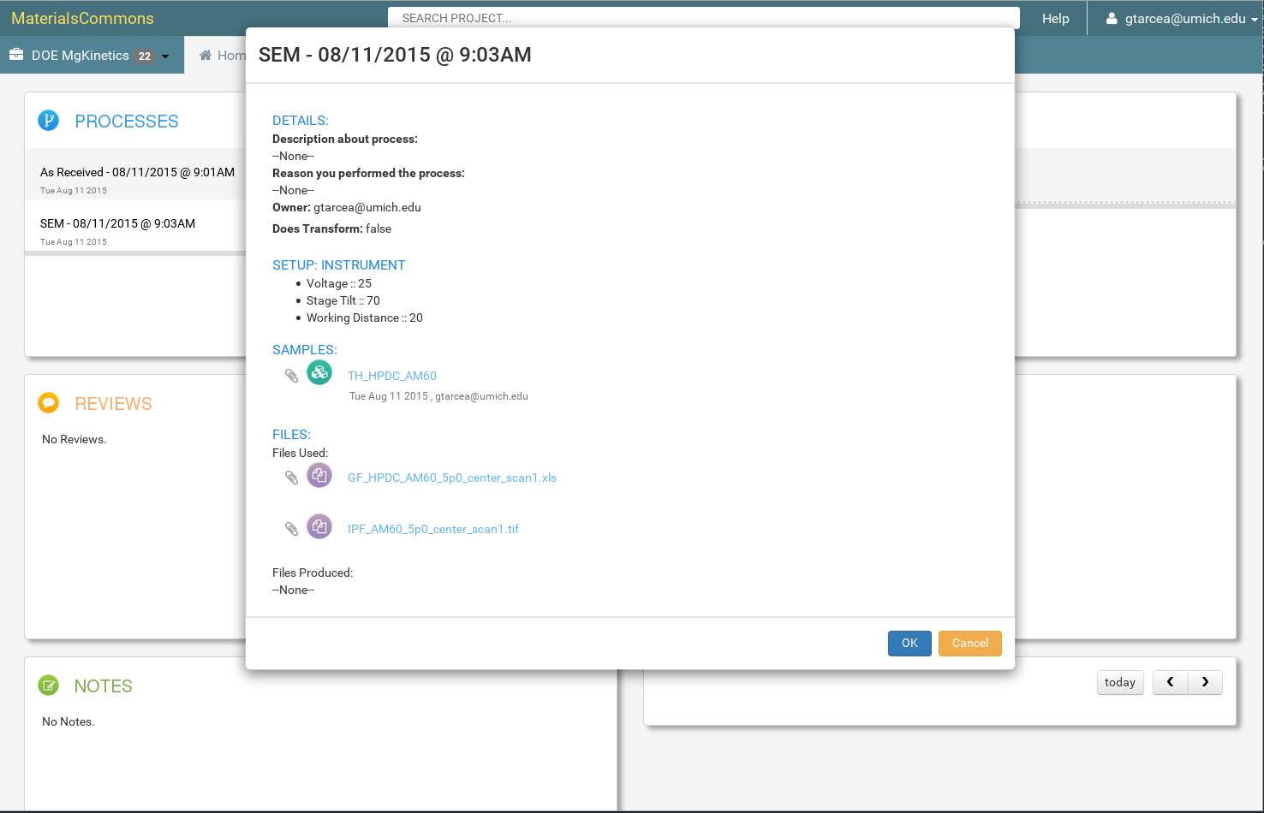
Materials Commons Home Page Quick Access
Provenance details gives you access
to all the attributes, objects and metadata
Provenance Graph and Elements
There is a Wizard for entering new Provenance
Samples and Attributes

Slide 23
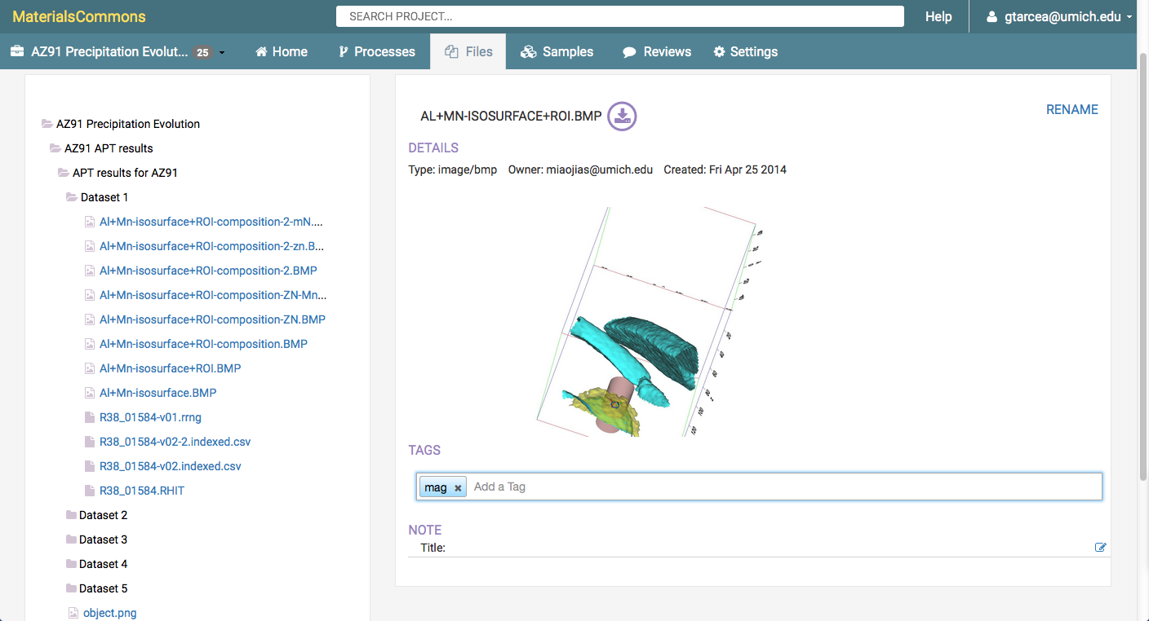
Materials Commons File Tree

Slide 24
Search and Use Data
File
Sample
Supplier
Composition
Geometry
Treatment
Process
Treatment
Sample
Sample
Text
Sample Attributes
Sectioning
Sample
Sample
Sample
Sample
Sample
Sample
Location
Orientation
Provenance:
The attribute A,
of sample S,
is value V,
as determined by process P.
Optical
SEM
TEM
Machining
Images
Measurements
Sample
Sample
Sample
Grain size
Morphology
Ppt. size
Grain orientation
Ppt. chemistry
Fatigue
Fatigue
Fatigue
N_{f} vs. Δε
N_{f} vs. Δε
N_{f} vs. Δε
Sample
Analysis
SEM
Images
Measurements
Crack location
Notes:
How search matches up with the model
Search helps you to navigate your data and provenance
Status
Model in place
Complex DSL makes it hard for users
Property value searches not enabled yet
Dictionary updates needed to enable easy search
Magnesium vs mg in search

Slide 25
Search Overview
Indexes objects and relationships
Working on dictionary of terms and synonyms
e.g Mg=magnesium
When changes are made index is updated in ‘real-time’ (1 second lag)
The search interface allows you to explore large project data sets

Slide 26
Searching Data: Next Generation
Provenance:
The attribute A, of sample S, is value V, as determined by process P.
Search:
General:
Find all samples that have attributes X, Y, Z and underwent process of type T.
Find all samples that have attribute X, as measured by process of type T.
Define materials using a pre-defined filter:
AZ91:
Select all samples that have composition (wt%):
Mg=90.8±0.1, Al=8.25±0.01, Zn=90.8±0.1, Si=0.035±0.005, Mg=0.22±0.01
AZ91-T6
Select all samples that match AZ91, with solution treatment and aging
Phase: HCP-Mg
Select all samples that are mostly Mg, and P6₃/mmc

Slide 27
Real Time Search
DB Change Indexer
DB Events
Real time indexing
Receive database changes
Update affected search objects
Understands relationships
New/Updated Documents
Documents
Database Cluster
Search Cluster

Slide 28
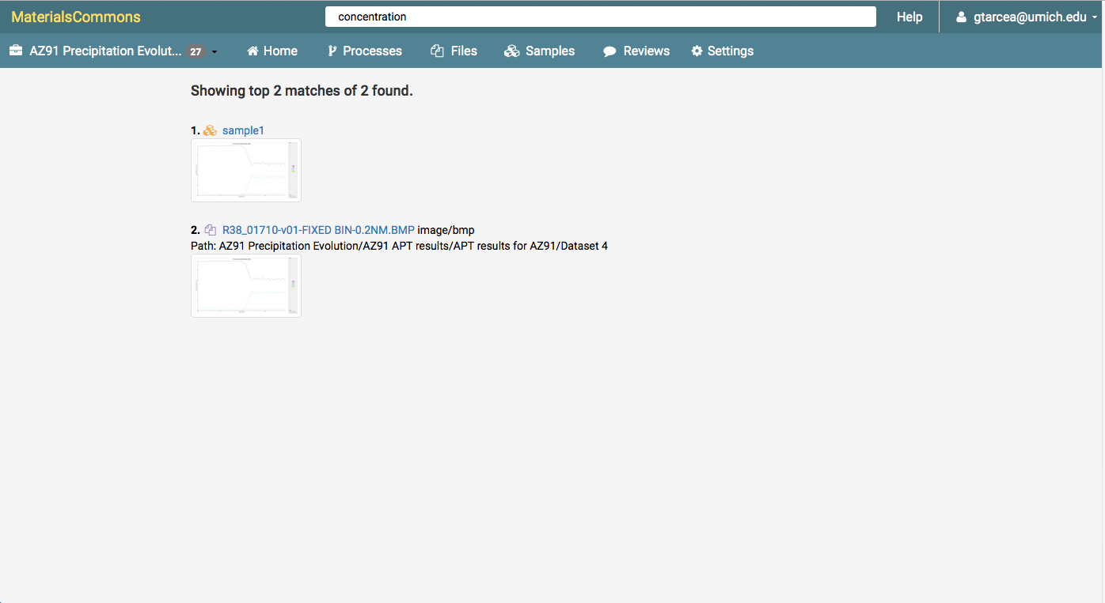
Materials Commons Search In Note
Search will match against multiple object types and search across relationships.
Here we see a search that matched the note in a file and the sample that the file is used in.

Slide 29
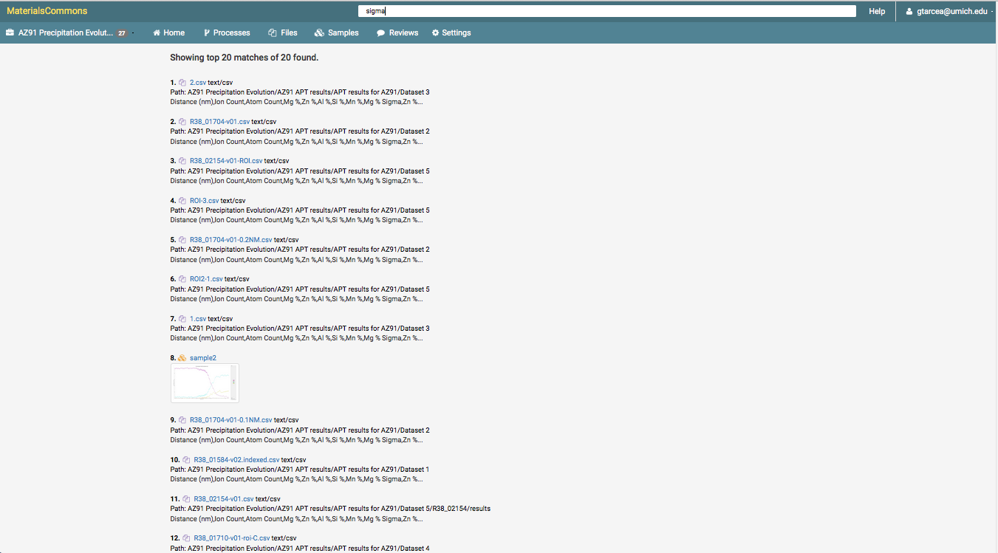
Materials Commons Search in Files
Match sample using a file containing the word “sigma” in the file

Slide 30
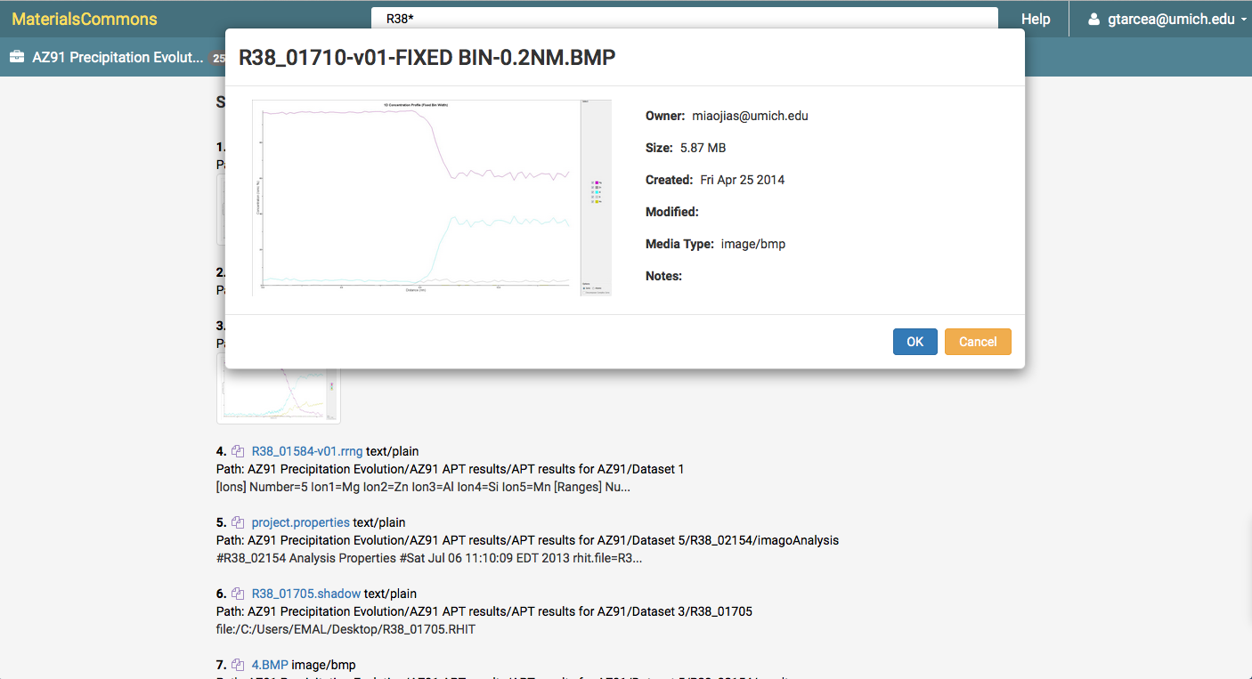
Materials Commons Search File Preview
Preview search hit

Slide 31
Scientific Knowledge Informs Provenance
Sample
Supplier
Composition
Geometry
Treatment
Samples with Attribute:
File
Composition C1
Process
Treatment
Sample
Sample Attributes
Sample
Text
Sectioning
Sample
Sample
Sample
Sample
Sample
Sample
Location
Orientation
Optical
SEM
TEM
Machining
Images
Measurements
Sample
Sample
Sample
Grain size
Morphology
Ppt. size
Grain orientation
Ppt. chemistry
Fatigue
Fatigue
Fatigue
N_{f} vs. Δε
N_{f} vs. Δε
Sample
N_{f} vs. Δε
Analysis
SEM
Images
Measurements
Crack location

Slide 32
Scientific Knowledge Informs Provenance
Sample
Supplier
Composition
Geometry
Treatment
Samples with Attribute:
File
Grain Size GS1
Process
Treatment
Sample
Grain Size GS2
Sample Attributes
Sample
Text
Sectioning
Sample
Sample
Sample
Sample
Sample
Sample
Location
Orientation
Optical
SEM
TEM
Machining
Images
Measurements
Sample
Sample
Sample
Grain size
Morphology
Ppt. size
Grain orientation
Ppt. chemistry
Fatigue
Fatigue
Fatigue
N_{f} vs. Δε
N_{f} vs. Δε
Sample
N_{f} vs. Δε
Analysis
SEM
Images
Measurements
Crack location

Slide 33
Scientific Knowledge Informs Provenance
Sample
Supplier
Composition
Geometry
Treatment
Samples with Attribute:
File
Orientation O1
Process
Treatment
Sample
Orientation O2
Sample Attributes
Sample
Text
Orientation O3
Sectioning
Sample
Sample
Sample
Sample
Sample
Sample
Location
Orientation
Optical
SEM
TEM
Machining
Images
Measurements
Sample
Sample
Sample
Grain size
Morphology
Ppt. size
Grain orientation
Ppt. chemistry
Fatigue
Fatigue
Fatigue
N_{f} vs. Δε
N_{f} vs. Δε
Sample
N_{f} vs. Δε
Analysis
SEM
Images
Measurements
Crack location

Slide 34
Use Data
Flexibly visualize and analyze
Comprehensive history of samples and analyses
Information resuse and replication
Fit constitutive models
Fit process models
Provenance graph -> workflow -> optimization:
Multi-scale integration
Material design
Model reduction
Optimal design of experiments and computations

Slide 35
Planned Features
Data publication and curation
Workflow and provenance visualization
Search improvements
Improved real time collaboration and sharing
Integration with other services (ICE, NIST Tools, Globus, etc…)
Additional charting/graphing
Allow user to use chart and perform data exploration
Security improvements
Docker containers for external installs
Single Sign on
Additional User guide updates

Slide 36
Materials Commons Rollout
Materials Commons Rollout
Grow to 40-50 external users over the next 6 months
Looking for Beta users who can work with us who understand
The system is evolving
Are willing to participate in providing high quality feedback
Who meet one of the following criteria:
Collaborating with PRISMS Center members on
PRISMS Use Case
PRISMS Software Application
Other approved collaborations
Or Anyone who:
Attends PRISMS MC Training
Can use existing templates (including User-defined “As-Measured” template)
Agrees to make information public in a reasonable time (e.g. 3 months after Beta ends)
We are looking to create partnerships that make us all successful!

Slide 37
Materials Commons Training
There will be a two hour Materials Commons training on Thursday
This will be a live session – I have created 60 training projects/accounts
The training will take you step by step through the major features of Materials Commons
90 slide step by step guide explaining concepts behind and how to use Materials Commons
You can find the slides at:
https://github.com/materials-commons/mctraining
Under the slides directory

Slide 38
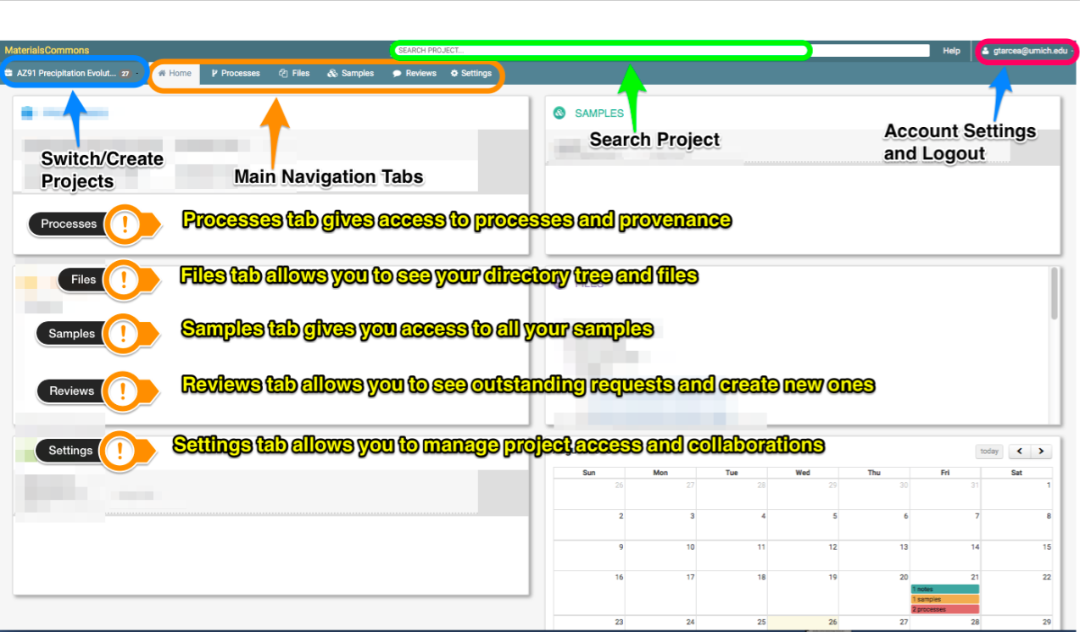
Training Example Slide 1

Slide 39
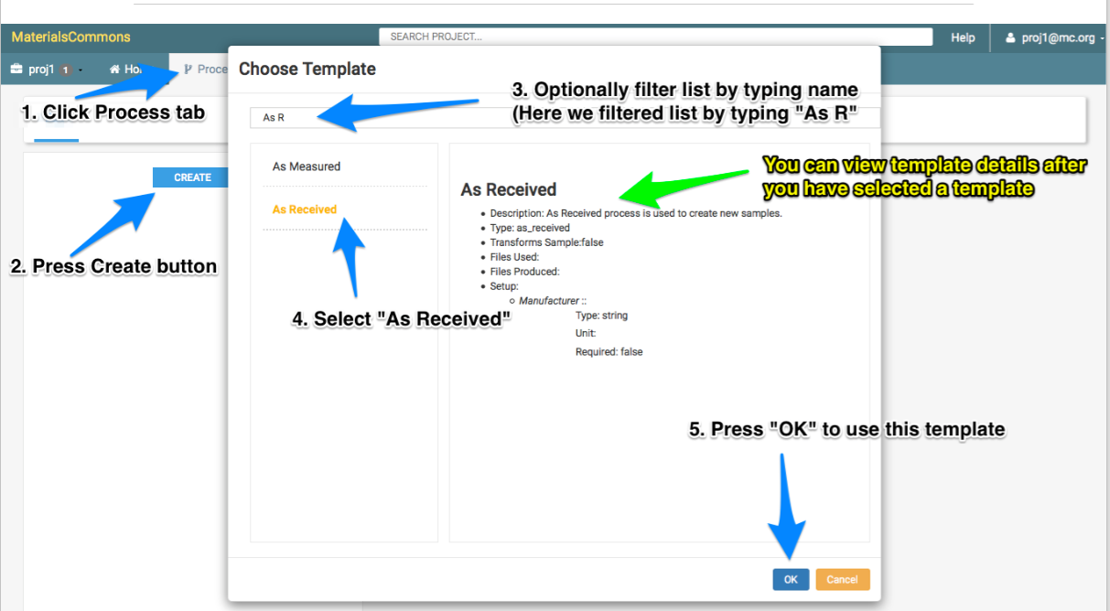
Training Example Slide 2

Slide 40
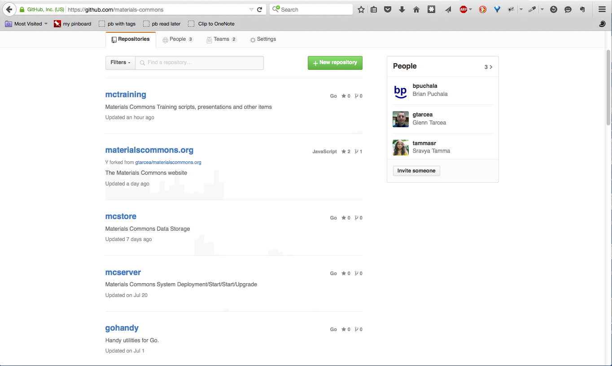
Materials Commons on Github
https://github.com/materials-commons
http://prisms-center.org contains an overview of the
MaterialsCommons code base:
http://prisms-center.org/#/mcommons/software
There are 26 repos (not all are active)

Slide 41
Conclusions
The Materials Commons is a novel information repository and collaboration platform for the materials community
With a current focus on PRISMS technical emphasis areas
Aims to be a seamless part of the scientific workflow
Structured data storage with provenance
Collaborative
Searchable
Enables data use/reuse for faster science, ICME & materials design
All code open sourced, MIT licensed and available at:
https://github.com/materials-commons

