Slide 1
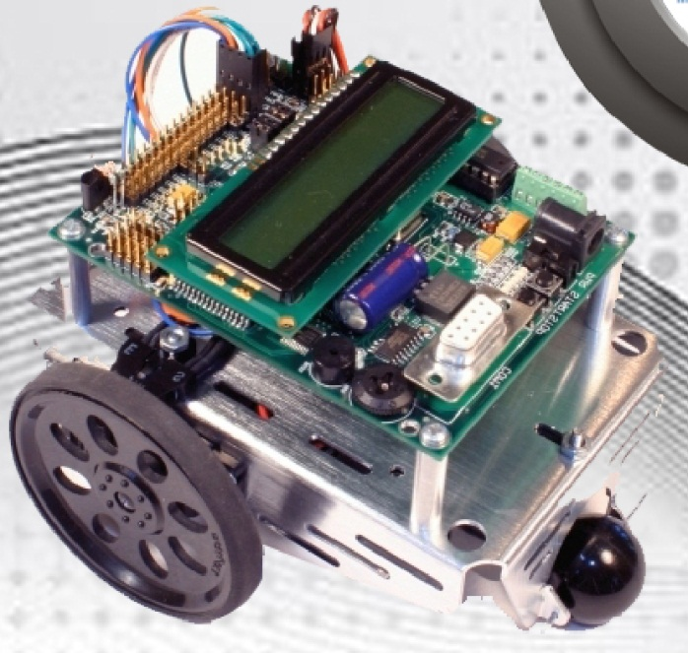
Mobile Controlled Robot Based on DTMF
GYAN TATIYA

Slide 2
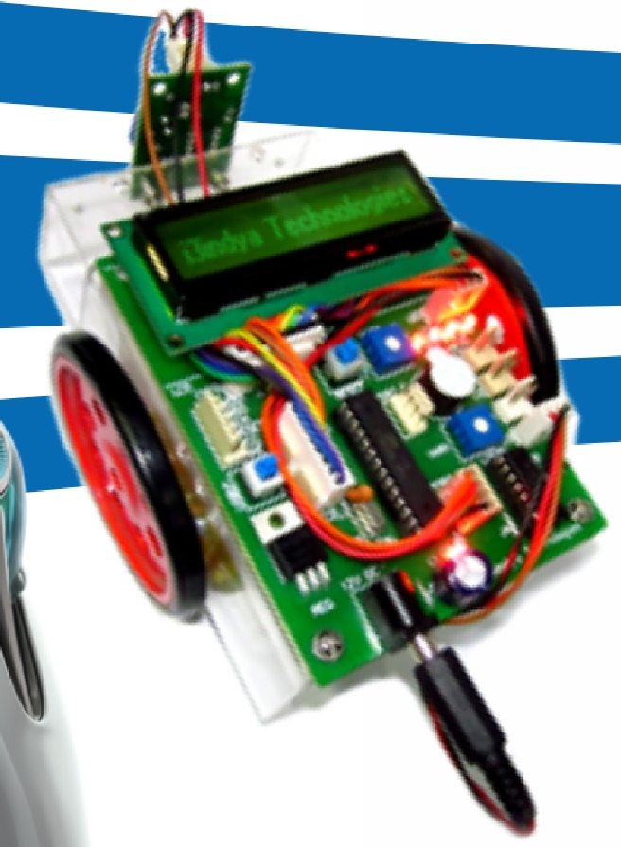
INDEX
Introduction
WHAT IS EMBEDDED SYSTEMS?
Abstract
Microcontroller (ATMEGA 16)
AVR Studio 4
Motor
LCD
DTMF

Slide 3
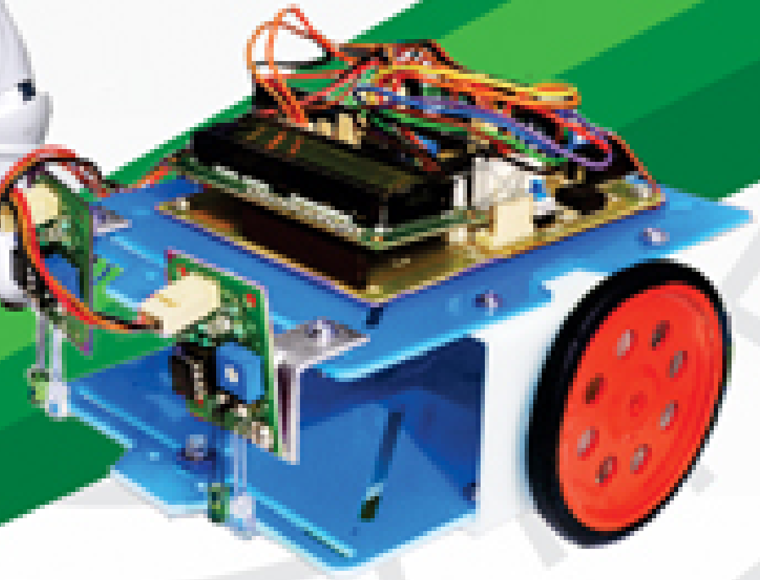
INTRODUCTION

Slide 4
WHAT IS EMBEDDED SYSTEMS?
Embedded systems are involved in almost every facet of modern life and all modern luxury equipment like Digital Cameras, Mobile Phones, GPS Devices, Televisions, DVD Players, Video Games, Microwave Ovens, Fax Machines, Spacecraft are some of the examples of Embedded Systems.
Embedded domain involves, software development, design and manufacture and even re-engineering of new and existing reference designs, development of device drivers, wired and wireless stacks and even porting of network protocols.

Slide 5
ABSTRACT
DTMF Mobile ROBO is a machine that can be controlled with a mobile . In this project, the robot is controlled by a mobile phone that makes a call to the mobile phone attached to the robot.
In the course of a call, if any button is pressed, a tone corresponding to the button pressed is heard at the other end of the call. This tone is called "Dual Tone Multiple-Frequency" (DTMF) tone.
The robot perceives this DTMF tone with the help of the phone stacked on the robot. The received tone is processed by the microcontroller with the help of DTMF decoder.
The microcontroller then transmits the signal to the motor driver ICs to operate the motors & our robot starts moving.

Slide 6
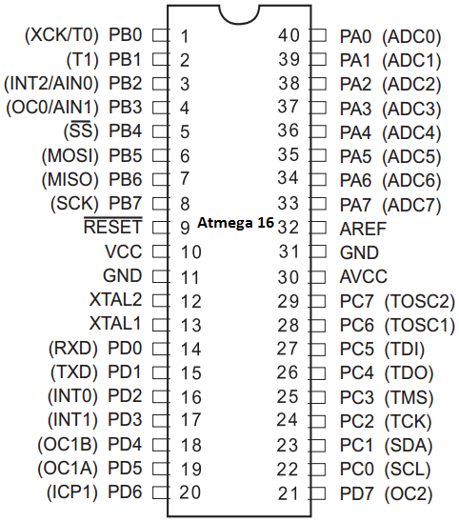
Microcontroller (ATMEGA 16)
ATMega16 Features
131 Instructions(16 or 32-bits)
32 8-bit GP registers
Throughput up to 16 MIPS
AVR Memory
16K programmable flash (instructions)
512Bytes EEPROM
1K internal SRAM
I/O and Packages - 32 Programmable I/O Lines - 40-pin PDIP
Operating Voltages - 4.5-5.5V for ATmega16
Speed Grades - 0-16 MHz for ATmega16
Pin Configurations

Slide 7
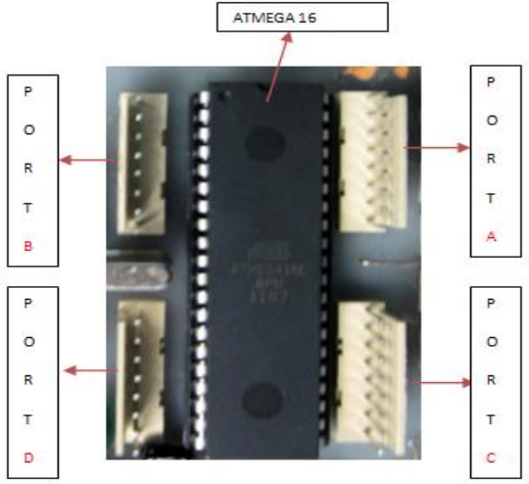
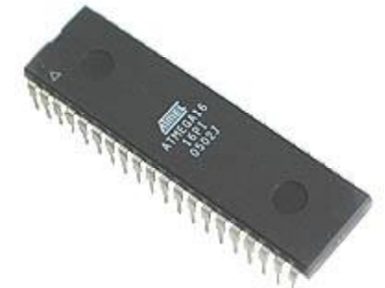
Microcontroller (ATMEGA 16)
Atmega16 have 16 KB flash memory for storing the program and four 8 bit ports which they do label as PA (PORT A), PB (PORT B), PC (PORT C), and PD (PORT D).
Now you are familiar with Atmega16 pin configuration. Now we will learn about how to connect Microcontroller to the PC for programming!

Slide 8

AVR Studio 4
AVR Studio is an Integrated Development Environment (IDE) for writing and debugging AVR applications in Windows 9x/ME/NT/2000/XP/VISTA/7 environments. AVR Studio provides a project management tool, source file editor, simulator, assembler and front-end for C/C++, programming, emulation and on-chip debugging.
AVR Studio supports the complete range of ATMEL AVR tools and each release will always contain the latest updates for both the tools and support of new AVR devices.

Slide 9
Motor
An electric motor is an electromechanical device that converts electrical energy into mechanical energy.
DC motor
A DC motor is an electric motor that runs on direct current (DC) electricity. DC motor has simply two wires.
After giving them DC supply. It will rotate in one direction and its direction can be changed by changing the polarity.

Slide 10
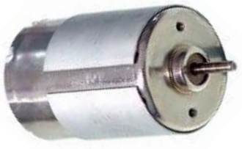
DC motor
We use L293D as a driver IC to interface with microcontroller
L293D- The L293D is ideal for controlling the forward/reverse/brake motions of small DC motors controlled by a microcontroller such as an AVR, 8051 microcontroller.
One l293D is capable of driving two DC motor at a time.

Slide 11
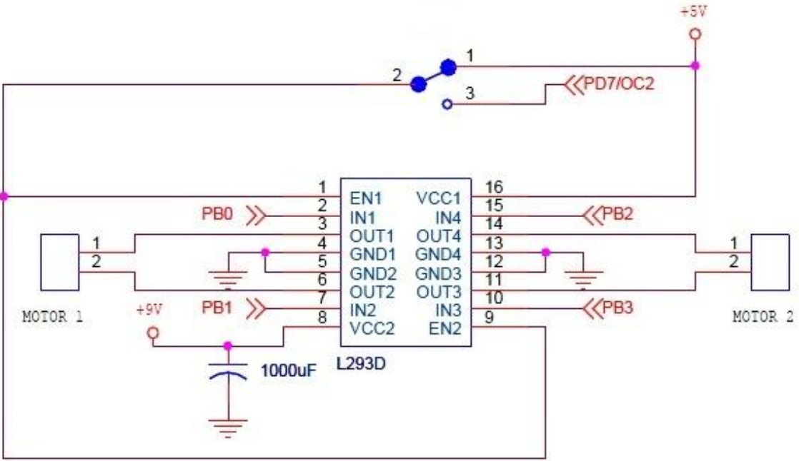
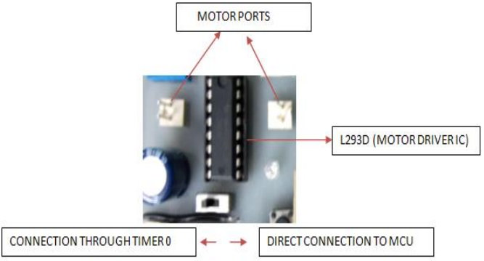
DC motor control using Driver L293D

Slide 12
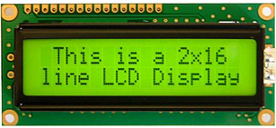
16x2 LCD
LCD (Liquid Crystal Display) screen is an electronic display module. A 16x2 alphanumeric LCD display is very commonly used in various devices and circuits.
The reason for choosing LCD over other display component or devices is that it is
-Low cost
-Easily programmable
-Large number of display character etc.
-even custom characters (unlike in seven segments)
-animations and so on.
A 16x2 LCD means it can display 16 characters per line and there are 2 such lines. In this LCD each character is displayed in 5x7 pixel matrix.

Slide 13
16x2 LCD
It has two type of register inbuilt that is
-Command Register
-Data Register
Command register is used to insert a special command into the LCD. Command is a special set of data which is used to give the internal command to LCD like Clear screen, move to line 1 character 1, setting up the cursor etc.
Data register is used to insert a data into the LCD.

Slide 14
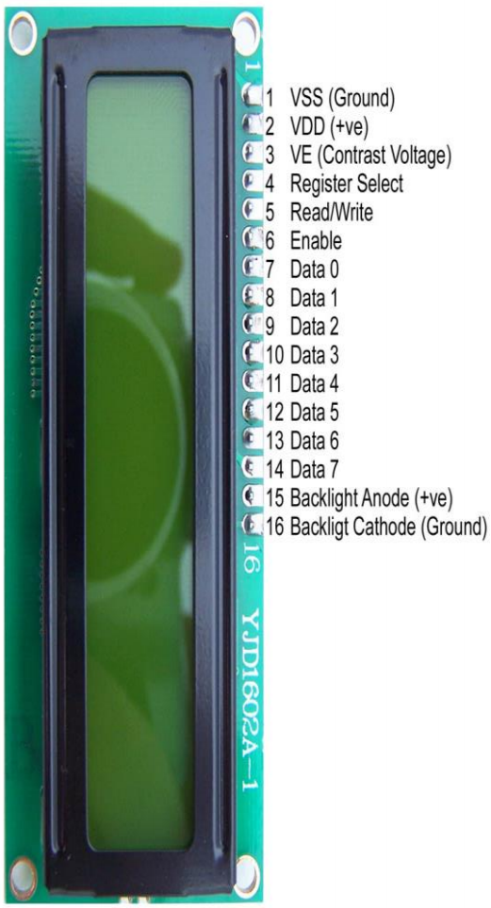
Pin Diagram of 16x2 LCD
Sr. No | Pin No. | Pin Description
1 | Pin 1 (GND) | This is a ground pin to apply a ground to LCD.
2 | Pin 2 (VCC) | This is the supply voltage pin to apply voltage to LCD.
3 | Pin 3 (VEE) | This is the pin for adjusting a contrast of the LCD display by attaching a variable resistor in between VCC and GND.
4 | Pin 4 (RS) | RS stands for Register Select. This pin is used to select command/data register. If RS=0 then command register is selected. If RS=1 then data register is selected.
5 | Pin 5 (R/W) | R/W stands for Read/Write. This pin is used to select the operation Read/Write. If R/W=0 then Write operation is performed. If R/W=1 then Read operation is performed.
6 | Pin 6 (EN) | En stand for Enable signal. A positive going pulse on this pin will perform a read/write function to the LCD.
7 | Pin 7-14 (DB0-DB7) | This 8 pin is used as a Data pin of LCD.
8 | Pin 15 (LED+) | This pin is used with pin 16(LED-) to setting up the illumination of back light of LCD. This pin is connected with VCC.
9 | Pin 16 (LEC-) | This pin is used with pin 15(LED+) to setting up the illumination of back light of LCD. This pin is connected with GND.

Slide 15
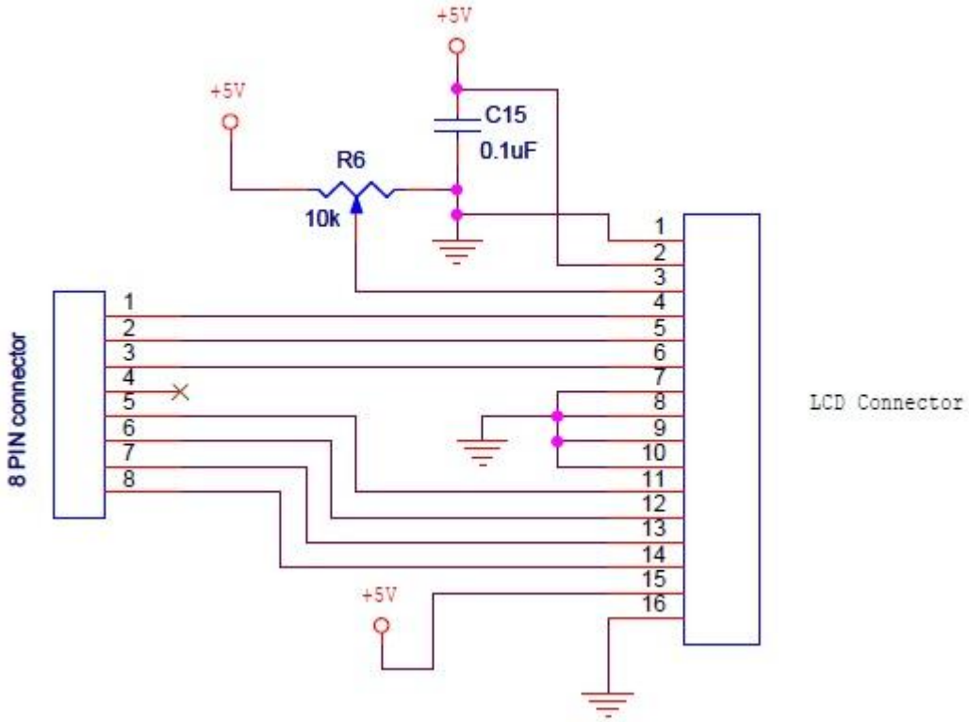
Interface 16x2 LCD with ATmega 16

Slide 16
Dual Tone Multiple-Frequency (DTMF)
DTMF is a multi frequency tone dialling system used by the push button keypads in telephone and mobile sets to convey the number or key dialled by the caller.
DTMF as the name suggests uses a combination of two sine wave tones to represent a key.
In this project the robot, is controlled by a mobile phone that makes call to the mobile phone attached to the robot in the course of the call, if any button is pressed control corresponding to the button pressed is heard at the other end of the call.
The received tone is processed by the Atmega16 microcontroller with the help of DTMF decoder MT8870 the decoder decodes the DTMF tone in to its equivalent binary digit and this binary number is send to the microcontroller, the microcontroller is preprogrammed to take a decision for any give input and outputs its decision to motor drivers in order to drive the motors for forward or backward motion or a turn.

Slide 17
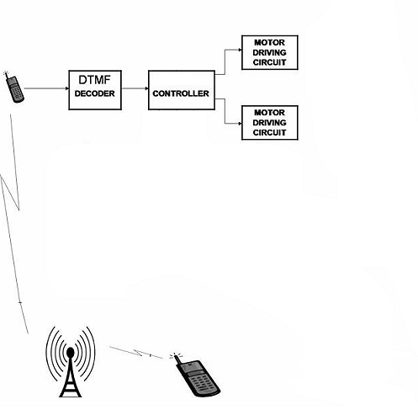
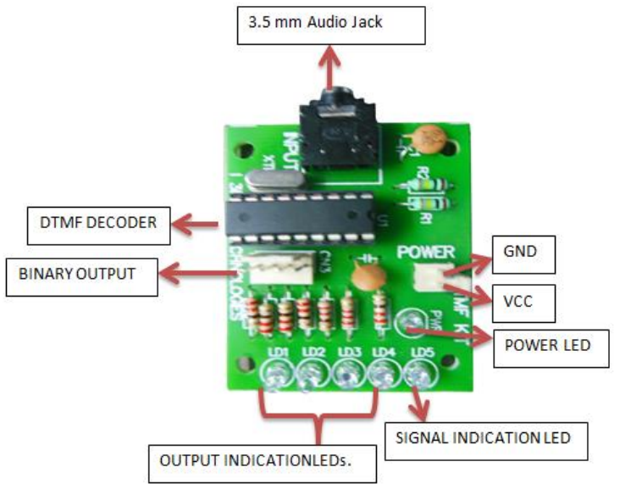
DTMF Block Diagram

Slide 18
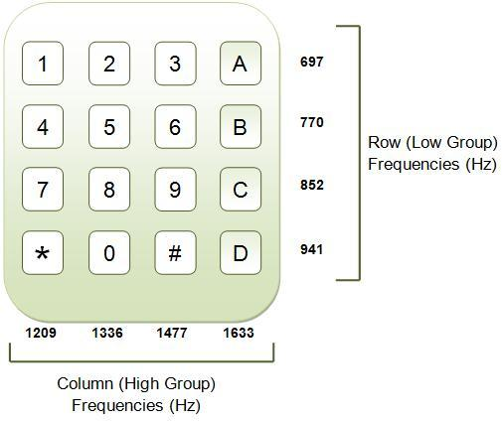
DTMF
A DTMF keypad generates a sinusoidal tone which is mixture of the row and column frequencies.
The row frequencies are low group frequencies. The column frequencies belong to high group frequencies. This prevents misinterpretation of the harmonics.
DTMF tones are able to represent one of the 16 common alphanumeric characters (0-9, A-D, *, #) on the keypad. This is equivalent to 4 bits of data, also known as nibble.

Slide 19
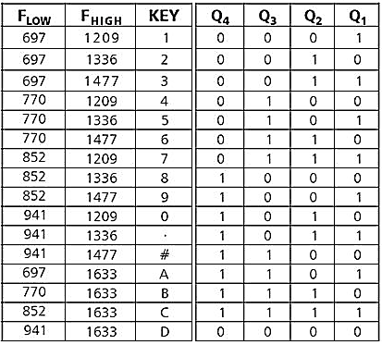
DTMF
If I am pressing a key let say 2, then it will give the combination of frequencies 697 &1336, and this will directly be given to our converter IC, the output of that IC would be 0010 (Q4,Q3,Q2,Q1) and robot will move forward as programmed.

Slide 20
Q & A

Slide 21
Thank you

