Slide 1

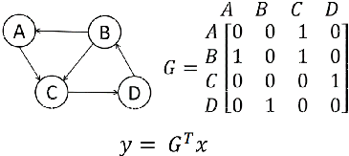
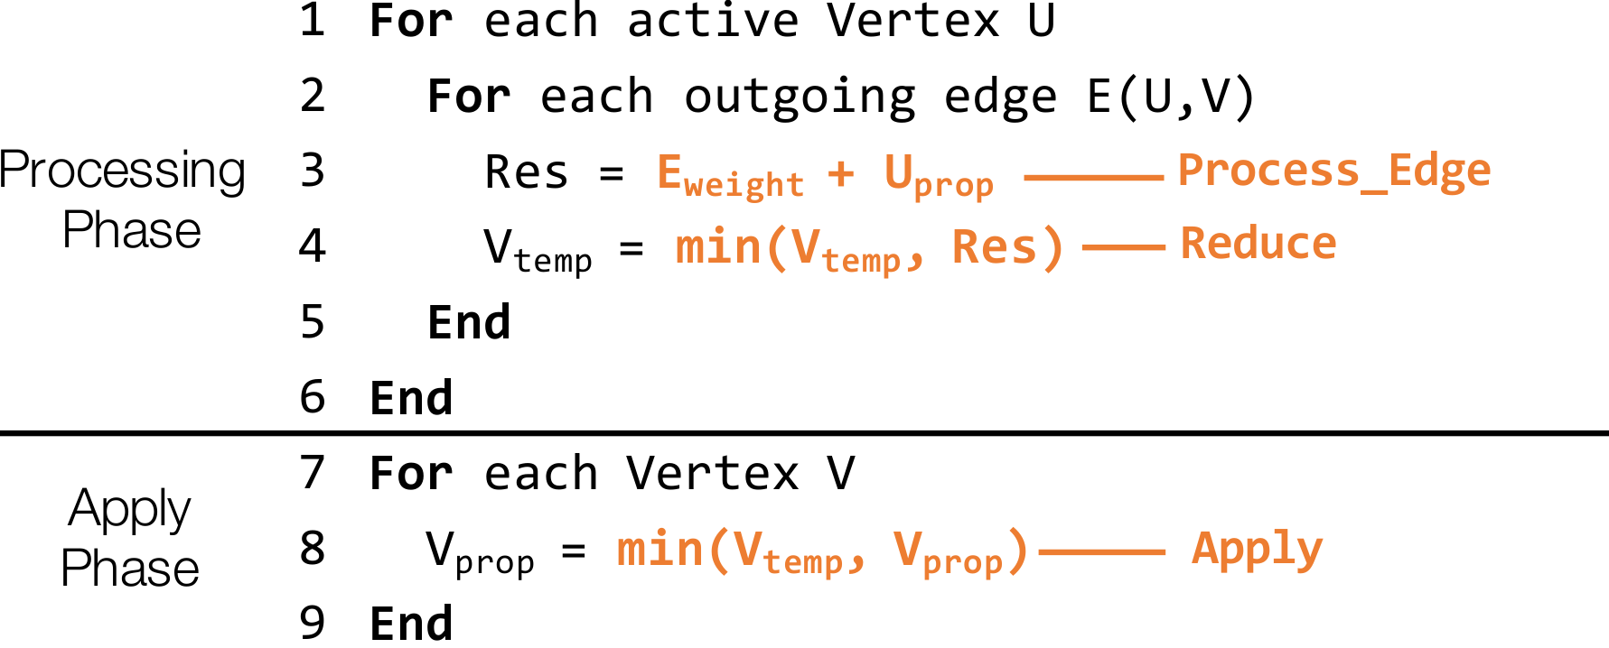
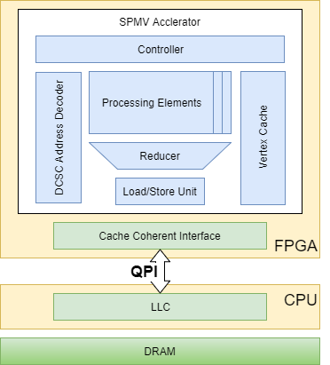
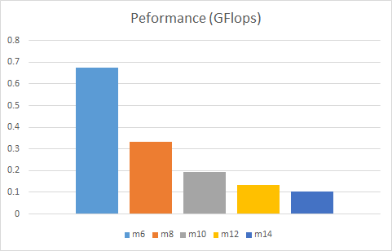

FlexGraph: A Reconfigurable Graph Analytics Accelerator
for Heterogenous CPU-FPGA Architectures
Graph Algorithms to Linear Algebra
Vertex Programming Model
SPMV-Based Processing Model
Assign
Sparse Matrix
Process
SPMV Accelerator
Apply
Sparse Vector
Software
C++ Vertex Programming API
SW/HW Codesign using Cash
Simulation using DramSim2
Hardware
SPMV Accelerator for Graph Analytics
Use Doubly-Compressed Sparse Matrix
Use Bitmask Sparse Vector
Target Intel Xeon-FPGA Platform
Results
Pick B/W ~ 0.7 Gflops
Linear Scaling for Processing Units

Slide 2
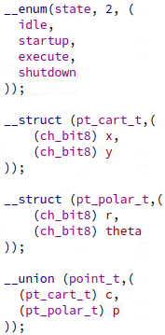
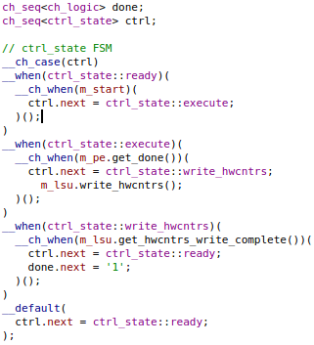
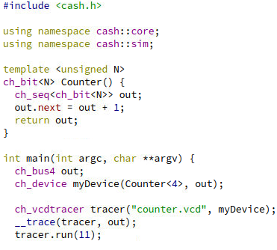
Cash: A C++ API for Hardware Simulation
Cash Development Flow
Aggregates (struct, union, enum)
Synchronous State Machine
RTL Simulator
Software Application
CPU
Hardware Description
Cash API
Verilog Model
FPGA
Motivation
Faster HW/SW Codesign
RTL Simulation for Design Space Exploration
Features
Single-Source SW/HW Programming API
Object Oriented + Generic Programming
Rapid Development via Shared Libraries
Fast Native Code Simulation
Verilog Model Generator
Applications
Pipelined MIPS Processor with Caches
AES Encryption
Single-Cycle Multi-Hop NoC Router
SPMV Accelerator
Generic Counter Full Example

