Slide 1
Pipeline Module

Slide 2
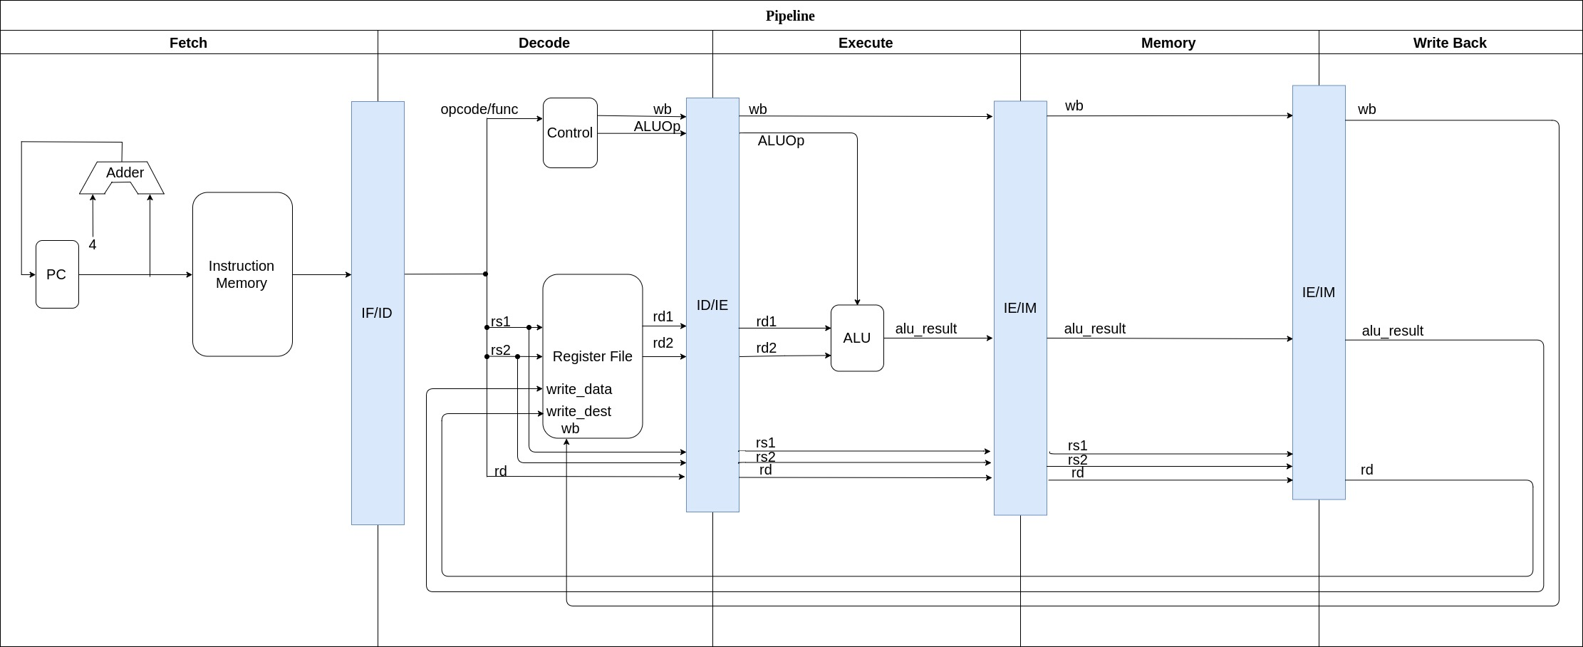
Current Pipeline: Only implements RISC-V R-Type

Slide 3
Next steps:
Download and use riscv-gcc compiler
Write C++ function to feed the pipeline with instructions from a file
Write tests for all R-Type instructions
Extend pipeline to fully model RocketChip RISC-V core

Slide 4
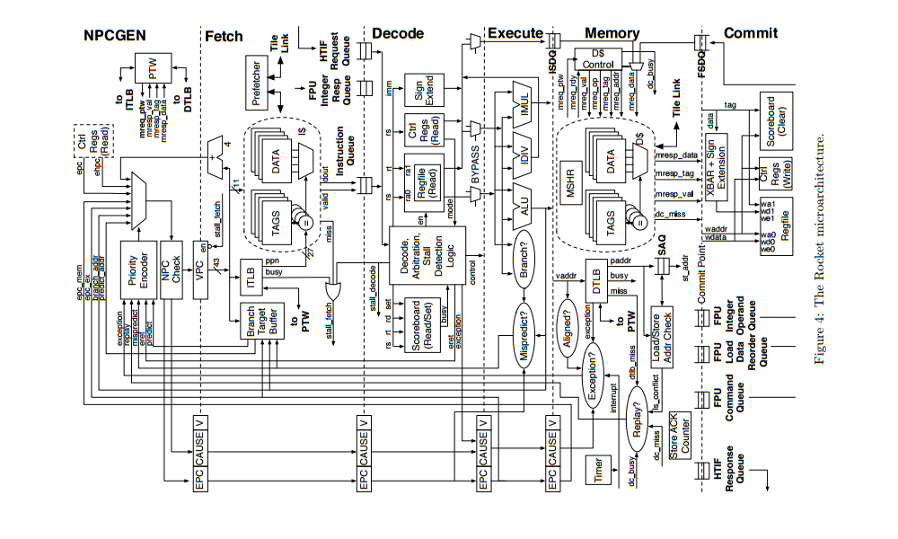
RocketChip Micro-architecture
Notes:
http://www-inst.eecs.berkeley.edu/~cs250/fa13/handouts/lab2-riscv.pdf

