Slide 1
RocketChip Core
Week 4 – Implementing RV32I (2/3)

Slide 2
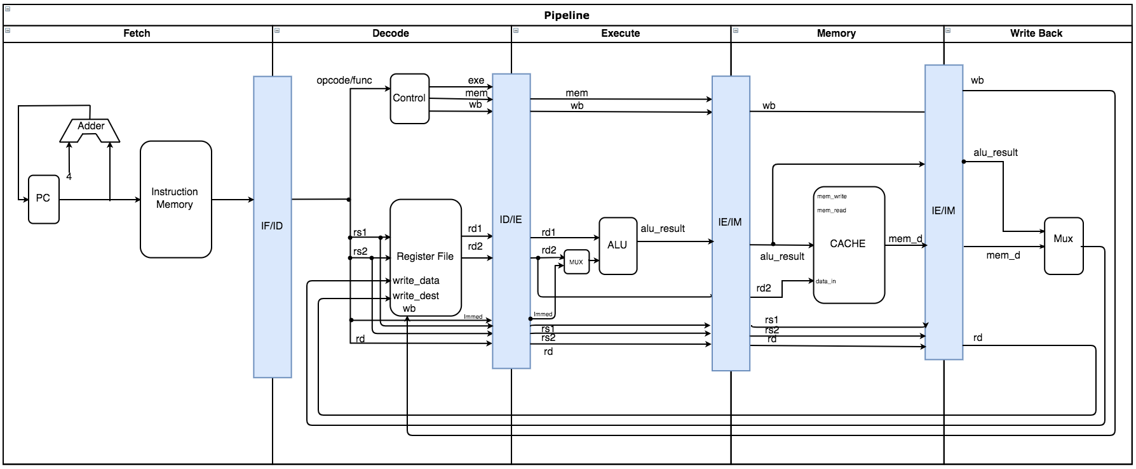
Current Pipeline: RV32I Progress (No Dependency Checking Yet)

Slide 3
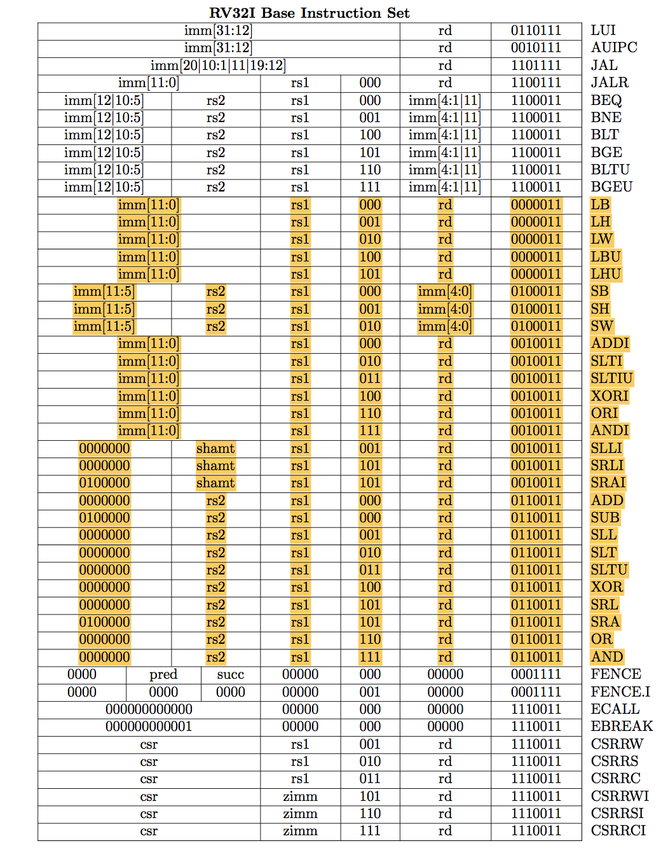
60% of RV32I is currently supported.

Slide 4
Challenges:
Initializing ROM from a file produces an error.
Restructuring my code to be able to have cleaner code in the future.

Slide 5
Milestones
Milestone | Description | Start Date | End date | Progress
RV32I | Core supports all integer computations and handles all control and data dependencies appropriately. | 14/09/2018 | 03/10/2018 | 70%
RV32IM | Core supports integer multiplication and division. | 03/10/2018 | 04/10/2018 | 0%
RV32IMFD | Core supports floating point registers, and both single and double precision loads and stores | 04/10/2018 | 11/10/2018 | 0%
RV32G | Core supports general-purpose scalar instruction set. | 11/10/2018 | 18/10/2018 | 0%
Note: riscv-gcc compiler allows program compilation for a specific RV32X which will be used for testing and pipeline verification throughout the process.

