Slide 1
Pipeline Module
Week 2 – Implementing the interface

Slide 2
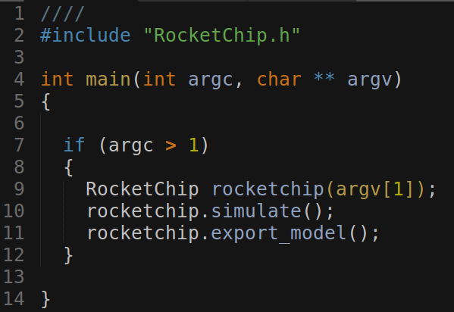
New: Device embedded inside RocketChip class

Slide 3

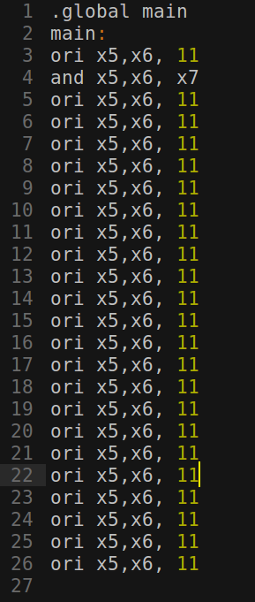
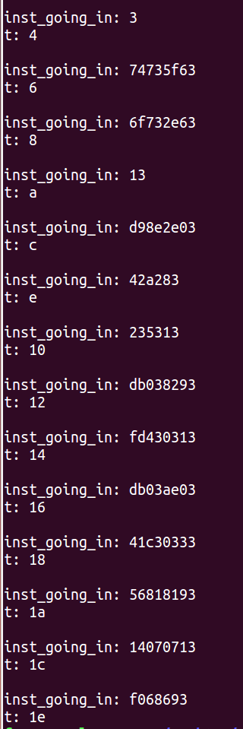

New Flow:
asm.S
C++ program will use risc-v 32 bit gcc compiler and elf2hex to produce asm.hex
C++ program will then read asm.hex and feed it into the pipeline.

Slide 4
Challenges:
Separating start-up code from the rest of the code.
Removing start-up code will only be used for testing specific kinds of instructions.
Start-up code might include instructions not yet implemented in the pipeline.
Should all program be in ROM or be fed to core from an external source?

Slide 5
Milestones
Milestone | Description | Start Date | End date
RV32I | Core supports all integer computations and handles all control and data dependencies appropriately. | 14/09/2018 | 27/09/2018
RV32IM | Core supports integer multiplication and division. | 27/09/2018 | 28/09/2018
RV32IMFD | Core supports floating point registers, and both single and double precision loads and stores | 28/09/2018 | 04/10/2018
RV32G | Core supports general-purpose scalar instruction set. | 04/10/2018 | 11/10/2018
Note: riscv-gcc compiler allows program compilation for a specific RV32X which will be used for testing and pipeline verification throughout the process.

