Slide 1
RocketChip Core
Week 3 – Implementing RV32I (1/2)

Slide 2
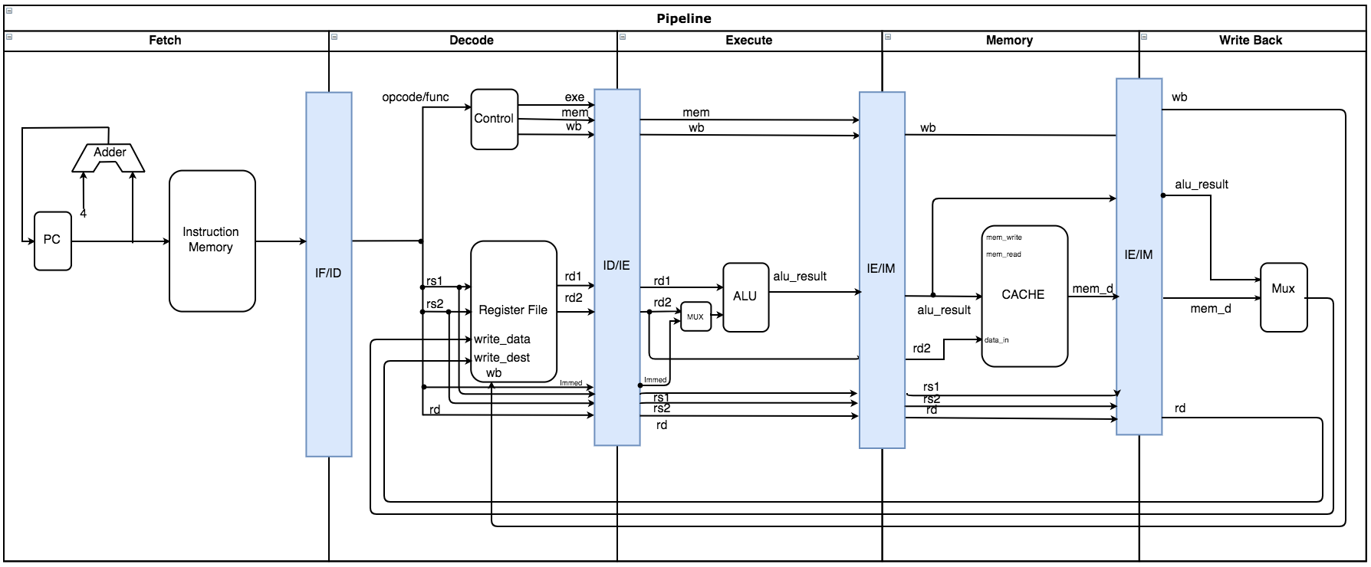
Current Pipeline: RV32I Progress (No Dependency Checking Yet)

Slide 3
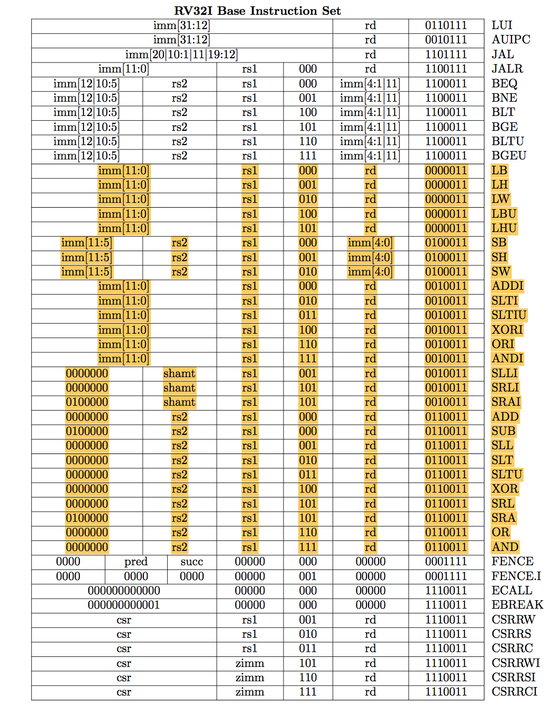
60% of RV32I is currently supported.

Slide 4
Challenges:
When there is a type error, CASH does not provide the line number for the error.
Increases debugging time.
Example: Indexing a 256-entry ROM with a 10-bit number.
Initializing ROM from a file produces an error.

Slide 5
Milestones
Milestone | Description | Start Date | End date | Progress
RV32I | Core supports all integer computations and handles all control and data dependencies appropriately. | 14/09/2018 | 27/09/2018 | 50%
RV32IM | Core supports integer multiplication and division. | 27/09/2018 | 28/09/2018 | 0%
RV32IMFD | Core supports floating point registers, and both single and double precision loads and stores | 28/09/2018 | 04/10/2018 | 0%
RV32G | Core supports general-purpose scalar instruction set. | 04/10/2018 | 11/10/2018 | 0%
Note: riscv-gcc compiler allows program compilation for a specific RV32X which will be used for testing and pipeline verification throughout the process.

