Slide 1
RocketChip Core
Week 5 – Implementing RV32I

Slide 2
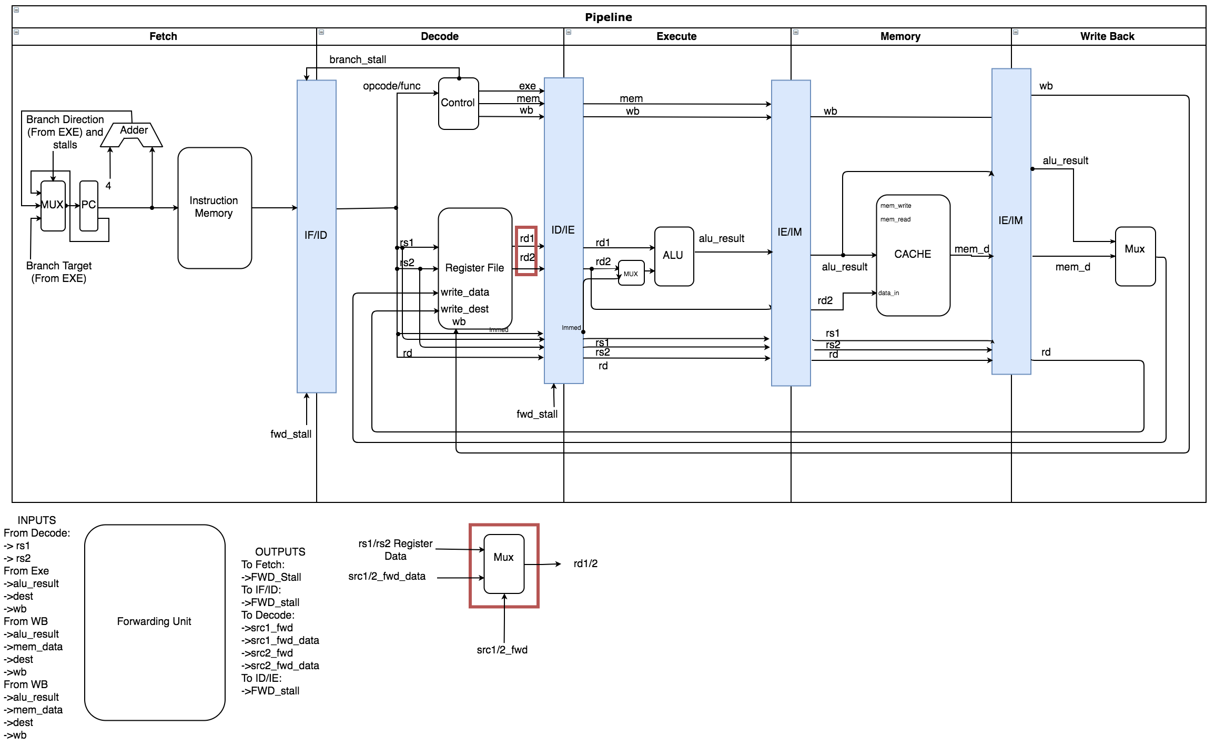
Current Pipeline: RV32I Progress

Slide 3
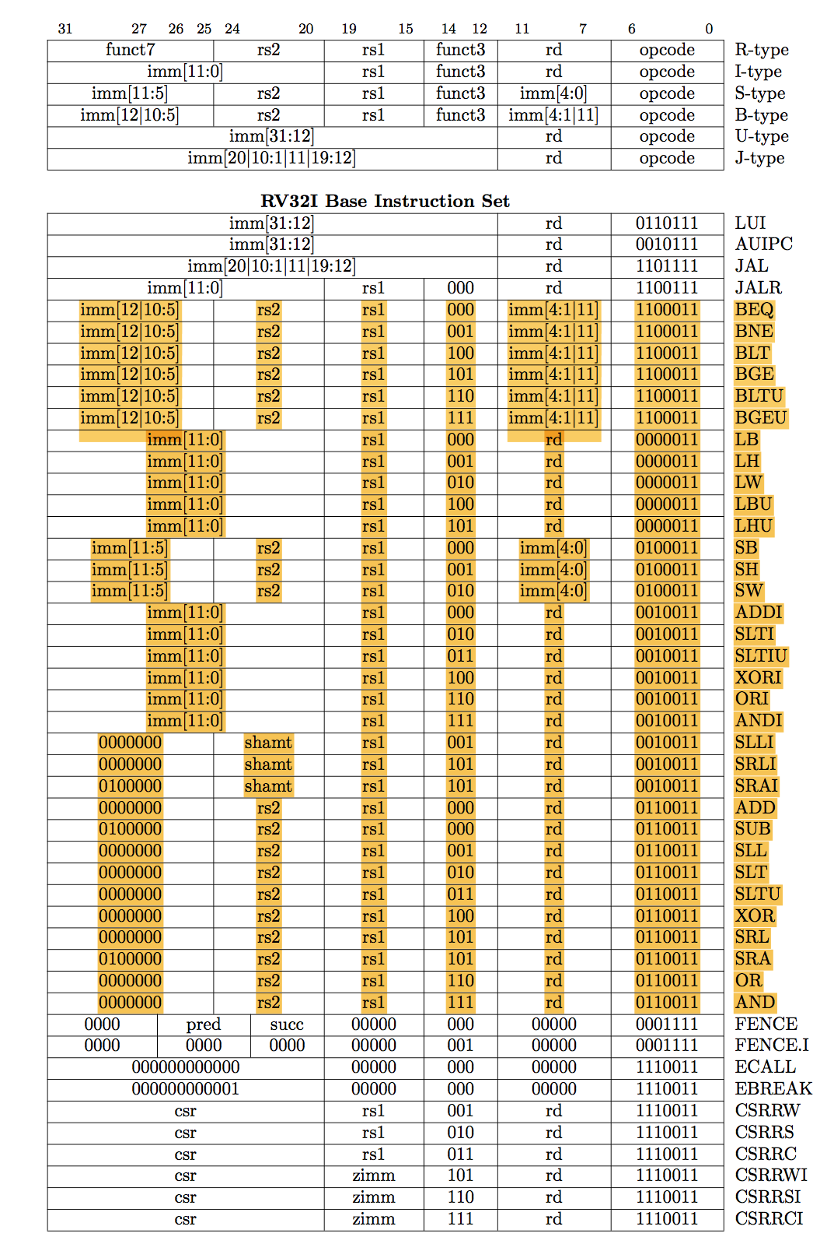
80% of RV32I is currently supported.

Slide 4
Challenges:
RISC-V gcc compiler is resolving branches and jump instructions to weird addresses. (Including the startup code)
Will have to write my own test cases until I figure out how RISV-V gcc expects the instruction structure in memory to be.

Slide 5
CODE DEMO

