Slide 1
RocketChip Core
Week 6 – Complete RV32I Core

Slide 2
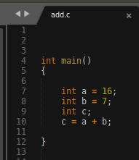
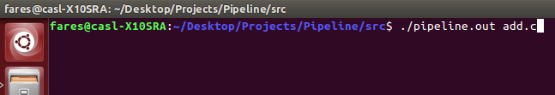
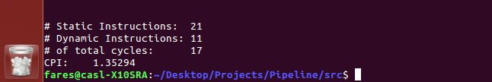
Steps to simulate the core:
1. program_name.c saved inside "traces" folder
2. Give file name as argument to the core
3. Get stats on program (Can also add # of loads, adds, addi, and # of stalls and flushes.

Slide 3
Pipeline Setup:
Branches cause 1 stall (No speculation)
Read after load causes 1 stall:
Load $3, 24($5)
Add $6, $3, $7
Loads and Stores take 1 cycle
Forwarding takes care of the rest of the data dependencies
Pipeline stops after 5 cycles of the last instruction entering.

Slide 4
Challenges:
CASH memory is causing a weird bug while simulating
Some Memory addresses change value without any code running that changes it.
Will discuss with Blaise regarding the issue.
Only problem standing to run any kind of applications.
How to present the output.
Program results are stored in memory realtive to the activation frame of the function.

