Slide 1

To Create Database

Slide 2
1.Database Design

Slide 3
2.Create Table
Notes:
Column/data type/pk/fk

Slide 4
3.Insert and Retrieve

Slide 5
4.Database Security

Slide 6
5.Database Performance
Notes:
Creating index / tuning queries/optimizing table structure

Slide 7
6.Choose DBMS software
Notes:
Mysql/postgresql/mangodb

Slide 8
7.How to connect to the database?
Notes:
Php/python/java

Slide 9
8.Know how to use Object_Relational Mapping(ORM)

Slide 10
9.Understand how to use database
backup and recovery

Slide 11
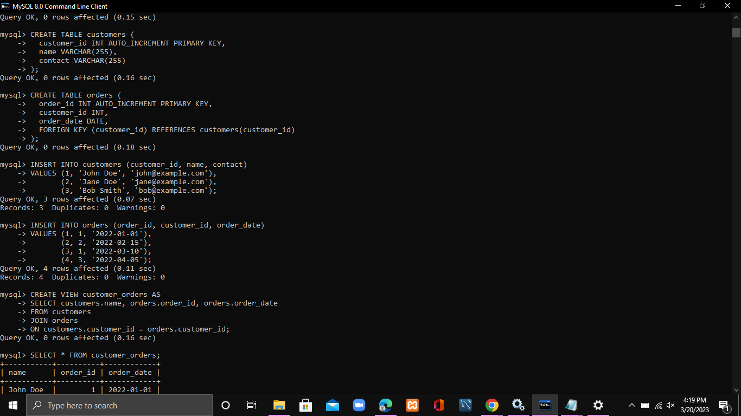

Slide 12

Thank You

