Slide 1


Slide 2
WHAT IS DATABASE?

Slide 3
why do we need to use database?

Slide 4
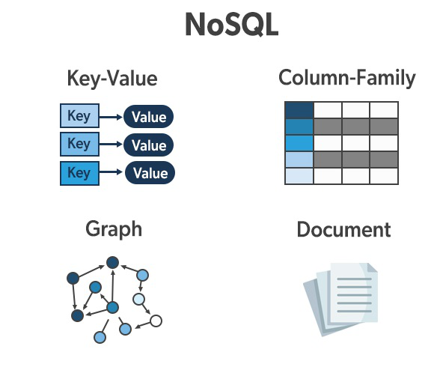

Slide 5
What is SQL?
SQL=Structured query language
A language to talk to relational database
SQL can’t write software application
SQL statement-
-Schema statement
-Data statement
-Transaction statement

Slide 6
Database Management system-DBMS
Relational Database Management System-RDBMS

Slide 7
RBDMS-Terminology
-Primary key
-Foreign key
-Result set
-Schema ( design)
*Relation schema-design of a table
*Database schema –design of a database

Slide 8
SQL statement
-Inserting records
-Updating records
-Delete records

Slide 9
Table Opreation
-SHOW TABLE
-list of all table in database
-table column name
-DESCRIBE tbname or DESC tbname
-rename table name
-RENAME TABLE tbname TO newtbname
-dalete table
-DROP TABLE tbname

Slide 10
-to add new coloum
#ALTER TABLE tablename ADD column_name data_type;
-to change column name
#ALTER TABLE tablename CHANGE column_name new_column _name
data_type;
-to dalete column
#ALTER TABLE tablename DROPCOLUMN column_name;

Slide 11
Importing CSV data to MySQL

Slide 12
Thank you
For your
Attention

