Slide 1

HELLO
EVERYONE

Slide 2


Slide 3
Why use MongoDB?

Slide 4
Unstructured Data
Database
Error Log
Desktop
User
User
location
Traffic
Statistics
Mobile
User

Slide 5
In SQL
Id
Name
phone
address

Slide 6
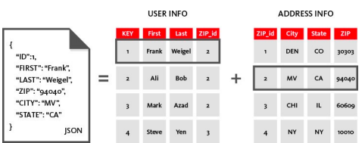
Nosql in MongoDb
Collect data in sql

Slide 7
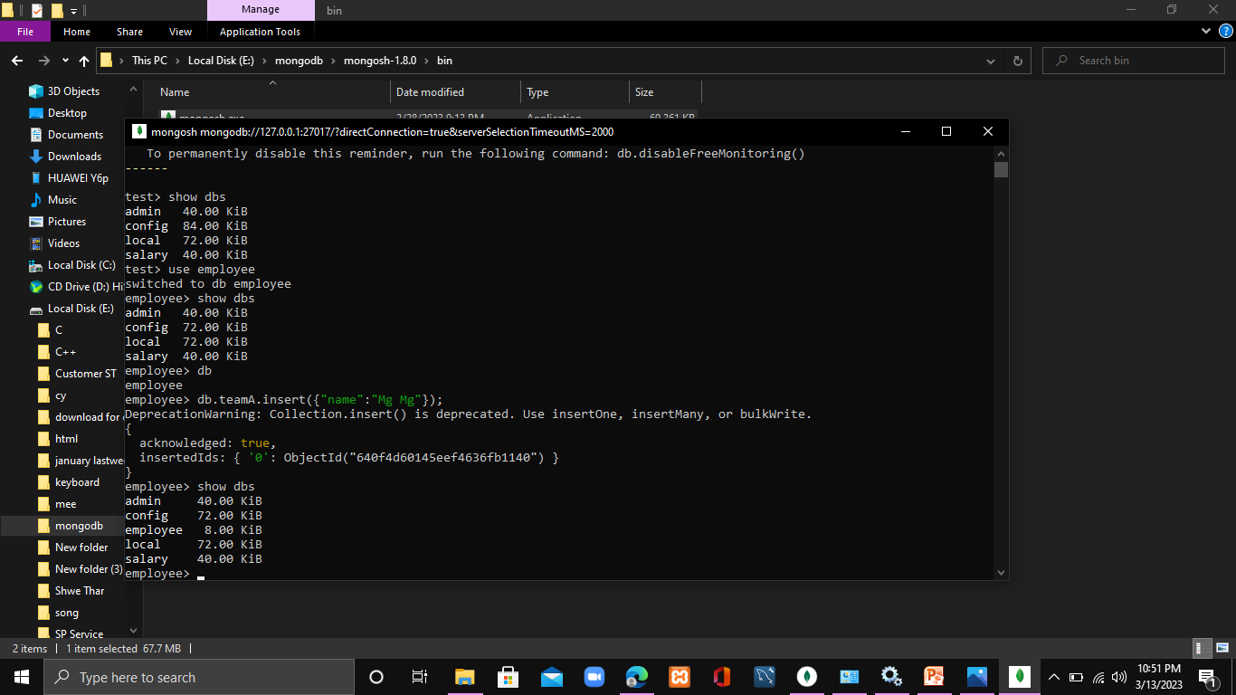

Slide 8
