Slide 1
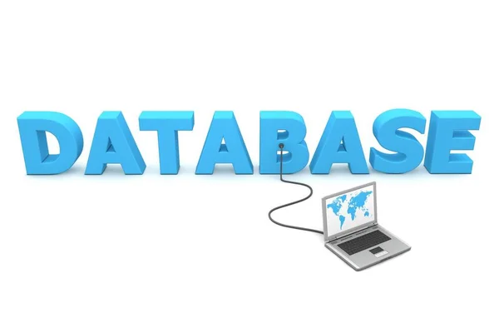
Present by
Nay Lin Kyaw

Slide 2

Notes:
Data –
to collect
to access
To del & upd

Slide 3
Relational Database
Non-Relational Database
Notes:
Most useful in DBMS

Slide 4
Relational Database
Non-Relational Database
SQL
NOSQL
Table
Document
Column
Graph
Key value
CAP
Consistency
Availability
Partition Tolerance
Notes:
2018-1s-50000GB
2023 so yin po myar
RBDMS mr a sin ma pyay ayan myr dk data nk so yin
Solve – upd memory and cpu
Consistency mr upd opration run k client side mr upd
Availability system always up and zero downtime
Partition Tolerance if shut down database sever,can do latshi alote ko

Slide 5
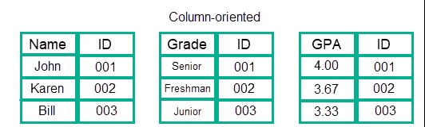
COLUMN ORIENTED
Example-BigTable,SampleData

Slide 6
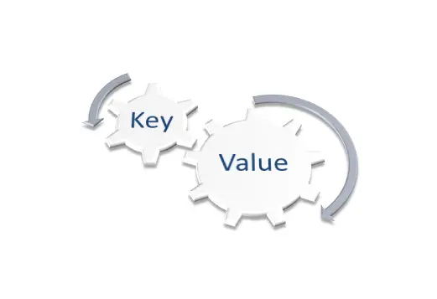
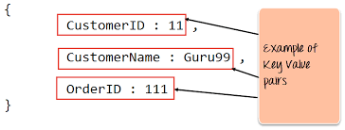
KEY & VALUE
Example-Redis,Dynamo a

Slide 7
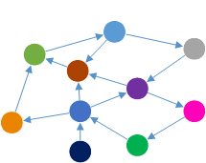
GRAPH
Example-OrientDB,Titan

Slide 8
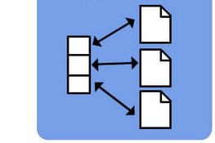
Document
Example-MongoDB,CouchDB

Slide 9
RBDMS
NON-RBDMS
Oracle
MySQL
SQL Server
PostgreSQL
IBM DB2
Microsoft Access
SQLite
MariaDB
Informix
Azure SQL
MongoDB
Redis
Neo4j
Amazon DynamoDB
MarkLogic
ScyllaDB

Slide 10


Slide 11
Truncate
Drop
Delete only row
Delete all row and column name

Slide 12


Function from MySQL
To count salary>$
To count max &min salary

Slide 13
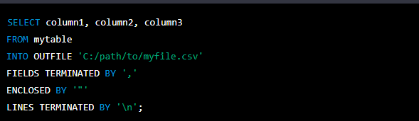
Data of database
To Excel

Slide 14

Thank You
For Your
Attention

