Slide 1
Hi
It’s me.Nyein Nyein Htwe.

Slide 2
Difference between Software Development and Web Development

Slide 3
What is Software Development?
Software development is the process programmers use to build computer programs. The process, also known as the Software Development Life Cycle (SDLC), includes several phases that provide a method for building products that meet technical specifications and user requirements.
The SDLC provides an international standard that software companies can use to build and improve their computer programs. It offers a defined structure for development teams to follow in the design, creation and maintenance of high-quality software. The aim of the IT software development process is to build effective products within a defined budget and timeline.

Slide 4
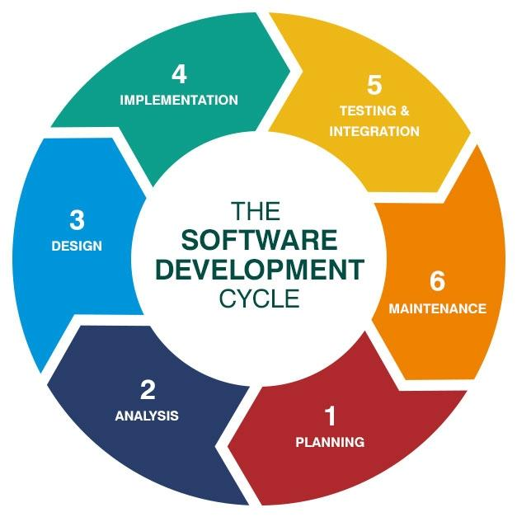
The Software Development Cycle

Slide 5
What is Web Development?
Web development, also known as website development, refers to the tasks associated with creating, building, and maintaining websites and web applications that run online on a browser. It may, however, also include web design, web programming, and database management.
Web development is closely related to the job of designing the features and functionality of apps (web design). The term development is usually reserved for the actual construction of these things (that is to say, the programming of sites).
The basic tools involved in web development are programming languages called HTML (Hypertext Markup Language), CSS (Cascading Style Sheets), and JavaScript.

Slide 6
Types of Web Development
There are three main types of web development: front-end development, back-end development, and full-stack development.

Slide 7
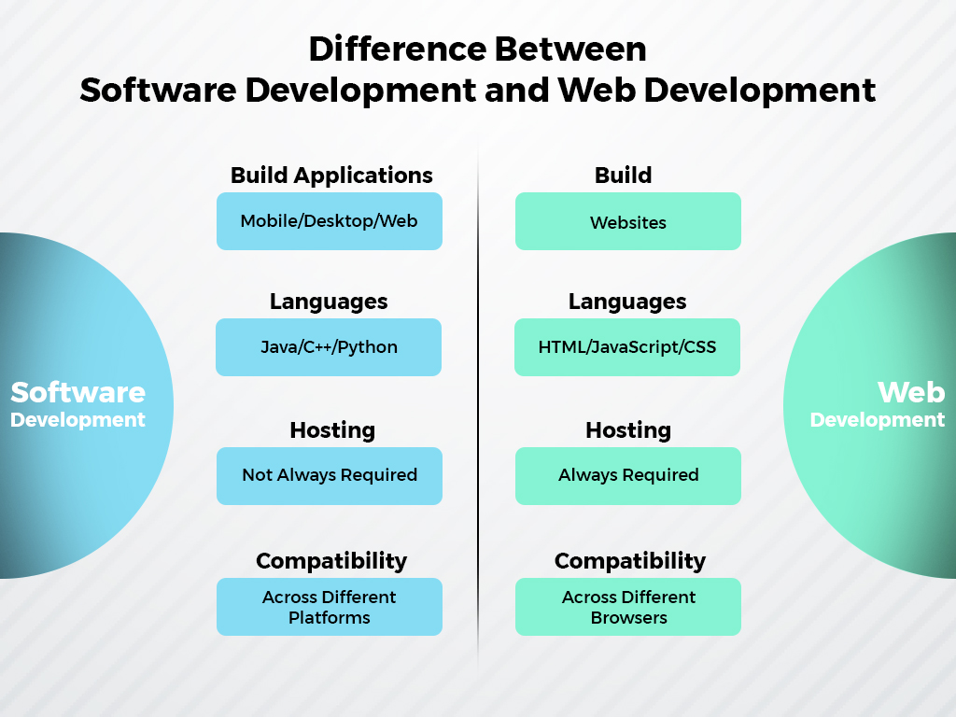
Difference between Software Development and Web Development

Slide 8
Website Development vs Software Development: Applications
Software developers build applications for the web, mobile phone, and desktop whereas web developers are IT professionals who build websites via writing code.

Slide 9
Website Development vs Software Development: Architecture
The architecture of website development involves both client-side and server-side. However, in software development, the applications are only client-side.

Slide 10
Website Development vs Software Development: Programming Languages
Software developers use languages such as Java, C++, and Python to build apps. On the other hand, web developers use languages such as HTML, JavaScript, and CSS to build websites.

Slide 11
Website Development vs Software Development: Designing
Usually, software design is straightforward whereas web development involves designing interactive, engaging front-end websites/apps that anyone can use.

Slide 12
Website Development vs Software Development: Platform
A software development platform is specific and can be a local system/server/machine. On the other hand, a website is usually cross-platform (mobile (Android/iOS), web). And it is deployed on a public server. It can be accessed via a public domain.

Slide 13
Website Development vs Software Development: Security & Robustness
Websites are more prone to cyber attacks, phishing, etc. as they are in the public domain. So, they are usually less robust than software apps that have enterprise-level security and are usually limited to local servers.

Slide 14
THANK YOU FOR YOUR ATTENTION.😁

