Slide 1
Hosting
Presented by Nyein Nyein Htwe.

Slide 2

What is Server?
A server is a computer program or device that provides a service to another computer program and its user, also known as the client.

Slide 3
What is Domain Name?
A domain name is the address of your website on the web and helps visitors find you. Examples of domain names are Google.com, Yahoo.com, Themeisle.com. In a previous post, we explain more about what domain names are and how they work.
Domain names make it easy for users to recall the name of the website. That’s one of the reasons why it’s important to pick a suitable name for your website.
To own a domain, you’ll need to register it using a service called a domain registrar.

Slide 4
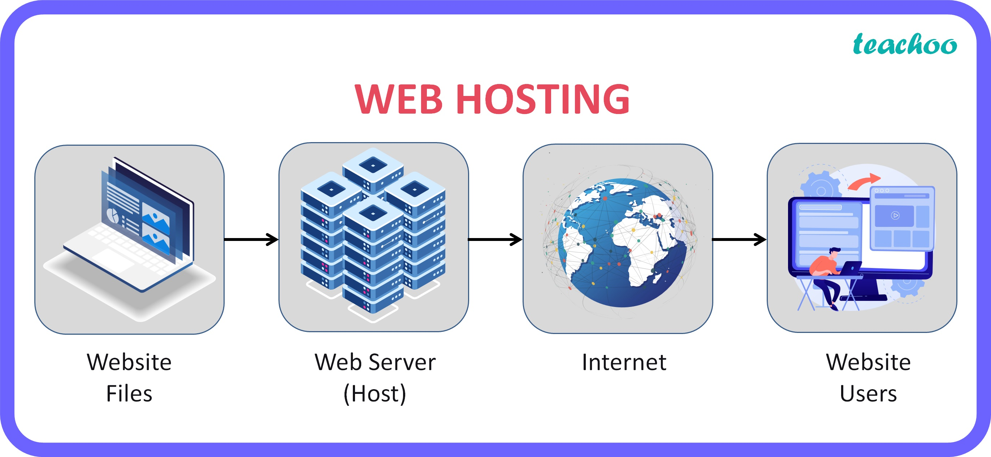
What is Web hosting?
Your website is made up of a number of files, folders and data. For visitors to be able to view your website, that information needs to be put on a server (a computer) that visitors can access. That’s where web hosting servers play a part. They store your website files for a small fee and allow visitors access to it.
In order to understand how to host a website, you should know that a web server is somewhat similar to a home computer, but it’s built specifically to store websites. It’s always on and connected to the internet continuously.
There are many different types of hosting, including shared hosting, virtual private server (VPS) hosting, dedicated hosting, and cloud hosting, each with its own unique features and benefits.

Slide 5
Why do we need hosting?
We need hosting for a variety of reasons, but primarily because it allows us to make websites and web applications accessible to the public through the internet.
When you create a website or web application, the files that make up the site (such as HTML, CSS, and JavaScript files) need to be stored on a server, which is a powerful computer designed to serve content over the internet. Hosting providers offer access to these servers, allowing you to store your website files and make them accessible to anyone with an internet connection.
Hosting also provides a number of other benefits, including:
Security: Hosting providers typically offer security measures to protect your website from cyber attacks and other security threats.
Storage: Hosting providers offer a range of storage options, allowing you to store as much data as you need for your website or web application.
Scalability: Hosting providers can easily scale up or down the resources (such as disk space and bandwidth) required for your website, depending on your needs.
Technical support: Hosting providers typically offer technical support to help you with any issues you may encounter with your website.
Overall, hosting is essential for anyone who wants to make their website or web application accessible to the public

Slide 6
How to use hosting?
Hosting refers to the process of storing your website files and making them accessible to the internet. Here are the general steps to use hosting:
Choose a hosting provider: There are various hosting providers available such as Bluehost, HostGator, and GoDaddy. You need to select one that meets your requirements, such as storage space, bandwidth, and security.
Choose a hosting plan: Hosting providers typically offer different plans that differ in terms of features and pricing. You should choose a plan that fits your budget and requirements.
Register your domain name: A domain name is your website's address on the internet. You can register a domain name with your hosting provider or a third-party domain registrar.
Upload your website files: After purchasing hosting, you can upload your website files to the server using an FTP client or through the hosting provider's file manager.
Configure your website: Once your website files are uploaded, you can configure your website by installing a CMS such as WordPress, Joomla, or Drupal.
Test your website: Before launching your website, you should test it to ensure that everything works correctly.
Launch your website: After testing, you can launch your website by making it live on the internet.

Slide 7
Free hosting
Free hosting refers to a hosting service that is offered for free, typically by a web hosting company or website builder. The hosting provider provides server space and bandwidth to host your website or application, without charging you any fees for the service. While free hosting may seem attractive, it often comes with certain limitations, such as limited storage and bandwidth, limited technical support, and the requirement to display ads on your website.

Slide 8
Paid hosting
Paid hosting, on the other hand, is a hosting service that requires payment in exchange for the hosting provider's resources and features. Paid hosting often offers more resources, such as unlimited storage and bandwidth, better technical support, and more advanced features like SSL certificates and domain registration. Paid hosting can be purchased on a monthly or yearly basis and is often offered with various pricing plans, each with its own set of features.

Slide 9
Thanks for your attention. Any Questions?

