Slide 1
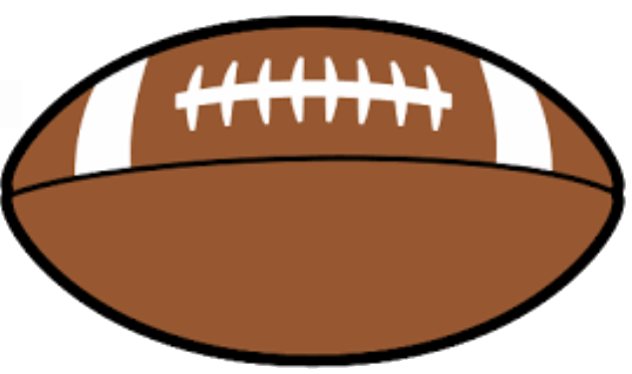
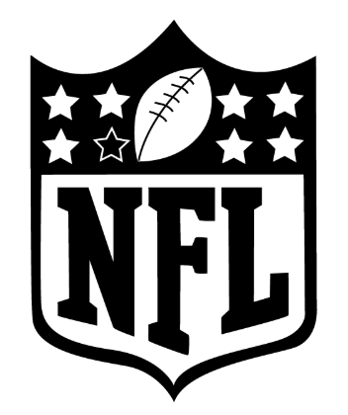
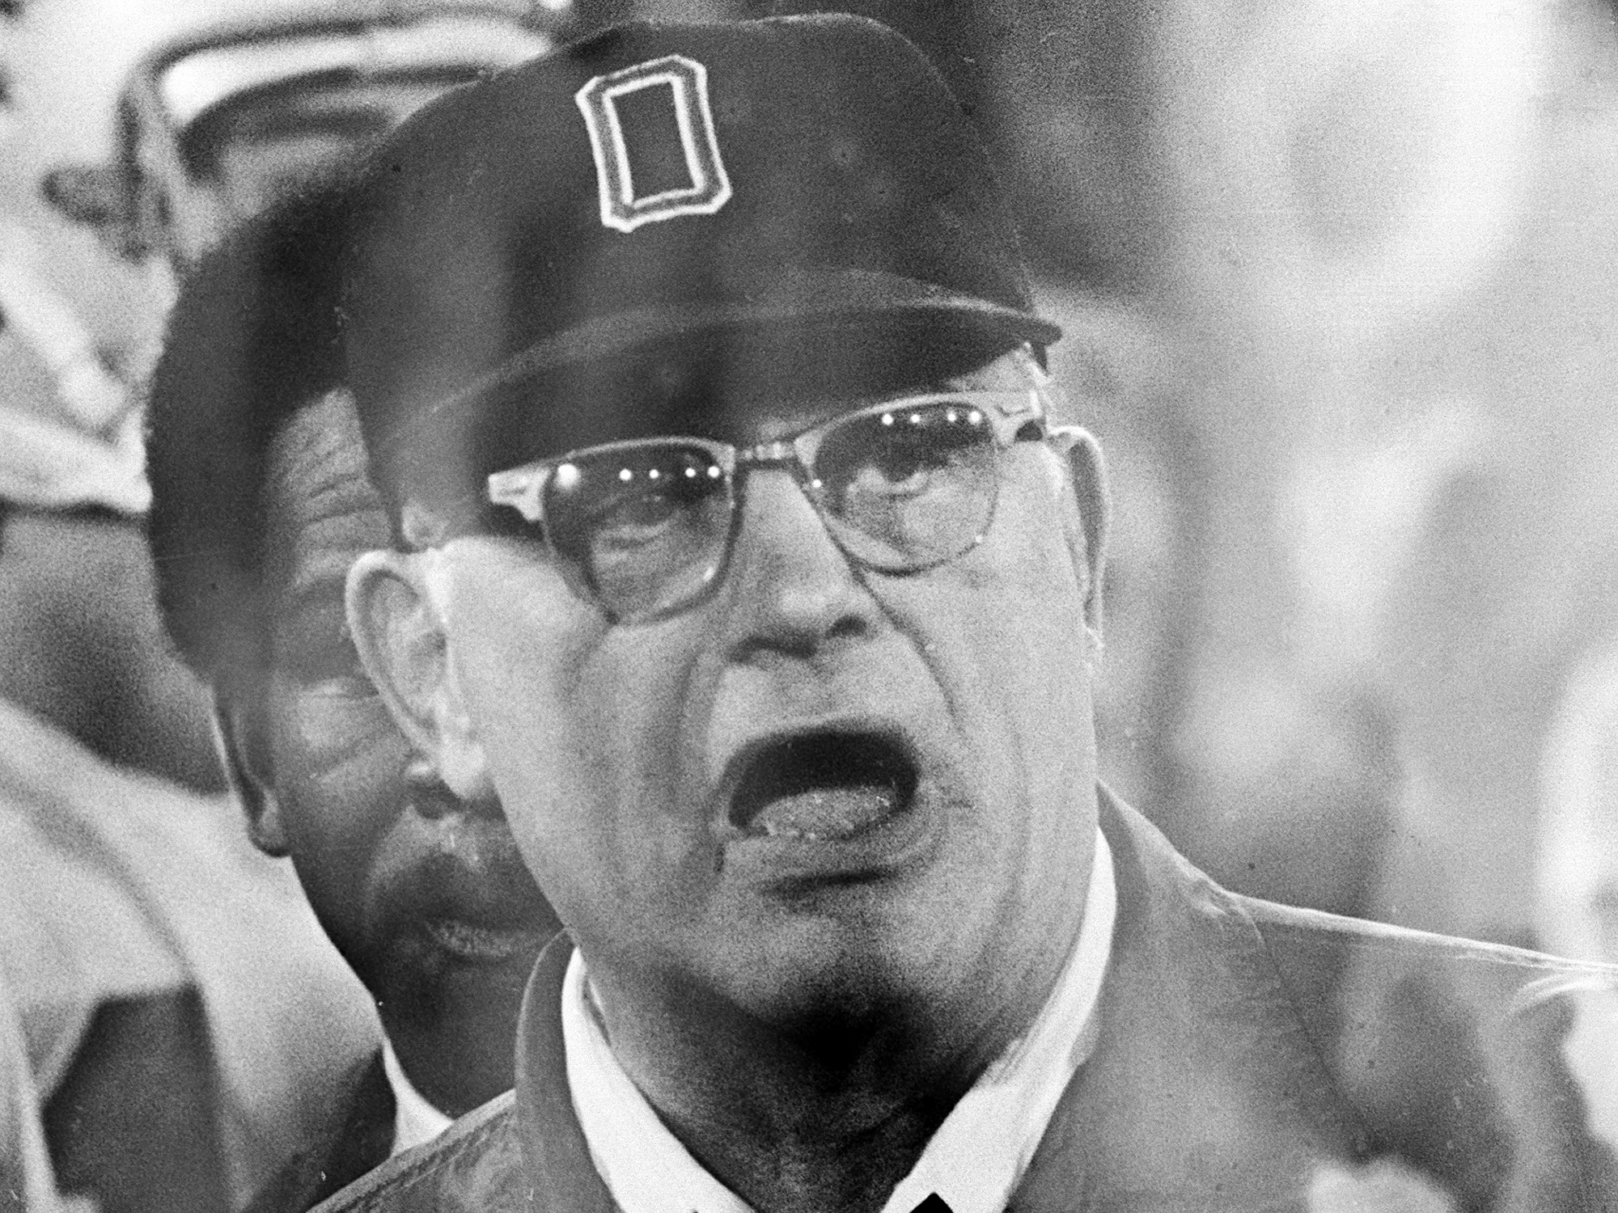
“On the ground, or through the air” - A statistical end to football’s classic debate
“There are three things that can happen when you throw a pass, and two of them are bad.”
Woody Hayes – Ohio State Buckeyes
1951-1979

Slide 2
Our Hypothesis: “On average running the football is a safer, more effective means of advancing down the, providing an NFL team a better chance of winning when compared to passing”
Null Hypothesis: “The effectiveness of a play is random irrespective of play type (run or pass) and the run vs pass percentage of winning teams is also random”
Key themes and questions to test our hypothesis:
1 | Advancing the ball down the field (and not losing yards) |  | Which play type averages higher gains in yardage per play? How often and how significant are the losses in yardage taken by play type (via sacks or tackles for loss)?
2 | Reducing the chances for error and keeping the ball out of opponent’s hands |  | Which play type is “riskier” based on the team’s chances of losing the ball (i.e. fumbles and interceptions) and in some cases even giving up points (safeties)? Does a tendency towards one play type correlate to higher time of possession during the game and the ability to keep the opponent from scoring?
3 | Making good decisions in adverse game conditions |  | Does the effectiveness of each play type change when poor weather conditions are introduced (snow and rain)?
4 | Understanding the game’s top players/teams over the past 10 years |  | Who has tended to have a larger impact on their team’s ability to win: top passers, or top rushers? Do the NFL’s top teams tend to rush or pass more often?

Slide 3

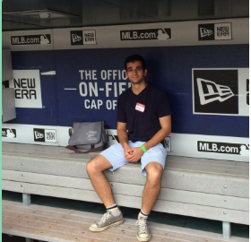



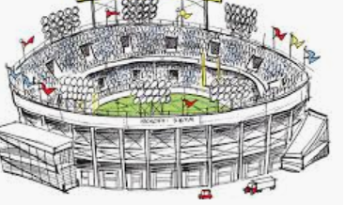

Our core dataset consisted of NFL play-by-play data, supplemented by “satellite” data sets to verify our inclinations
Core dataset: Kaggle detailed NFL play-by-play data from 2009-2018 (10 years)
449k rows by 255 columns
Play type, yards gained, lost, turnovers time of possession
Game date, winning team/losing team
Satellite datasets:
API weather data (to determine games with precipitation)
Stadium data mapped to game date
Individual player stats

Slide 4

We took a simplistic approach to create our test dataset, and completed cleanup and analysis on an individual basis
Core Dataset
Satellite Datasets
Phase 1:
Phase 2:
Phase 3:
Exploration of Core Dataset
Test Dataset Creation / Cleanup
Analysis and Satellite Connection
Studied Kaggle dataset for points that relate to our hypothesis
Identified relevant columns of information and created smaller, representative test dataset
Individual cleanup of test data to answer specific questions; Connection of APIs and adjacent datasets where applicable

Slide 5
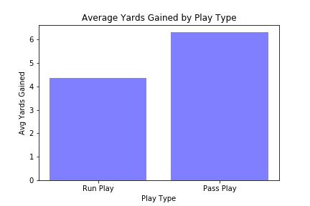
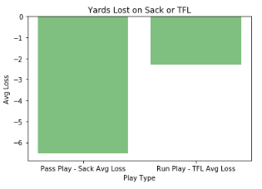
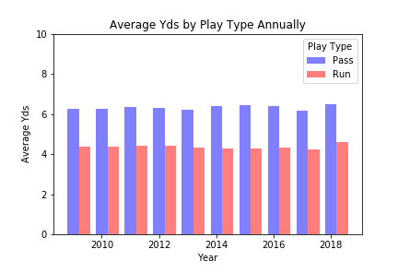
Running plays average less yards per play but involve less risk of lost yardage as compared to passing
Average Yards Gained, Overall Dataset
Data Regarding Losing Yardage, Overall Dataset

Slide 6
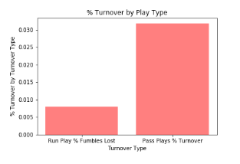
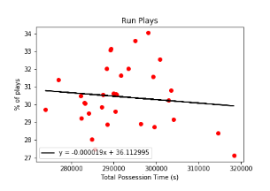
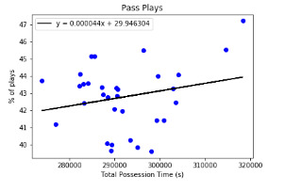
Pass plays appear to be about three times as likely to result in a turnover, while time of possession is a bit harder to predict
Turnovers by Playtype
Time of Possession by Play Type

Slide 7
We accessed a weather API to identify inclement weather in certain games…
NOAA Weather API
Daily Summary Data
Table: TEAMS
Team Id
Join: TeamName
StationId,Date
TABLE: STADIUMS
Weather Station, StadiumType
JSON: WEATHER
Date, StationId, Rainfall, Snowfall
TABLE: GAMES
Game Date
Join: HomeTeamId
TABLE: WEATHER
Date, StationId, Rain_Or_Snow_FLAG
Join: StationId,Date
TABLE: GAMES_ENRICHED
Game Date, Teams, Rain_Or_Snow_FLAG
KAGGLE Core Dataset
Table: PLAYS, Rain_Or_Snow_FLAG

Slide 8
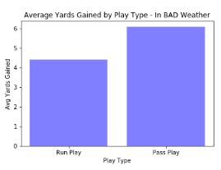
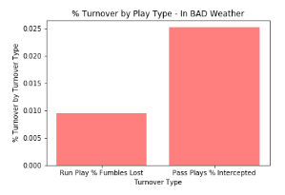
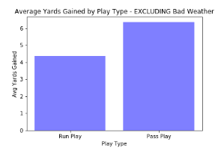
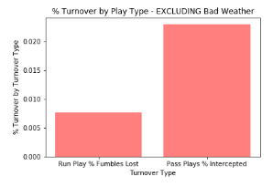
Adverse weather appears to have limited impact on overall play performance, with the exception of increased fumbles on run plays
Average Yards Gained, Inclement Weather
Turnovers, Inclement Weather

Slide 9
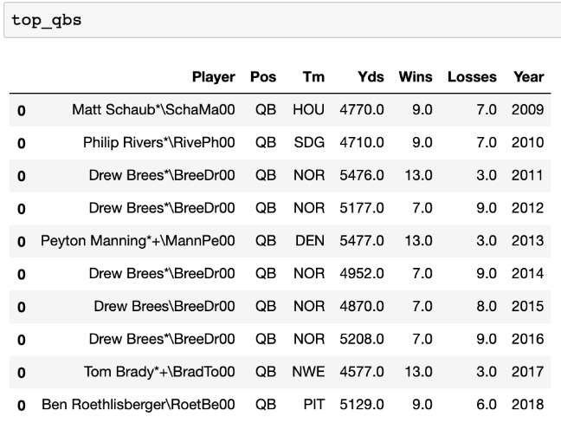
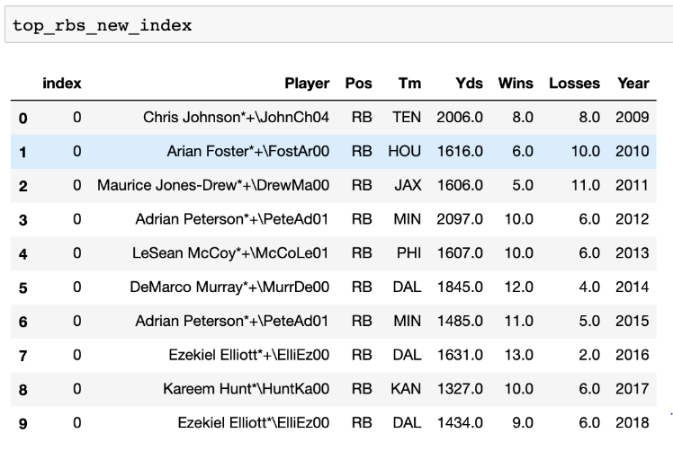
We also analyzed the league’s top quarterbacks and running-backs to determine their impact on game outcomes
Top Quarterbacks
Top Running Backs:

Slide 10
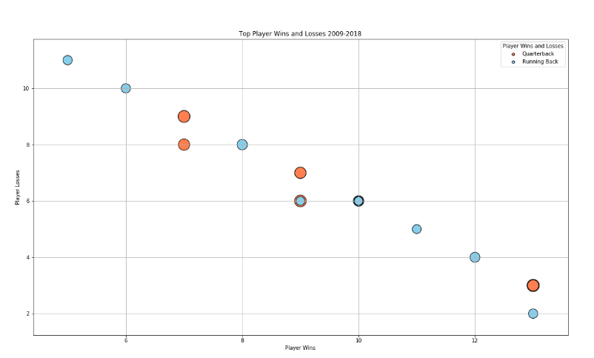
Running backs tend to have a higher impact on their team’s ability to win games
Top Players Wins and Losses

Slide 11
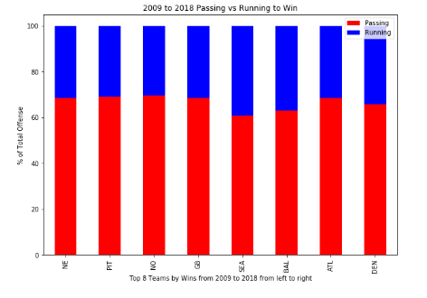
Interestingly though, the top NFL teams of the past 10 seasons have heavily leaned in favor of a pass-style offense
The Play Calling Mix of Top NFL Teams:

Slide 12
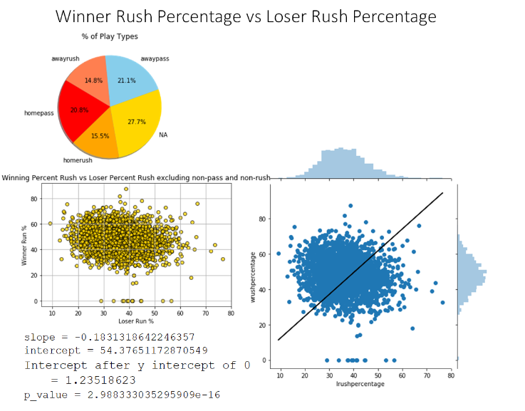
However, it would appear that increasing a team’s run percentage has a positive impact on their ability to win a game
The Play Calling Mix of Top NFL Teams:

Slide 13
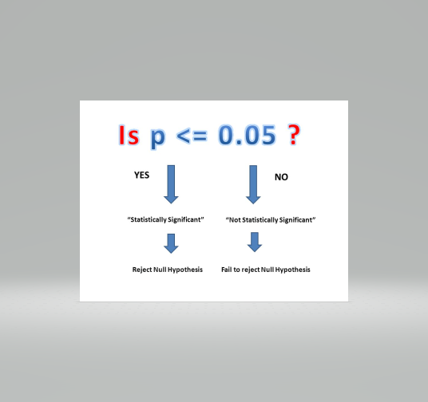
P-value Winner Rush Percentage vs Loser Rush Percentage
Given that (p_value = 2.988333035295909e-16 < .05) we see Loser and Winner percentage is statistically significant
and would reject Null Hypothesis
Null Hypothesis – Run percentage does not influence winning percentage

Slide 14
Our conclusions and ideas for further testing:
Advancing the Ball Downfield
While passing the ball results in slightly higher average yards per play than rushing, the risk of losing serious yardage is higher for passing plays (sacks)
This trend is consistent across all years of our dataset
Reducing Chances of Turnovers
Passing plays appear to be three times as likely to result in a turnover as compared to rushing plays
Safeties are about even across play types
Time of possession is difficult to analyze
Running appears to be the more effective play-type for all teams, while passing is best for the top teams
Making Good Calls in Bad Weather
Bad weather games do not change the overall trend of yards gained by play type
Bad weather is more likely to result in a fumble on all play types
The NFL’s Top Teams and Performers
The NFL teams with top running backs have outperformed those with the top quarterbacks overall
Still, the NFL’s select top teams heavily favor passing plays (70% of plays)
If we had more time:
Check if top teams have higher rushing % than opponents
Bins of yards for “big plays”
Evaluate if teams with better defense can sufficiently mitigate downside risk of pass plays in order to benefit from potential upside
Expand data set (to NCAA perhaps)

