Slide 1



Exact Symmetry Preservation in Discretized PDEs with String Theory
W. A. Horowitz
University of Cape Town
July 2, 2024

Slide 2
Symmetries are Fundamental
Noether:
Translations => conservation of momentum
Rotations => conservation of angular momentum
Time => conservation of energy
U(1) => conservation of charge
Weinberg:
Spacetime => possible particle content
Wigner program
Lorentz => possible field terms in Lagrangian
Wilson:
Effective field theories preserve symmetries of fundamental theory

Slide 3
Discretization Breaks Symmetries
Numerical evaluation of PDEs, actions, etc. usually discretizes space and/or time
Discretization breaks continuous symmetries into discrete ones
Lose exact energy/momentum conservation
Particle content changes
E.g. difficulties in lattice QCD
Is there a way to discretize but maintain symmetries?
Notes:
Fermion doubling problem in lattice QCD

Slide 4
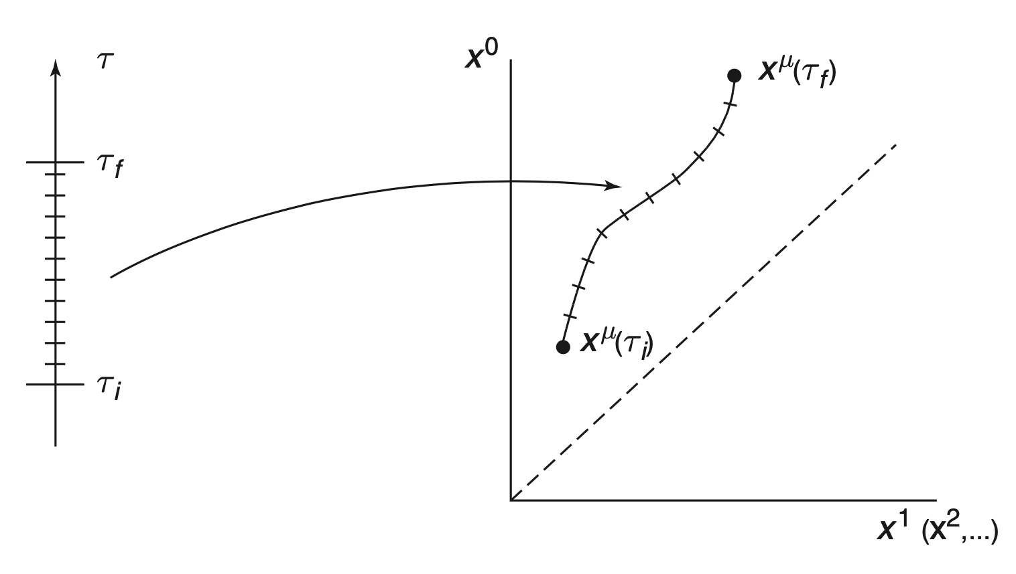
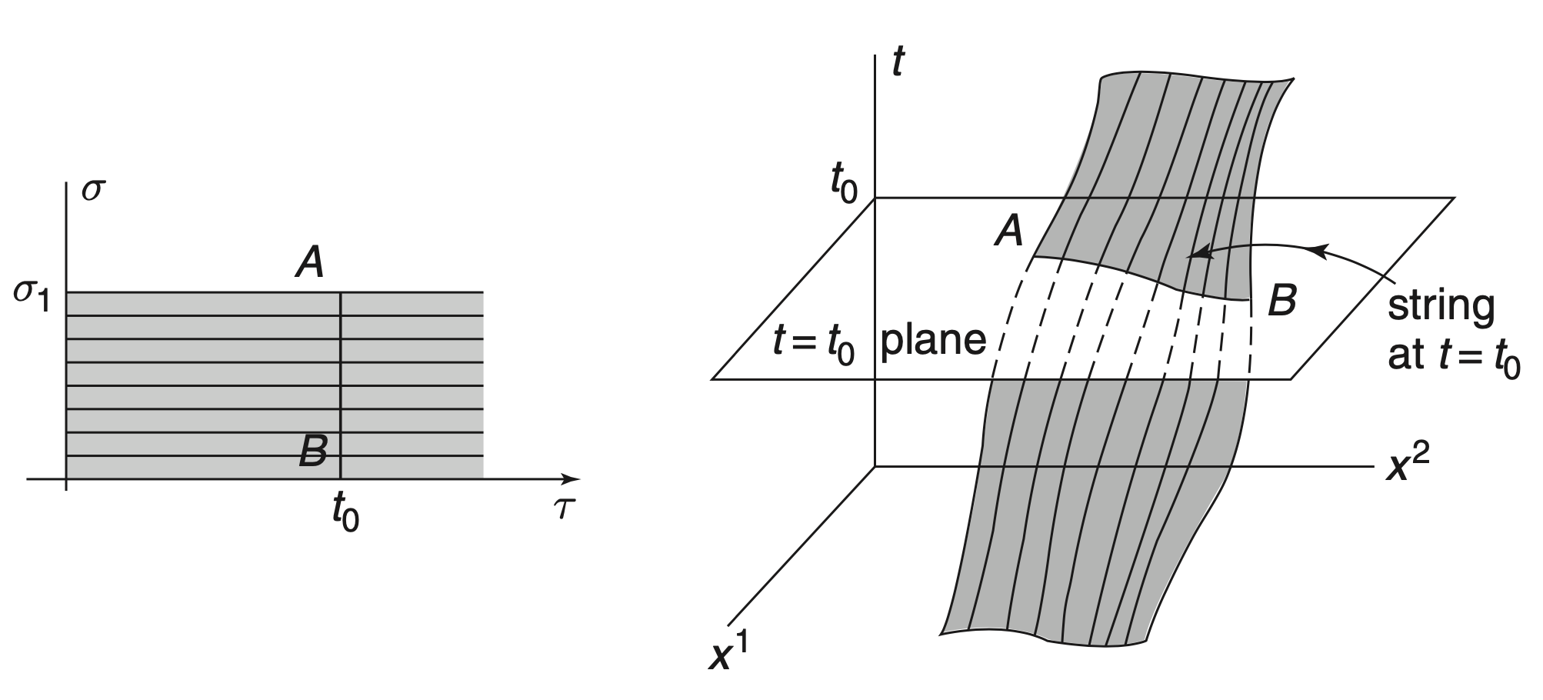
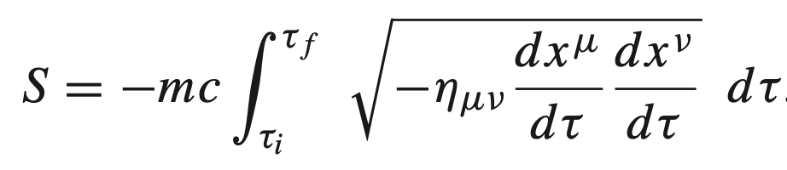
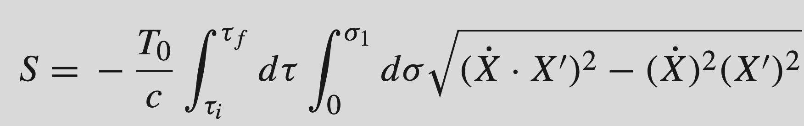
Reparameterization Invariant Actions
Physics shouldn’t depend on coordinates
=> reparameterization invariance of physics
Relativistic Point Particle
Relativistic String
Mapping from 1D parameter to 1D worldline in spacetime
Mapping from 2D parameter to 2D worldsheet in spacetime

Slide 5
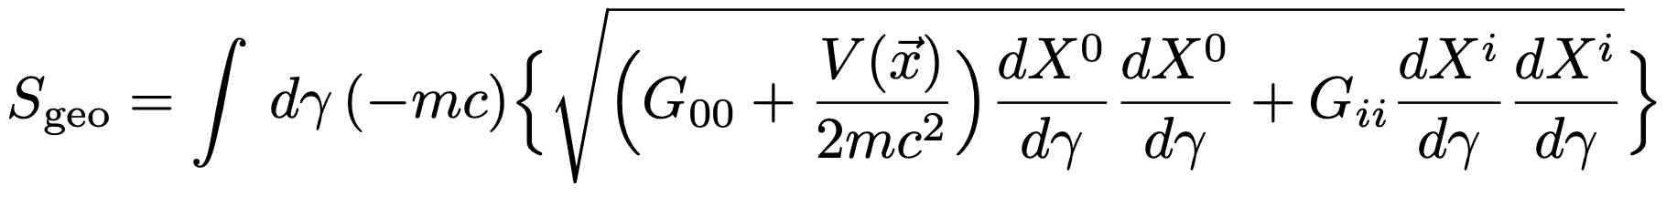
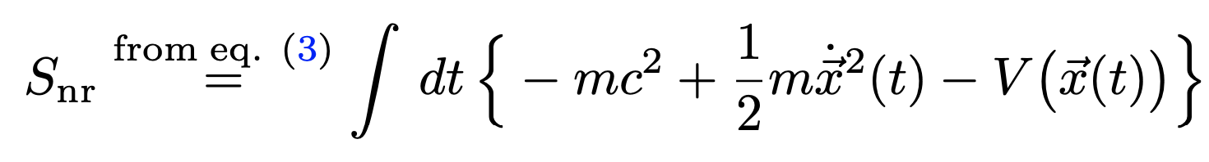
Non-relativistic Limit
Include a potential for point particle
For small velocities, v<<c, expand relativistic point particle action
Conclusion: ½ is possibly a general sign of expansion from reparam inv action

Slide 6
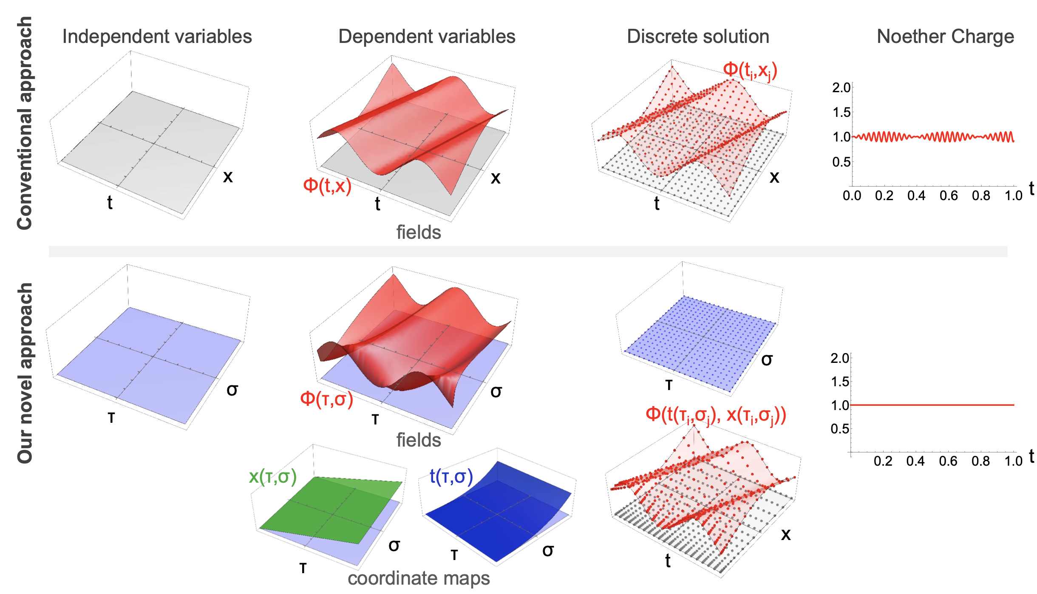
Dynamical Coordinates
Idea: make the coordinates that fields depend on themselves dynamical
Discretize the parameter space that the coordinates depend upon

Slide 7
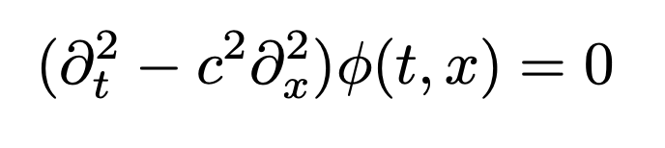
Specific Example: Waves
Motivation:
Canonical 2nd order PDE
Extraordinary importance
Fundamental physics
Industry applications
…
Treatment of boundary conditions open problem
No good method to allow waves to escape finite region

Slide 8
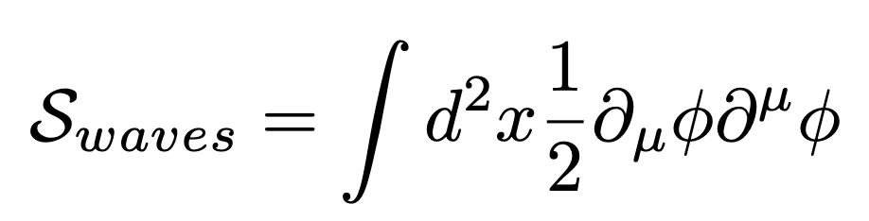
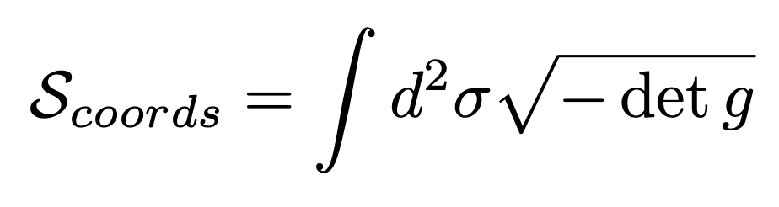
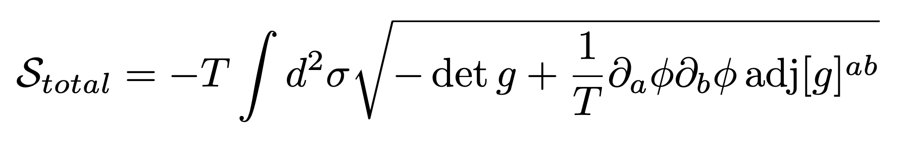
Specific Example: Waves in a Box
Take field as massless scalar
Include coordinates in dynamics
Combine with some large parameter T
T similar to m in relativistic point particle action
Expansion in T reproduces original actions up to (1/T²)

Slide 9
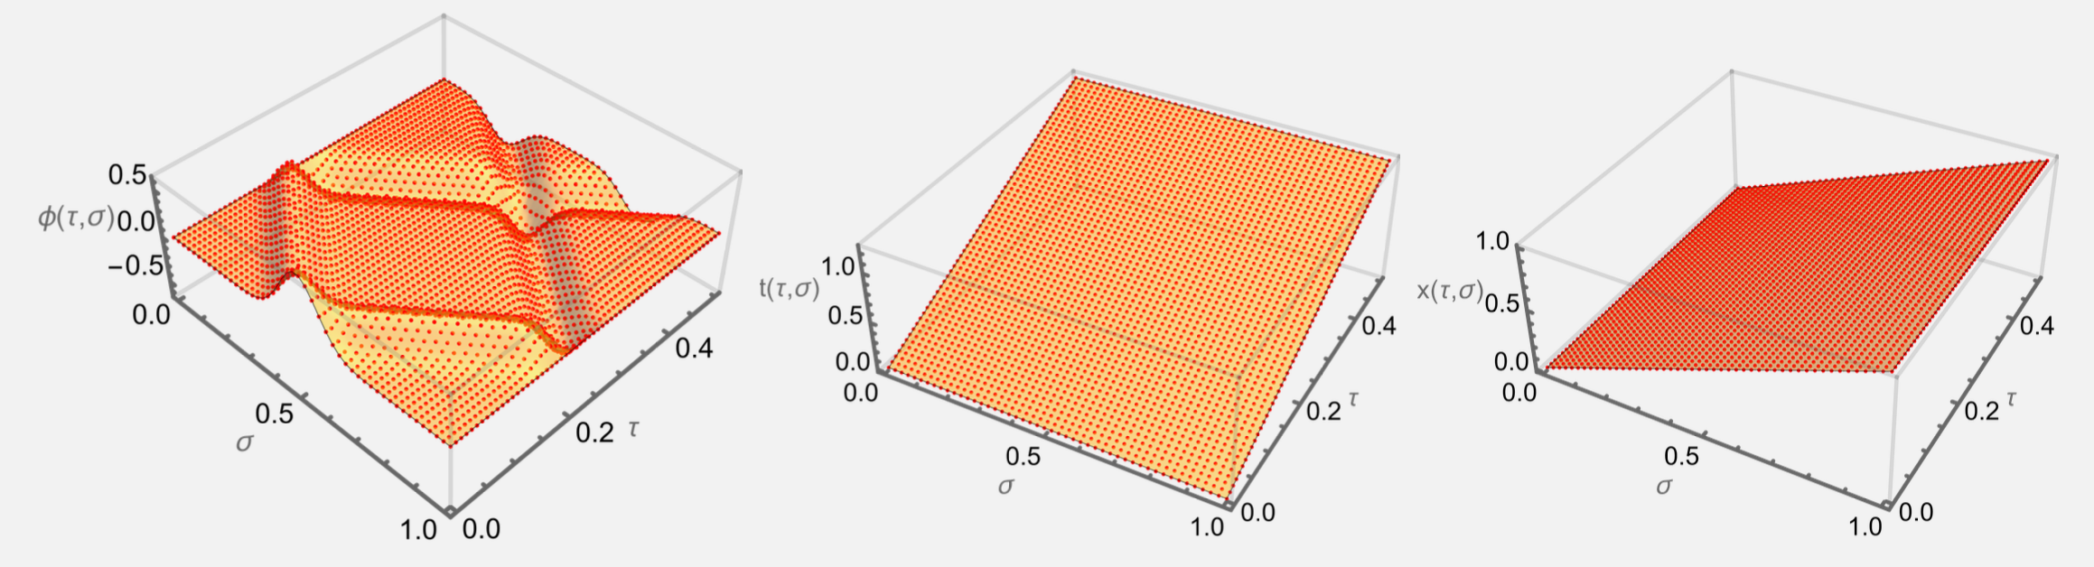
Numerical Results 1/3
For simplest first attempt, take t(τ,σ), x=σ
Can solve modified Euler-Lagrange PDEs or by extremizing S
Wave solution correct to sub-percent
Rothkopf, WAH, and Nordström, arXiv:2404.18676

Slide 10
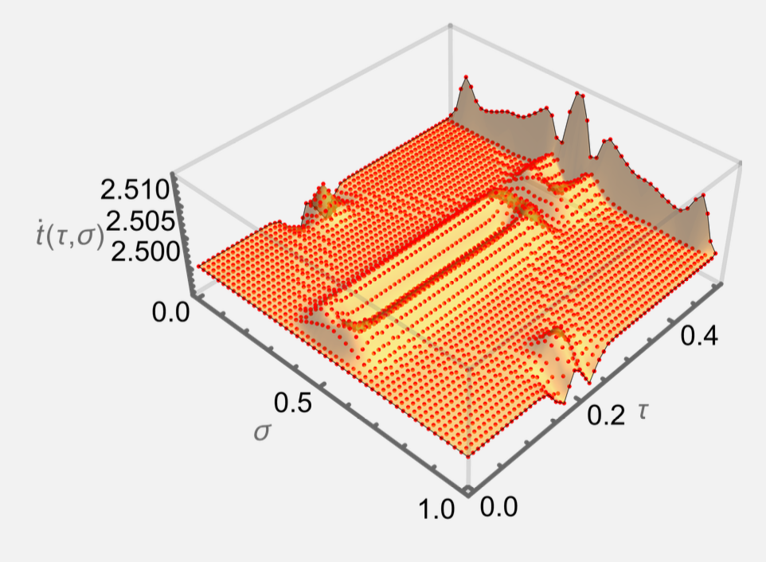
Numerical Results 2/3
Solution automatically includes mesh refinement:
Time speeds up in regions of small wave variation
Time slows down in regions of large wave variation
Rothkopf, WAH, and Nordström, arXiv:2404.18676

Slide 11
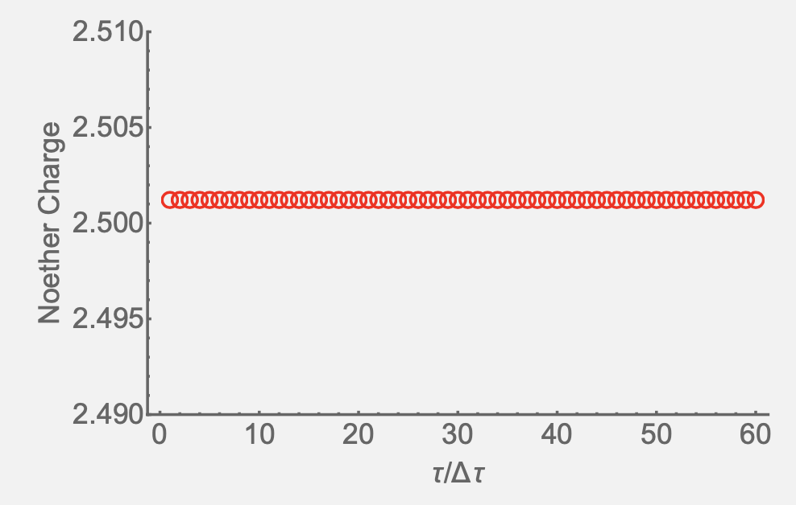
Numerical Results 3/3
Exact energy conservation (to global accuracy of simulation, Δ~10⁻⁶)
Rothkopf, WAH, and Nordström, arXiv:2404.18676

Slide 12
Conclusions and Outlook
Novel action including coordinates in dynamics exactly preserves spacetime symmetry even after discretization
Future work includes
generalizing to t(τ,σ) and x(τ,σ); see center of mass preservation (from boost invariance)
including additional spatial dimensions; see angular momentum conservation
generalization of boundary value conditions
significant importance in numerical PDEs

