Slide 1
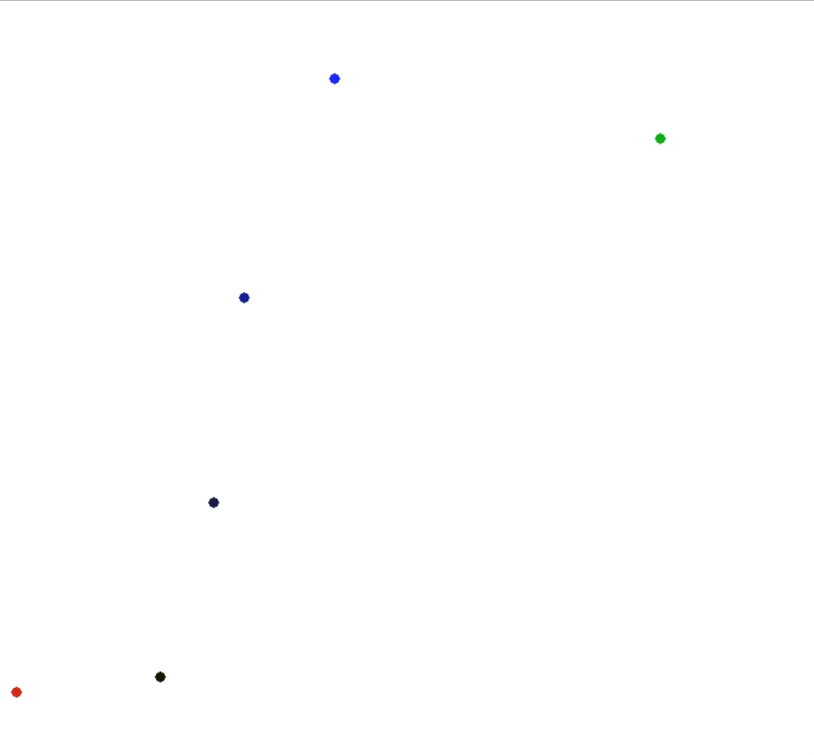
n drones and 1 package, 2D, Euclidean
Speed: 5, 7, 9, 12 (unit/s)
Red: package. Green: target. Black to Blue: agents (slowest agent is black, fastest agent is blue). Number of points used: 400.

Slide 2
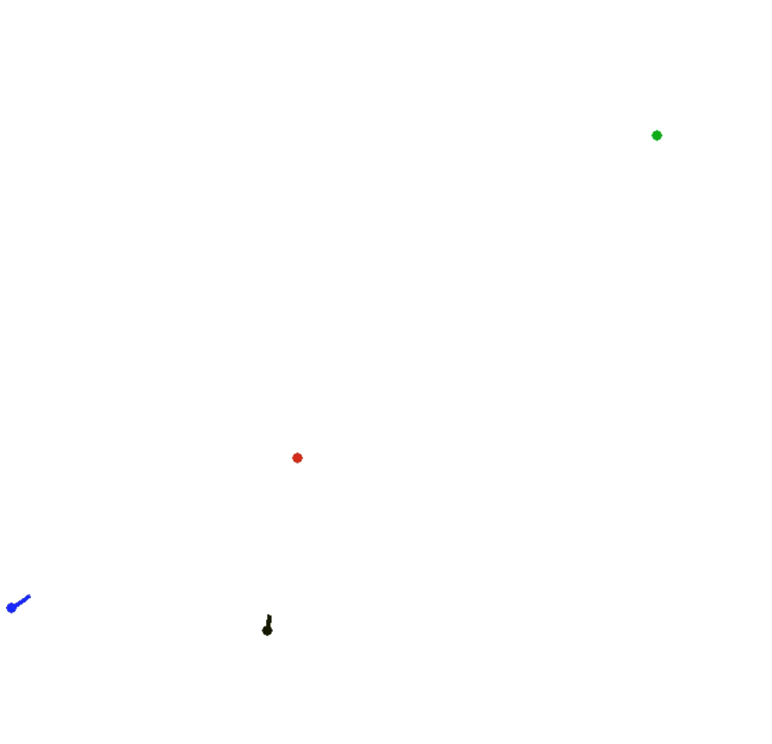
n drones and 1 package, 2D, Euclidean
Speed: 6, 8

Slide 3
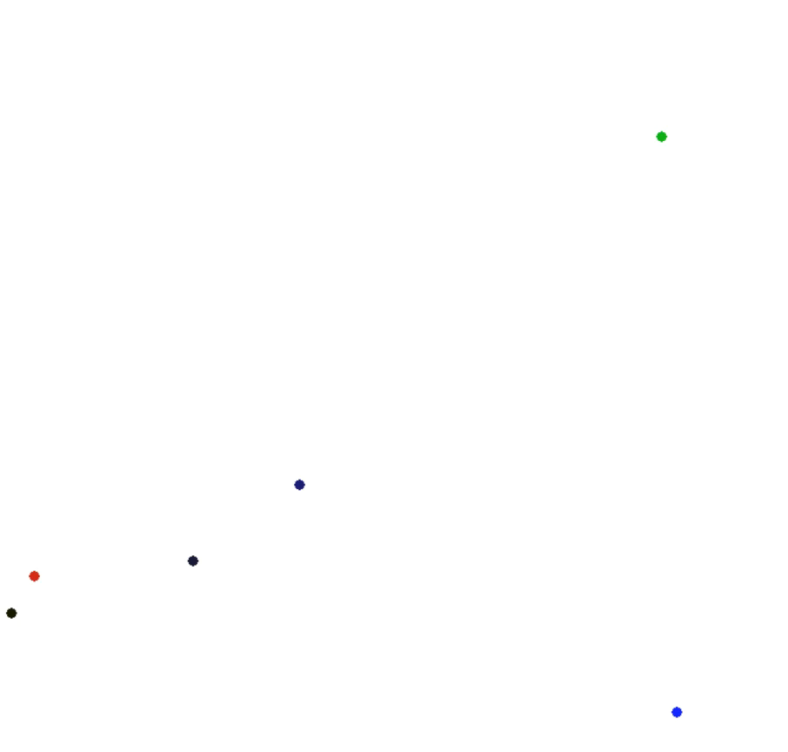
n drones and 1 package, 2D, Euclidean
Speed: 5, 7, 9, 14

Slide 4
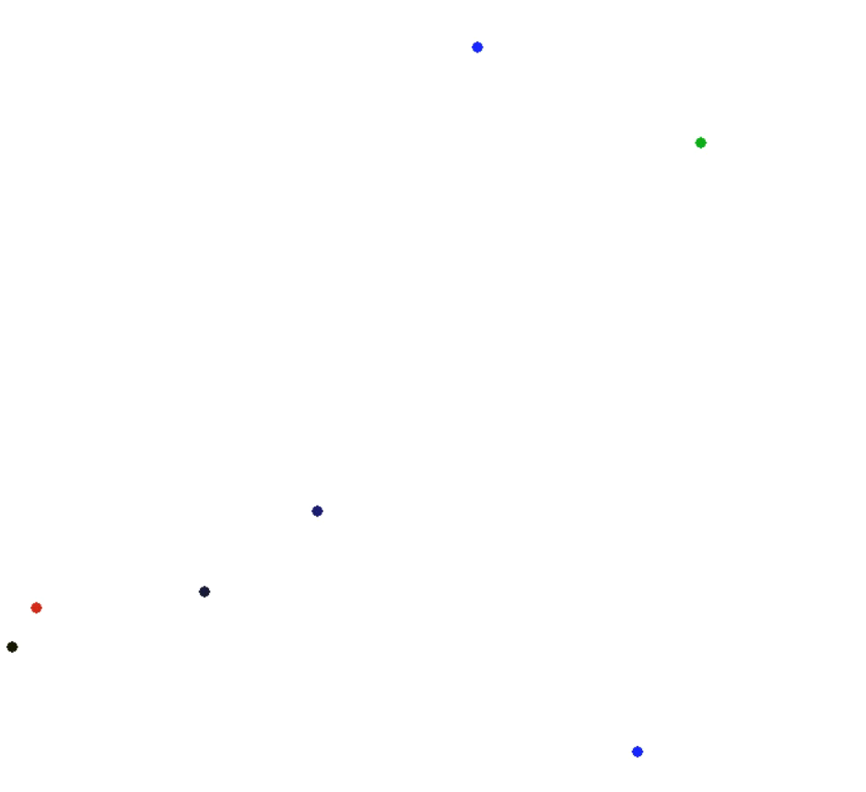
n drones and 1 package, 2D, Euclidean
Speed: 5, 7, 9, 14, 14.2

