Slide 1
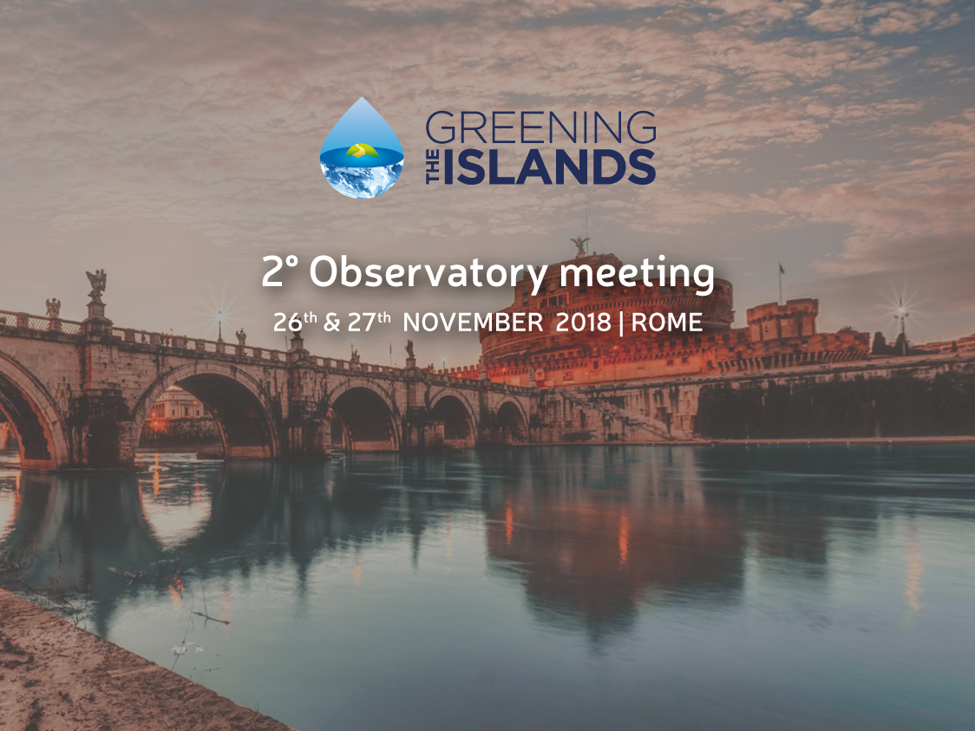
Emilio Sani
e.sani@sazalex.com
Policies for the sustainability of the islands: benchmarking of the islands within the Observatory Focus Group

Slide 2

2° Observatory meeting
26th & 27th November 2018 | Rome
Benchmark of the policies to create a best practice
Access to potable water
Access to electrical and thermal energy
Wastes management infrastructures
Clean mobility
are the key elements for the environmental sustainability and economic development of small islands
A benchmark of current policies is the first step to create a best practice

Slide 3
2° Observatory meeting
26th & 27th November 2018 | Rome
Access to potable water the key questions. Management and tariffs
What is the % of local water used in your island? In what %, is such water desalinized, taken from storage of rain water, drawn from lakes, rivers and groundwater?
Is water a public or private resource? Is the manager of the water in charge of the whole cycle of adduction, transmission, distribution, treatment and sale of the water?
Is the manager of the water system paid by the customers of the islands or by the Government?
Is water’s tariff cost reflective?
Can the manager of the water system charge higher tariffs to the customer if it makes investments like desalinization plants or plants for the re-use of water?
Are higher tariffs conditional to the achievement of a minimum efficiency of the system (maximum amount of losses and/or minimum treshold of reuse to be respected)?
Emilio Sani Lawyer

Slide 4
2° Observatory meeting
26th & 27th November 2018 | Rome
Access to potable water the key questions. Incentives
Does the manager of the water system receive a public support? Is such support linked to the cost of transportation of the water by ship?
Are there incentives for investments for the re-use of the water and/or for the reduction of the losses?
Are there incentives to replace the transportation of potable water by ship with desalinization plants?
What kind of incentives: Cash contribution to the investments, tax credits, yearly contribution paid by the customers in the inland in the bill of water, discounts or tax savings on the energy necessary for the functioning of such plants, premium for any quantity of water locally produced and consumed, commitment to use at least a certain quantity of water drawn or produced locally, other?
What has been the most efficient instrument to promote the use of local water?
Emilio Sani

Slide 5
2° Observatory meeting
26th & 27th November 2018 | Rome
Waste management in the islands
In what % are the wastes disposed locally? How is the local disposal in %: landfills, incineration, reuse ?
Who is in charge of the waste management? a private body or the government?
Is the manager of the wastes in charge of the whole cycle from collection to disposal?
Is the manager of the waste system paid by the customers of the islands or by the Government?
Can the manager of the wastes increase the tariffs if it makes investments for the optimization of the cycle of the wastes and the local disposal?
Is there a present or future commitment not to transport the wastes in the inland or not to use landfills to dispose wastes? Is there a penalty or a tariff-mechanism to penalize the managers of the wastes that use landfills or transport the wastes to the inland and do not plan investments to manage wastes locally in the islands?
Emilio Sani Lawyer

Slide 6
2° Observatory meeting
26th & 27th November 2018 | Rome
Waste management in the islands. Incentives
Does the manager of the waste system receive a public support? Is such support linked to the cost of transportation of the wastes to the inland?
Are there incentives for investments for plants for the reuse and recycle of the wastes or the energy-use of the wastes ?
What kind of incentives: Cash contribution to the investments, tax credits, yearly contribution paid by the customers in the inland in the waste tariff, premium for the energy produced by wastes, premium for any ton of waste locally disposed, commitment to dispose locally at least a % of the wastes, other?
What has been the most efficient instrument to promote the local disposal of wastes?
Emilio Sani Lawyer

Slide 7
2° Observatory meeting
26th & 27th November 2018 | Rome
Clean Mobility in the Islands. Public Mobility.
In what % public and private transportation is fuelled by electricity localy produced or by renewable sources?
Is there a public transportation service ?
Are the public vehicles fuelled by fossil sources?
Is there a mechanism of support to the public transportation in the island ?
Is such support conditional to the respect of environmental criteria?
Are there mechanisms of incentivation for the switch to clean vehicles ? What mechanisms: Tax credits, Tax savings, cash contribution to the investment, increase of tickets and cost of transportation conditional to environmental investments, reimbursement of costs in proportion of tons of fossil fuel saved, other?
Emilio Sani Lawyer

Slide 8
26th & 27th November 2018 | Rome
Clean Mobility in the Islands. Private Mobility.
Are there incentives to the purchase of electric vehicles ? What kind of incentives: tax savings, capital contribution to the cost of purchase, free circulation in the islands with restrictions to other vehicles, free or agevolated supply of electrical energy from public distributors?
Are there incentives to the purchase of electrical energy for electric vehicles? What kind of incentives: Free energy when the vehicle is charged in proximity of a renewable power plant from the energy of such power plant, energy without taxes or charges, energy discounted because partially paid by the Government?
What has been the most efficient instrument to promote the use of local fuel for transportation?
Emilio Sani Lawyer

Slide 9
2° Observatory meeting
26th & 27th November 2018 | Rome
Clean energy in the Islands. Thermal energy
In what % thermal energy is produced using local renewable sources?
Is the island connected to the gas national netwok?
Are there economic aids or supports for the transportation of gas and/or oil to the island?
Are there incentives to the installation of heating pumps, thermal solar plants or other mechanisms for the production of thermal energy with resources available in the island?
What incentives? Premium per any kWht produced with local resources and locally consumed, cash contribution to the investment, tax credit, tax saving on the taxes on the consumption of energy or fuels, commitment to have a certain % of thermal energy produced locally, other?
Are there incentives to district heating systems in the islands?
What has been the most efficient instrument to promote use of local fuel for thermal energy?
Emilio Sani Lawyer

Slide 10
2° Observatory meeting
26th & 27th November 2018 | Rome
Clean energy in the Islands. Electrical energy
In what % renewable energy is produced using local renewable sources?
Is the island connected to the National System for the transmission of energy?
Are there economic aids or supports for the transportation of gas and/or oil to the island for the local production of electric energy?
Are there incentives to the installation of power plants fuelled by renewable sources ?
What incentives? Premium per any kWhe produced with local renewable sources, tax credit, tax saving, cash contribution to the investment, commitment to have a certain % of electrical energy produced locally, purchase of energy by the Government at high price, other?
Is there an incentive to the self-consumption of energy? What: exemption from charges and taxes on energy self-consumed, net metering, premium on the energy self-consumed, tax credit, tax saving?
What has been the most efficient instrument to promote the production of electrical energy from local renewable sources?
Emilio Sani Lawyer

Slide 11
2° Observatory meeting
26th & 27th November 2018 | Rome
The scope of the survey.
To prepare a best practice report with:
General figure on environmental sustainability in the islands.
Different policies for water supply and switch to efficient use of local resources
Different policies for waste disposal and support to local disposal;
Different policies for public and private transportation and switch to local non fossil fuels;
Different policies for supply of thermal energy and switch to local renewable sources;
Different policies for supply of electrical energy and switch to local renewable sources
The most efficient incentives for the switch to environmental sustainable services;
The most innovative projects
Proposal for a standardization of policies and best practices in the small islands
Emilio Sani Lawyer

Slide 12
2° Observatory meeting
26th & 27th November 2018 | Rome
An Italian best practice: the new incentives for energy
in the small islands
A special regulation to support the switch to local renewable fuel for the electrical and thermal energy consumed in the small islands
A minimum treshold of consumption of renewable energy in any small energy must be achieved within December 31 2020.
Emilio Sani Lawyer

Slide 13
2° Observatory meeting
26th & 27th November 2018 | Rome
The incentives for the switch to sustainable production
of thermal energy
The new regulation incentivates the installation of solar thermal plants or (just for the production of hot water) the installation of heating pumps
The incentive is :
For the solar panels: the minimum between 65 % of the cost of investment and a formula that takes into consideration the surface of the plant
For the heating pumps: for hot water 50 % of the cost of investment with a maximum limit of Euros 850
The incentive is paid within 6 months from the filing of the application
.
Emilio Sani Lawyer

Slide 14
2° Observatory meeting
26th & 27th November 2018 | Rome
The incentives for the switch to sustainable production
of electrical energy
For the new renewables power plant installed in the small islands:
A feed in tariff is paid for the energy injected into the the grid
A premium is paid for the energy self-consumed
The incentive is for 20 years and is different for any island
Emilio Sani Lawyer

Slide 15
2° Observatory meeting
26th & 27th November 2018 | Rome
The quantification of the incentive to be paid for the electrical energy
produced and injected into the grid in the small islands
The producer of energy may choose for the incentive on the energy injected into the grid between:
A fixed tariff for any group of islands. In the islands with the lower tariff: 155 Euros per MWh per residential plants and 122.7 Euros per MWh for plants > 200 kW;
A variable tariff that is equal to a fixed amount per the average cost of diesel fuel, with a minimum and a maximum. Minimum values are in the island with the lower tariff: Euros 147.5 for residential plants and Euros 116.7 for plants > 200 kW;
The above tariffs include the value of the energy.

Slide 16
2° Observatory meeting
26th & 27th November 2018 | Rome
The quantification of the incentive to be paid for the electrical energy
self-consumed in the small islands
The producer of energy is entitled to receive a premium equal to the balance between:
The incentive tariff to be paid for the energy injected into the grid and
The value of the electricity self-consumed. Such value is equal to the sum of the average national market price + the average amount of charges that are added to such price in the bill of electricity (except for consumption tax and vat)

Slide 17
2° Observatory meeting
26th & 27th November 2018 | Rome
What is the procedure for the obtainment of the incentive?
The application for the incentive is filed to a company called GSE S.p.A. that is in charge of the incentives in the field of energy;
GSE S.p.A. enters into an agreement with the producer for the payment of the incentives. The incentive includes the price of the energy produced and not self-consumed.
The incentive is paid for the whole amount of the energy produced and injected into the grid net of the energy consumed for the auxiliary services
GSE sells into the market the energy that it purchases from the plants in the small islands.

Slide 18
THANK YOU
Emilio Sani
Tel: +393775556440
e.sani@sazalex.com

