Slide 1
#08 Web Infrastructure
Client/Server Computing and Web Technologies

Slide 2
Web Infrastructure
Cloud Computing
Serverless (Firebase & Cloud Functions)

Slide 3
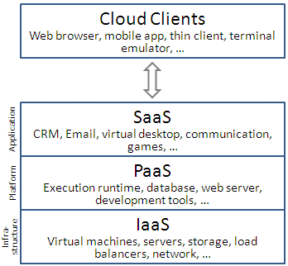
Cloud Computing
Infrastructure as a service (IaaS)
Platform as a service (PaaS)
Software as a service (SaaS)

Slide 4
IaaS: NIST's Definition
"where the consumer is able to deploy and run arbitrary software, which can include operating systems and applications. The consumer does not manage or control the underlying cloud infrastructure but has control over operating systems, storage, and deployed applications; and possibly limited control of select networking components (e.g., host firewalls)."

Slide 5
Infrastructure as a service (IaaS)
Dereference low-level details of underlying network infrastructure
like physical computing resources, location, data partitioning, scaling, security, backup etc.
Pools of hypervisors within the cloud operational system
support large numbers of virtual machines and the ability to scale services up and down according to customers' varying requirements.
Often offer additional resources such as
virtual-machine disk-image library, raw block storage, file or object storage, firewalls, load balancers, IP addresses, virtual local area networks (VLANs), and software bundles.

Slide 6
PaaS: NIST's definition
The capability provided to the consumer is to deploy onto the cloud infrastructure consumer-created or acquired applications created using programming languages, libraries, services, and tools supported by the provider. The consumer does not manage or control the underlying cloud infrastructure including network, servers, operating systems, or storage, but has control over the deployed applications and possibly configuration settings for the application-hosting environment.

Slide 7
SaSS: NIST's definition
The capability provided to the consumer is to use the provider's applications running on a cloud infrastructure. The applications are accessible from various client devices through either a thin client interface, such as a web browser (e.g., web-based email), or a program interface. The consumer does not manage or control the underlying cloud infrastructure including network, servers, operating systems, storage, or even individual application capabilities, with the possible exception of limited user-specific application configuration settings.

Slide 8
Case Study: Digital Ocean Droplet
From the Create menu in the top right of the control panel, click Droplets.
Choose an image, which can be a Linux distribution, container distribution, one-click app, snapshot, or backup.
Choose a size for your Droplet, which determines its RAM, disk space, and vCPUs as well as its price. You can choose to double the SSD on a plan as well.
Choose a datacenter region.
Choose an SSH key, if you’ve added one. If you choose not to use SSH keys, your Droplet’s password will be emailed to you after creation.
Enter a name and click Create.

Slide 9
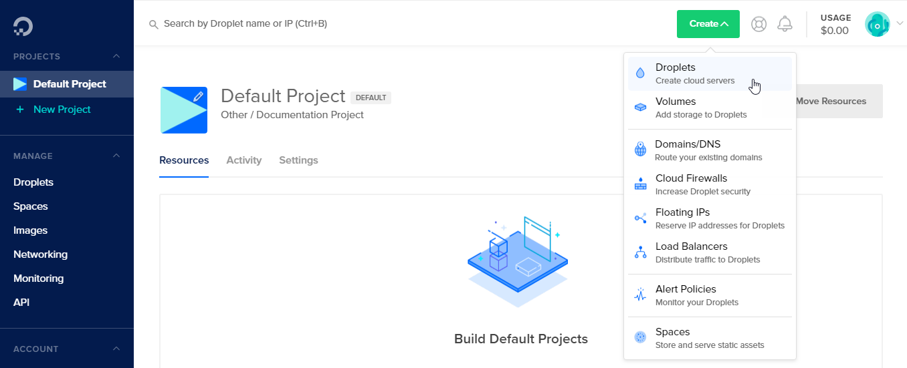

Slide 10
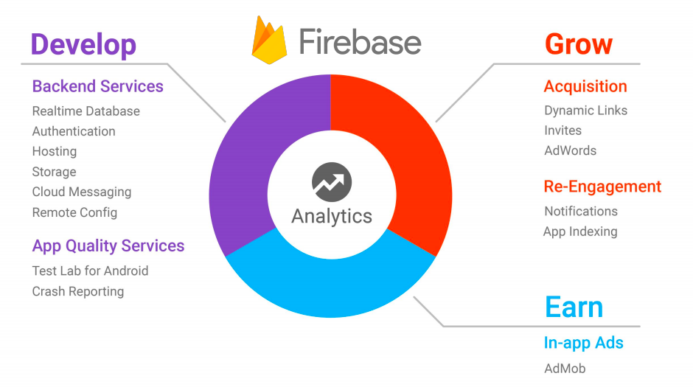

Slide 11
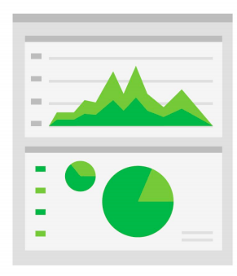
Analytics
Determine the effectiveness of notifications and update your re-engagement strategy.
Discover what in-app activities trigger in-app purchases and surface these appropriately; improve your user's experience to increase engagement and monetization.
Remote Config can target custom app experiences at members of different
Analytics will provide campaign attribution reporting for AdWords, App Indexing, App Invites, Dynamic Links, and Notifications.

Slide 12
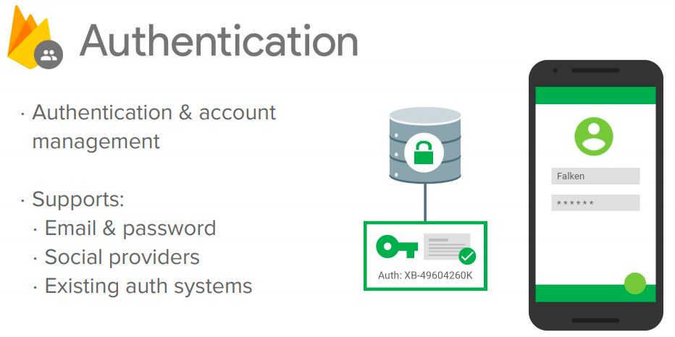

Slide 13
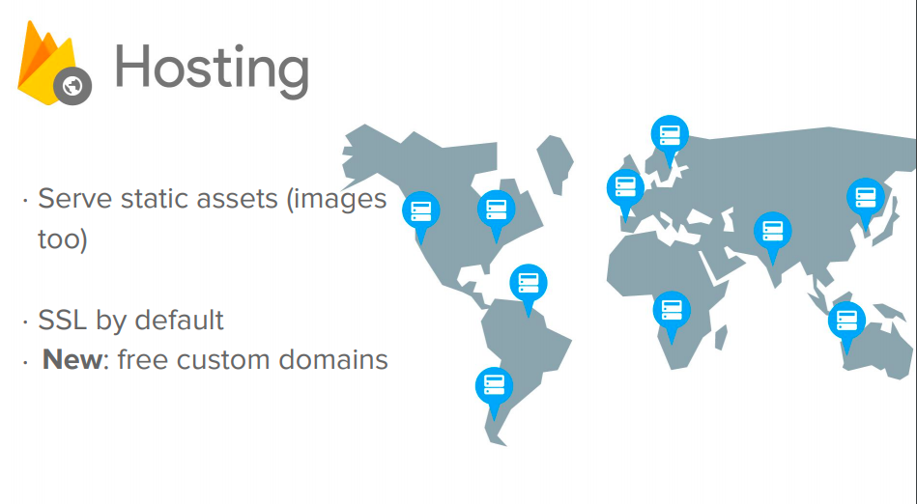
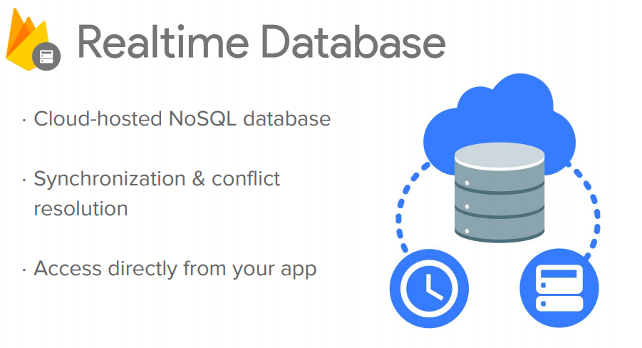

Slide 14
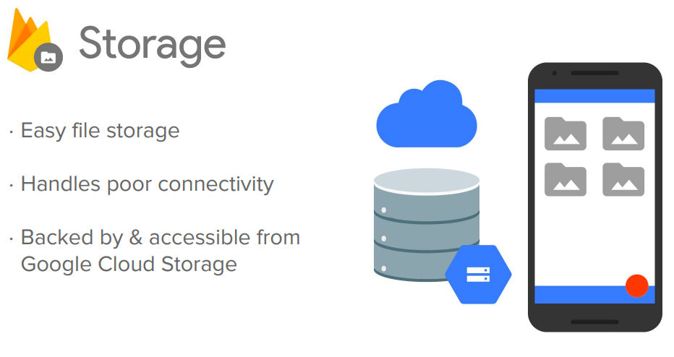

Slide 15
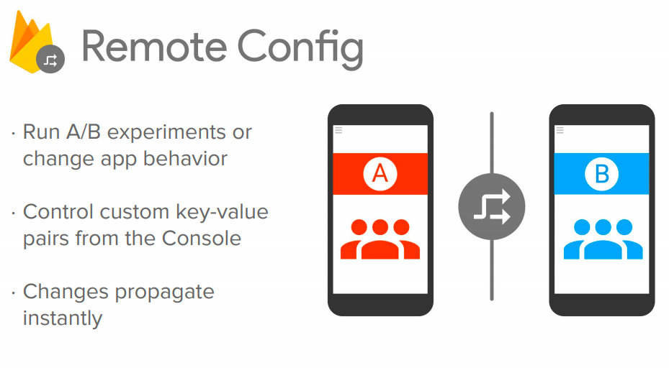

Slide 16
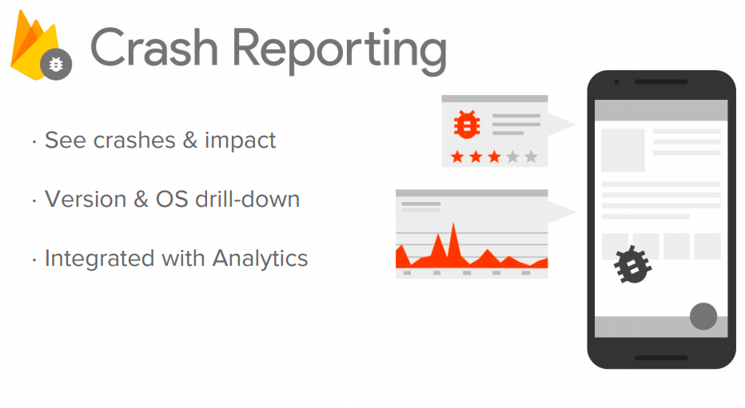

Slide 17
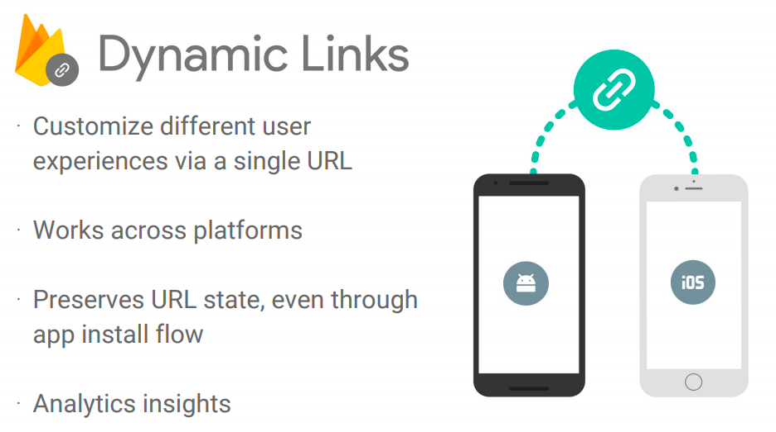

Slide 18
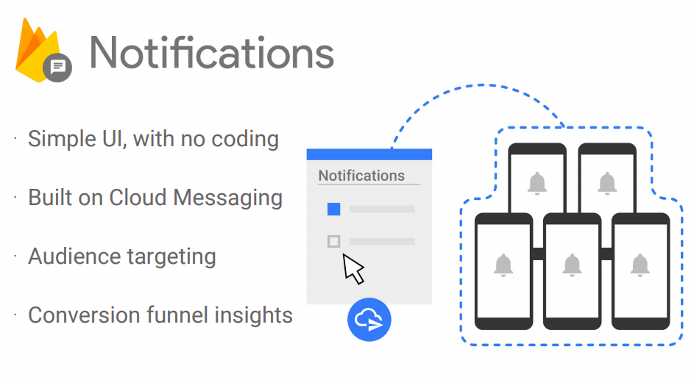

Slide 19
Case Study
React and Firebase Realtime Database
https://medium.com/equinox-blog/%E0%B8%A5%E0%B8%AD%E0%B8%87%E0%B9%83%E0%B8%8A%E0%B9%89-react-firebase-realtime-database-%E0%B8%81%E0%B8%B1%E0%B8%99%E0%B9%80%E0%B8%96%E0%B8%AD%E0%B8%B0-30b134b905a8

Slide 20
Case Study
Deploy React App to Firebase Hosting
https://medium.com/@julienrioux/deploy-react-js-app-on-firebase-c7fa6ddc153f

Slide 21
Cloud Function
Cloud Functions gives developers access to Firebase and Google Cloud events, along with scalable computing power to run code in response to those events.
Typical use cases might fall into these areas:
Notify users when something interesting happens.
Perform Realtime Database sanitization and maintenance.
Execute intensive tasks in the cloud instead of in your app.
Integrate with third-party services and APIs.

Slide 22
No Backend
Backendless
deployd
Firebase
Hoodie
Kinvey
remoteStorage
Sockethub
Stamplay
List from nobackend.org/solutions

