Slide 1
#09 Web Deployment
Client/Server Computing and Web Technologies

Slide 2
Web Deployment
Production Environment
Reverse Proxy
Docker
Load Test

Slide 3
Production Environment
App must be build or run in production mode.
Case Study:
https://expressjs.com/en/advanced/best-practice-performance.html

Slide 4
Things to do
Dev part
Use gzip compression
Don’t use synchronous functions
Do logging correctly
Handle exceptions properly
Ops part
Set NODE_ENV to “production”
Ensure your app automatically restarts
Run your app in a cluster
Cache request results
Use a load balancer
Use a reverse proxy

Slide 5
PM2
Advanced, production process manager for Node.js
Offering Cluster Mode
Simple Application Declaration
Example: process.yml
apps: - script: src/main.js name: mms env: NODE_ENV: production
>> npm install pm2@latest -g
>> pm2 start process.yml
>> pm2 startup

Slide 6
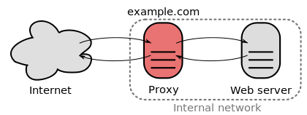
Reverse Proxy
a type of proxy server that retrieves resources on behalf of a client from one or more servers.
Unlike a forward proxy, which is an intermediary for its associated clients to contact any server, a reverse proxy is an intermediary for its associated servers to be contacted by any client.
Notes:
These resources are then returned to the client, appearing as if they originated from the proxy server itself.

Slide 7
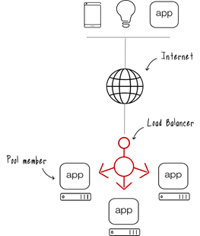
Load Balancer
Acts as a reverse proxy
Distributes network or application traffic across a number of servers.
To increase capacity (concurrent users) and reliability of applications.
Some industry standard algorithms are:
Round robin
Weighted round robin
Least connections
Least response time

Slide 8
Case Study: Nginx as a reverse proxy
How To Set Up a Node.js Application for Production on Ubuntu 18.04
https://www.digitalocean.com/community/tutorials/how-to-set-up-a-node-js-application-for-production-on-ubuntu-18-04

Slide 9
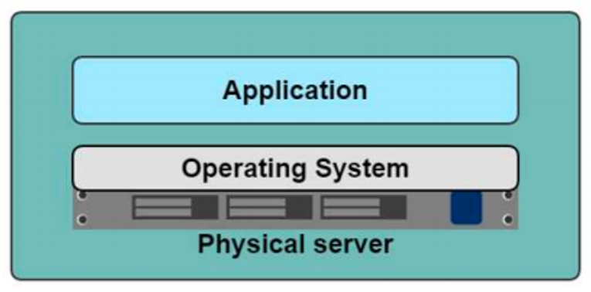
Depolyment in Dark Ages
One Application on one physical server
Slow Deployment times
Huge costs
Wasted resources
Difficult to scale
Difficult to migrate
Vendor lock in

Slide 10
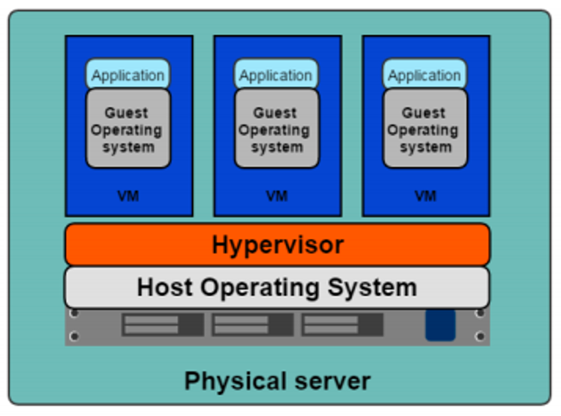
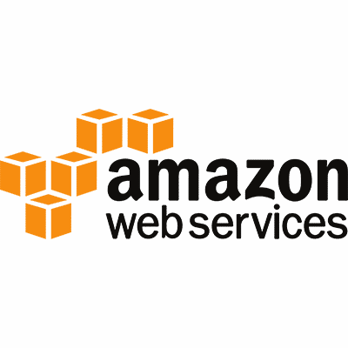
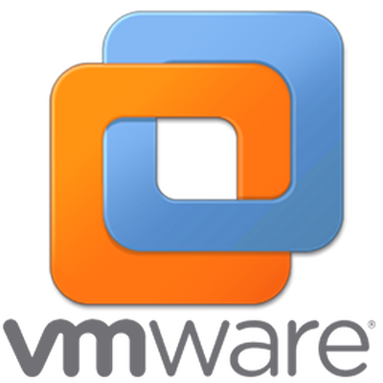

Hypervisor-based Virtualization
One Physical server can contain multiple applications. Each application runs in a virtual machine (VM).
Better resource pooling
One physical machine divided into multiple virtual machines
Easier to scale
VMs in the cloud
Rapid elasticity
Pay as you go model

Slide 11
Limitations of VMs
Each VM stills requires
CPU allocation
Storage
RAM
An entire guest operating system
The more VMs you run, the more resources you need
Guest OS means wasted resources
Application portability not guaranteed

Slide 12
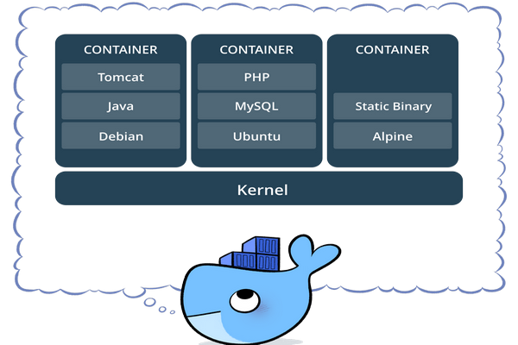
What is container?
Standardized packaging for software and dependencies
Isolate apps from each other
Share the same OS kernel
Works with major Linux and Windows Server

Slide 13
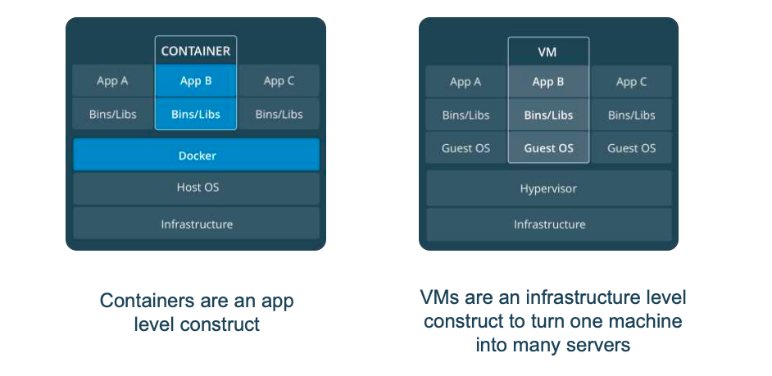
Comparing Containers and VMs

Slide 14
Load Testing
Kind of Performance Testing which determines a system's performance under real-life load conditions.
Determine how the application behaves when multiple users access it simultaneously.
This testing usually identifies -
The maximum operating capacity of an application
Determine whether the current infrastructure is sufficient to run the application
Sustainability of application with respect to peak user load
Number of concurrent users that an application can support, and scalability to allow more users to access it.

Slide 15
Goals of Load Testing
Response time for each transaction
Performance of System components under various loads
Performance of Database components under different loads
Network delay between the client and the server
Software design issues
Server configuration issues like a Web server, application server, database server etc.
Hardware limitation issues like CPU maximization, memory limitations, network bottleneck, etc.

Slide 16
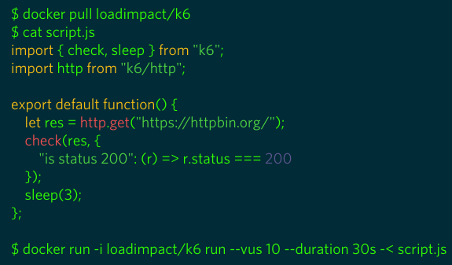
K6
k6 is a developer centric open source load testing tool for testing the performance of your backend infrastructure.

Slide 17
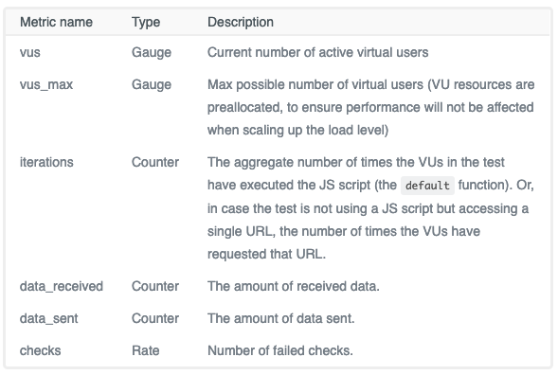
K6 Metrics

Slide 18
HTTP-specific built-in metrics
Metric name | Type | Description
http_reqs | Counter | How many HTTP requests has k6 generated, in total.
http_req_blocked | Trend | Time spent blocked (waiting for a free TCP connection slot) before initiating request. float
http_req_waiting | Trend | Time spent waiting for response from remote host (a.k.a. "time to first byte", or "TTFB"). float
http_req_duration | Trend | Total time for the request. It's equal to http_req_sending + http_req_waiting + http_req_receiving (i.e. how long did the remote server take to process the request and respond, without the initial DNS lookup/connection times). float
See completed list of metrics at https://docs.k6.io/docs/result-metrics

Slide 19
Case Study
K6 with InfluxDB and Grafana
https://docs.k6.io/docs/influxdb-grafana
Note: Docker Compose is a tool for defining and running multi-container Docker applications.

