Slide 1
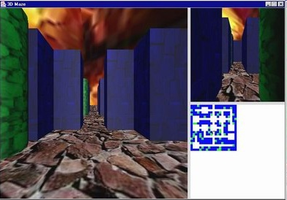
Introduction to Java 3D
241-302, Computer Engineering Lab II (3rd Year)
Dr. Andrew Davison WiG Lab Office, CoE ad@fivedots.coe.psu.ac.th

Slide 2
Contents
1. Java 3D Overview
2. What is a Scene Graph?
3. A Java 3D Skeleton
4. Lighting a Scene
5. Making a Background
6. 3D Shapes
7. Shape Colour
8. Transformations
9. More Information

Slide 3
1. Java 3D Overview
A high-level API for building interactive 3D applications and applets
uses a scene graph to model/control the 3D scene
Fast and efficient impl. on a variety of platforms
built on top of OpenGL and DirectX
Other features:
object behaviors
user interaction
loaders for many 3D file formats

Slide 4
Some Application Areas
Scientific/Medical/Data visualization
Geographical information systems (GIS)
Computer-aided design (CAD)
Simulation
Computer-aided education (CAE)
Games
my interest!

Slide 5
2. What is a Scene Graph?
A scene graph is a tree-like data structure that stores, organizes, and renders 3D scene information (3D objects, materials, lights, behaviours).
The scene graph makes 3D programming considerably easier than directly coding in OpenGL or DirectX.

Slide 6
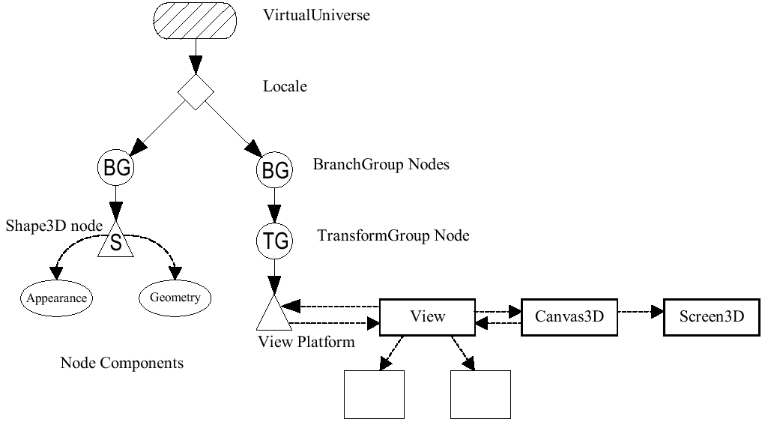
A Typical Scene Graph
Content Branch
View Branch

Slide 7
Scene Graph Symbols
Nodes and Node Components (objects)
Arcs (object relationships)
Group
Parent-child link
Leaf
Node Component
Reference
Other objects

Slide 8
3. A Java 3D Skeleton
All our Java 3D programs embed a scene inside a JPanel, which is part of a JFrame
this allows Swing GUI controls to be utilized along side the Java 3D panel (if necessary)
We will develop an example called Checkers3D during the course of these slides.

Slide 9
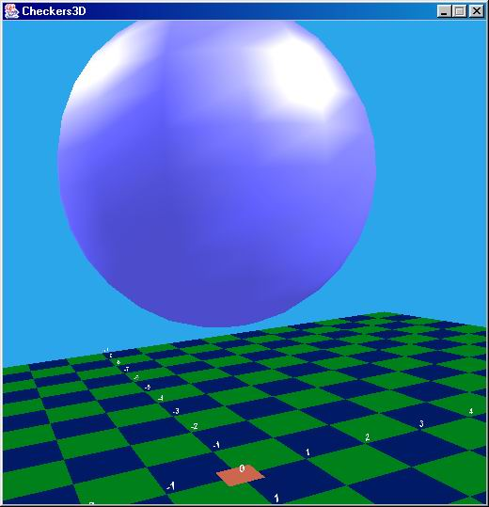
Checkers3D
The scene consists of
a dark green and blue tiled surface (and red center)
labels along the X and Z axes
a blue background
a floating sphere lit from two different directions
the user (viewer) can move through the scene by moving the mouse

Slide 10
Checkers3D.java
public class Checkers3D extends JFrame { public Checkers3D() { super("Checkers3D"); Container c = getContentPane(); c.setLayout( new BorderLayout() ); WrapCheckers3D w3d = new WrapCheckers3D(); // panel holding the 3D scene c.add(w3d, BorderLayout.CENTER); setDefaultCloseOperation( JFrame.EXIT_ON_CLOSE ); pack(); setResizable(false); // fixed size display setVisible(true); } // end of Checkers3D() public static void main(String[] args) { new Checkers3D(); } } // end of Checkers3D class

Slide 11
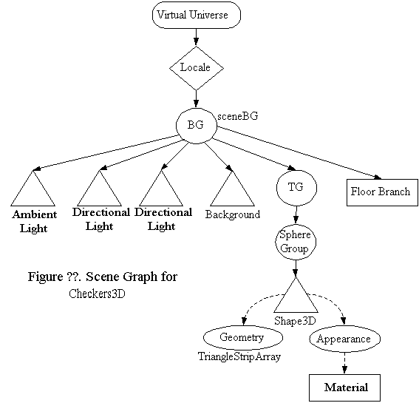
Scene Graph for Checkers3D
view branch
not shown

Slide 12
Building the Scene Graph
The VirtualUniverse, Locale, and view branch graph often have the same structure across different applications
programmers usually create them with the SimpleUniverse utility class

Slide 13
WrapChecker3D Constructor
private SimpleUniverse su; private BranchGroup sceneBG; // for content branch private BoundingSphere bounds; : public WrapCheckers3D() { setLayout( new BorderLayout() ); setOpaque( false ); setPreferredSize( new Dimension(PWIDTH, PHEIGHT)); GraphicsConfiguration config = SimpleUniverse.getPreferredConfiguration(); Canvas3D canvas3D = new Canvas3D(config); add("Center", canvas3D); canvas3D.setFocusable(true); canvas3D.requestFocus(); su = new SimpleUniverse(canvas3D); :

Slide 14
createSceneGraph(); initUserPosition(); // set user's viewpoint orbitControls(canvas3D); // controls for moving the viewpoint su.addBranchGraph( sceneBG ); } // end of WrapCheckers3D()

Slide 15
createSceneGraph()
private void createSceneGraph() // initilise the scene below sceneBG { sceneBG = new BranchGroup(); bounds = new BoundingSphere(new Point3d(0,0,0), BOUNDSIZE); lightScene(); // add the light addBackground(); // add the sky sceneBG.addChild( new CheckerFloor().getBG() ); // add the floor floatingSphere(); // add the floating sphere sceneBG.compile(); // fix the scene } // end of createSceneGraph()

Slide 16
4. Lighting a Scene
There are four types of lighting:
ambient light
directional light
point light
spotlight
Any number of these can be added to a scene.
A shape must be set up to reflect light (see later).

Slide 17
4.1. Ambient Light
Ambient light has the same intensity in all locations and directions
used as a kind of 'background' lighting in many scenes

Slide 18
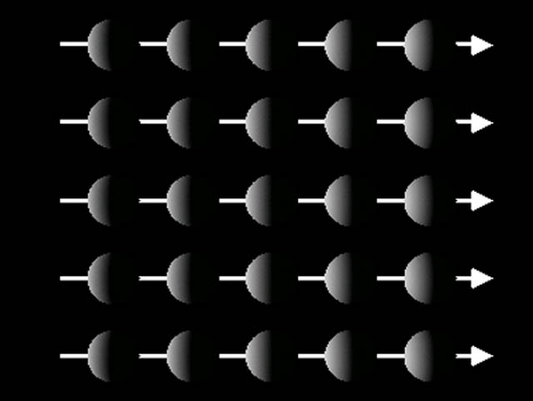
4.2. Directional Light
Provides light shining in one direction
often used to approximate the sun

Slide 19
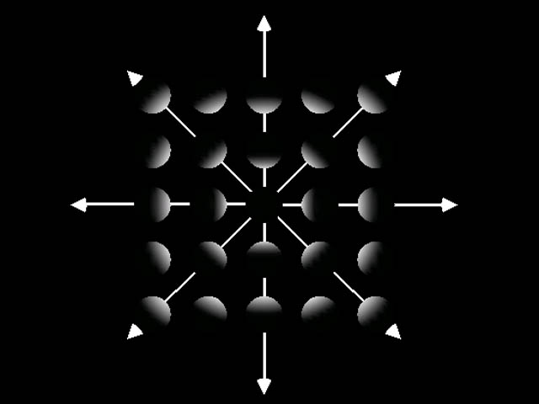
4.3. Point Light
Light emitted from a point
the intensity changes with distance
often used to approximate light bulbs, candles, etc.

Slide 20
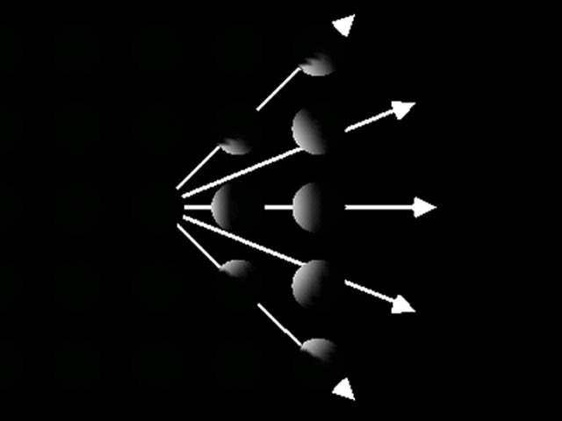
4.4. SpotLight
Adds direction and concentration to the PointLight

Slide 21
4.5. lightScene() in WrapChecker3D
private void lightScene() /* One ambient light, 2 directional lights */ { Color3f white = new Color3f(1.0f, 1.0f, 1.0f); // Red, Green, Blue values in 0-1 range // Set up the ambient light AmbientLight ambientLightNode = new AmbientLight(white); ambientLightNode.setInfluencingBounds(bounds); sceneBG.addChild(ambientLightNode); :
Lights must be given
bounds in which to
operate.

Slide 22
// Set up the directional lights Vector3f light1Direction = new Vector3f(-1.0f, -1.0f, -1.0f); // (x,y,z) left, down, backwards Vector3f light2Direction = new Vector3f(1.0f, -1.0f, 1.0f); // (x,y,z) right, down, forwards :
+
-
z-axis
-
x-axis
+
+
viewer
-
y-axis

Slide 23
DirectionalLight light1 = new DirectionalLight(white, light1Direction); light1.setInfluencingBounds(bounds); sceneBG.addChild(light1); DirectionalLight light2 = new DirectionalLight(white, light2Direction); light2.setInfluencingBounds(bounds); sceneBG.addChild(light2); } // end of lightScene()

Slide 24
5. Making a Background
private void addBackground() // A blue sky { Background back = new Background(); back.setApplicationBounds( bounds ); back.setColor(0.17f, 0.65f, 0.92f); // sky colour sceneBG.addChild( back ); } // end of addBackground()
A background can be a constant
colour (as here), an image,
or a geometry.

Slide 25
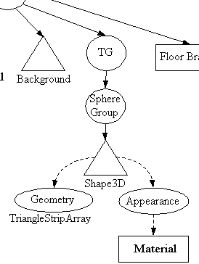
6. 3D Shapes
A 3D shape is defined as a Shape3D object.
Each Shape3D object has two node components:
Geometry
made up of coordinates (vertices)
Appearance
e.g. colour, texture, transparency, material
continued

Slide 26
There are several predefined shape classes in com.sun.j3d.utils.geometry:
Box, Sphere, Cone, Cylinder
we use Sphere in Checkers3D
Usually these classes are insufficient, and a shape's geometry must be built by connecting vertices.

Slide 27
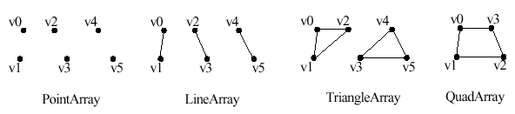
Building Geometry
The GeometryArray class is the parent for several useful geometry subclasses

Slide 28
7. Shape Colour
You can specify a shape's colour in three ways:
in the shape's material
used when the scene is illuminated (as here)
in the shape's colouring attributes
used when the shape is unreflecting
in the vertices of the shape's geometry
also for unreflecting shapes

Slide 29
Illuminating a Shape
A shape will reflect light when:
the scene has lights
set up in lightScene()
the shape has material information
see the next few slides
the shape has a geometry containing normals
done automatically in predefined shapes (Sphere, Box, etc.)

Slide 30
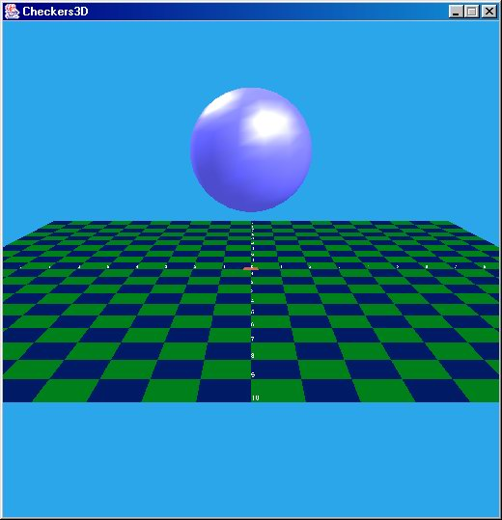
Types of Shape Reflection
ambient
reflection
(blue here,
but often set
to black)
specular
reflection
(white)
diffuse
reflection
(blue)
no shadow
no reflection
for the floor

Slide 31
Material
The Material is part of a shape's Appearance node component.
The Material object specifies ambient, diffuse, specular, and emissive colors and a shininess value
emissive colour is a kind of glowing effect, but it does not illuminate other shapes

Slide 32
Creating a Material
private void floatingSphere() // A shiny blue sphere located at (0,4,0) { // Create the blue appearance node Color3f black = new Color3f(0.0f, 0.0f, 0.0f); Color3f blue = new Color3f(0.3f, 0.3f, 0.8f); Color3f specular = new Color3f(0.9f, 0.9f, 0.9f); Material blueMat = new Material(blue, black, blue, specular,25.0f); // ambient,emissive,diffuse,specular,shininess blueMat.setLightingEnable( true ); Appearance blueApp = new Appearance(); blueApp.setMaterial(blueMat); : // position the sphere: see later }

Slide 33
8. Transfomations
A shape is transformed using a TranformGroup object.
The three basic transformations:
translation: move the shape to a new location
rotation: rotate the shape around the X, Y, Z axes
scaling: resize the shape
A TransformGroup object is initialised using Tranform3D objects.

Slide 34
Translation
Build a shape
Shape3D myShape = new Shape3D(myGeo, myApp);
Translation
Transform3D t3d = new Transform3D();
t3d.set( new Vector3d(2.0, 1.0, -2.0) );
Create a transform group, set transform, add the shape
TransformGroup tg = new TransformGroup(t3d);
tg.addChild(myShape);

Slide 35
Rotation
Build shape
Shape3D myShape = new Shape3D(myGeo, myApp);
Rotation (around z-axis)
Transform3D t3d = new Transform3D();
t3d.rotZ(0.785); // rotate by 45 degrees
Create a transform group, set transform, add the shape
TransformGroup tg = new TransformGroup(t3d);
tg.addChild(myShape);

Slide 36
Scaling
Build shape
Shape3D myShape = new Shape3D(myGeo, myApp);
Scaling by 1.75 in X, Y, and Z
Transform3D t3d = new Transform3D();
t3d.set(1.75);
Create transform group, set transform, add the shape
TransformGroup tg = new TransformGroup();
tg.setTransform(t3d); // another way
tg.addChild(myShape);

Slide 37
Composite Transformations
Combine translations, rotations, and scaling. Methods:
void setTranslation( Vector3d vectorTranslation );
void setRotation( AxisAngle4d axisangleAxis );
void setRotation( Matrix3d matrixRotation );
void setScale( double scaleFactor );

Slide 38
Positioning the Sphere
private void floatingSphere() // blue sphere located at (0,4,0) { : // set up the blue material // position the sphere Transform3D t3d = new Transform3D(); t3d.set( new Vector3f(0,4,0)); TransformGroup tg = new TransformGroup(t3d); tg.addChild( new Sphere(2.0f, blueApp) ); // set its radius and appearance sceneBG.addChild(tg); } // end of floatingSphere()

Slide 39
9. More Information
First install the version of Java at CoE:
http://java.sun.com/javase/downloads/
JDK 6, update 20
should be installed before Java 3D
Or download the latest version from Oracle:
Java SE 8u25
http://www.oracle.com/technetwork/java/ javase/downloads/
old but still good

Slide 40
Java 3D Software and Docs
Main site:
https://java3d.dev.java.net/
Download page
https://java3d.dev.java.net/binary-builds.html
Get the Java 3D 1.5 installer for your OS. e.g.
java3d-1_5_2-windows-i586.exe
continued

Slide 41
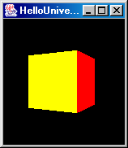
Test the installation
download HelloUniverse.java from http://fivedots.coe.psu.ac.th/Software.coe/ LAB/Java3D/
javac HelloUniverse.java
java HelloUniverse
you should see a rotating coloured cube
continued

Slide 42
Get the documentation:
it describes the core API and the utility classes
Download the examples source code:
contains about 40 small-to-medium examples
a great help
Download the Java 3D tutorial
http://java.sun.com/developer/ onlineTraining/java3d/

Slide 43
9.1 Resources here at CoE
CoE Students can get Java and Java 3D from Aj. Somchai's excellent Java pages:
http://java.coe.psu.ac.th/
Java
http://java.coe.psu.ac.th/RefImp.html#JavaSE
Java 3D
http://java.coe.psu.ac.th/RefImp.html#Java3D
continued

Slide 44
Java things to get:
JavaSE 6.0u20 SDK (WindowsFull)
Java 3D things to get:
Java3D 1.5.2 installer (Windows)
Java3D 1.5.2
API Document
Examples

Slide 45
Java 3D Books
Both of these are
in the CoE library,
or available from me.
Java 3D API Jump-Start
Aaron E. Walsh, Doug Gehringer Prentice Hall; 0-1303-4076-6, 2001
Java 3D Programming
Daniel Selman Manning Pub.; 1-9301-1035-9; 2002
http://www.manning.com/selman/
continued

Slide 46
The Java 3D chapters from my online book:
http://fivedots.coe.psu.ac.th/~ad/jg/
The complete Checkers3D application is explained in chapter 15:
http://fivedots.coe.psu.ac.th/~ad/jg/ch8/

Slide 47
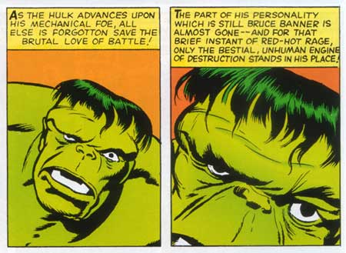
Java 3D Help
Hulk not smash.
Hulk like Java 3D
Ask me!
Forums:
http://www.java.net/forums/javadesktop/ java-desktop-technologies/java-3d
http://www.javagaming.org/index.php/ board,14.0.html
continued

Slide 48
Java 3D at Sun
http://java.sun.com/products/java-media/3D/
j3d.org
http://www.j3d.org
continued

Slide 49
The Java 3D interest mailing list
http://archives.java.sun.com/archives/ java3d-interest.html or
http://www.mail-archive.com/ java3d-interest@java.sun.com/
comp.lang.java.3d newsgroup
http://groups.google.com/groups? group=comp.lang.java.3d

