Slide 1

IEEE’s
Hands on Practical Electronics (HOPE)
Lesson 4: Capacitance

Slide 2

Last Week
Ohm’s Law
Kirchoff’s Voltage and Current Laws
  KVL: Voltage around a loop sums to zero.
  KCL: Current into a node equals current out.
Series Resistors:
R_{total} = R₁ + R₂ + R₃ + …+ R_{n}
Parallel Resistors:

Slide 3
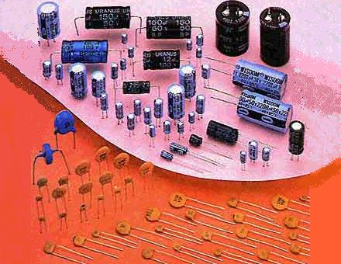
This Week
Capacitors and
Capacitance

Slide 4
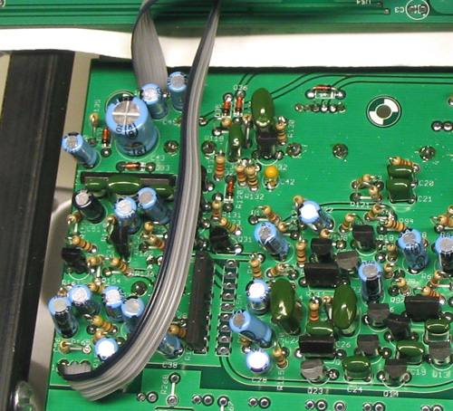

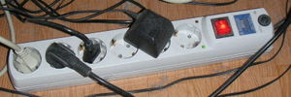
Everyday Use
Capacitors are used in circuits to store energy, and in turn provide “bursts of energy.”
  Examples:
  - Jump-starting a motor
  - Operating a camera’s flash
Capacitors are also used in surge protectors to prevent sudden changes in voltage.

Slide 5
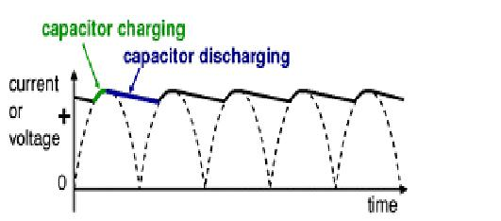
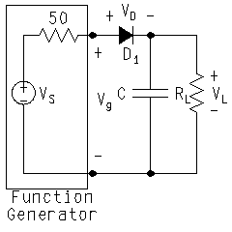
Everyday Use (cont.)
Capacitors can be used to convert from AC to DC.
  Power outlets in your house all provide Alternating Current (AC), but most electronic equipment needs Direct Current (DC) to function.
  Capacitors smooth AC to provide DC, whose average voltage is almost the peak value, as shown below.

Slide 6
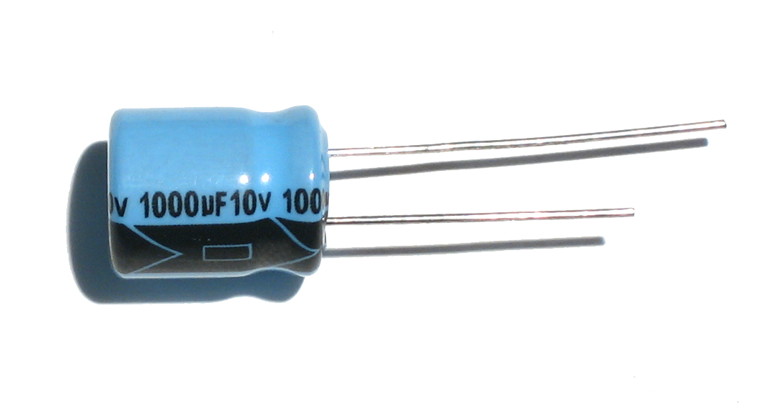
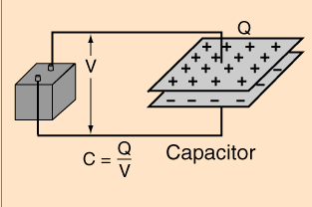
Capacitor
An electrical device that can store energy in the electric field between a pair of closely-spaced plates.
When current is applied to the capacitor, electric charges build up on each plate. Each plate has the exact same amount of charge, but one plate has positive charges and the other negative charges.
Can be used in circuits to store energy, similar to a battery.

Slide 7
Capacitance
A measure of the amount of charge (Q) stored on each plate for a given voltage (V) that appears between the plates.
Measured in units of Farads (F).
Capacitance is a physical property of the capacitor, and cannot be changed (like the resistance of a resistor). Capacitors are manufactured to have a certain amount of capacitance.

Slide 8
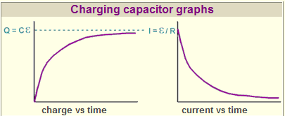
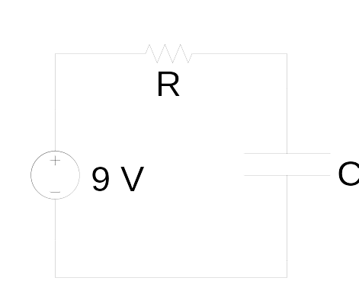
Charging Capacitor Graphs
The battery in the circuit is being used to charge the capacitor.
As time increases,
  Charge on the capacitor plates increases (as shown in the graph above)
  Current (rate at which charges move) through the circuit decreases
    As more charges are deposited on the plates, the more they repel new charges coming onto the plate. This causes charges to move more slowly, which means less current flows through the circuit.

Slide 9
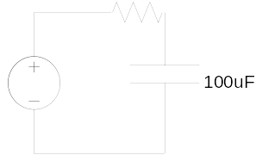
Why does charge flow?
Charges always flow from high voltage areas to low voltage areas, to try to bring both areas to equilibrium.
9V

Slide 10
Why does charge flow?
9V
Charges always flow from high voltage areas to low voltage areas, to try to bring both areas to equilibrium.
Initially, the left side of the resistor is at 9V and the right side is at 0V. Current flows in the circuit, and electric charge begins to build up in the capacitor.
0V
9V
0V

Slide 11
Why does charge flow?
9V
Charges always flow from high voltage areas to low voltage areas, to try to bring both areas to equilibrium.
Initially, the left side of the resistor is at 9V and the right side is at 0V. Current flows in the circuit, and electric charge begins to build up in the capacitor.
As charges continue to flow in the circuit (and get stored in the capacitor), the voltage across the capacitor increases.
5V
9V
0V

Slide 12
Why does charge flow?
9V
Charges always flow from high voltage areas to low voltage areas, to try to bring both areas to equilibrium.
Initially, the left side of the resistor is at 9V and the right side is at 0V. Current flows across the resistor, so charges flow from the battery into the capacitor.
As charges continue to flow in the circuit (and get stored in the capacitor), the voltage across the capacitor increases.
9V
9V
0V
Current (charges) stop flowing when the voltage across the capacitor is equal to the voltage of the battery, which in our case is 9V. The circuit is considered ‘off’.

Slide 13
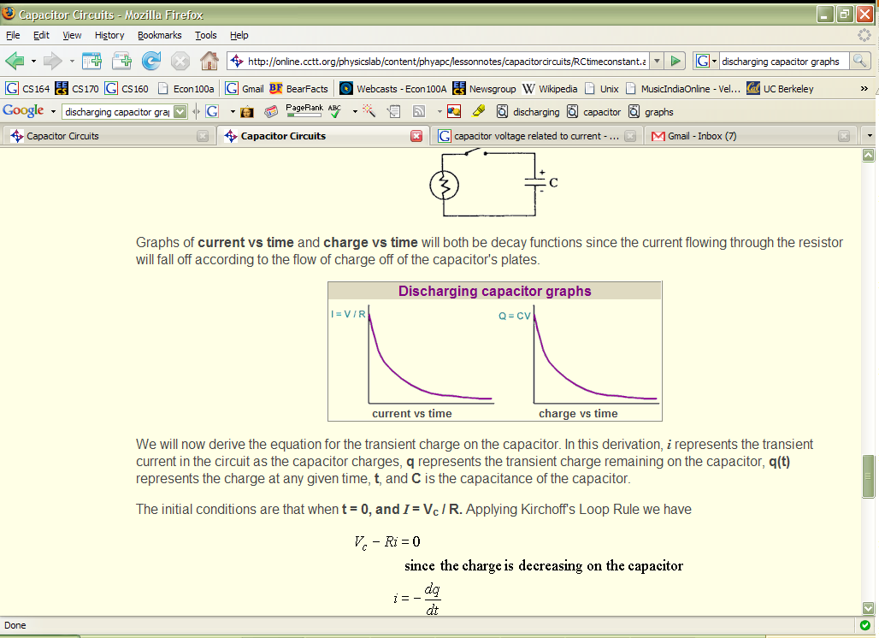
Capacitor Discharging
The battery must be removed from the circuit to discharge the capacitor. When this happens, the capacitor acts as a battery and provides energy to the circuit.
As time increases:
  The amount of charge on the capacitor plates decreases (as in graph above)
  The current (rate at which charges move) through the circuit decreases
  At the beginning, a large number of charges want to get out, because there is a lot of repulsion. As more charges are removed from the plates, the remaining charges repel each other less, so they move slower and less current flows through the circuit.

Slide 14
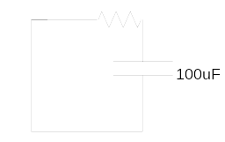
Why does charge flow out of a capacitor?
Because the battery has been removed, the voltage difference across the resistor is 9V (remember, voltage is relative).
So, charge flows out of the capacitor, across the resistor: in the opposite direction. It can be used to light up an LED (as in today’s lab).
0V
9V
0V

Slide 15
Why does charge flow out of a capacitor?
Because the battery has been removed, the voltage difference across the resistor is 9V (remember, voltage is relative).
So, charge flows out of the capacitor, across the resistor: in the opposite direction. It can be used to light up an LED (as in today’s lab).
Charge continues to flow until the voltage on both sides of resistor is equal. In this example, that means 0V - when the capacitor is fully discharged.
0V
0V
0V
This happens when the charge on the capacitor is 0V (after the capacitor is completely discharged).

Slide 16
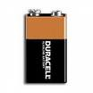
Capacitor versus Battery
A capacitor stores a very small amount of charge compared to a battery.
A capacitor is charged up much faster than a battery, and is discharged just as quickly.
A capacitor will only drive a circuit for a fraction of a second, while a battery drives it for much longer.

Slide 17
Charging Speed
The speed at which a capacitor is charged depends on:
  Capacitance of the capacitor
  Resistance of the resistor
The charging speed is inversely related to the product of capacitance and resistance, RC.
The larger the product, RC, the slower the capacitor charges.

Slide 18
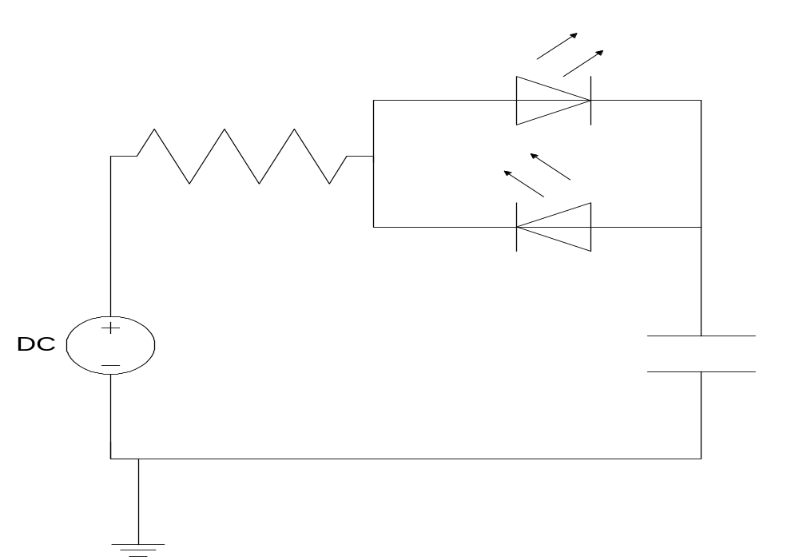
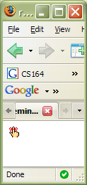
Today’s Lab
Remember: current only flows through an LED in 1 direction; that is from the positive side to the negative side.

