Slide 1
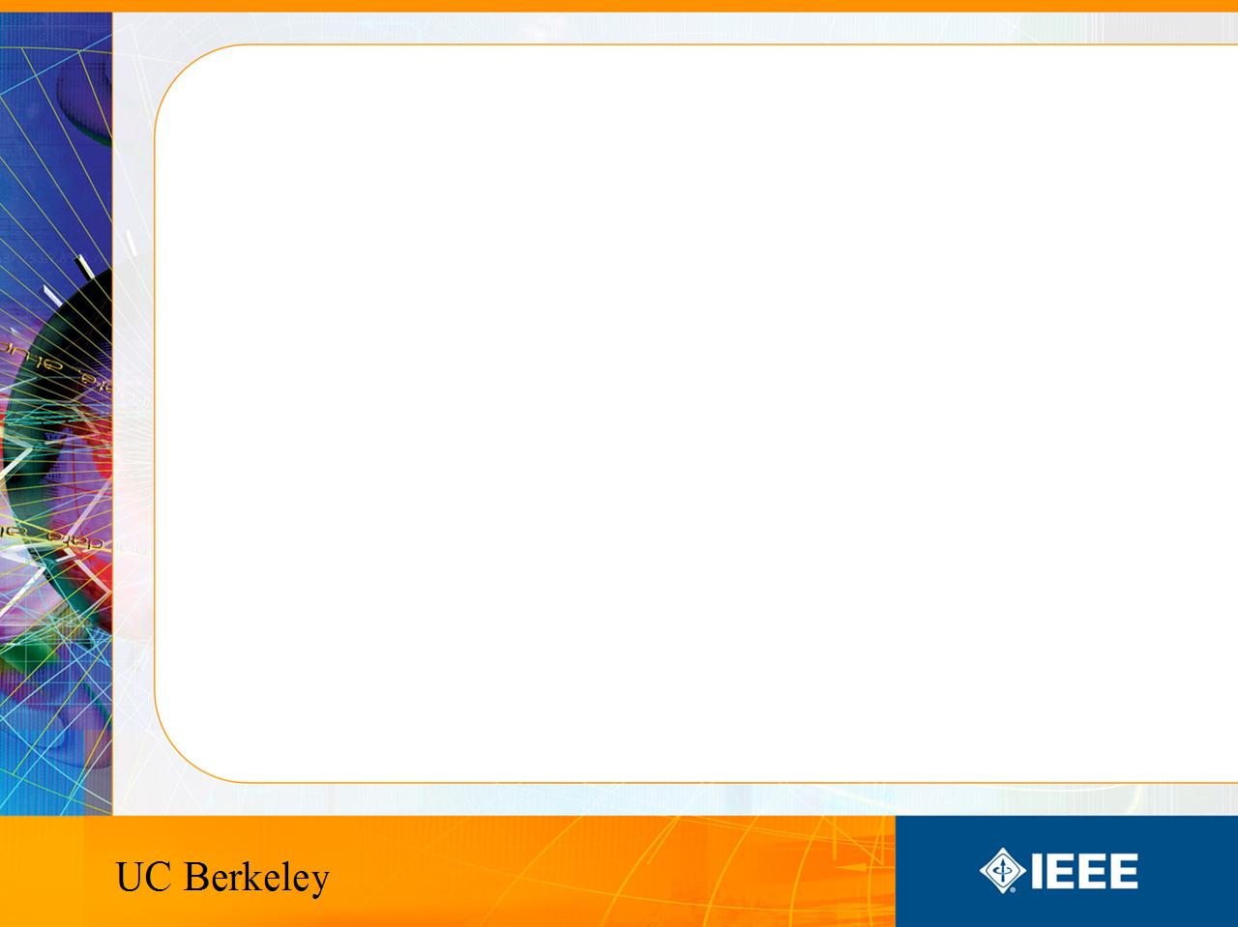
IEEE’s
Hands on Practical Electronics (HOPE)
Lesson 6: PN Junctions, Diodes, Solar Cells

Slide 2
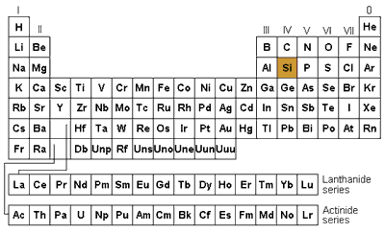
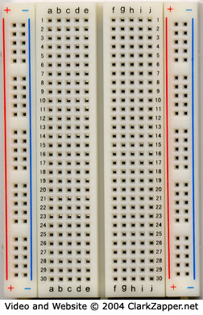
Last Week
Silicon (Si) – Semiconductor
Breadboards – Convenient tools to build circuits quickly

Slide 3
This Week
PN Junctions
  Review of P- and N-type
  What they are
  How they are used
    Diodes
      LEDs
    Solar Cells

Slide 4
Review: Doping
Remember from last week:
P-type silicon
  Heavily doped with elements like boron
  Lots of holes (positive charge carriers)
N-type silicon
  Heavily doped with elements like arsenic or phosphorous
  Lots of electrons (negative charge carriers)

Slide 5

PN Junctions
The combination of P-type and N-type semiconductors together in very close contact is a PN Junction.
This can be created by doping one side of silicon p-type and one side n-type.
Note: You cannot just put a p-type and n-type next to each other and call it a PN junction, they must be connected atomically.

Slide 6
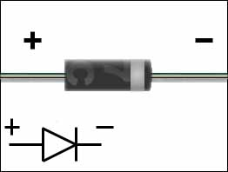
PN Junctions
A PN Junction is also called a diode.

Slide 7
Diode Usage
Diodes are used to
  prevent current from flowing in the wrong direction
  prevent too much current from flowing in a direction
  indicate if there is current flowing (LEDs)
There are many other types of diodes used for specific purposes, for example gold doped diodes and diodes designed to work in reverse breakdown
  See: http://en.wikipedia.org/wiki/Diode

Slide 8
PN Junctions
P-type has more positive charges (holes) and n-type has more negative charges (electrons).
They diffuse and reach equilibrium. (Remember basic chemistry.)
  Things move from higher concentrations to lower concentrations.

Slide 9
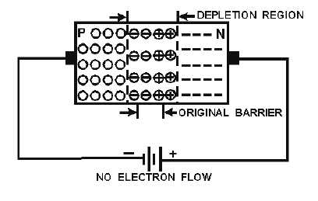
Depletion Region
Free electrons flow from the N side (which has an excess of electrons) to the P side (which has a lack of electrons, or an excess of holes).
At equilibrium, a “depletion region” exists in between the p-type and n-type areas. That area is depleted of charge carriers so cannot conduct current.

Slide 10
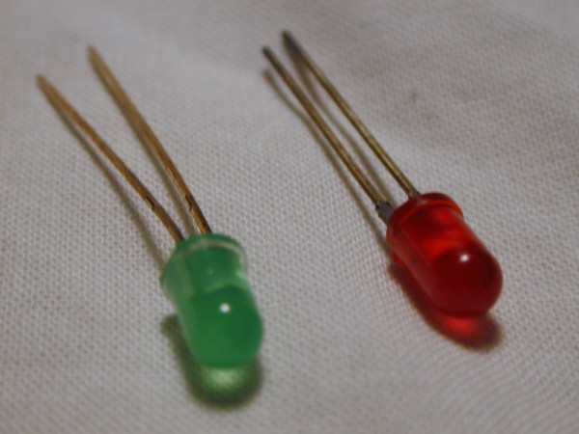
LEDs
LEDs are diodes which emit light when there is current flowing through it.
By forward biasing a LED it lights up, no biasing or reverse biasing leave the LED off.

Slide 11
Diode Biasing
Reverse:
  Connect the P-side to the - terminal and the N-side to the + terminal.
  This causes electrons and holes to move away from the junction, and less current flows through the diode.
Zero (equilibrium):
  No battery is connected.
  The electrons and holes don’t flow in a particular direction, so no current flows through the diode.
Forward:
  Connect the P-side to the + terminal and the N-side to the - terminal.
  This causes electrons and holes to move toward the junction, and more current flows through the diode.

Slide 12
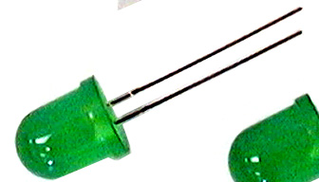
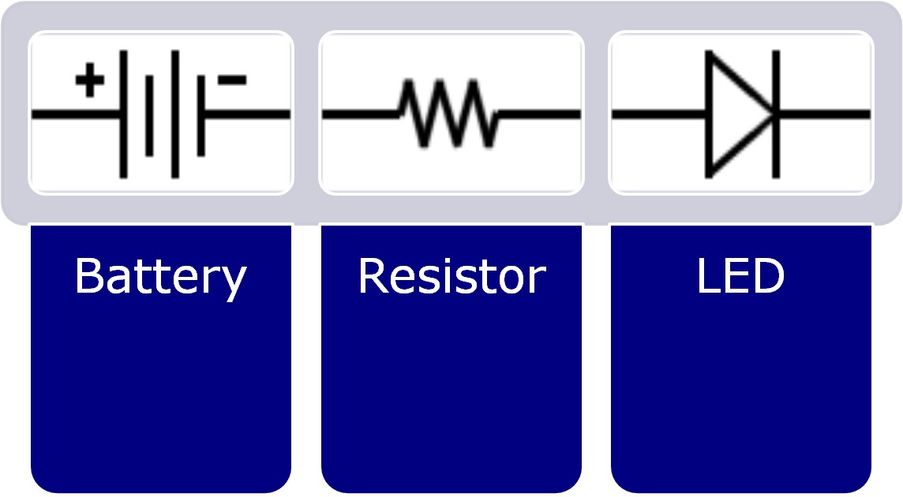
LEDs
LED = Light Emitting Diode
Diodes that light up when current flows through it
LEDs only allow current to go through it in one direction
By forward biasing an LED, it lights up. No biasing or reverse biasing leaves the LED off.
Current Flows

Slide 13
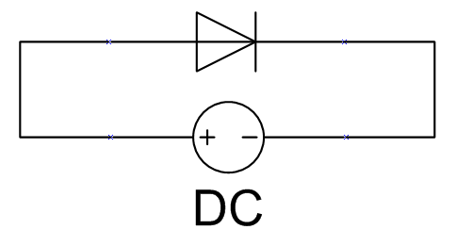
Forward Biasing
Have you biased diodes in other lessons?
  Remember week 1?

Slide 14
Forward Biasing
How does forward biasing keep an LED on?
  It never reaches equilibrium, by forcing electrons in through the n side and letting them leave the p side.

Slide 15
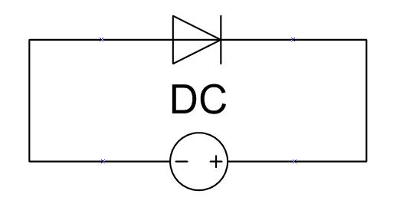
Reverse Biasing
Reverse biasing a diode is done by inserting the + end of the battery closer to n side of diode (LED is off)
The depletion region grows when you reverse bias the LED, and no current flows
The depletion region is charge neutral and this non conductive

Slide 16
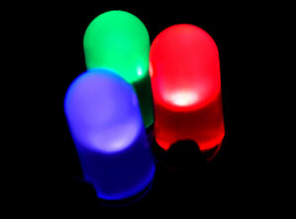
LEDs
LED = Light Emitting Diode
How they work:
  The electrons moving through the diode either cause heat, or light. Engineers design specific diodes to emit more light, hence the name light emitting diode (LED)

Slide 17
LEDs are colorful
FROM WIKIPEDIA: Conventional LEDs are made from a variety of inorganic semiconductor materials, producing the following colors:
Aluminum gallium arsenide (AlGaAs) - red and infrared
Aluminum gallium phosphide (AlGaP) – green
Aluminum gallium indium phosphide (AlGaInP) - high-brightness orange-red, orange, yellow, and green
Gallium arsenide phosphide (GaAsP) - red, orange-red, orange, and yellow
Gallium phosphide (GaP) - red, yellow and green
Gallium nitride (GaN) - green, pure green (or emerald green), and blue also white (if it has an AlGaN Quantum Barrier)
Indium gallium nitride (InGaN) - near ultraviolet, bluish-green and blue
Silicon carbide (SiC) as substrate — blue
Silicon (Si) as substrate — blue (under development)
Sapphire (Al₂O₃) as substrate — blue
Zinc selenide (ZnSe) - blue
Diamond (C) - ultraviolet
Aluminum Nitride (AlN), aluminum gallium nitride (AlGaN) - near to far ultraviolet (down to 210 nm)

Slide 18
LED Usage
Will be discussed further in a future lecture
Used to generate light (hence the light emitting part)
  More efficient than incandescent bulbs!
  Difficult to break by dropping. (try that with a light bulb)
Used anywhere where they need to generate light
  Bike lights
  Car brake lights

Slide 19
LED Usage
LEDs have many other advantages:
  An LED’s emitted light can be directed; no parabolic mirrors are necessary to focus light
  Their color does not change while dimming
  Last about 3x-30x longer than fluorescent bulbs
  LEDs achieve full brightness in microseconds
  LED’s can be printed on a circuit board
  LED’s don’t have Mercury! (some fluorescent lamps do)
  Some of you probably have an LED on your key-chain

Slide 20
Solar Cells
If we use current to emit light, can we use the reverse process? (use light to create current?)
  Yes. We use solar cells for this purpose.
Solar cells use light and generate current.

Slide 21
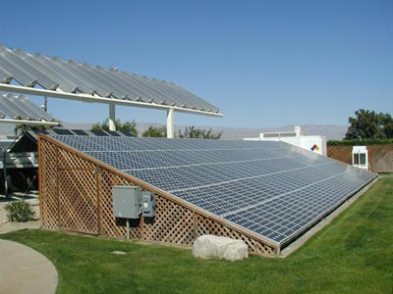
Solar Cell
Also derived from a PN junction

Slide 22
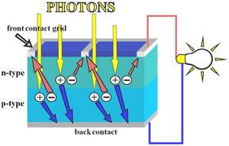
Solar Cells
The atoms in a PN junction in equilibrium are usually at rest
But when struck by a photon, an electron / hole pair is freed

Slide 23
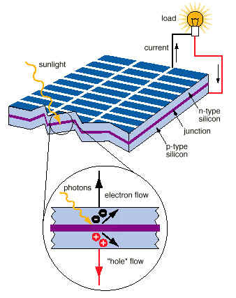
Solar Cells
The free electron and hole created by the photon are now free to travel though the circuit.
This only works in a semiconductor as the electrons are not held too tightly.

Slide 24
Usage
Solar Cells are used to generate electricity
  http://en.wikipedia.org/wiki/Solar_cell
CalSol is a Berkeley’s solar car racing team
  http://www.me.berkeley.edu/calsol/about.php

