Slide 1

IEEE’s
Hands on Practical Electronics (HOPE)
Lesson 8: Transistors

Slide 2
Last Week
Transistors
  Metal Oxide Semiconductor Field Effect Transistor
  Drain, Body, Source, Gate
  Function as an electronic switch
NMOS
  Gate voltage higher than source => current ON
  Gate voltage lower than source => current OFF

Slide 3
This Week
PMOS Transistors
Review: NMOS Transistors
PMOS Operation
Lab

Slide 4
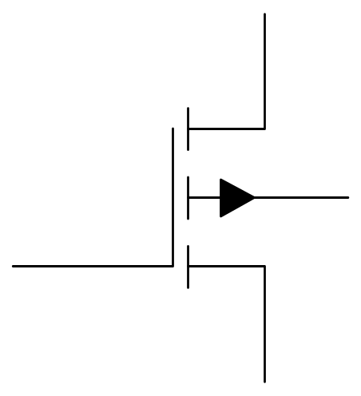
PMOS
For a PMOS, whichever terminal is biased at a higher potential (voltage) is called the source, the other is called the drain.
S
G
B
D

Slide 5
PMOS
Fabrication will be discussed in a later lesson. Today, we’ll explain how PMOS transistors work.
S
G
B
D

Slide 6
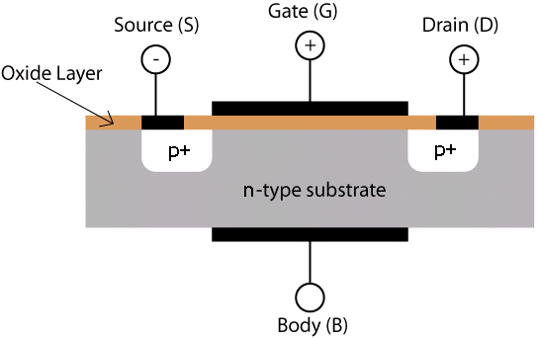
PMOS
We saw this last week for NMOS.
For a PMOS, N-type regions become P-type regions and vice versa.

Slide 7
PMOS
To turn on a PMOS, apply a voltage to the gate that is lower than the source voltage.

Slide 8
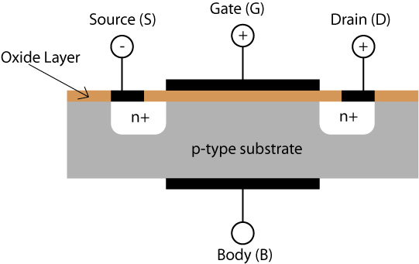
PMOS
A gate voltage higher than the source will not turn on the PMOS

Slide 9
Review: NMOS Transistor
Remember these pictures from last week?

Slide 10
Review: NMOS Transistor
With too LOW of a gate voltage, electrons cannot get through.
No current flows.
No current
N type
N type
P type

Slide 11
Review: NMOS Transistor
Apply a voltage to make the p-type material behave like n-type.
Current flows.
Current
N type
N type
N type

Slide 12
Review: NMOS Transistor
Gate voltage LOWER than source voltage
N type
N type
P type

Slide 13
Review: NMOS Transistor
Gate voltage HIGHER than source voltage
Current
N type
N type
N type

Slide 14
PMOS Transistor
With too HIGH a gate voltage, holes cannot get through: no current.
No current
P type
N type
P type

Slide 15
PMOS Transistor
Apply a voltage to make the n-type material behave like p-type
Current
P type
P type
P type

Slide 16
PMOS Transistor
Gate voltage HIGHER than source voltage
No current
P type
N type
P type

Slide 17
PMOS Transistor
Gate voltage LOWER than source voltage
Current
P type
P type
P type

Slide 18
Summary
You are given two different voltages (HIGH & LOW).
Applying the two voltages to the terminals of a MOSFET and one of the two voltages to the gate, the following combinations are possible:
Type | Gate Voltage | Current?
PMOS | HIGH | OFF
PMOS | LOW | ON
NMOS | HIGH | ON
NMOS | LOW | OFF

Slide 19
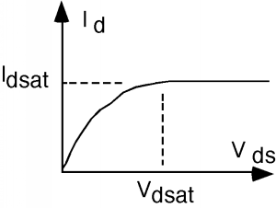
Sample Circuit
V
V
DD
DD
This is a graph of I_{d} versus V_{in}
R
R
D
D
i
i
D
D
+
+
v
v
DS
DS
–
–

Slide 20
Drain current
This graph is an approximate graph of the drain current.
The first portion behaves like a parabola.
Then it flattens, and increasing the voltage does not increase the current. This is “saturation.”

Slide 21
Digital Logic
Digital Logic only concerns itself with ON or OFF
ON can be considered to be above some value, and OFF can be considered to be below that value.

Slide 22
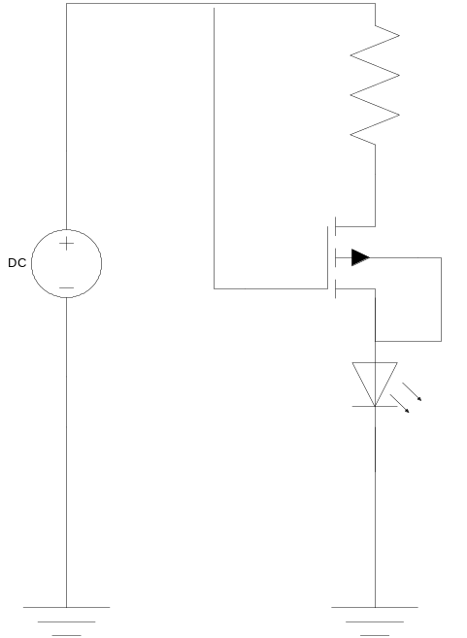
Lab
PMOS transistor is OFF
Current does not flow
LED is OFF

Slide 23
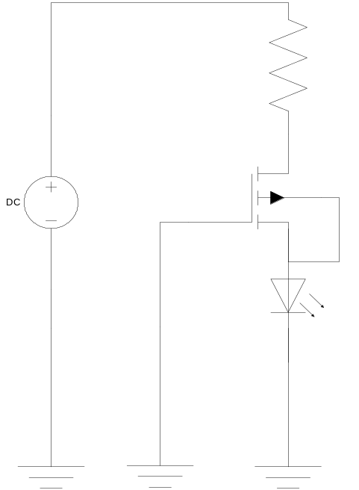
Lab
PMOS transistor is ON
Current flows
LED is ON

Slide 24
Lab
Be sure to connect all the wires – ask for help if you need it.

Slide 25
Lab
Unplug the wire from the gate to 9V and plug that wire into ground.
Do not just leave it “floating”!

Slide 26
Lab
How does the circuit from last week compare to the circuit from this week?

Slide 27
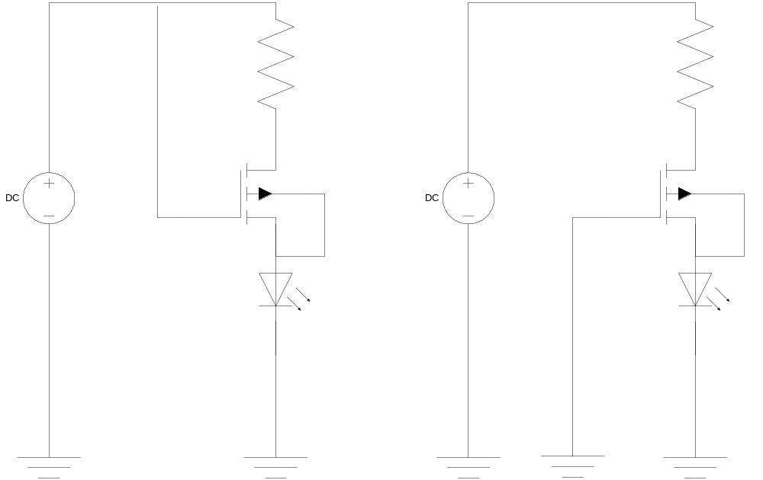
Lab

