Slide 1
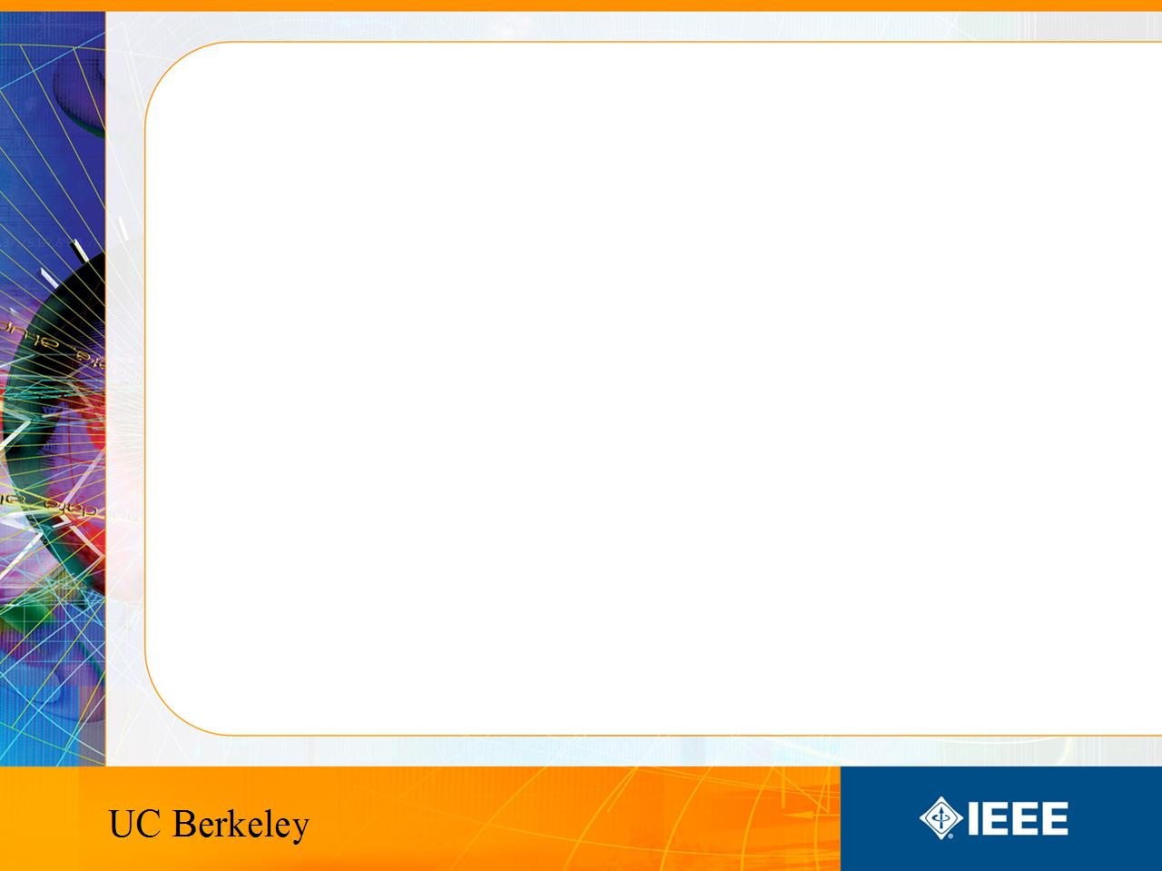
IEEE’s
Hands on Practical Electronics (HOPE)
Lesson 10: Fabrication

Slide 2
Last Week
CMOS
Digital Logic
  Logic Gates: NOT, AND, OR
  Logic Gates: NAND, NOR
Constructing simple CMOS logic gates

Slide 3
This Week
Wrap Up
Course Evaluations
Final Projects

Slide 4
Circuits Today
Circuits today are significantly smaller than those we built in class
The miniaturization continues because they:
  Are cheaper
  Are faster
  Are More portable
  Use less energy

Slide 5
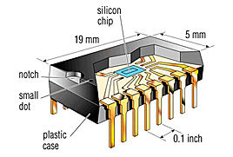
Integrated Circuits (IC)
All the functionality we have seen such as resistors, transistors, capacitors and voltage dividers etc. is now printed on a chip.

Slide 6
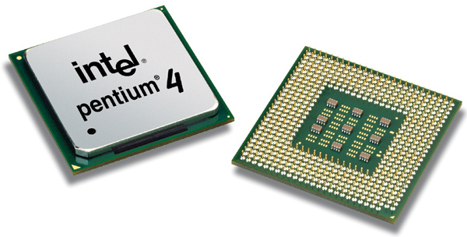
Integrated Circuits
How do you make something so complex so small?
  Pentium 4 has over 125 million transistors

Slide 7
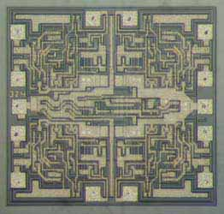
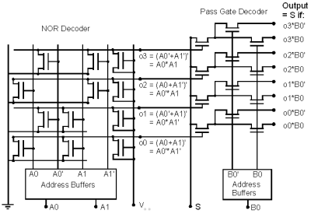
How to make an IC
1) Make a schematic
2) Make a mask

Slide 8
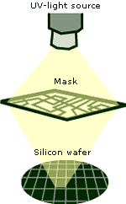
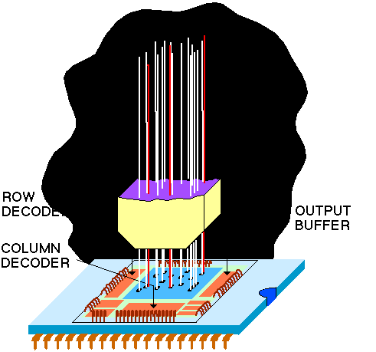
How to make an IC
3) Use UV light and the mask to etch a pattern on the silicon
4) Shine lights of certain elements to dope the silicon.

Slide 9
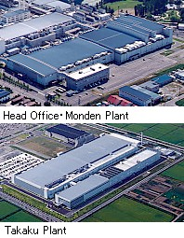
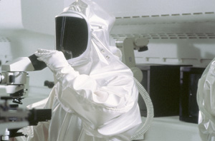
How to make an IC
5) Buy a factory
6) Keep it clean because particles of dust can damage your circuits

Slide 10
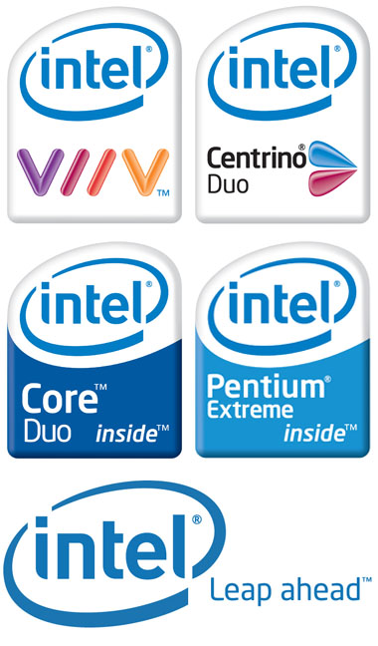
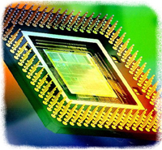

How to make an IC
7) Watch the money roll in.
Makes about $38 billion in gross revenue per year
Makes about $5 billion is gross revenue per year

Slide 11
Can I design a chip now?
Everything you learned can be implemented on an IC today.
Why don’t we teach IC… $1 million dollar cost to make new masks, which is a course material fee of $50,000… and then the whole factory thing…

Slide 12
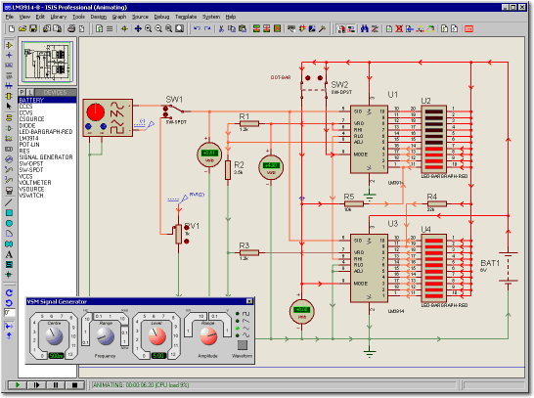
Simulations
Modern day tests are done via simulations.
Programs like SPICE, etc. are used.
Prototypes are expensive to build and companies would rather have some
way of verifying somewhat
if it works before investing
heavily in prototypes.

Slide 13
To Learn More
EE40 or EE100 is a good place to start
Join IEEE and build more circuits in our lab.

Slide 14
Course Evaluations
Anonymous
Will not affect your grade
Used to improve the course for following semesters
Very Important

Slide 15
Finishing Circuit
If you can’t finish your circuit after today, you can leave it with us in the lab and come back to work on it.

