Slide 1
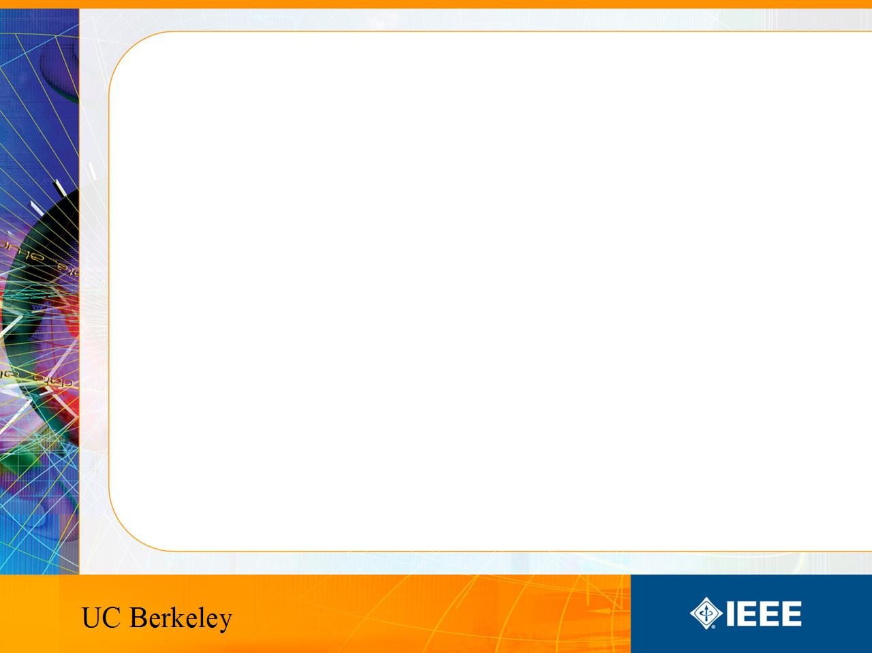
IEEE’s
Hands on Practical Electronics (HOPE)
Lesson 1: Introduction

Slide 2
Course Information
This is the IEEE Hands on Practical Electronics (HOPE) decal
EE98/198
Day/Time: Wed 5-6:30P
Website: http://ieee.eecs.berkeley.edu/
  Lectures and labs will be posted each week

Slide 3
This Week
The goal of today’s lesson is to:
  Become familiar with some basic EE components and tools
  Build a basic circuit
We will explain the underlying principles of the circuit in the next lesson

Slide 4
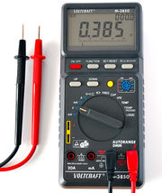
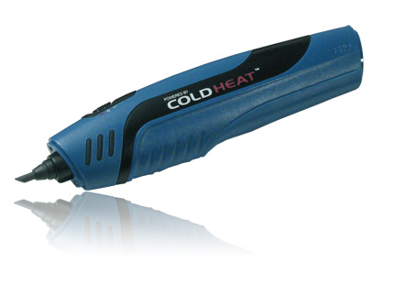
Tools
ColdHeat Soldering Iron
Digital Multimeters
Safe, but clumsy
Measures various values – voltage, current, resistance, etc.
Uses a lot of battery power
Easy to read display and accurate reading measurements

Slide 5
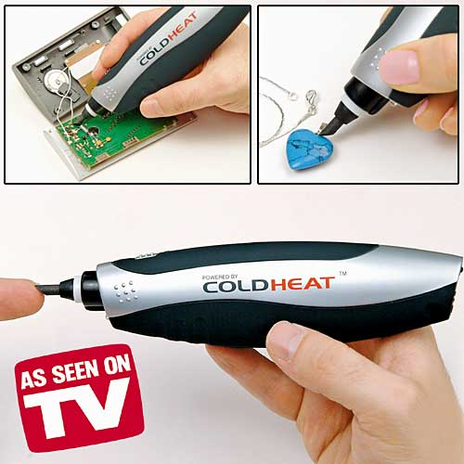
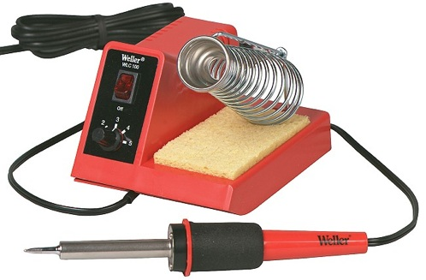
Soldering Iron
Cold heat soldering iron
  Used for instructional and safety purposes
  They are safe but clumsy.
  Batteries die quickly so you may need to change them before you start.
Regular soldering iron
  Used by professionals
  We do have a few of these, but be careful not to burn yourself when using them.

Slide 6
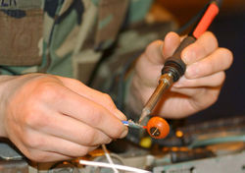
Soldering
Repairing damaged circuits requires soldering the broken leads together

Slide 7

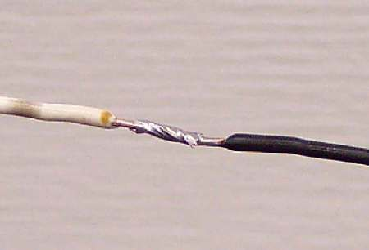
Soldering
To solder, we need:
  Soldering iron
  Solder
    An alloy made of lead and tin. It is used to provide a path for the current to flow between two components.
    Recently, solder was required to be lead-free and other replacement soldering alloys are being researched.
    See: http://en.wikipedia.org/wiki/Solder#Lead-free_solder
Before soldering
  First lay out the circuit on the board
  Twist tie the components together to make sure it works

Slide 8
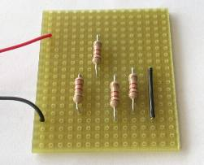
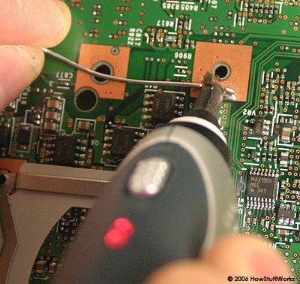
Soldering
To use the cold heat soldering irons
  Bring the solder right on top of the wires
  Put the tip of the soldering iron on the solder to melt the solder and connect the wires.
Tip: Solder under the breadboard to avoid messy connections

Slide 9
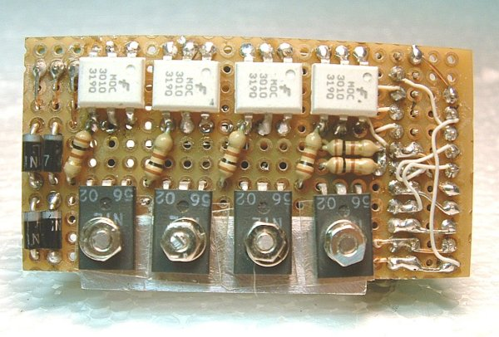
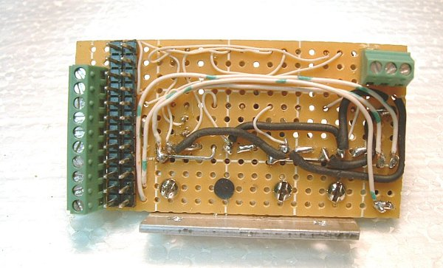
More Soldering

Slide 10
Soldering Usage
Soldering is used to assemble circuits
It is an alternative to welding. Plumbing pipes can also be soldered together
Solder provides a nearly permanent, but reversible connection

Slide 11
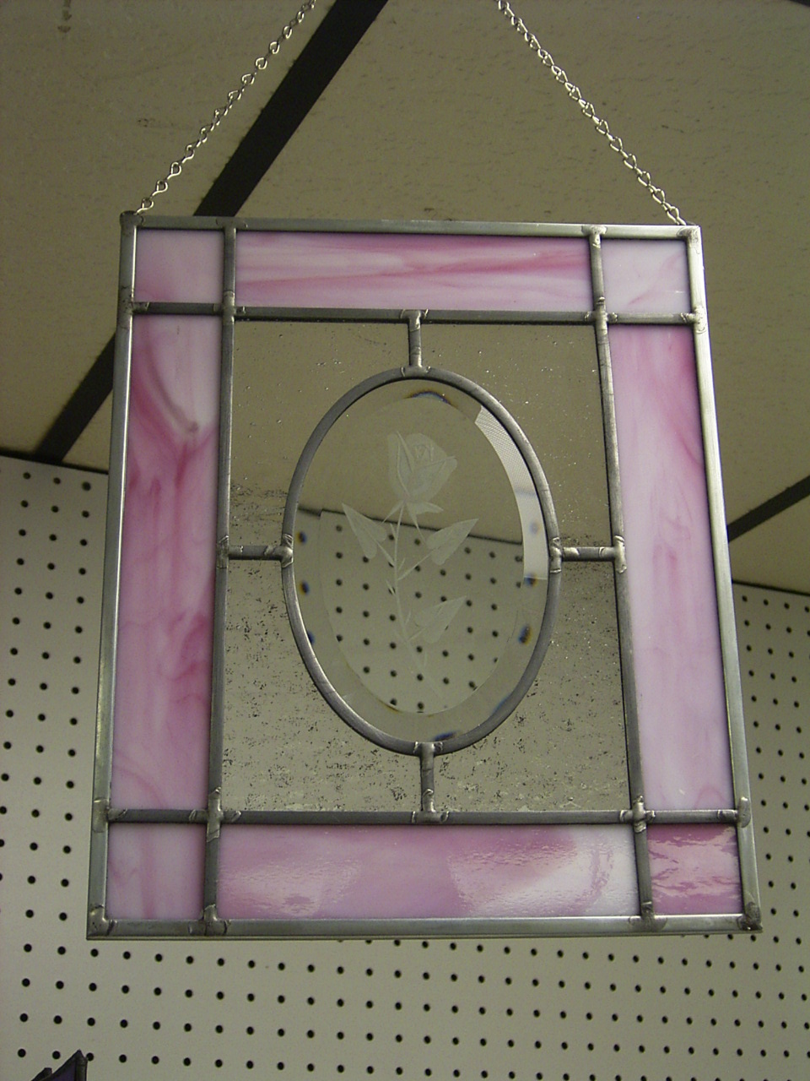

Soldering Usage
Soldering is also used for small things such as:
  Jewelry
  Stained Glass

Slide 12
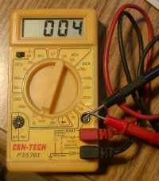
Digital Multimeter (DMM)
Combination of
  Ammeter: measures current
  Voltmeter: measures voltage
  Ohmmeter: measures resistance
We will go into more detail on how to use multimeters next week

Slide 13
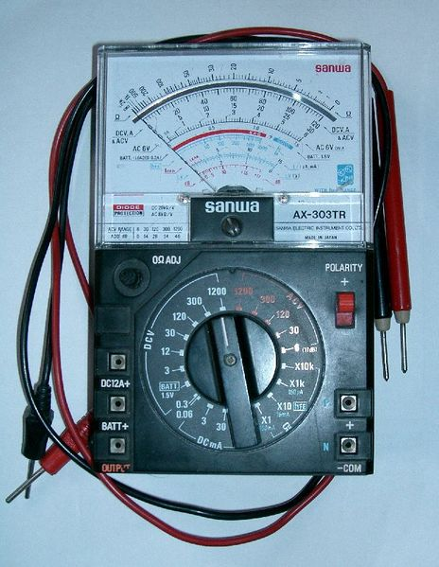
DMM Usage
A Digital Multimeter is a measurement device commonly used as a diagnostic tool.
Fancier multimeters can measure more quantities such as frequency, temperature, conductance, inductance, capacitance and so on.

Slide 14
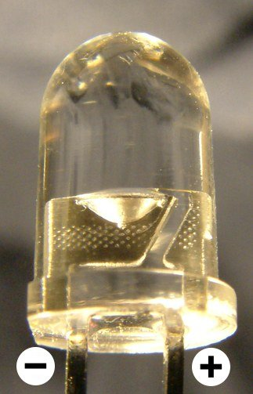
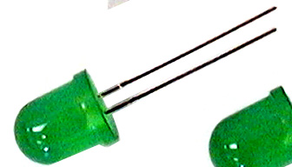
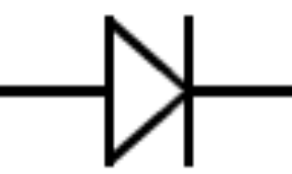
LED Introduction
LED = Light Emitting Diode
Lights up when current flows through it
LED’s only allow current to go through it in one direction
Current Flows
LED’s have 1 lead that is longer than the other. The longer lead is the
+
-
positive side. Current flows from the longer lead to the shorter lead.

Slide 15
LED Usage
Will be discussed further in a future lecture
Used to generate light (hence the light emitting part)
  More efficient than incandescent bulbs!
  Difficult to break by dropping. (try that with a light bulb)
Used anywhere where they need to generate light
  Bike lights
  Car brake lights

Slide 16
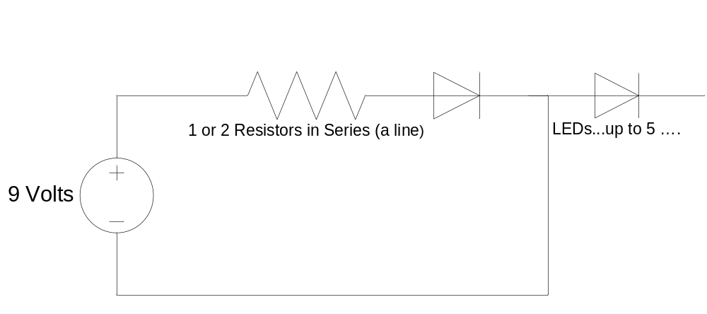
Circuits
Closed loop – There is a path for the current to flow back to the other end of the battery
Circuits will only work if there is a closed loop
The following circuit diagram contains a closed loop starting from the battery to the resistor, through the first LED and then back to the battery

Slide 17
Today’s Lab
Move the battery around to see where the current flows. The LEDs will turn on when current flows through them.

Slide 18
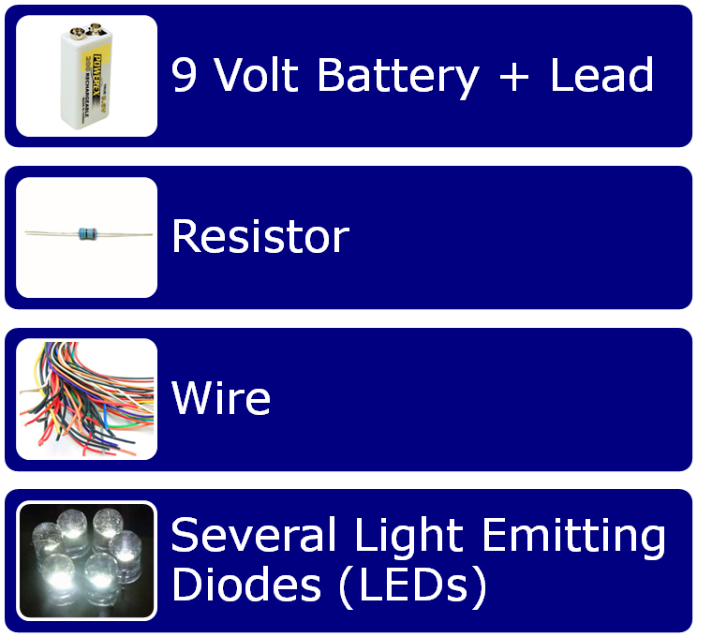
Components

Slide 19
Today’s Lab
Test what happens when you connect 1 lead of the battery to the first LED, the 2nd LED etc.
DO NOT SOLDER THE BATTERY LEADS!
Questions to consider:
  Will the first LED light up?
  Will the second?
Connect the battery lead behind the 2nd LED. Does it light up?

