Slide 1

IEEE’s
Hands on Practical Electronics (HOPE)
Lesson 3: Ohm’s Law, Equivalent Resistances

Slide 2
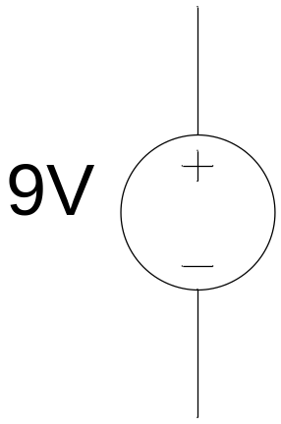
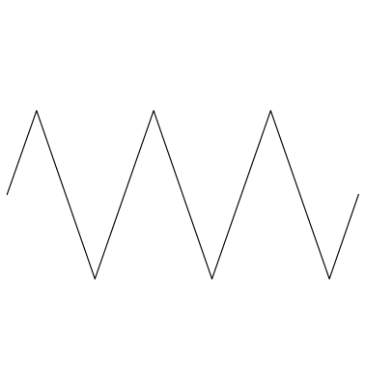
Last Week
Voltage
Current
Resistance

Slide 3
Review
Voltage – Difference in electrical potential between two points in a circuit
Current – Flow (movement) of electric charge
Resistance – How much a circuit element impedes the flow of electric charge (current)

Slide 4
This week
Nodes
Kirchoff’s Voltage & Current Laws
Ohm’s Law
Series and Parallel Resistances
Equivalent Resistance

Slide 5
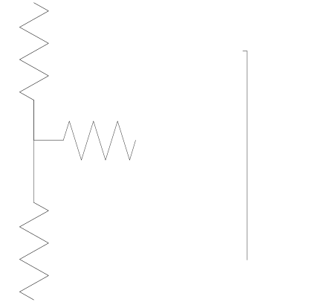
Nodes
Any point on a circuit is called a node.
Even a point on a wire is called a node.
This is a node
This is also a node
This is the same node

Slide 6
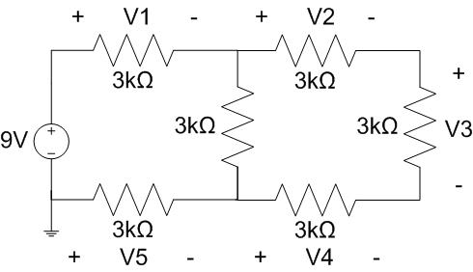
Kirchoff’s Voltage Law (KVL)
The voltage changes in a loop always sum to zero.
A loop is just a circle - a path that starts and ends at the same point.
In the big loop here,
V₁ + V₂ + V₃ + V₄
+ V₅ - 9V = 0

Slide 7
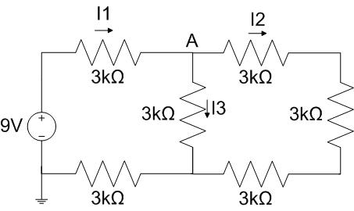
Kirchoff’s Current Law (KCL)
The sum of the currents entering a node equals the sum of those leaving.
At node A here,
I₁ = I₂ + I₃

Slide 8
Ohm’s Law
V = IR
V = Voltage (volts, V)
I = Current (amps, A)
R = Resistance (ohms, Ω)

Slide 9
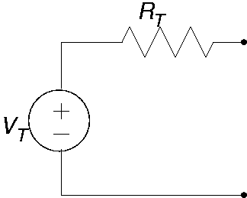
Ohm’s Law
Calculating V using Ohm’s Law:
Example:
  Calculate the voltage across R_{T} if
    I_{T} = 5 mA
    R_{T} = 1000 Ω
    Using Ohm’s Law,
    V_{T} = I_{T} * R_{T}
    V_{T} = (0.005 A)*(1000 Ω )
    V_{T} = 5 Volts

Slide 10
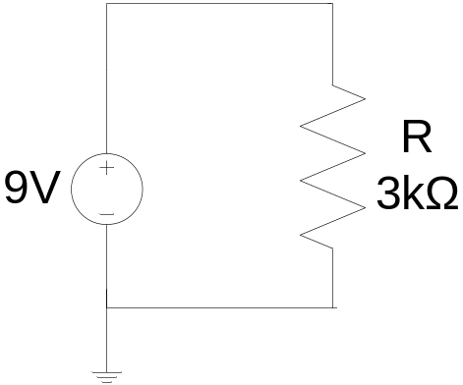
Example
What is the current through the resistor?
V = IR  I = V/R
I = V/R = 1V/ 1Ω = 1A

Slide 11
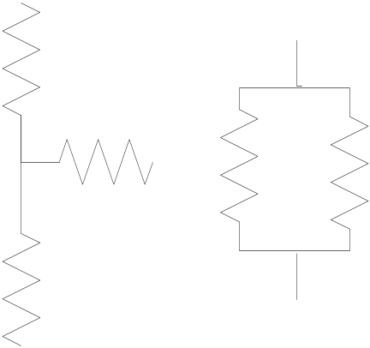
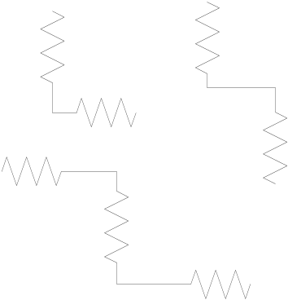
Resistors in Series
The current leaving one resistor must go through the next resistor – it has no other path to take.
These resistors are in series.
These resistors are not in series.

Slide 12

Resistors in Series
To find the total resistance of all the components, add the individual resistances of each component:
R_{total} = R₁ + R₂ + R₃ + … + R_{n}

Slide 13
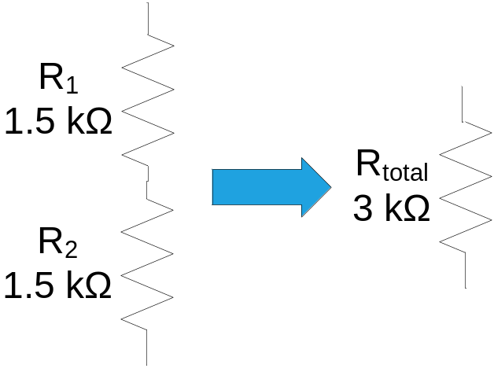
Resistors in Series
Example: Given R₁ = 1.5 kΩ and R₂ = 1.5 kΩ,
  R_{total} = 3 kΩ
Total resistance of two resistors :
Current is the same through all resistors connected in series

Slide 14

Resistors in Parallel
Sometimes written: A || B
  Especially if the math is ugly!
Two components are in parallel if:
  The tops are both connected to the same node.
  The bottoms are both connected to the same node.

Slide 15

Resistors in Parallel
The inverse of the total resistance is equal to the sum of the inverses of the individual resistances.

Slide 16
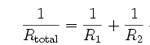
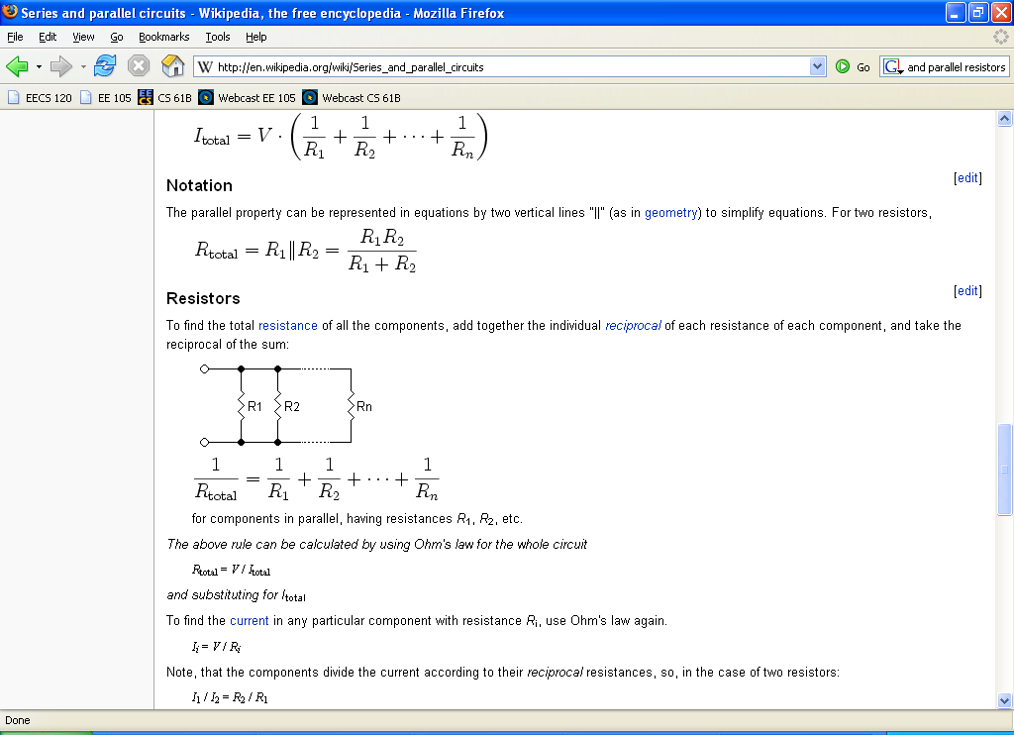
Two Resistors in Parallel
Example: Given R₁ = 1.5 kΩ and R₂ = 1.5 kΩ,
  R_{total} = 0.75 kΩ
Solving for R_{total} gives us the product R₁ R₂ over the sum
R₁ + R₂. Just remember: “product over sum.”
  Pitfall: “Product over sum” only holds for two parallel resistors, because it comes from algebraic simplification!
The voltage is the same across any number of resistors connected in parallel.

Slide 17
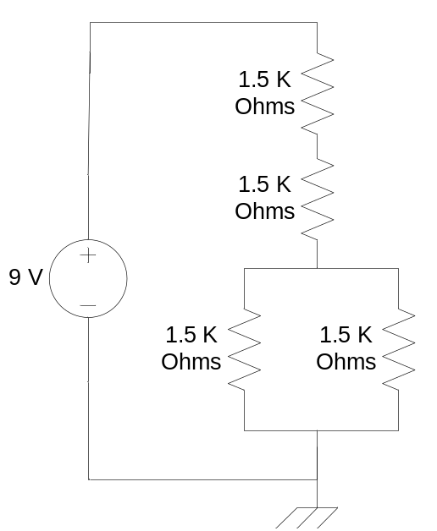
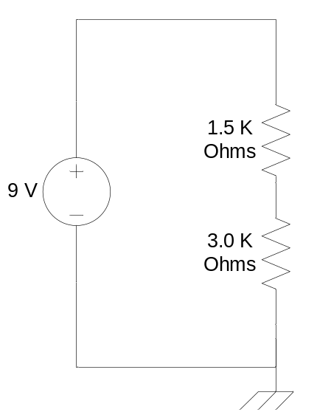
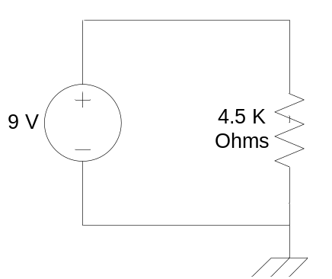
Calculating R_{total}
Resistors R₁ & R₂ are in series, while R₃ & R₄ are in parallel. Their equivalent resistances are in series, so just add.
R1
R1 + R2
R2
3.0 K
Ohms
→
→
3.75 K
Ohms
0.75 K
Ohms
R3
R4
R3 || R4

Slide 18
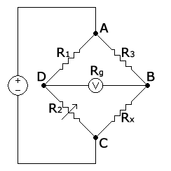
Everyday Use
A Wheatstone bridge uses a network of resistors with a variable resistance (R₂) to measure the value of an unknown resistance (R_{x}).
Resistors appear in nearly every
circuit – they limit current flow
so that circuits don’t burn out.
A Wheatstone Bridge

Slide 19
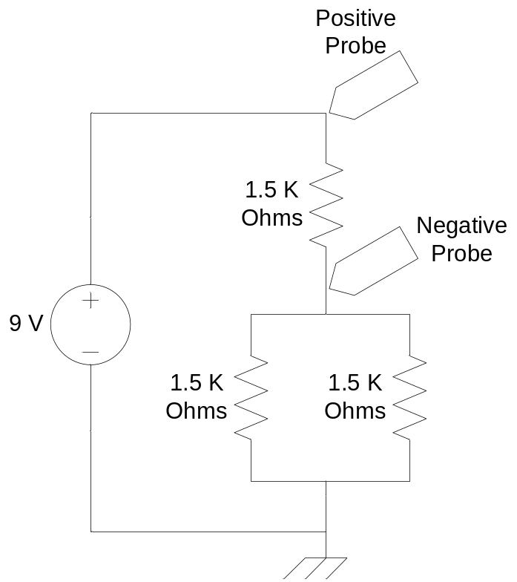
Measuring Voltage
What is V across R₁? R₂ || R₃?
The parallel resistors simplify to an equivalent of one 0.75 kΩ resistor
R_{total} = 1.5 kΩ + 0.75 kΩ = 2.25 kΩ
I_{total} = V_{total}/R_{total} = 9/2.25 = 4 mA
V₁ = I_{total}*R₁ = 4 mA*1.5 kΩ = 6 V
V_{2 || 3} = I_{total}* (R₂ || R₃)
= 4 mA*0.75 kΩ = 3 V
R₁
R₂
R₃

Slide 20
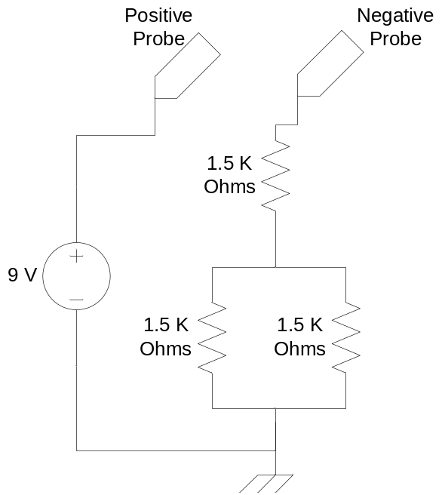
Measuring Current
What is I for R₁, R₂, and R₃?
I_{total} = V / R_{total}
I_{total} = 9 V / 2.25 kΩ = 4 mA
I through R₁ = 4 mA
I through R_{2 || 3} = I through R₁
= I through R₂ + I through R₃
I through R₂ = I through R₃ = 2 mA
  Current divides evenly between R₂ and R₃ because they have the same resistance
R1
R2
R3

Slide 21
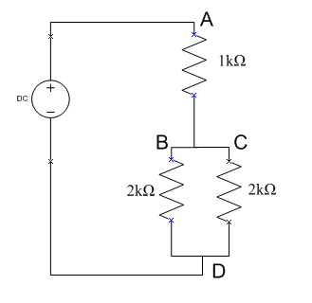
Measuring Voltages
V_{BD} means:
  V_{B} - V_{D}
  Red lead (+) at B
  Black lead (-) at D
The reason: voltage is
relative!
  V_{BD} is the voltage at B
  minus the voltage at D

Slide 22
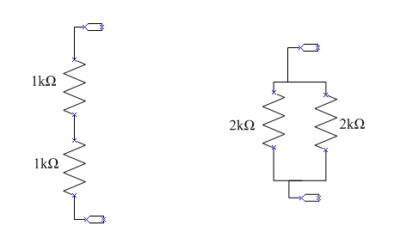
Equivalent Resistance
Calculate BEFORE measuring experimentally!

Slide 23
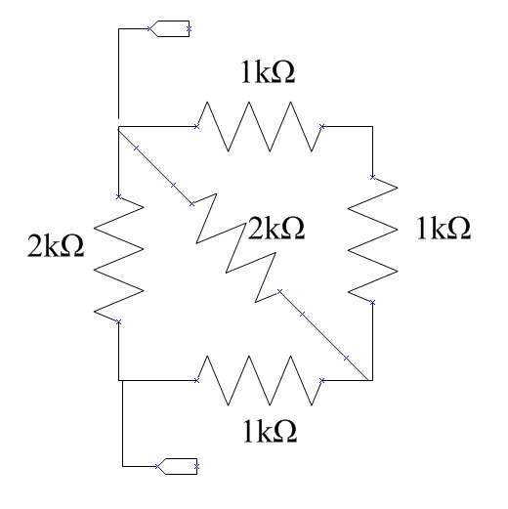
Equivalent Resistance
Calculate BEFORE measuring experimentally!

Slide 24
Lab Time

