Slide 1
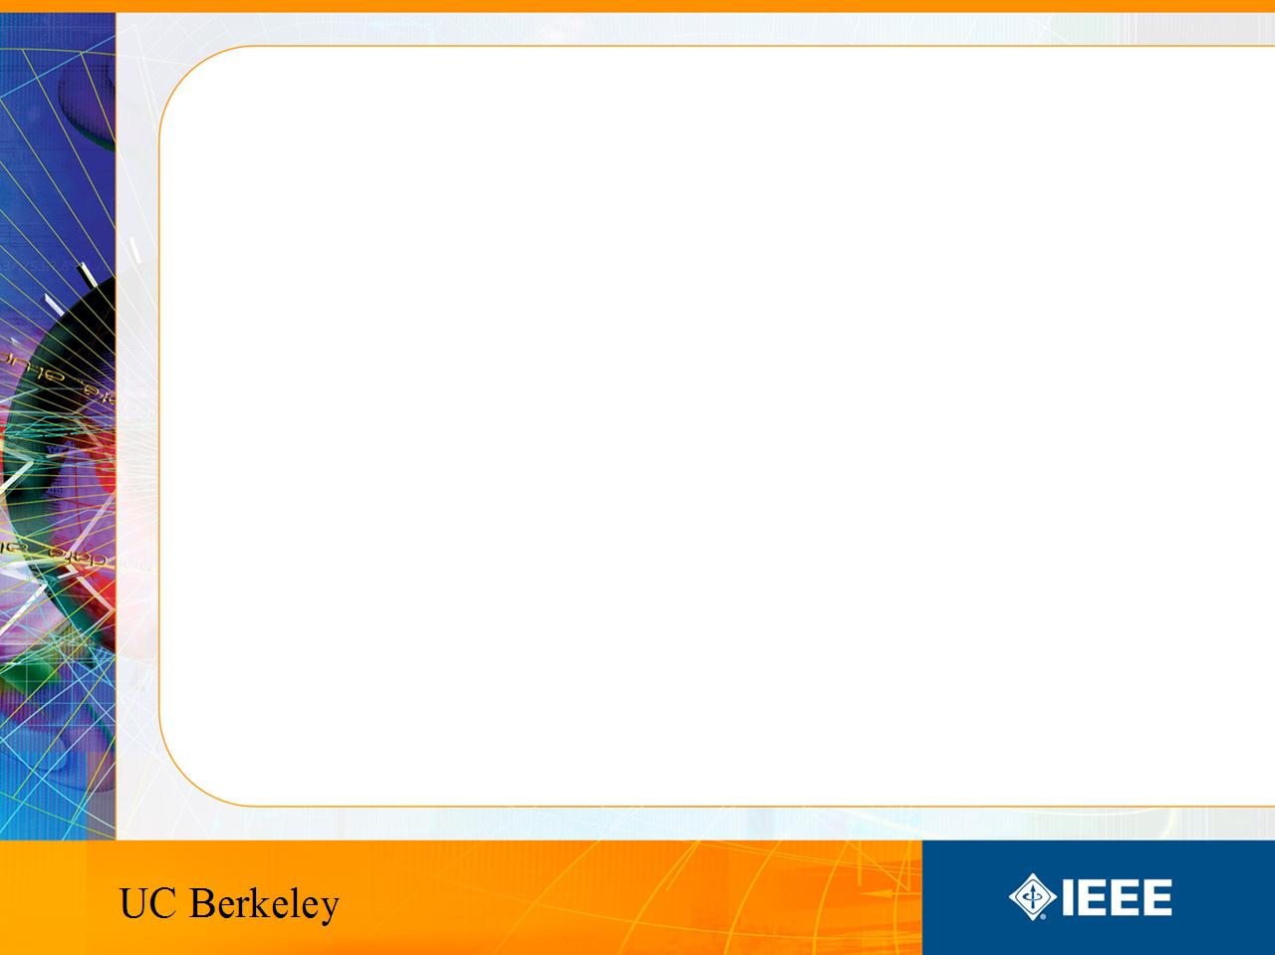
IEEE’s
Hands on Practical Electronics (HOPE)
Lesson 5: Silicon, Breadboards

Slide 2
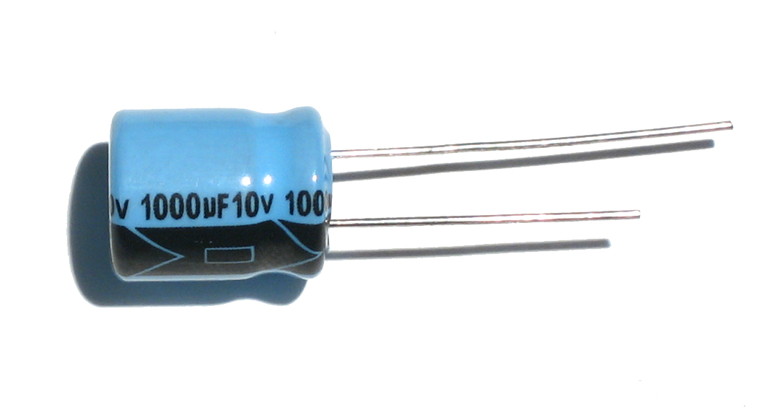
Last Week
Capacitors
  Q = CV
  Similar to batteries
  Charge exponentially
  Charging time related to RC

Slide 3
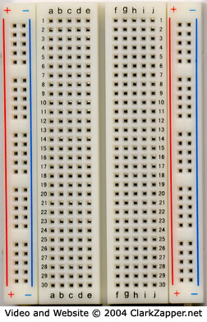
This Week
Silicon
  Properties
  Charge Carriers
    Electrons
    Holes
  Doping
Breadboards
  Usage

Slide 4
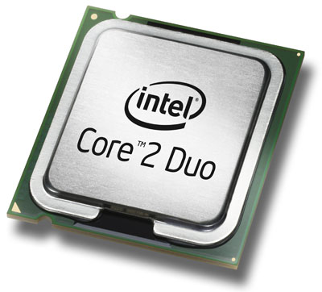
Silicon in Everyday Use
Silicon is used today in many different applications. The one you are probably most familiar with is your computer processor.

Slide 5
Insulator vs. Conductor
Insulators do not conduct current
  Examples: plastic, wood
Conductors conduct current
  Examples: metal, ionized water.

Slide 6
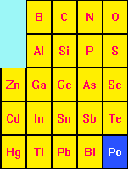
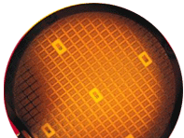
Semiconductors
Is there something between an insulator and a conductor?
  Yes. It is called a semiconductor.
  Examples: germanium, silicon, carbon (diamond allotrope)

Slide 7
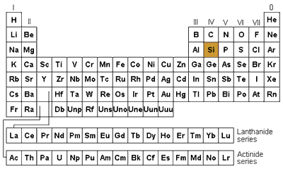
Semiconductor – Silicon (Si)
Semiconductor (from wikipedia): A material with an electrical conductivity that is intermediate between that of an insulator (no free electrons) and a conductor (free electrons). A semiconductor behaves as an insulator at very low temperatures, and has an appreciable electrical conductivity at room temperature although much lower conductivity than a conductor.
Semiconductors do not follow Ohm’s Law.

Slide 8
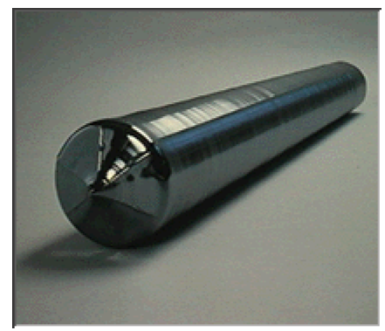
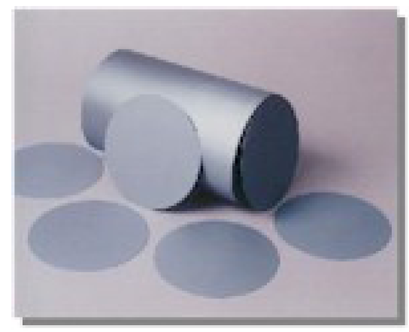
Industrial Use
Silicon is the most common substance used in modern day fabrication.

Slide 9
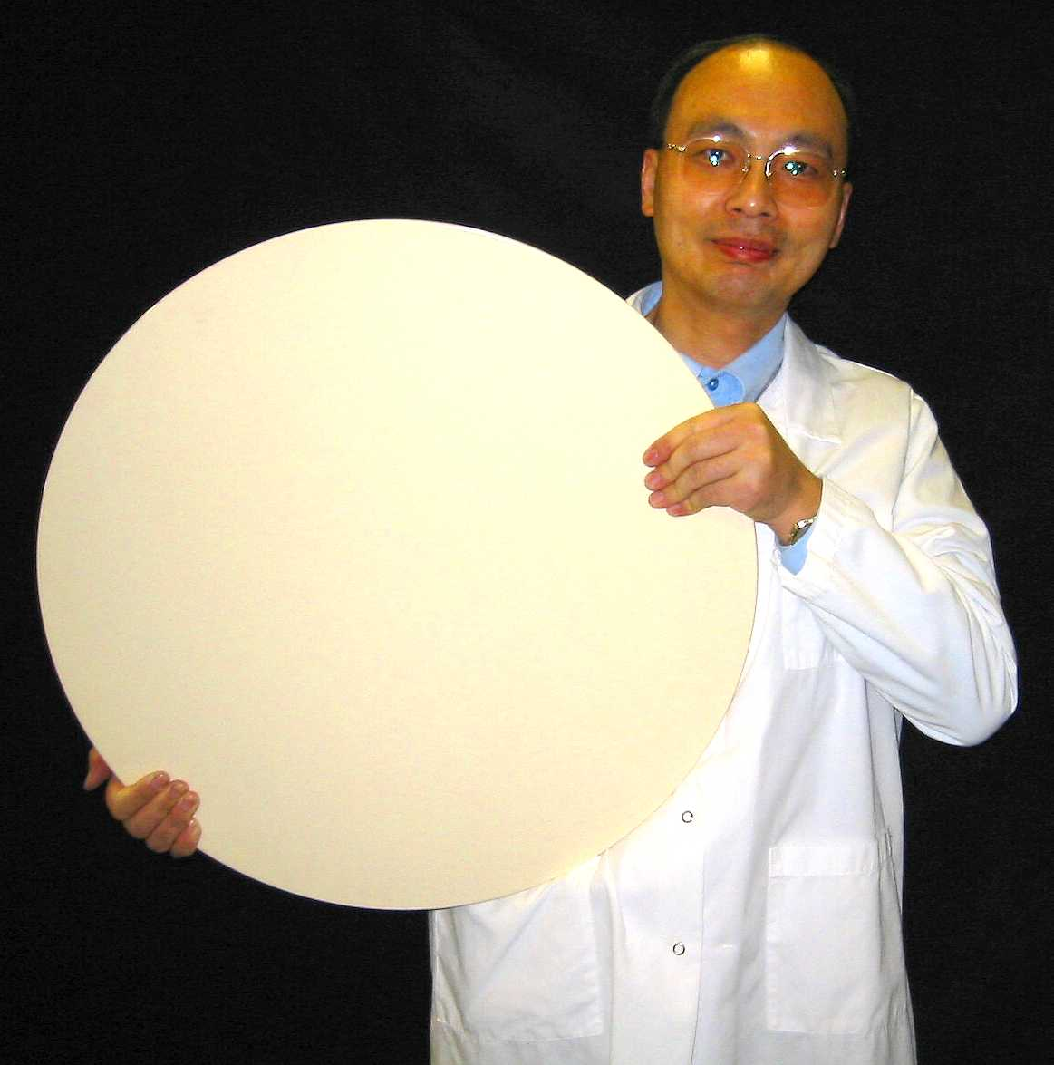
Silicon Wafers
They are polished to be smooth on one surface
  Why only one surface?
    You only build on one side
Wafers are about .75 mm thick
Wafers are usually made 300mm in diameter
  For non metric system users that is about 12 inches

Slide 10
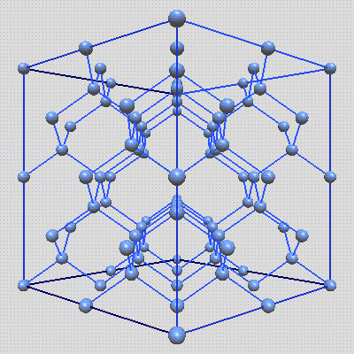
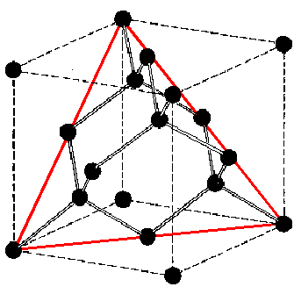
Structure of Silicon
Pure silicon forms tetrahedral bonds in a crystal lattice. (Each silicon atom is connected to four others)

Slide 11
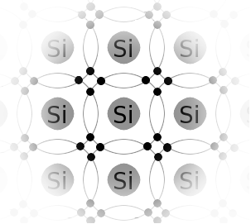
For Simplicity
We will represent it in two dimensions by drawing them at 90 degree angles.
Remember chemistry? Silicon has all covalent bonds so all electrons are locked in place.
If current is defined as moving electrons, is this form of silicon a conductor?

Slide 12
Charge Carriers
The negative charge carrier is called an electron.
There is no charge carrier equivalent of an electron. The electron’s antimatter counterpart is called a positron, which cannot co-exist with regular matter. We can however model the lack of an electron as a positive charge carrier. We will call this a hole.

Slide 13
Doping
By adding impurities to silicon, you can alter its behavior.
Impurities are elements like boron or phosphorous which have 3 or 5 valence electrons. When put into a lattice with silicon which has 4 valence electrons, there is either more or less electrons than there should be.

Slide 14
Doping
If silicon has
  more negative charge carriers
  more electrons
  doped more heavily with elements with 5 valence electrons
It is considered n-type.

Slide 15
Doping
If silicon has
  more positive charge carriers
  more holes
  doped more heavily with elements with 3 valence electrons
It is considered p-type.

Slide 16
Doping
By doping silicon with elements like boron (with 3 valence electrons) there is a lack of an electron in the crystal lattice. This hole can move too. Neighboring electrons can jump in to fill this space, which effectively means the hole moved.
Once again, there is no positive charged particle moving around, but we can characterize the absence of an electron as a positive charge.

Slide 17
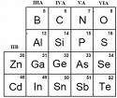
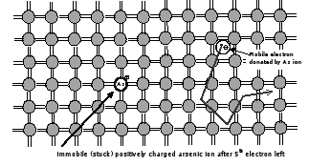
Doping
Arsenic is like phosphorous. It has 5 valence electrons.
If silicon is doped with arsenic, it will have extra electrons which can “hop” from place to place.

Slide 18
Silicon
Why do we use silicon?
  It’s cheap. Sand (SiO₂) is made up of silicon.
  It is well behaved and well understood
Do they use other materials other than silicon?
  Yes, but commercially silicon has dominated.

Slide 19
Breadboards
Used to build circuits quickly
Can salvage parts afterwards
Does not require soldering

Slide 20
Breadboards
DO NOT SOLDER ANYTHING ON THESE!!!
DO NOT SOLDER ANYTHING ON THESE!!!
DO NOT SOLDER ANYTHING ON THESE!!!

Slide 21
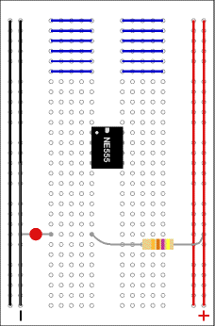
Breadboards
Already wired on the back.
The long rails through the entire length of the breadboard are wired vertically.
Usually used to supply a reference voltage for your circuit

Slide 22
Breadboards
The five pin columns are wired horizontally.
Adjacent columns of five are NOT connected internally. (They are two separate groups of five.)
In some cases you may wish to connect it manually.

Slide 23
Lab
In today’s lab we will experiment with solar cells and learn to build circuits on breadboards.
Get to it!

