Slide 1
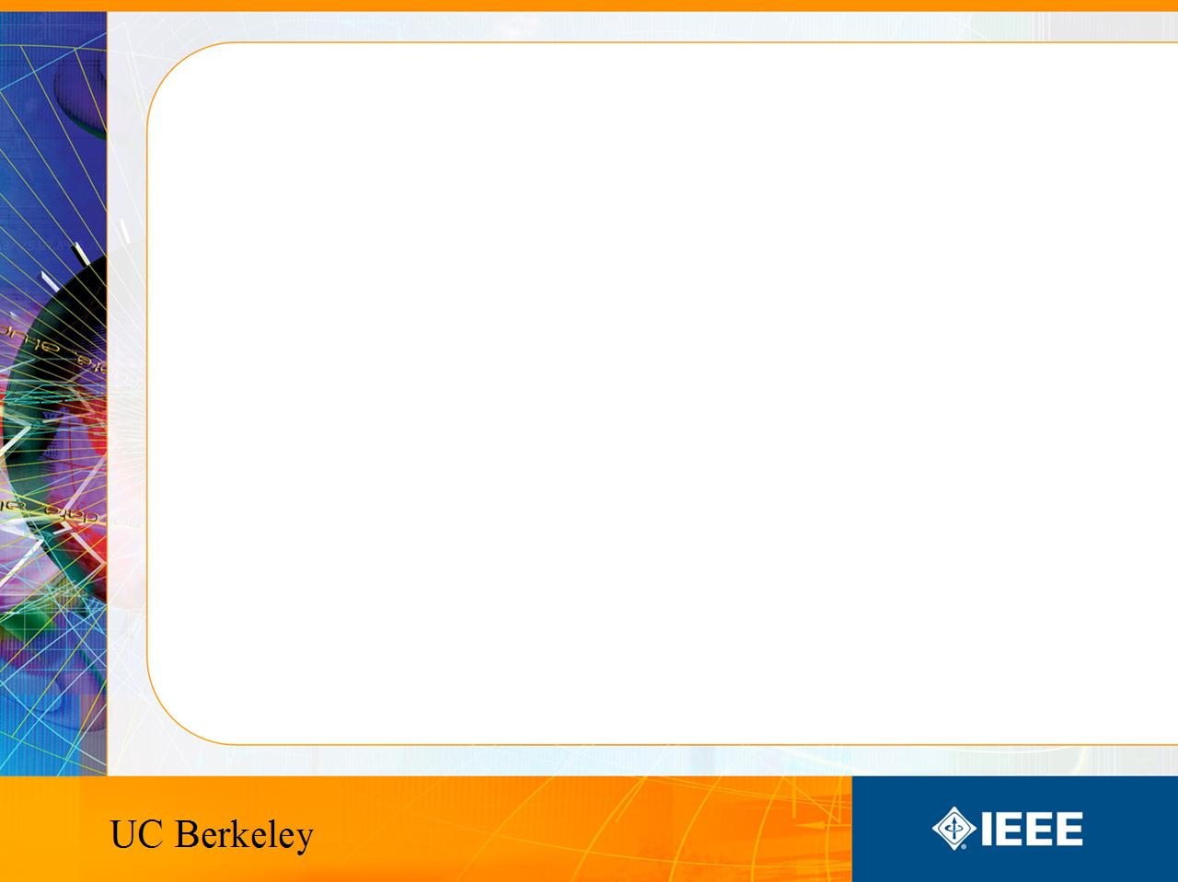
IEEE’s
Hands on Practical Electronics (HOPE)
Lesson 7: Transistors

Slide 2
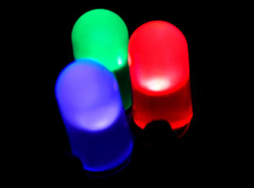
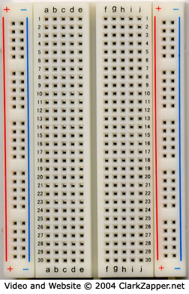
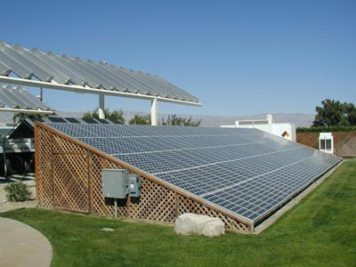
Last Week
PN Junctions (Diodes, Solar Cells)
Breadboards

Slide 3
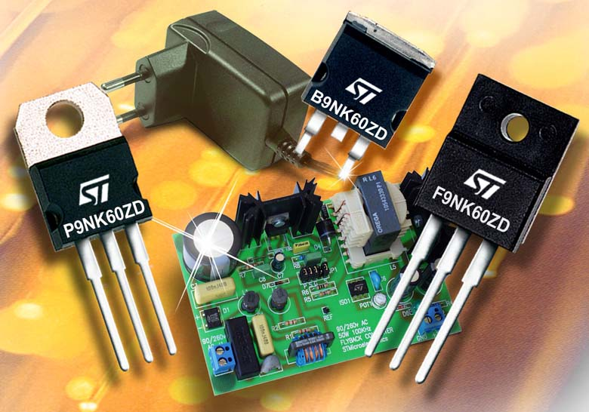
This Week
MOSFETS
  Significance
  Types
  Common Names
  Basic Physics
  Functions/Uses

Slide 4
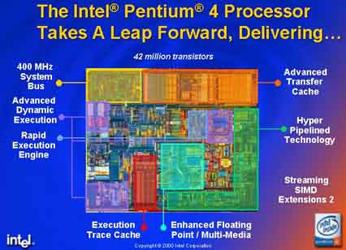
Does this really matter?
Transistors are the heart of the digital revolution and are responsible for the growth of everyday electronics.
Transistors are also used in analog systems.

Slide 5
Quotes
“The most important invention of the 20th century” – IEEE
“One of the most significant discoveries” –NSF
“most important invention of the 20th century” -PBS

Slide 6
MOSFET
Metal
Oxide
Semiconductor
Field
Effect
Transistor
Which of the six words do you think is the most important?
The properties of semiconductors are what make this technology possible.
MOSFETs are the most common type of transistor used today.

Slide 7
Types
There are two types of MOSFETS
They correspond to the charge carriers
  Holes
  Electrons
The two types are respectively called
  PMOS
  NMOS

Slide 8
Other terms you may hear or see
MOS transistor
M-O-S (pronounced letter by letter)
p-MOS, n-MOS
p-MOSFET, n-MOSFET

Slide 9
What is a transistor?
Easiest Answer: switch
Change the applied voltage to allow or stop current flow.
This can be referred to as a voltage controlled current switch.

Slide 10
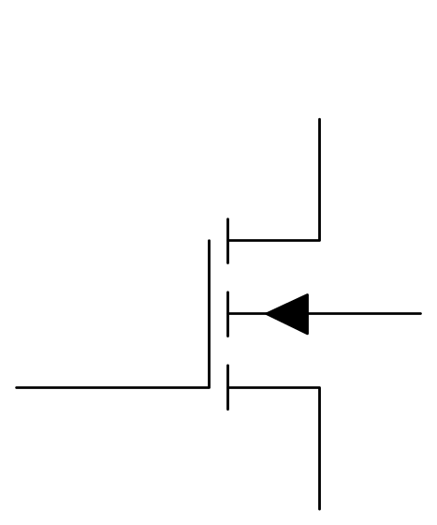
MOSFET
MOS transistors have 4 terminals.
They are:
Drain (D)
Body (B)
Source (S)
Gate (G)
D
G
B
S

Slide 11
MOSFET
When a transistor is on, we will consider it a short.
When a transistor is off, we will consider it an open circuit.
Remember a short allows current to flow,
an open circuit does not.

Slide 12
MOSFET
MOS transistors are symmetric so the Source and the Drain can be flipped when referring to a single device.
D
G
B
S

Slide 13
NMOS
We will start with NMOS because they are more straightforward to learn.
D
G
B
S

Slide 14
NMOS
For an NMOS, whichever terminal is biased at a higher potential (voltage) is called the drain, the other is called the source.
D
G
B
S

Slide 15
NMOS
We will discuss fabrication in a later lesson. For now we will just go over how it works.
D
G
B
S

Slide 16
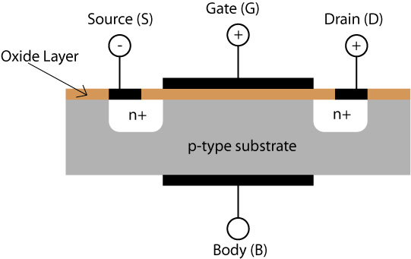
NMOS
This is a picture of a cross section of a transistor.
You can see the four terminals on this device.

Slide 17
NMOS
Remember PN Junctions? They prevent current from flowing
This is essentially two back to back diodes.

Slide 18
NMOS
To turn it on, apply a voltage to the gate that is higher than the source

Slide 19
NMOS
A gate voltage lower than the source will not turn on the NMOS

Slide 20
Picture
With too low a gate voltage, electrons cannot get through: no current.
No current
N type
N type
P type

Slide 21
Picture
Apply a voltage to make the p-type material behave like n-type
Current
N type
N type
N type

Slide 22
Picture
Gate voltage lower than source voltage
N type
N type
P type

Slide 23
Picture
Gate voltage higher than source voltage
Current
N type
N type
N type

Slide 24
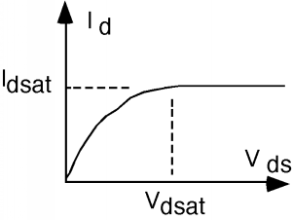
Drain current
In this course you will only need to worry about ON or OFF.

Slide 25
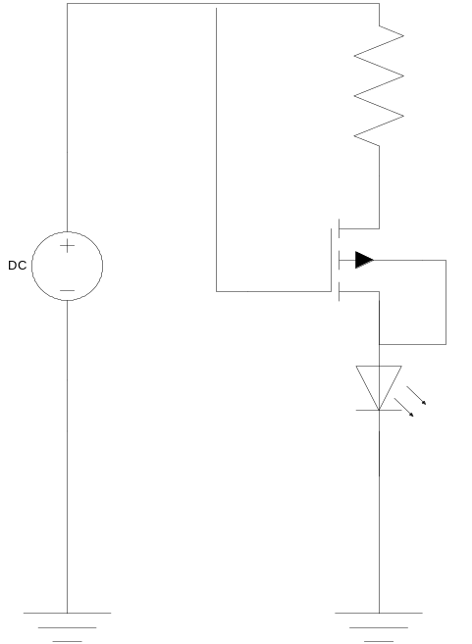
Lab
Transistor is ON
Current flows
LED is ON

Slide 26
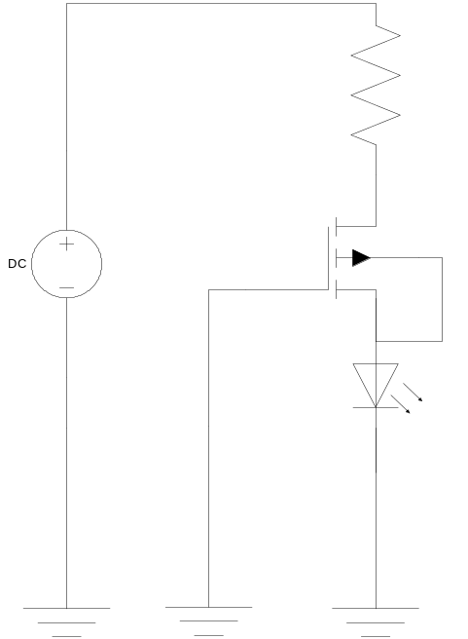
Lab
Transistor is OFF
Current does not flow
LED is OFF

Slide 27
Lab
Be sure to connect all the wires

Slide 28
Lab
Unplug the wire from the gate to 9V and plug that wire into ground.
Do not just leave it “floating”

Slide 29
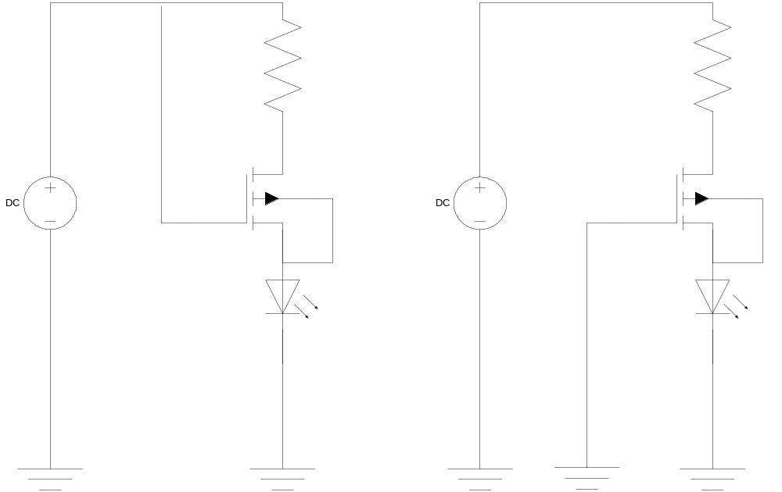
Lab

