Slide 1
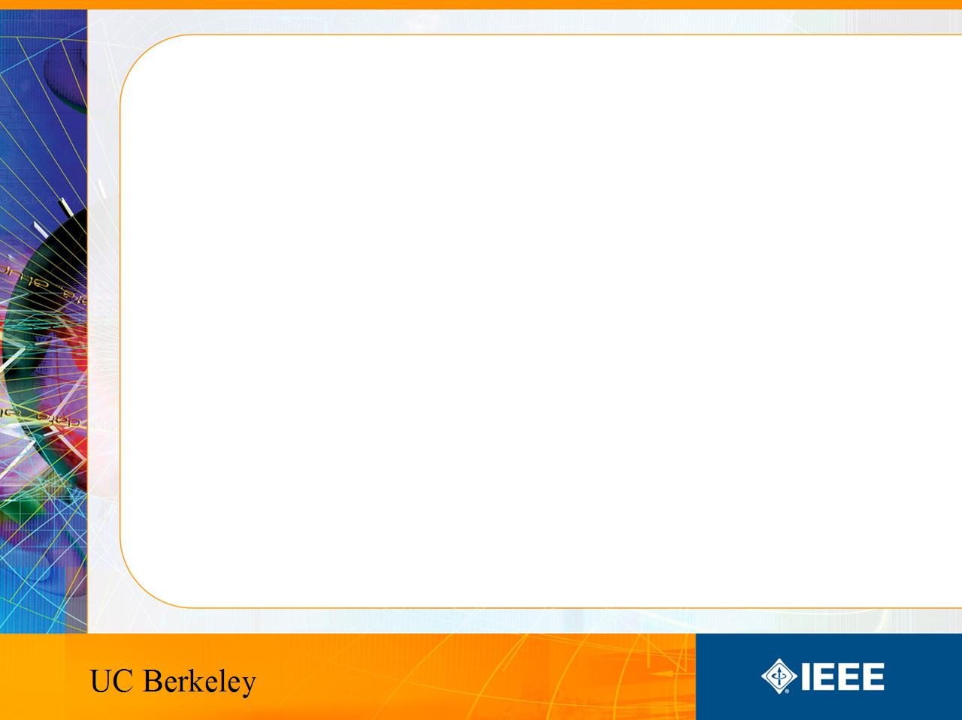
IEEE’s
Hands on Practical Electronics (HOPE)
Lesson 9: CMOS, Digital Logic

Slide 2
Last Week
Type | Gate Voltage | Current?
PMOS | HIGH | OFF
PMOS | LOW | ON
NMOS | HIGH | ON
NMOS | LOW | OFF
Transistors
  PMOS
  NMOS vs. PMOS

Slide 3
This Week
CMOS
Digital Logic
  Logic Gates
Constructing simple CMOS logic gates

Slide 4
CMOS
Complimentary MOS
Uses both types of MOS to make a circuit
  NMOS
  PMOS
Special style of design so the NMOS and PMOS compliment each other
Uses low power because of its complimentary nature

Slide 5
Logic
Logic is logical
Logic is a stateless way to calculate consistent results with the same input
In other words, logic systems always take inputs and give out answers.

Slide 6
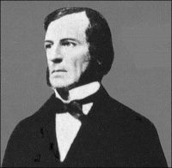
Boolean Algebra
An algebra with booleans.
  True or False, 0 or 1, ON or OFF
Developed by George Boole (1815-1864)
Easy to use for computers,
due to the compatibility with
binary.

Slide 7
Logic
What is it?
You have already encountered it in your daily life.
You use it in your speech.
Simple logic functions: NOT, AND, OR.

Slide 8
Terms
Logical operations – functions, i.e. ANDs, ORs, NOTs.
Logic gate – an representation of a logical operation
Combinational logic – a combination of logic gates that performs a complex logical function

Slide 9
Notation
NOT: ~A, ¬A, A
AND: AB, A•B
OR: A+B
YES, True, HIGH, 1 all mean the same thing
NO, False, LOW, 0 all mean the same thing

Slide 10
Logic Gates
A logic gate performs a logical operation on one or more logic inputs and produces a single logic output. (from wikipedia)

Slide 11
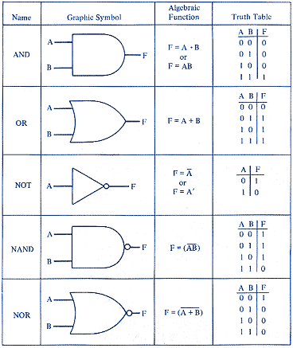
Gate Symbols
Examples of logic gates.

Slide 12
NOT
Means opposite
For example
  I am happy
  I am NOT happy
Compare the above with the following
  Happy
  ¬Happy

Slide 13
AND
You can buy a new car if your dad AND your mom say ok.
MOM | DAD | NEW CAR?
0 | 0 | 0
0 | 1 | 0
1 | 0 | 0
1 | 1 | 1

Slide 14
OR
You can buy a new car if your dad OR your mom say ok.
MOM | DAD | NEW CAR?
0 | 0 | 0
0 | 1 | 1
1 | 0 | 1
1 | 1 | 1

Slide 15
OR
Let’s change the names a bit
A | B | OUT
0 | 0 | 0
0 | 1 | 1
1 | 0 | 1
1 | 1 | 1

Slide 16
Logical expressions
Any logical expression can be implemented with NOTs, ANDs and ORs.

Slide 17
More Complex Functions
NAND = NOT(AND(x, y))
NOR = NOT(OR(x, y))
NAND and NOR are logically sufficient
Logically sufficient – able to implement all logic with only one type of logic gate.

Slide 18
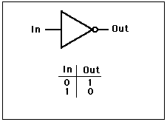
NOT gate
A NOT gate inverts your input
~A, ¬A, A

Slide 19
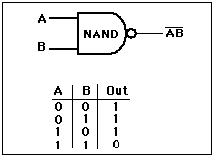
NAND gate
NAND is the NOT of an AND
Written as ~AB (or any combination of NOT and AND notation)

Slide 20
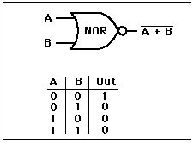
NOR gate
NOR is the NOT of an OR
Written as ~(A+B) (or any combination of NOT and OR notation)

Slide 21
In real life
NANDs are used more often than NORs because they are based on NMOS instead of PMOS
But why bother with NOTs?
  Answer: NAND and NOR take 4 transistors each, but NOT only takes 2.

Slide 22
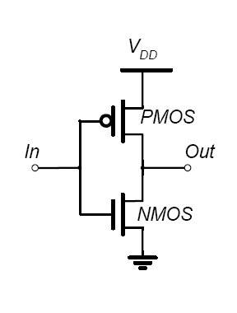
Transistor CMOS NOT gate

Slide 23
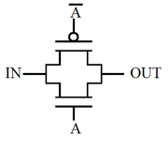
Transistor AND gate

