Slide 1
Semantic Graphs for Modeling Cyber-Physical Systems
Or, how to do work with large amounts of data from complicated systems that are all unique, constantly changing, and have no good documentation
Dr. Gabe Fierro
https://gtf.fyi
Assistant Professor, Computer Science
Joint Appointment @ NREL

Slide 2
There’s Data Everywhere
Internet of Things:
Cheaper, more ubiquitous sensors
Digital control and monitoring systems
Data-oriented processes, techniques
More data about cyber-physical systems than ever before
This data is difficult to discover, access, and understand
We are data rich, but information poor

Slide 3
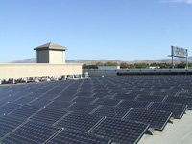
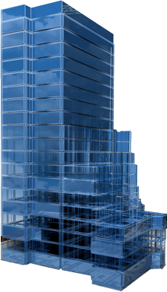


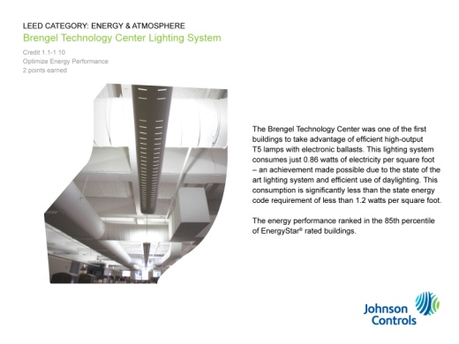





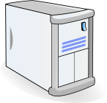


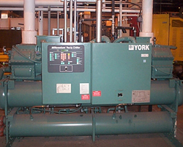

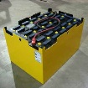
There’s Data Everywhere
Solar PV
Zoom in on buildings:
75% of US electricity, 40% of energy consumption
Thousands of sensors, control points
Decades of research into data-driven applications
Grid-aware operation
Occupant comfort
Automated fault detection
Intelligent controls
Etc…
Cameras
Lighting
Information & Communications Technology (ICT) Systems
Servers
Fans
Building Automation & Control System
AHUs
Stats
Meter
Smart Grid
SubMeter
Chillers
PHEVs
Battery Storage

Slide 4
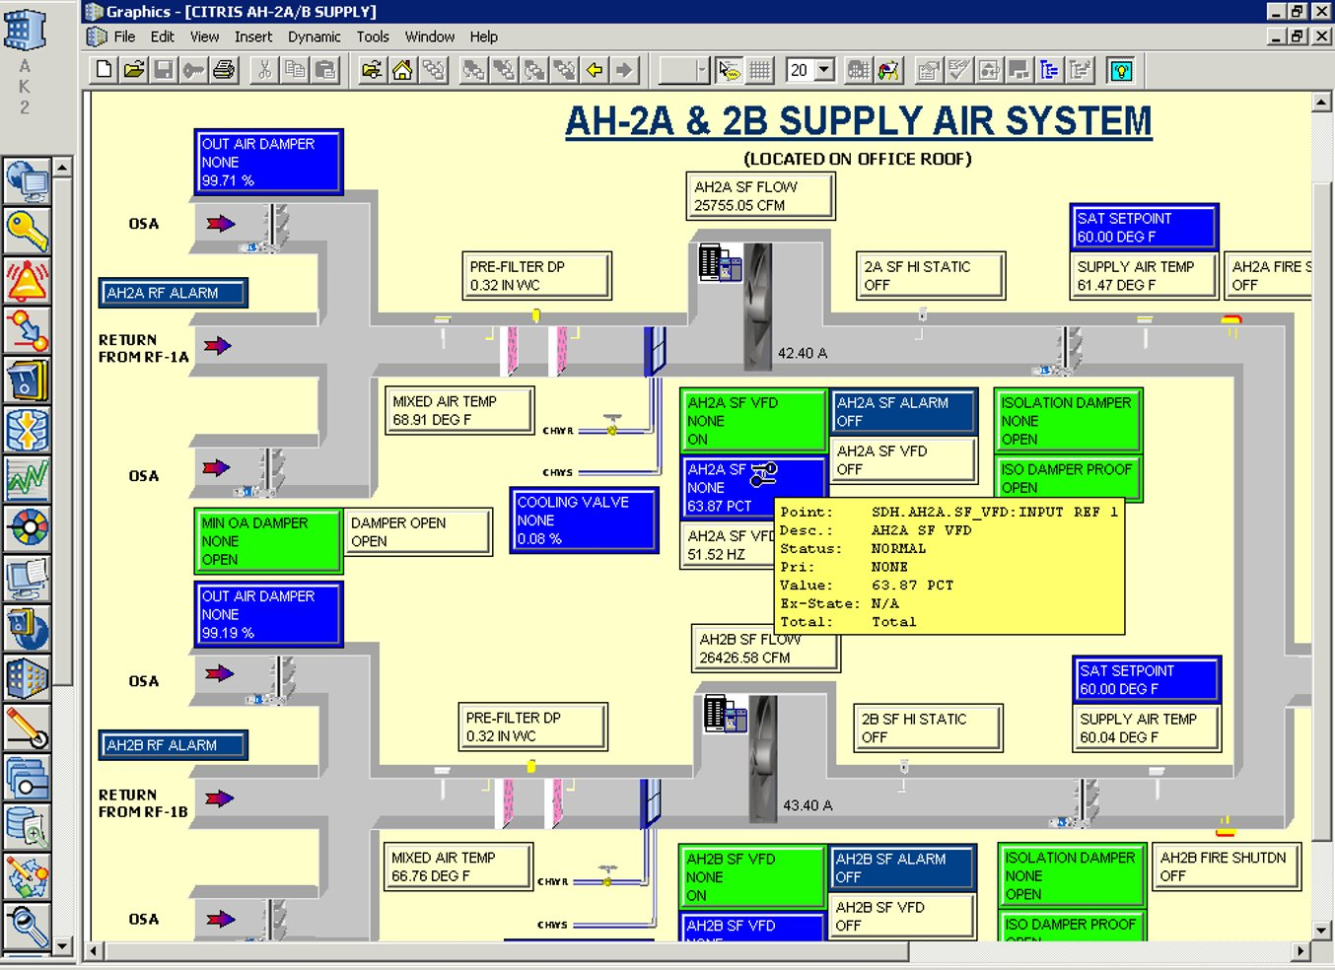

Slide 5
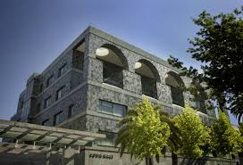
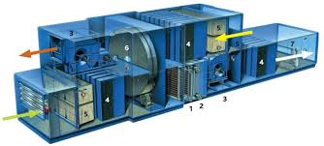
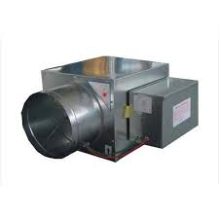
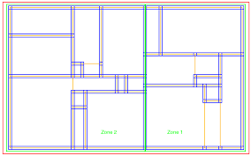
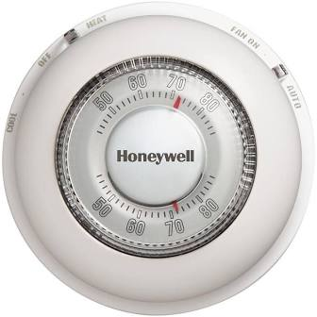
What’s in a Name?
AHU
VAV box
Zone
Thermostat
Setpoint control target
72F
Equip ID
Zone Name
SODA1R465__ARS
SODA1R465__ARS
SODA1R465__ARS
SODA1R465__ARS
SODA1R465__ARS
SODA1R465__ARS
SODA1R465__ARS
SODA1R465__ARS
Site name
Air Handling Unit
Zone/Room
Padding / delimiter
Zone Air Temperature Setpoint
Labels like these often the only up-to-date and readily-available source of metadata
Site-specific conventions; sometimes no labels at all
No consistent, standard metadata for cyberphysical system data

Slide 6
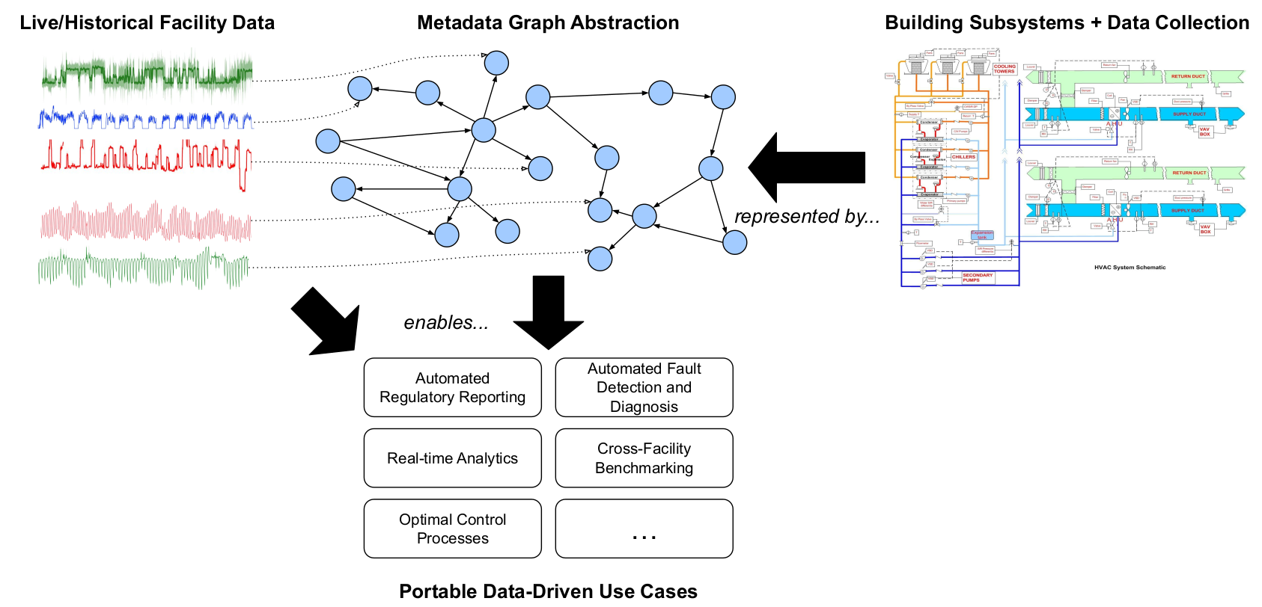

Slide 7
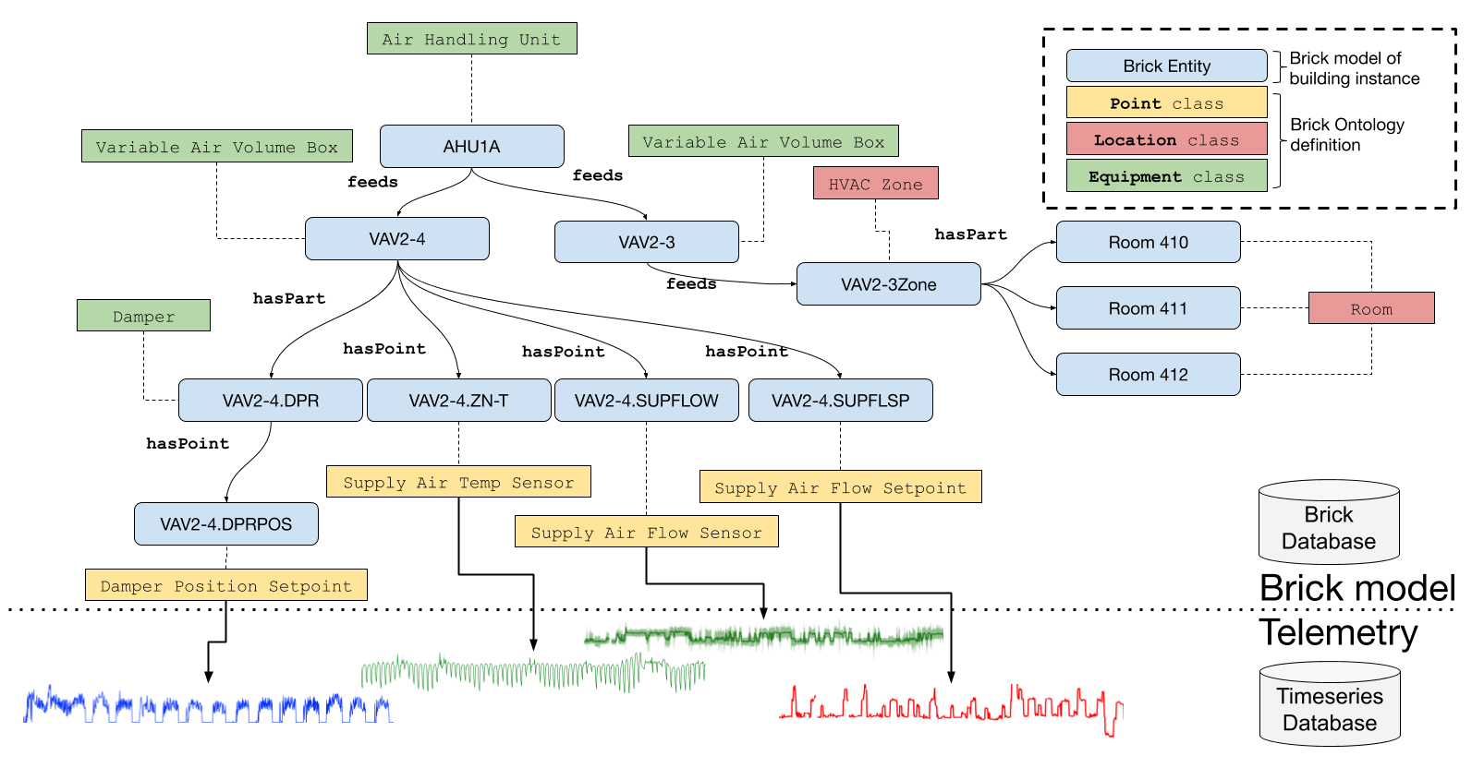
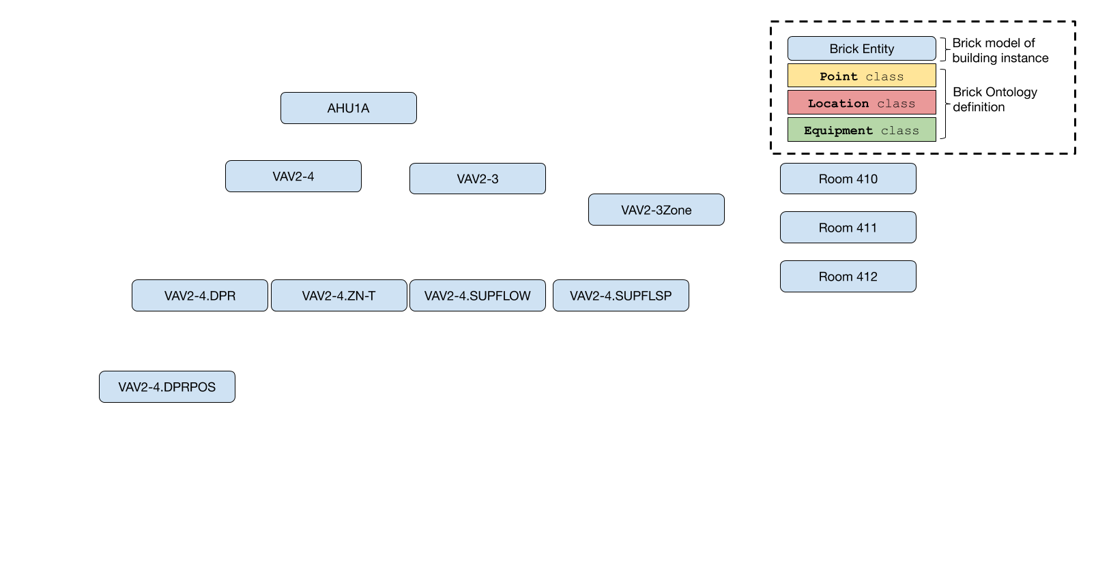
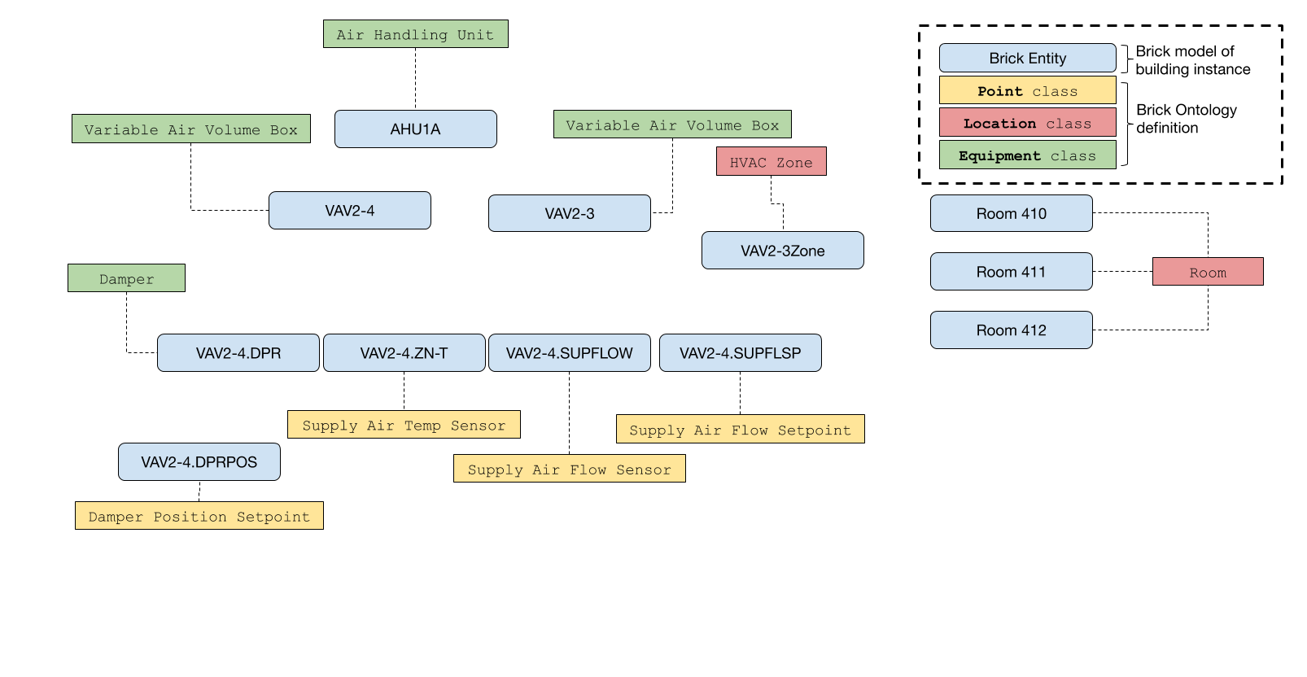


Slide 8
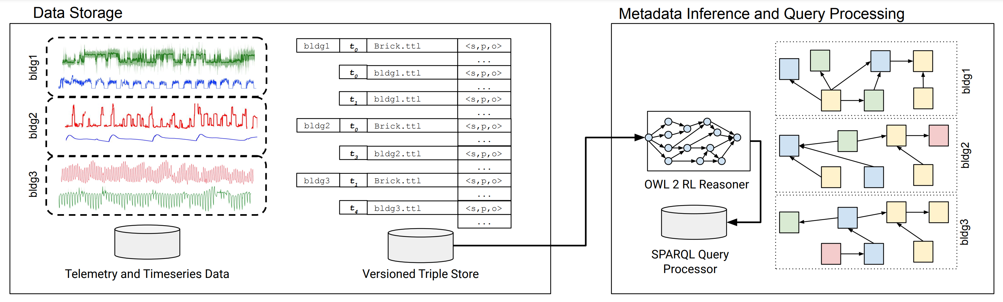
New Platforms for Data-Driven Cyber-Physical Systems
Standardized, machine-readable metadata for CPS
Novel semantic graph-based representations of topology and composition
Buildings (Brick: https://brickschema.org/)
Smart Grids (in progress)
ASHRAE, DOE, NREL, PNNL, LBNL collaborations
Enable uniform discovery of resources at scale
Investigate new hybrid graph/timeseries data systems for data-driven IoT/CPS applications
Enable new applications of ML/AI in CPS at scale
Developing new techniques for efficient query processing, logical inference over societal-scale graphs linked with telemetry
Have data about real-world systems/environments? Send me an email! gtfierro@mines.edu

