Slide 1
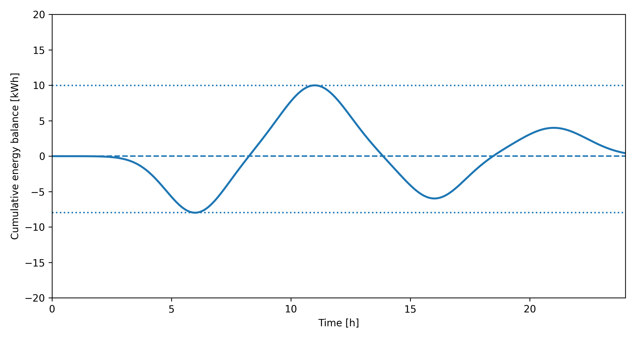




$$\max{(B\left(t\right))}$$
Charging
Travelling
$$C_{min}$$
$$\min{(B\left(t\right))}$$
$$SOC_{start}$$

