Slide 1
PERFORMANCE ISSUE ANALYZE

Slide 2
  Summary
JVM Memory Structure
  Structure
  Heapdump&Threaddump
  Monitor tools
  Analysis tools
Performance Issue Analyze
  JVM status monitor
  Logging structure
  LUNIX command
  TOP SQL

Slide 3
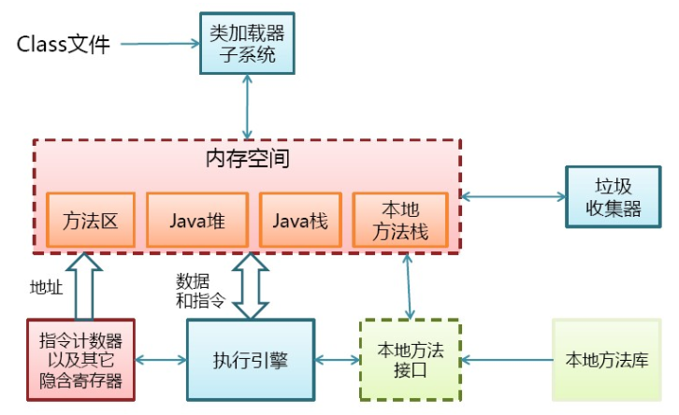
Structure

Slide 4
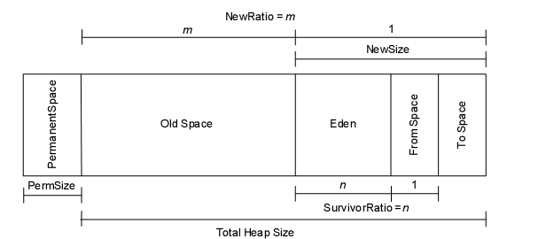
Structure

Slide 5
Heapdump&Threaddump
Heapdump
  内存堆快照
  –XX:+HeapDumpOnOutOfMemoryError
  jmap -dump:format=b,file=/weblogs/heapdump/HeapDump.hprof
  Threaddump
  栈快照
  jstack <PID> >> <FilePath>

Slide 6
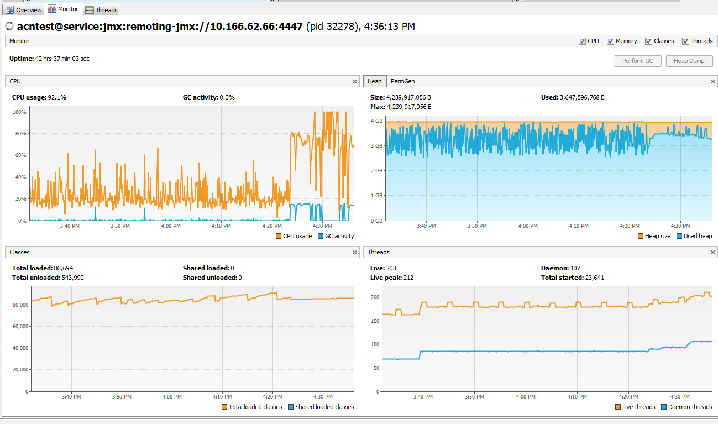
Monitor tool
jvisualvm_production-monitor.docx

Slide 7
Analysis tools
IBM HeapAnalyzer
  JVisualVM
  MemoryAnalyzer

Slide 8
JVM status monitor
jvisualvm_production-monitor.docx

Slide 9
Logging structure
logstructure.docx

Slide 10
LUNIX command
less
grep

Slide 11
TOP SQL
CUP
  IO
  Executions

