Slide 1
Business Engine – Drools Expert
Copyright © 2012 Accenture All Rights Reserved. Accenture, its logo, and Accenture High Performance Delivered are trademarks of Accenture.

Slide 2
Agendia
What Is Drools Expert
Example
How To Use
Rete Algorithm
When Is It Used
Implementation in RCS
Best Practice
Copyright © 2009 Accenture All Rights Reserved.

Slide 3
What Is Drools Expert
Drools Is An Rule Engine
It Express Logic In Declarative Manner
  when <conditions> then <actions>
It Can Conduct Inference
Unclear Requirement
Rework
Low Quality
Behind Schedule
OT
Catch Up
Project Fail
Over Budget
Project Success
Increase Budget
Copyright © 2009 Accenture All Rights Reserved.

Slide 4
Example 1
Scenario
  An insured have bought more than one Policy
  If a policy is effective before event date, this policy is eligible for payment
  If the eligible policy cover ‘ABC’ product, the major beneficiary will be paid 100% SA
Copyright © 2009 Accenture All Rights Reserved.

Slide 5
Example 1
Structured Programming
  for each policy {
  if policy is effective after event date{
  for each product of this policy{
  if product code is ‘ABC’ {
  for each beneficiaries {
  if the beneficiary is major {
  pay the beneficiary 100% SA
  }
  }
  }
  }
  }
  }
Copyright © 2009 Accenture All Rights Reserved.

Slide 6
Example 1
Drools Rules
  when
  $policy: Policy(effective date after event date)
  $product: Product(code = ‘ABC’, policyId = $policy.id)
  $client: Client ( is major, $client.policyId = $policy.id)
  then
  pay $client 100% SA of $product.
  end
Copyright © 2009 Accenture All Rights Reserved.

Slide 7
Example 2
Declarative programming
If it is not raining, go outside
If it is raining, you need an umbrella
If you need an umbrella, take an umbrella from closet
Structured programming flow chart
Declarative programming
If it is not raining, go outside
If it is raining, you need an umbrella
If you need an umbrella, take an umbrella from closet
If there is no umbrella in closet , wait 15 minutes
Structured programming flow chart
Declarative programming
If it is not raining, go outside
If it is raining, you need an umbrella
If you need an umbrella, take an umbrella from closet
If there is no umbrella in closet , wait 15 minutes
During waiting, if someone with umbrella come in, take the umbrella
Structured programming flow chart
yes
Start
Someone come in?
no
Start
Start
Wait 15 minutes
yes
15 mins passed?
no
yes
Raining ?
no
Raining ?
yes
no
no
yes
Raining ?
Go out
Take umbrella
Umbrella available?
no
Go out
yes
Umbrella available?
Go out
yes
End
Take umbrella
End
Take umbrella
Copyright © 2009 Accenture All Rights Reserved.
End

Slide 8
How To Use
Preparation
  Download drools from http://www.jboss.org/drools/
  Copy the jar file to your classpath
  Copy the plugin to your eclipse folder
Copyright © 2009 Accenture All Rights Reserved.

Slide 9
How To Use
Create a package
PackageBuilder builder = new PackageBuilder();
builder.addPackageFromDrl( new InputStreamReader( getClass().getResourceAsStream( "package1.drl" ) ) );
Package pkg = builder.getPackage();
Copyright © 2009 Accenture All Rights Reserved.

Slide 10
How To Use
Create A RuleBase
RuleBase ruleBase = RuleBaseFactory.newRuleBase();
ruleBase.addPackage( pkg );
Copyright © 2009 Accenture All Rights Reserved.

Slide 11
How To Use
Create A Working Memeory
StatefulSession session = ruleBase.newStatefulSession();
Copyright © 2009 Accenture All Rights Reserved.

Slide 12
How To Use
Execute Rules
Person person = new Person( "Bob", 30 );
person.setLikes( "cheese" );
FactHandle handle = session.insert( person );
session.fireAllRules();
Copyright © 2009 Accenture All Rights Reserved.

Slide 13
How To Use
Prepare The Rules
import function my.package.foo.Person
rule “test rule"
when
$person: Person(likes == “cheese”)
then
System.out.println( $person.getName() + “ like cheese“ );
end
Copyright © 2009 Accenture All Rights Reserved.

Slide 14
How To Use
Use update() or insert() to adjust the facts
import function my.package.foo.Person
rule “test rule"
when
$person: Person(likes == “cheese”)
then
System.out.println( $person.getName() + “ like cheese“ );
$person.setLikes(“apple”); update($person);
Person p = new Person();
p.setLikes(“orange”); insert(p)
end
  In this example, if there are rules are fried when there is person like apple or orange. They will be fired after the “test rule” is executed because of the update() and insert() statements.
Copyright © 2009 Accenture All Rights Reserved.

Slide 15
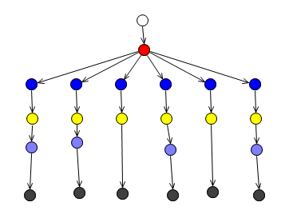
Rete Algorithm
Rete Tree
Copyright © 2009 Accenture All Rights Reserved.

Slide 16
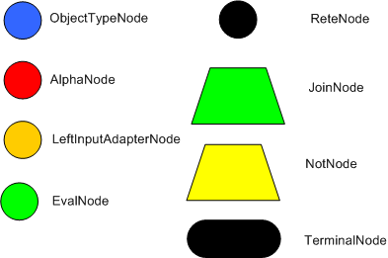
Rete Algorithm
Rete Nodes
Copyright © 2009 Accenture All Rights Reserved.

Slide 17
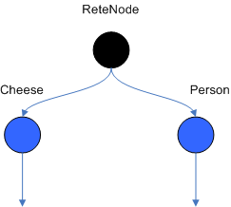
Rete Algorithm
Object Type Nodes
Copyright © 2009 Accenture All Rights Reserved.

Slide 18
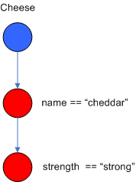
Rete Algorithm
Alpha Nodes
Copyright © 2009 Accenture All Rights Reserved.

Slide 19
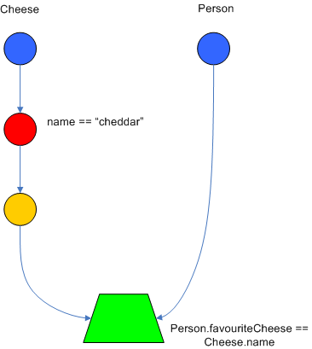
Rete Algorithm
Join Nodes
Copyright © 2009 Accenture All Rights Reserved.

Slide 20
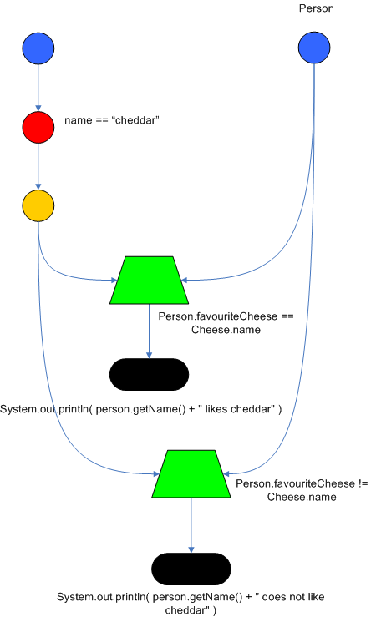
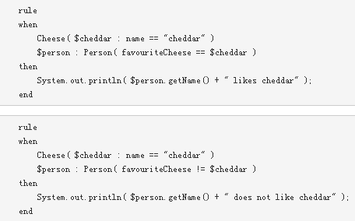
Rete Algorithm
Join Nodes
Copyright © 2009 Accenture All Rights Reserved.

Slide 21
When Is It Used
The problem is beyond any obvious algorithm based solution
Traditional solution is too fragile
The problem is too complex and it is hard to understand fully
Logic changes often
Copyright © 2009 Accenture All Rights Reserved.

Slide 22
Implementation In RCS
Problems
  There are a lot of dependences between the calculation. For examples, anesthetist fee depends on surgery fee. It is difficult to design an algorithm to solve all these dependences.
  There are a lot of limitation for the middle values of the calculation. Such as, the max payment for each confinement is 1,000.
  When new products are added, the algorithm may be changed significantly.
  There are many products. It is very difficult to understand all products features at the beginning.
  Different local business unit has different products. Their features are different.
Copyright © 2009 Accenture All Rights Reserved.

Slide 23
Implementation In RCS
Solution
Benefit item is
the unit for payment
Variable can be a
parameter of rule of
other benefit.
Benefit, rule, var and
Accumulator are pojos in
working memory.
Each benefit has N
Rules.
Benefit 1
Benefit 2
Rule 3
Rule 4
Rule 1
Rule 2
Each rule initialize
one variable.
Var 3
Var 4
Var 1
Var 2
Accumulator 2
Accumulator 3
Accumulator 1
Accumulator make
sure do not exceed
max limit.
Only 1 variable is
the payment
Variable can be a
parameter of other
rule
Copyright © 2009 Accenture All Rights Reserved.

Slide 24
Best Practice
Do not update DB in rule
If you do not need inference, do not use update()/insert()
Do not put heavy calculation in “when” part.
Apply indexing
  No indexing
  rule "find brothers"
  when
  p1: Person()
  p2: Person( mother == $p1.mother )
  then // do something end
  Apply indexing
  rule "find brothers"
  when
  p1: Person($monther)
  p2: Person( mother == $mother )
  then // do something end
Copyright © 2009 Accenture All Rights Reserved.

Slide 25
Best Practice
Do not often call update to the same object.
  If all rules are written in below pattern, the engine will be very busy.
  rule “update context"
  when
  $ctx: Context()
  …
  then
  // do something end
  update($ctx)
Register an AgendaEventListener to control the execution time.
Copyright © 2009 Accenture All Rights Reserved.

Slide 26
Q & A
Copyright © 2009 Accenture All Rights Reserved.

