Slide 1
A Reverse Dictionary using Explicit Semantic Analysis
Omar Khazamov, Remy Oukaour, Ganesa Thandavam
CSE 507, Stony Brook University

Slide 2
Goals
“Reverse dictionary” function—find the common concept behind an overly specific word or phrase
An improved measure of semantic relatedness between two words or phrases

Slide 3
Existing Tools
Visuwords <visuwords.com>
JavaScript Visual WordNet <kylescholz.com/projects/wordnet/>
Thinkmap Visual Thesaurus <visualthesaurus.com>

Slide 4
Motivation
These tools look fancy, but are limited by the WordNet network
They do not attempt to guess the meaning of input, only look up exact words in WordNet
Wikipedia has fewer actual words than WordNet, but more semantic context (articles vs. dictionary glosses)

Slide 5
Explicit Semantic Analysis
(Gabrilovich and Markovitch, 2007)
Treats each Wikipedia article as a concept, with individual words having more or less relevance for every concept
Two words’ relatedness can be measured by the similarity of their concept vectors

Slide 6
Algorithm
Download enwiki-latest-pages-articles.xml (40.4 GB, 13,675,673 pages), an XML dump of Wikipedia's database from April 4, 2013
Parse the Wikipedia dump, rejecting articles that are redirects, proposed for deletion, or are too short; and stem the words in the remaining articles. The output is stemmed-articles.txt (7.52 GB, 1,857,524 articles).
Calculate the TF-IDF score for each word in each article.

Slide 7
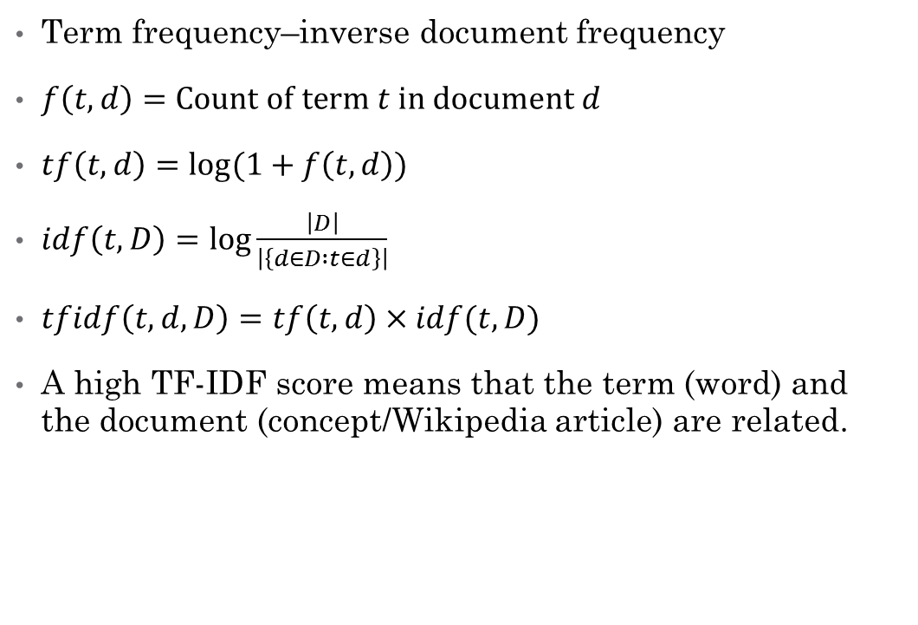
TF-IDF Scores
Term frequency–inverse document frequency
$f\left(t,d\right)=Count of term t in document d$
$tf\left(t,d\right)=\log{(1+f\left(t,d\right))}$
$idf\left(t,D\right)=\log{\frac{\left|D\right|}{\left|\left\{d∈D :t∈d\right\}\right|}}$
$tfidf\left(t,d,D\right)=tf\left(t,d\right)×idf(t,D)$
A high TF-IDF score means that the term (word) and the document (concept/Wikipedia article) are related.

Slide 8
Algorithm (cont’d.)
Create an inverted index, mapping words to concept vectors, as an SQLite database. Words not found in an English dictionary, and word-concept pairs with TF-IDF scores below a certain threshold, are rejected.
To compare two phrases, query the database for their concept vectors (the sum of the vectors for each word in the phrase), and calculate the cosine similarity.

Slide 9
Reverse Dictionary Applications
Enter related words to find a word that slipped your mind
What is “the phenomenon by which plants prepare food using sunlight and carbon dioxide” called?
What is “the algorithm for fast matrix multiplication” called?
Surprisingly few other tools:
OneLook <onelook.com/reverse-dictionary.shtml>
Dictionary.com <reference.com/reverse>
Reverse Dictionary <worddictionary.com.au/reverse-dictionary.php>

Slide 10
Semantic Relatedness Applications
Not the same as semantic similarity (“dog” and “cat” are related, but not similar)
Enter an unfamiliar word and a familiar one to see their relatedness
Unlike WordNet, entire phrases can be evaluated at once

Slide 11
Limitations
Queries are slow—database is 10 GB, more than will fit into RAM
We tried different indices and settled on an index on (word_id, tfidf) for the inverted_index table based on our data access patterns
Wikipedia’s semantic information is not as well-suited for dictionary definitions of words (people and places have encyclopedia articles, words usually don’t)

Slide 12
Evaluation
WordSim353: human-evaluated relatedness scores for 353 pairs of words (uses the mean of 16 humans’ scores)
We measured correlation of the human scores with ours
Pearson correlation coefficient: 0 for uncorrelated data, 1 for perfectly correlated, −1 for anti-correlated

Slide 13
Results
Method | Correlation with human
Random baseline | −0.07
Our ESA | 0.49
Gabrilovich et al. ESA | 0.75
LSA (Latent Semantic Analysis) | 0.56
WordNet | 0.33–0.35
WikiRelate! | 0.19–0.48
Roget's Thesaurus | 0.55

Slide 14
Evaluation (cont’d.)
Word Sense Disambiguation: use our tool to compute semantic relatedness for WSD, compared with Lesk and PageRank
To be done—queries are slow

