Slide 1
Visual Dictionary
Using Explicit Semantic Analysis
Omar Khazamov, Remy Oukaour, Ganesa Thandavam
CSE 507

Slide 2
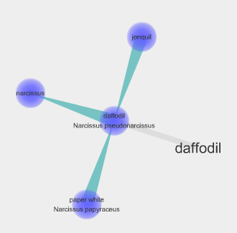
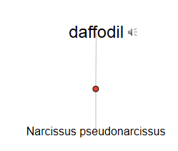
Existing Tools
Visuwords <visuwords.com>: Displays WordNet relations to synsets of a given word
Visual Thesaurus <visualthesaurus.com>: Only displays WordNet synsets of a given word
Visuwords’ output for “daffodil”
Visual Thesaurus’ output for “daffodil”

Slide 3
Lacking Features
All synsets are given equal weight – “dog” matches “domestic dog,” “frump,” “cad,” etc.
No easy way to compare words’ similarity – have to look them up separately and traverse their tree of synset relations
Similarity based on synset relations is not the same as relatedness

Slide 4
Explicit Semantic Analysis
Computing Semantic Relatedness using Wikipedia-based Explicit Semantic Analysis (Evgeniy Gabrilovich and Shaul Markovitch, 2007)
Compares semantic relatedness of words based on their presence in concepts derived from Wikipedia articles

Slide 5
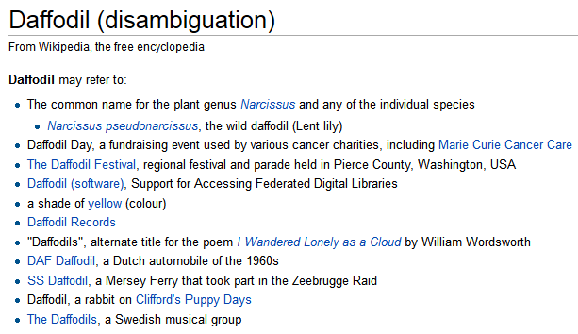
Motivation
Wikipedia’s category structure is likely to be more relevant to users’ queries than WordNet’s hierarchy
Wikipedia’s disambiguation page for “daffodil”

Slide 6
Goal
Users will be able to enter a word into our Visual Dictionary and see the concepts that best relate to it
Entering two words will show their relatedness, measured by their relevance in shared concepts

Slide 7
Procedure
Extract article text from a Wikipedia database dump – remove graphics, Wiki and HTML markup, etc
Treat each article as a concept
Calculate, for each word in each concept, its tf-idf score in that concept
Term frequency—inverse document frequency: ratio of a term’s frequency in a document (article) to the term’s rarity in all documents
Build an inverted index mapping words to vectors of tf-idf scores for concepts

Slide 8
Interaction
When the user enters a word, look it up in the inverted index
List the concepts with highest tf-idf scores for the word
When two words are entered, compare their concept vectors using a similarity measure (e.g. cosine similarity) and display the result as their relatedness

