Slide 1
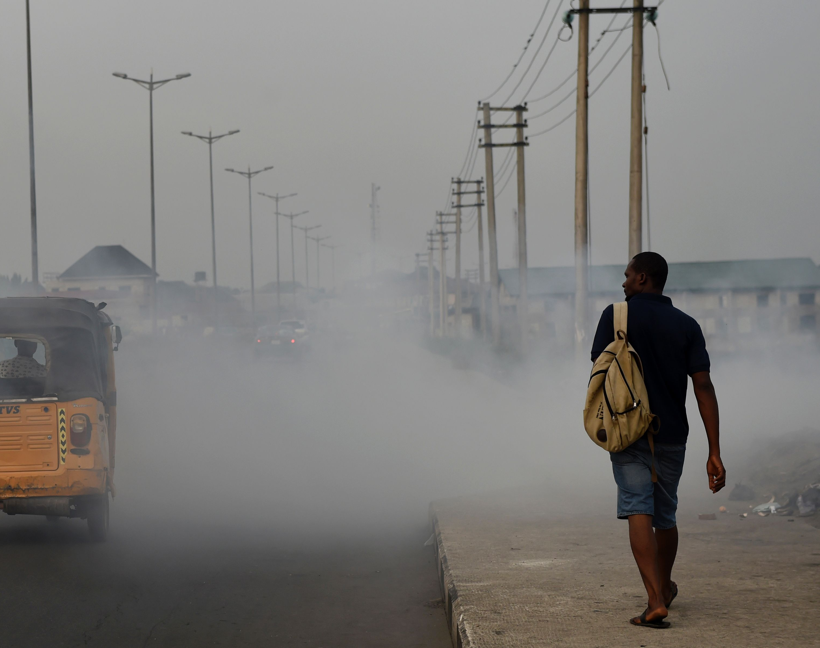
The Global Impact of Air Pollution on Human Health (2010–2019)

Slide 2
“Air pollution kills 7 million people every year — WHO.”
Air pollution stands as one of the gravest global health threats of our time. Fine particulate matter (PM2.5) penetrates deep into the lungs and enters the bloodstream, leading to millions of preventable deaths each year. The World Health Organization (WHO) attributes approximately 7 million annual deaths to this silent killer.
This presentation delves into how air-pollution-related deaths varied by region, country, and gender between 2010 and 2019, highlighting the urgent need for action.

Slide 3
Data and Source
Source: WHO Global Health Observatory (Air Pollution Mortality & PM2.5 dataset).
Collected by: World Health Organization (WHO) for public research.
Timeframe: 2000–2020, analyzed 2010–2019 for consistency.
Method: Country-level mortality estimates from PM2.5 exposure.
Dataset size: ~12,000 rows × 9 columns (categorical + continuous).
License: Open-access under WHO data use policy.
Variables include - Region, Country, Gender, Year, PM2.5 level, and Deaths.

Slide 4

Research Framework
Main Question:
How has air pollution affected global mortality patterns (2010–2019)?
Sub-Questions:
How have deaths changed globally and regionally over time?
Which countries are most and least affected, and how does air quality differ?
How do gender patterns vary across regions?
Goal:
Understand global, regional, and demographic inequalities in air-pollution-related deaths.

Slide 5
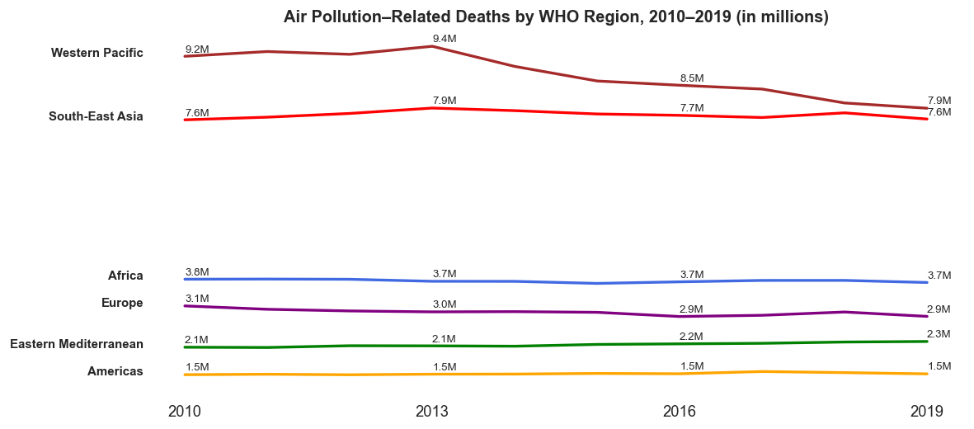
Global Trends Over Time

Slide 6
Western Pacific and South-East Asia had the highest deaths throughout the decade.
Both regions show a slight decline after 2013, hinting at policy or health improvements.
Africa and Europe remained stable but still high.
Americas had the lowest death rates globally.
Overall, progress is uneven, with densely populated regions still most at risk.

Slide 7
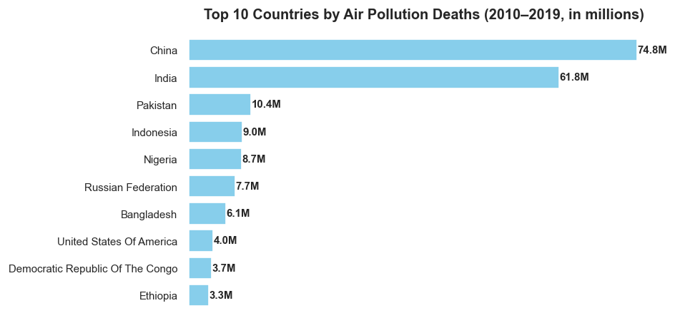
Country-Level Analysis

Slide 8
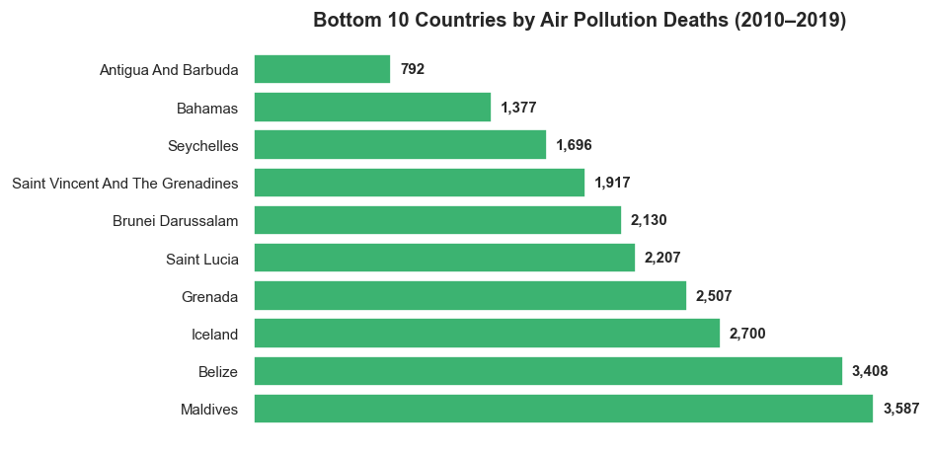

Slide 9
Dominance of Asian Giants
China (74.8 million) and India (61.8 million) alone account for over half of all global deaths due to air pollution, underscoring the immense challenge faced by these populous nations.
Industrialization & Population Density
The most affected countries are predominantly Asian nations, characterized by high population densities and extensive industrial activity.
Minimal Impact Nations
Conversely, small island states and northern European nations such as the Maldives, Iceland, and Grenada recorded negligible deaths, reflecting cleaner environments and often lower population densities.

Slide 10
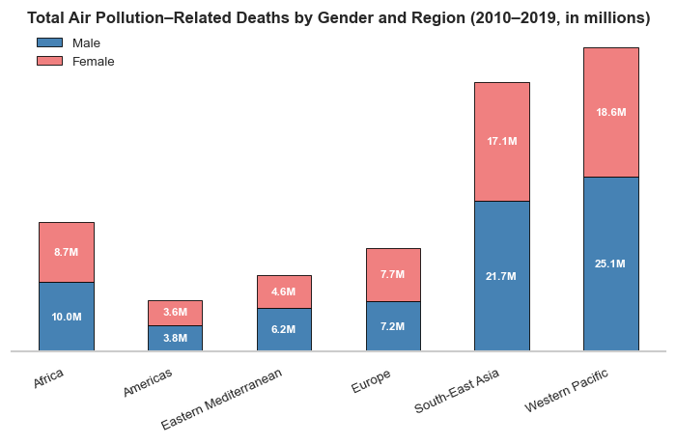

Slide 11
Gender Mortality Gap
A consistent, albeit slight, trend indicates men experience higher mortality rates than women across most regions, suggesting differential exposure or physiological responses.

Slide 12
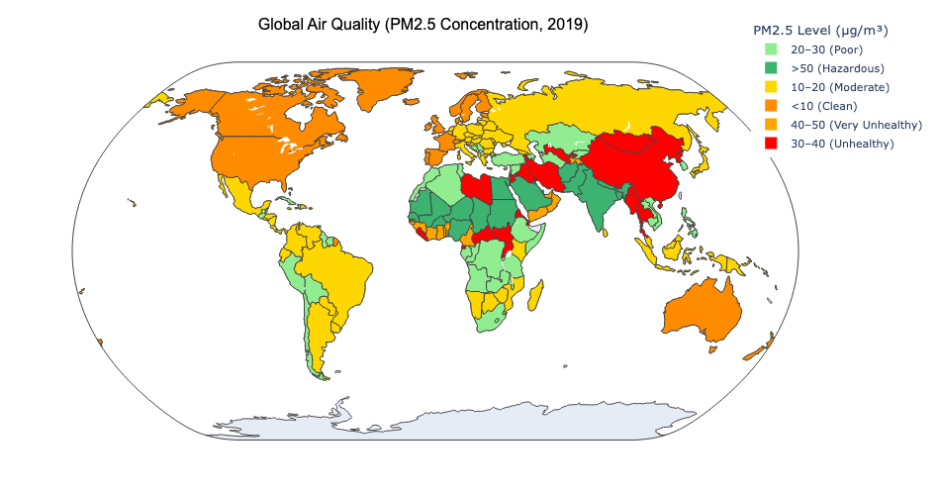
Regional Air Quality

Slide 13
Key Points:
PM2.5 levels vary sharply across regions — Asia and the Middle East face the highest pollution.
Countries like India, China, and parts of Africa record “Unhealthy” to “Hazardous” levels.
North America, Europe, and Oceania show much cleaner air (<20 µg/m³).
The map highlights a clear geographical divide between developed and developing regions.
Interpretation:
Higher PM2.5 concentration means greater health risk — linking directly to increased air-pollution-related deaths seen in other charts.

Slide 14
Conclusion
Air pollution remains a major global health threat, responsible for millions of deaths yearly.
Western Pacific and South-East Asia bear the heaviest burden, while the Americas remain least affected.
High PM2.5 levels strongly correlate with elevated mortality rates.
Gender differences are minor, but regional gaps are vast.
Despite small declines, global progress is uneven and insufficient.

