Slide 1
FEW-SHOT CLASS-INCREMENTAL LEARNING
STAG-STI
Spatio-Temporal Graph Integration with Contrastive Pre-Conditioning
for Forward-Compatible Few-Shot Class-Incremental Learning
Evaluated on CIFAR-100 · miniImageNet · CUB-200 + Cross-Domain Transfer
Official CEC / FACT splits · full ablation & improvement study
Review 2 · Project Presentation

Slide 2
MOTIVATION
02
The Problem: Learning Continuously from Few Examples
● Real-world models must keep learning new categories after deployment — a medical system meets a new disease, a retail model a new product.
● New classes arrive with only a handful of labelled examples (5-shot), not the thousands used in base training.
● Catastrophic forgetting: naively fine-tuning on new classes destroys knowledge of old ones.
● Overfitting: 5 examples are far too few to train a deep network from scratch.
● FSCIL must balance stability (retain old) and plasticity (absorb new) at once.
The FSCIL dilemma
Stability ⇄ Plasticity
▸ Too much plasticity → forgets base classes
▸ Too much stability → can't learn novel classes
▸ Few shots → prototypes are noisy & biased
▸ No replay → cannot revisit old data
STAG-STI · Few-Shot Class-Incremental Learning · Review 2

Slide 3
OBJECTIVE
03
Research Objective & Project Scope
Goal: Design and validate a forward-compatible FSCIL system that maximises novel-class learning without forgetting — and quantify every design choice.
Architecture
Evaluation
Analysis
Implement the full STAG-STI 8-stage pipeline: contrastive pre-conditioning + topology-aware graph attention + age-decaying memory.
Benchmark on 3 standard datasets on official splits, plus a cross-domain transfer test. Report the full FSCIL metric set.
Ablate every component, run an evidence-driven improvement study, and identify the true accuracy bottleneck.
Key design decisions: official CEC/FACT splits · exact official few-shot support samples · deterministic fantasy views · CUB novel sessions 10-way · frozen backbone at incremental time · no exemplar replay.
STAG-STI · Few-Shot Class-Incremental Learning · Review 2

Slide 4
BACKGROUND
04
FSCIL Protocol: How Evaluation Works
● Session 0 (base): many classes, abundant data — trains the backbone.
● Sessions 1…T (incremental): each adds N new classes with K shots (N-way K-shot).
● Disjoint label spaces: a class appears in exactly one session.
● Global evaluation: after each session, test over *all* classes seen so far.
● Frozen backbone: after base training, weights never change — only prototypes are added.
● Nearest-prototype classification: cosine similarity to stored class prototypes.
Session timeline
S0
base
S1
S2
…
S_T
classes seen grows each session →
▸ Accuracy naturally declines as more classes compete.
▸ Success = a slow, graceful decline, not a cliff.
STAG-STI · Few-Shot Class-Incremental Learning · Review 2

Slide 5
ARCHITECTURE
05
STAG-STI Pipeline — End to End
Eight stages turn a few raw images into a robust, forward-compatible class prototype:
1 Fantasy Views ×M
2 Frozen Backbone fθ
3 Projection Wₚ
4 SupCon Head
→
→
→
Deterministic multi-view augmentation
ResNet-18 → 512-d features
512-d → 256-d bottleneck
Contrastive pre-conditioning
5 Topology Scorer gφ
6 GATv2 Attention
7 Prototype Pooling
8 STI Memory Hₜ
→
→
→
Learns the view/class graph
Message passing over the graph
Aggregate → one prototype
Age-decaying stability prior
Final stage: a cosine classifier scores queries against all prototypes. Queries skip the graph — only prototypes are graph-refined, keeping inference cheap.
STAG-STI · Few-Shot Class-Incremental Learning · Review 2

Slide 6
COMPONENT 1 OF 3
06
Contrastive Pre-Conditioning (SupCon)
● A supervised contrastive (SupCon) head shapes the feature space during base training.
● Pulls same-class features together, pushes different classes apart on a hypersphere.
● Why it matters for FSCIL: a well-spread, well-clustered space means a 5-shot prototype lands in a meaningful region.
● Operates on the raw 512-d backbone features (in_dim = backbone_out_dim).
● Temperature 0.15, weight λ_supcon = 0.3 — tuned to avoid over-tight clustering that harms novel classes.
Intuition
Better-organised base features
↓
Novel prototypes generalise better
↓
Higher novel-class accuracy
STAG-STI · Few-Shot Class-Incremental Learning · Review 2

Slide 7
COMPONENT 2 OF 3
07
Topology-Aware Graph Attention (GATv2)
● A topology scorer gφ predicts how strongly nodes (views/classes) should be connected.
● GATv2 performs attention-weighted message passing over that learned graph.
● Multiple fantasy views of the same class exchange information → a denoised, consensus prototype.
● Supervised by a graph BCE loss (λ_graph = 0.25) so the learned adjacency is meaningful, not arbitrary.
● Dropout inside the GAT fights Phase-B overfitting on the small episodic batches.
What the graph gives
▸ Noise averaging across views of one class
▸ Structure awareness — related classes inform each other
▸ Query-independent — only prototypes pass through the graph
▸ Isolated in the ablation study (see Slide 15)
STAG-STI · Few-Shot Class-Incremental Learning · Review 2

Slide 8
COMPONENT 3 OF 3
08
Spatio-Temporal Memory (Age-Decaying Prior)
● The STI memory Hₜ stores every class prototype and controls how much each can still change.
● An age-based stability prior: older classes harden (β → 1), new classes stay plastic (β ≈ 0).
● Controlled by a gate Γ and reset gate R_gate; hardening speed κ = 2.0, offset κ₀ = 3.0.
● Directly targets the stability–plasticity trade-off: protect the old, adapt the new.
● Enables incremental additions with no replay and no backbone updates.
Age → stability
New class β ≈ 0 (plastic)
↓ time / sessions
Aged class β → 1 (frozen)
Result: recent classes adapt,
established classes are protected.
STAG-STI · Few-Shot Class-Incremental Learning · Review 2

Slide 9
EXPERIMENTAL SETUP
09
Datasets & Evaluation Protocol
Dataset
Resolution
Base / Novel
Sessions
Backbone
CIFAR-100
32×32
60 / 40
8 × (5-way 5-shot)
ResNet-18 (CIFAR stem)
miniImageNet
84×84
60 / 40
8 × (5-way 5-shot)
ResNet-18
CUB-200-2011
224×224
100 / 100
10 × (10-way 5-shot)
ResNet-18 (ImageNet-pretrained)
Cross-domain
84×84
mini → CUB
10 × (10-way 5-shot)
miniImageNet backbone (frozen)
● Official CEC / FACT splits used throughout — vendored under fscil/splits/ for exact reproducibility.
● Incremental support uses the exact official few-shot samples, not random draws.
● Cross-domain is this project's own protocol: base representation from miniImageNet, novel classes from CUB.
STAG-STI · Few-Shot Class-Incremental Learning · Review 2

Slide 10
EXPERIMENTAL SETUP
10
Evaluation Metrics
Aᵢ
A₀ / A_T
PD ↓
Accuracy after session i over all classes seen
Base (first) and final-session accuracy
Performance Drop = A₀ − A_T (forgetting)
A_B / A_N
HM
Avg
Base-only / novel-only accuracy at the end
Harmonic mean of A_B and A_N (balance)
Mean accuracy across all sessions
Why HM matters most: a model can inflate overall accuracy by acquiescing to base classes. HM only rises when BOTH base and novel accuracy are healthy — it is the honest FSCIL score.
STAG-STI · Few-Shot Class-Incremental Learning · Review 2

Slide 11
EXPERIMENTAL SETUP
11
Implementation & Training Recipe
● Framework: PyTorch, Apple-Silicon (MPS) backend.
● Phase A — backbone: cross-entropy pretraining, 30 epochs, cosine LR, label smoothing 0.1, Mixup/CutMix, random erasing, early stopping.
● Phase B — STAG-STI: 50 episodic epochs, 100 episodes/epoch, 15-way 5-shot 5-query episodes, composite loss (cls + SupCon + graph + stability).
● Phase C — incremental eval: freeze everything; add prototypes session by session.
● Reproducibility: fixed seed 42, deterministic fantasy views, namespaced checkpoints.
Composite Phase-B loss
▸ L_cls — query classification (λ = 1.0)
▸ L_supcon — contrastive (λ = 0.3)
▸ L_graph — topology BCE (λ = 0.25)
▸ L_stab — memory + gate reg. (λ = 0.1)
Weights tuned on a held-out val split to balance clustering vs novel-class flexibility.
STAG-STI · Few-Shot Class-Incremental Learning · Review 2

Slide 12
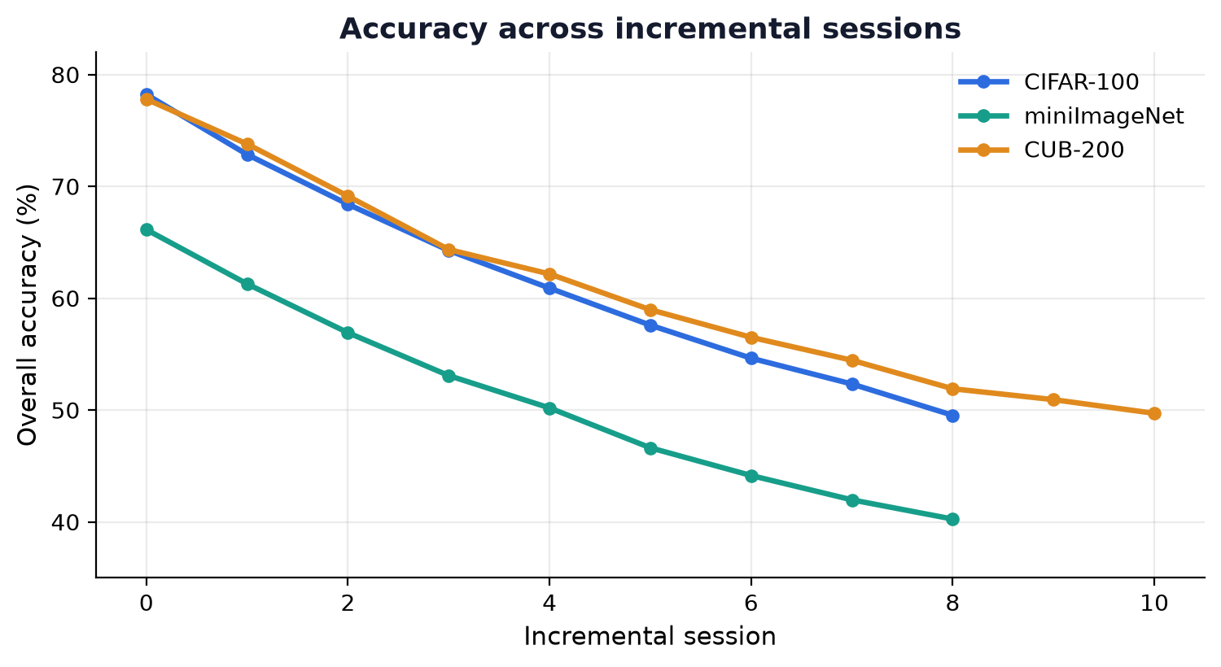
RESULTS
12
In-Domain Performance (Official Splits)
Dataset
A₀
A_T
PD↓
Avg
A_B
A_N
HM
Reading the results
CIFAR-100
78.2
49.5
28.7
62.1
68.7
20.8
31.9
miniImageNet
66.1
40.2
25.9
51.2
56.1
16.4
25.4
▸ Base accuracy is strong (66–78%).
▸ Decline is graceful, not a cliff — the memory prior is working.
▸ CUB holds up best (HM 42.6) thanks to its ImageNet-pretrained backbone.
▸ miniImageNet is hardest (HM 25.4) — weakest backbone, hardest novel transfer.
▸ Numbers are single-run, first-pass on official splits — internally consistent, not seed-averaged.
CUB-200
77.8
49.7
28.1
60.9
69.0
30.9
42.6
STAG-STI · Few-Shot Class-Incremental Learning · Review 2

Slide 13
RESULTS
13
Improvement: Transductive Prototype Rectification
A BD-CSPN-style transductive step refines novel prototypes using unlabelled test features — the only lever that improved every metric.
Dataset
Final (ind.)
Final (transd.)
A_N (ind.)
A_N (transd.)
HM (ind.)
HM (transd.)
CIFAR-100
49.53
50.17
20.75
21.45
31.87
32.76
miniImageNet
40.25
40.89
16.45
16.53
25.44
25.64
CUB-200
49.71
50.91
30.85
33.52
42.64
45.06
● Every metric improves on all three datasets — no base↔novel trade.
● Biggest gain on CUB: A_N +2.7, HM +2.4 (transductive refinement helps most when novel prototypes are noisiest).
● Combined with full-data base prototypes on weak backbones, best-config gains reach +1.2 to +1.6 overall (next slide).
STAG-STI · Few-Shot Class-Incremental Learning · Review 2

Slide 14
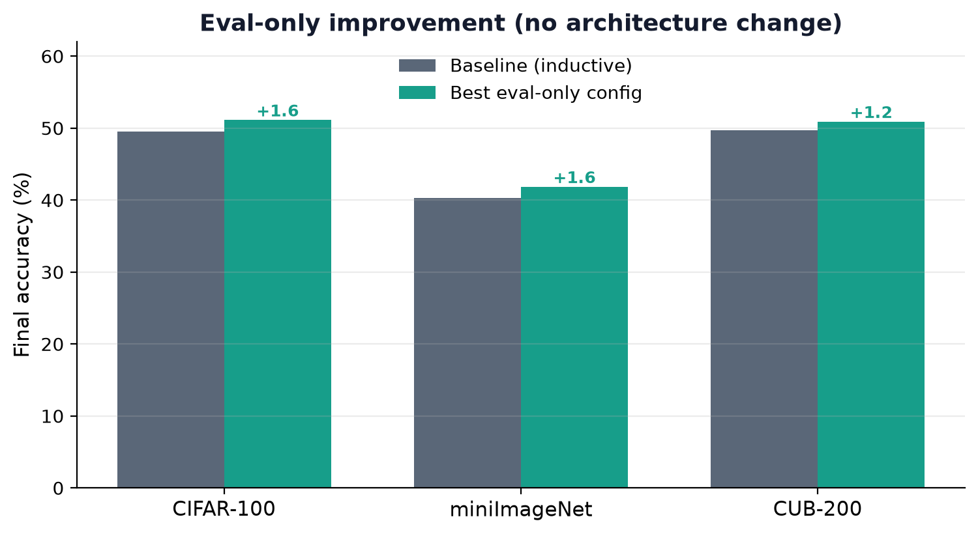
RESULTS
14
Cross-Domain Transfer & Best-Config Gains
Cross-domain: miniImageNet → CUB
66.7%
44.3%
Base (miniImageNet)
Final (all seen)
22.4
14.8
PD (forgetting)
HM
Domain shift is hard: A_N drops to 8.4 — features tuned on natural images transfer only partially to fine-grained birds.
Best eval-only stack: full-data base prototypes (where the backbone is weak) + transductive rectification — no architecture change, no retraining.
STAG-STI · Few-Shot Class-Incremental Learning · Review 2

Slide 15
ANALYSIS
15
Ablation Study (CIFAR-100)
Each component removed in isolation, sharing the same frozen backbone. HM is the deciding metric.
Configuration
A₀
A_T
A_B
A_N
HM
Full model
78.22
49.53
68.72
20.75
31.87
− contrastive (SupCon)
78.53
49.28
69.97
18.25
28.95
− topology (GAT graph)
77.75
49.69
70.98
17.75
28.40
− age-decay (STI)
78.50
49.46
70.15
18.43
29.18
● Removing any component lowers HM — every piece earns its place.
● Ablations raise A_B but crash A_N: without the full model, the system defaults to over-favouring base classes.
● The components' shared job is to protect novel-class accuracy — exactly the FSCIL bottleneck.
STAG-STI · Few-Shot Class-Incremental Learning · Review 2

Slide 16
ANALYSIS
16
CLOSER-Style Base Objective (Transfer Study)
Testing an alternative base objective (Oh et al., ECCV'24) that spreads features and reduces inter-class distance for reusable low/mid features.
Dataset
A_T
A_B
A_N
HM
ΔA_N
ΔHM
CIFAR-100
46.42
61.12
24.38
34.85
+3.6
+3.0
miniImageNet
37.38
53.23
13.60
21.67
−2.8
−3.8
CUB-200
47.98
64.49
31.84
42.63
+1.0
−0.0
● Dataset-dependent, not universal: helped CIFAR-100 (+3.0 HM), hurt miniImageNet (−3.8 HM), neutral on CUB.
● An honest negative-ish result: no single base objective wins everywhere — the right recipe depends on backbone strength.
● Reported transparently rather than cherry-picked — a core part of the analysis.
STAG-STI · Few-Shot Class-Incremental Learning · Review 2

Slide 17
ANALYSIS
17
Improvement Study — What Actually Works
Every no-architecture-change lever, measured honestly:
✓ Helped
✗ Did not help
▸ Transductive rectification — every metric up, all datasets
▸ Full-data base prototypes — helps weak-backbone datasets (mini)
▸ Best stack: +1.2 to +1.6 overall accuracy, free
▸ Novel-logit bias — only trades base ↔ novel
▸ Test-time / support augmentation — no reliable gain
▸ Feature centering — negligible effect
▸ Longer backbone (100 ep) — blocked by compute (see Slide 19)
STAG-STI · Few-Shot Class-Incremental Learning · Review 2

Slide 18
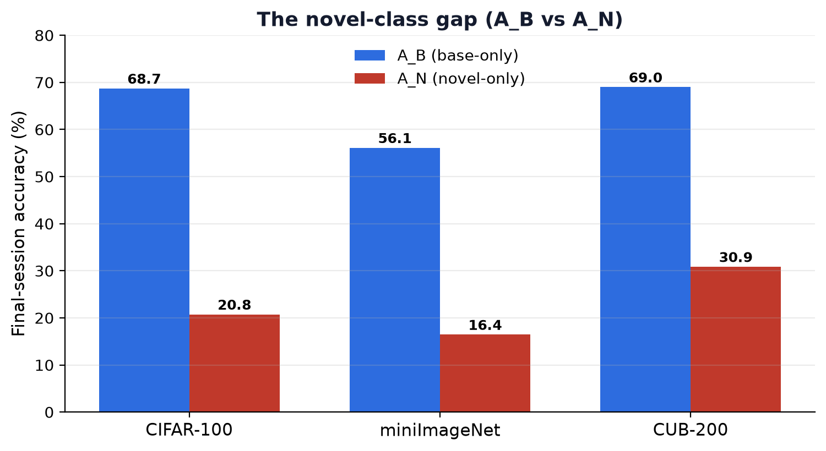
ANALYSIS
18
Key Finding — Novel-Class Accuracy Is the Bottleneck
The central insight
▸ Across all datasets A_N (16–31%) ≪ A_B (56–69%).
▸ The model remembers base classes well; it struggles to learn novel ones.
▸ Overall accuracy and PD hide this — HM exposes it.
▸ Every effective lever we found targets A_N specifically.
▸ The ceiling is backbone quality: a stronger frozen representation lifts A_N and A_B together.
STAG-STI · Few-Shot Class-Incremental Learning · Review 2

Slide 19
REFLECTION
19
Engineering Challenges, Bugs Fixed & Limitations
Bugs caught by verifying results
Config-leak fixes
▸ CUB base collapse 1% → 78% — 100-class joint graph was out-of-distribution for the 15-way GAT; fixed by chunking base prototypes by episode-way.
▸ Cross-domain crash — per-sample vs per-class mask shape mismatch; fixed.
▸ Per-dataset hyperparameters leaking across runs (e.g. CUB LR into CIFAR) — fixed with capture-once defaults.
▸ Ablation weights not restoring — fixed with idempotent restore.
Honest limitations
● Numbers are single-run, first-pass on Apple-Silicon — internally consistent and reproducible, but not seed-averaged or tuned to compete with published SOTA.
● Backbone training is compute-capped on this machine (long background jobs are reaped ~40 min), so the biggest lever — a fully-trained backbone — could not be completed here. It needs a GPU.
● The cross-domain protocol is this project's own definition, not a citable standard.
STAG-STI · Few-Shot Class-Incremental Learning · Review 2

Slide 20
Conclusion & Future Work
WHAT WAS DELIVERED
▸ Full STAG-STI pipeline implemented and validated on 3 datasets + cross-domain, official splits.
▸ Complete ablation (every component earns its place) and an honest improvement study.
▸ +1.2 to +1.6 overall accuracy from eval-only levers, no architecture change or retraining.
▸ Central finding: novel-class accuracy (A_N) is the bottleneck; the ceiling is backbone quality.
FUTURE WORK
▸ Train the frozen backbone to completion on a GPU (100–200 epochs) to lift A_N and A_B together.
▸ Seed-averaged runs and comparison against published FSCIL baselines.
▸ Extend transductive rectification and explore stronger self-supervised base objectives.

