Slide 1

CamAutoGUI
HEMASUNDAR U 920221104016
KANISKA MP 920221104020
THEJESH BHAGAVANTH G 920221104052
SIBI S 920221104046
Department of Computer Science and Engineering
AMD Pervasive AI Developer Contest
FEBRUARY 20, 2024
Notes:
1

Slide 2
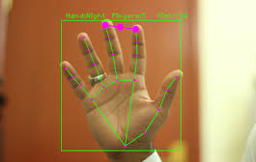

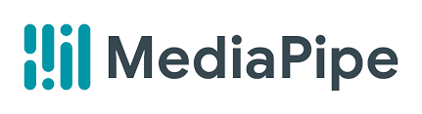
INTRODUCTION
Abstract:
CamAutoGUI is a Python GUI project enabling hands-free mouse control via computer vision. Users define screen regions, and the application tracks objects or gestures within these areas, simulating mouse movements and clicks. Designed for convenience and accessibility, it offers efficient control for presentations, gaming, and accessibility aids.
CamAutoGUI
Page 2
Notes:
2

Slide 3
OBJECTIVE, SCOPE OF THE WORK
OBJECTIVE & SCOPE:
The objective of the CamAutoGUI project is to develop a Python-based graphical user interface (GUI) application that utilizes computer vision techniques to enable hands-free mouse control.
Designing and implementing a user-friendly GUI for defining screen regions and controlling mouse actions.
Integrating computer vision algorithms to track objects or gestures within defined regions.
Simulating mouse movements and clicks based on the tracked objects or gestures.
Testing the application's functionality and usability across different computing environments.
Enhancing accessibility and productivity by providing an alternative mouse control solution for various tasks such as presentations, gaming, and accessibility aids.
CamAutoGUI
Page 3
Notes:
3

Slide 4
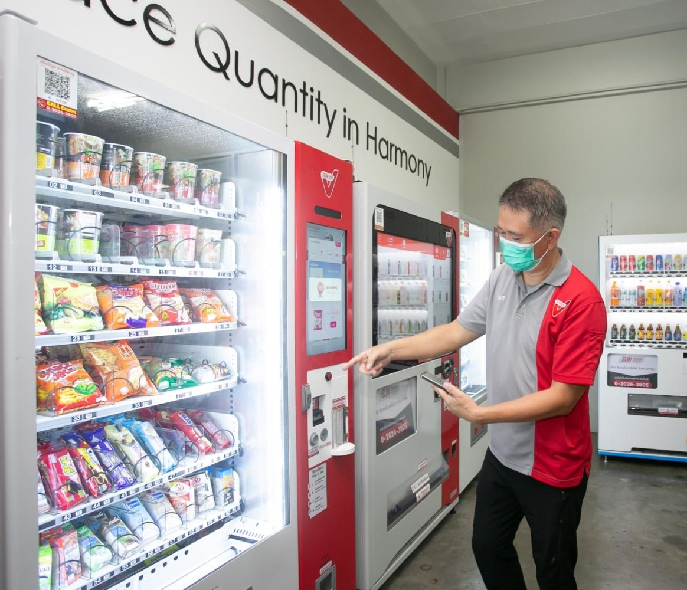
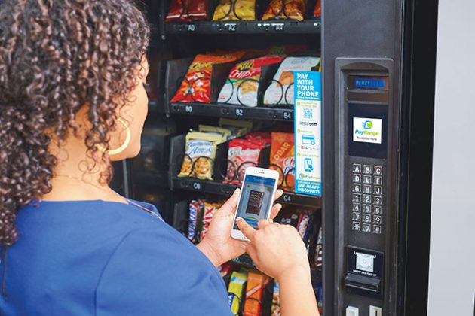
EXISTING WORK
BANUBA Touchless Vending Machine
CamAutoGUI
Page 3
Notes:
4

Slide 5
PROPOSED WORK AND ITS ADVANTAGES
Proposed Work:
The core idea involves creating a hands-free mouse control system by leveraging computer vision, hand detection, and gesture recognition. The system will use OpenCV and Media Pipe for precise hand tracking, define gestures corresponding to mouse actions, and simulate mouse movements accordingly. A user-friendly GUI using PyAutoGUI will be developed for easy configuration. This streamlined approach aims to enable intuitive computer interaction through natural hand gestures. This has wide variety of applications.
Advantages:
Flexibility: Adaptable to diverse hand gestures with customizable recognition. Real-Time Interaction: Responsive mouse control for immediate interaction.
Python Ecosystem: Utilizes popular Python libraries, enhancing accessibility.
No Additional Hardware: Relies on standard webcams, eliminating the need for extra hardware.
Cross-Platform Compatibility: Runs on various operating systems for broad usability.
CamAutoGUI
Page 3
Notes:
5

Slide 6




BLOCK DIAGRAM
START
GET CAMERA FEED
AI Model (Media Pipe)
Uses TensorFlow Lite
Track Hand & Get Co-Ordinates
Make Mouse Movement
STOP
CamAutoGUI
Page 4
Notes:
6

Slide 7
METHODOLOGY
Camera Feed
Getting Coordinates
Mouse Movement
Tracking the gestures
Development Environment Setup:
Install OpenCV and Media pipe for computer vision.
Camera Initialization:
Initialize webcam or camera for real-time video feed.
Hand Detection and Tracking:
Use Media Pipe Hands for detecting and tracking hand movements.
Gesture Recognition:
Define hand gestures corresponding to mouse actions.
Mouse Control Simulation:
Simulate mouse movements and clicks based on recognized gestures.
User Interface Development:
Design GUI using PyAutoGUI for defining screen regions and mouse control.
CamAutoGUI
Page 5
Notes:
7

Slide 8
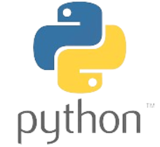

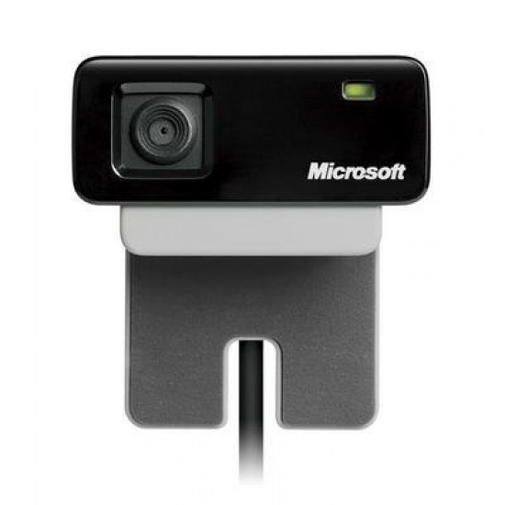
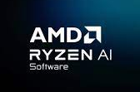
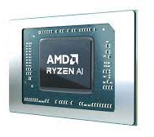
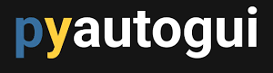
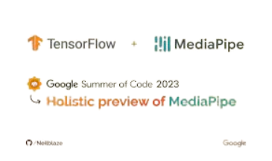
HARDWARES AND SOFTWARES USED
Web Camera (Any)
AMD Ryzen™ AI
AMD Ryzen AI Software (For TensorFlow Model)
Python
TensorFlow
Media Pipe
PyAutoGUI
OpenCV
CamAutoGUI
Page 6
Notes:
8

Slide 9
CONCLUSION
In conclusion, the proposed hands-free mouse control system represents an innovative fusion of computer vision, gesture recognition, and simulated mouse interactions. By harnessing the capabilities of OpenCV, MediaPipe, TensorFlow, and PyAutoGUI, this solution aims to provide users with a seamless and intuitive method for interacting with computers through natural hand gestures. The integration of precise hand tracking, gesture-based mouse actions, and a user-friendly interface signifies a significant step towards enhancing accessibility and user experience. This project not only showcases the potential of cutting-edge technologies but also envisions a future where hands-free computing becomes an integral part of our daily interactions with digital devices.
CamAutoGUI
Page 7
32
Notes:
9

Slide 10
THANK YOU
Notes:
10

