Slide 1
Computational Seismology
Review of Weeks 1-3

Slide 2
Computing & Performance
History of computing → orders-of-magnitude speedups
Modern desktops/laptops = supercomputers on the desk
Toolchain setup: Miniconda, VS Code, GitHub Desktop
Linux workflow: ssh, scp, compiling & running code
Performance comparison:
C / Fortran vs Python
Python loops vs NumPy vectorization

Slide 3
Seismic Instrumentation & Data
History of seismic instruments & digitizers
Real station demo:
Trillium seismometer + Centaur digitizer
Seismic + infrasound
Analog → digital conversion
Filters:
causal vs acausal
effect on P-wave onsets
filter order and ringing

Slide 4
DSP Foundations
(ADC: Sampling, Aliasing, and Quantization)
Interpolation
Detrending
Convolution
Discrete Time Fourier Transform (time -> frequency domain)
Tapering
Filtering
Deconvolution (e.g. remove instrument response)
Cross-correlation (and auto-correlation)
Downsampling & upsampling

Slide 5
Python Foundations
Python knowledge check (diagnostic, not graded)
Python crash course (core syntax)
Data types (scalar and containers)
Loops
Conditionals
Functions

Slide 6
Key takeaway
Modern seismology is a computational pipeline — from sensor → bits → signal processing → interpretation.

Slide 7
Computational Seismology
Where are we going next?

Slide 8
Shift to interactive classes
From watching & listening → doing
Work on your own laptops
Real tools, real data, reproducible workflows

Slide 9
Computational tools (used every week from now on)
Miniconda – managing scientific Python environments
VS Code – notebooks, scripts, debugging
GitHub Desktop – version control & reproducibility
NumPy, Matplotlib, Pandas – numerical analysis, plotting, data handling
ObsPy …

Slide 10
ObsPy: the seismic data pipeline backbone
Reading and visualizing waveform data
Working with event catalogs
Working with station metadata
Building intuition for how seismic data are structured

Slide 11
From instruments to physical units
Seismometer + digitizer response
StationXML metadata
Pre-processing pipeline:
detrend, taper, filter
deconvolve instrument response
change units (counts → ground motion)

Slide 12
How this fits the course
These skills form the cornerstone for everything that follows:
event detection (STA/LTA)
phase picking
hypocenter location
analysis of continuous waveform data
building processing pipelines
automation
machine learning

Slide 13
Three types of seismic data
Waveform data
SEED id (net.sta.loc.chan)
Start and end time
Sampling rate
Timeseries vector
Event metadata (catalogs)
Classification
Arrivals (phase picks)
Origin(s): time, coordinates
Quantification: amplitudes, magnitudes (station, network)
Station metadata
Name
SEED id (net.sta.loc.chan)
Coordinates
Instrumentation
Instrument responses
Operation date windows

Slide 14
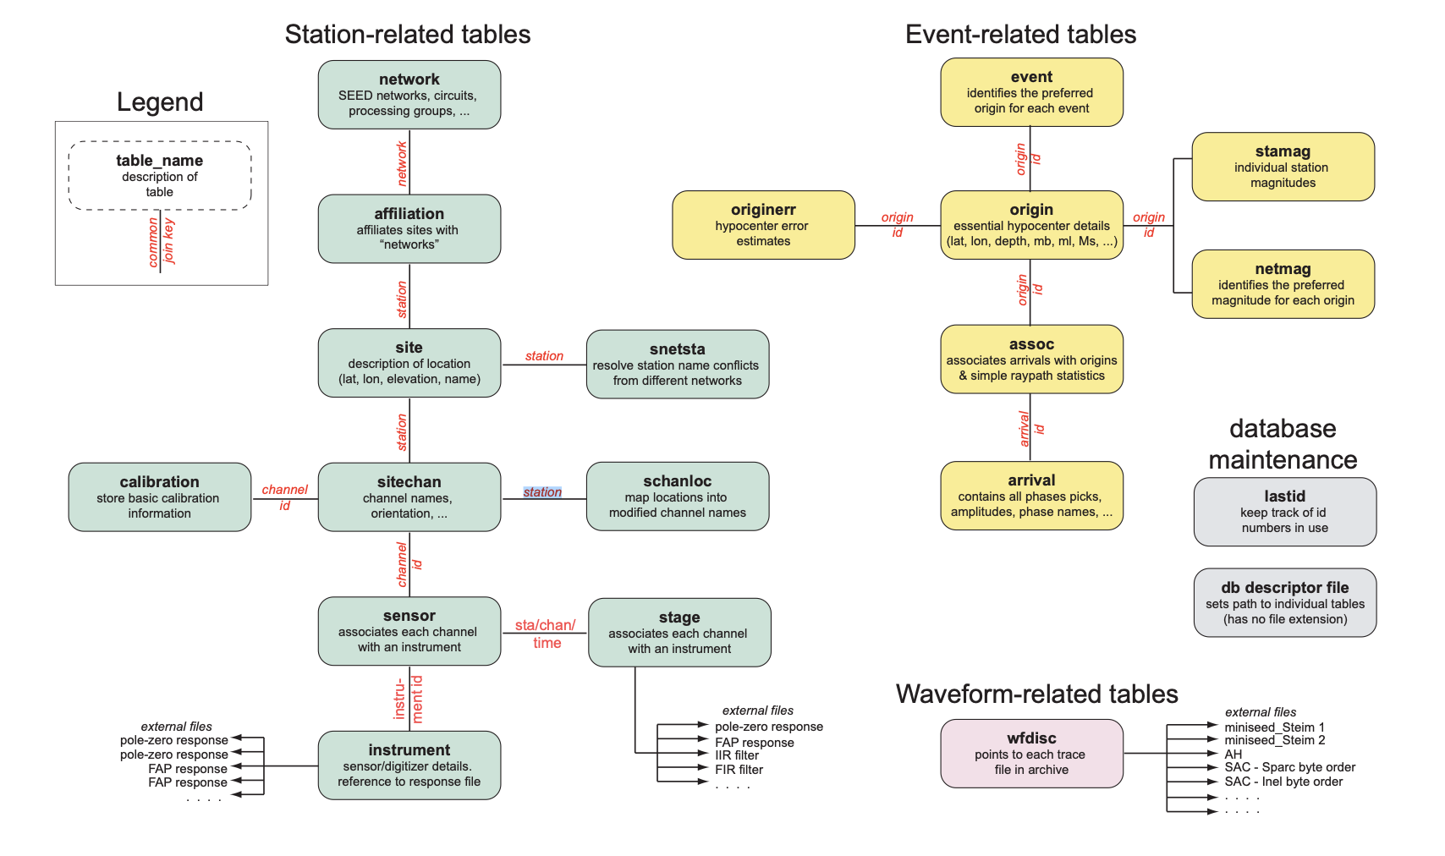
Database schema: CSS3.0 (Antelope) minimal
This is an Entity-Relationship Diagram: a data model
Each event can have:
Multiple origins
Which can have
Multiple magnitudes
Need a preferred origin and magnitude
AQMS (Earthworm) and SeisComP use similar database schema
wfdisc: one row per miniseed or sac file on disk

Slide 15
Modern data interchange formats
Waveform data: MiniSEED
Best organized as daily files per SEED id in an SDS archive
Event metadata: QuakeML
Station metadata: StationXML
Work with these formats! You will find more tools available.
SEED files combine MiniSEED and dataless SEED (an older way to store station metadata).

Slide 16
ObsPy
Waveform data:
Trace: one object per SEED id, per time window
Timeseries vector stored as a numpy array
Stream: container object for multiple Trace objects
Event metadata:
Event: one object per event
Catalog: container object for multiple Event objects
Station metadata:
Inventory: Hierachy of metadata
Network
Station
Channel (& Location)
Response
Object-oriented data model designed around MiniSEED, QuakeML, and StationXML

Slide 17
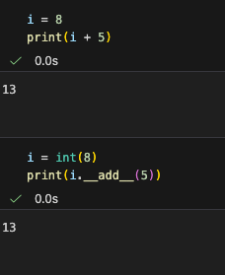
Object-oriented Programming (OOP)
Python has builtin data types
Scalars: int, float, bool, str
Containers: tuple, list, set, dict
These are classes that define:
Properties
Methods: functions that are “internal” to that data type, e.g.
int: add(), subtract(), multiply(), divide()
str: append(), lower(), …
Any instance of a class is an object
You can make your own classes, to represent new data types. Examples:
numpy array
Pandas DataFrame
ObsPy: Trace, Stream, Event, Catalog, Inventory, Response
Variables are names that point to objects

Slide 18
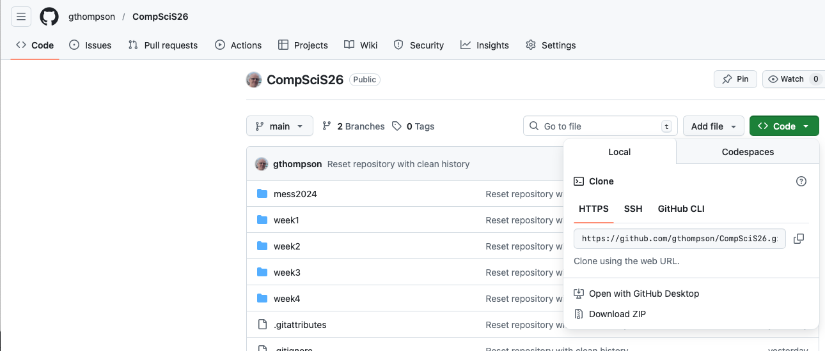
Let’s setup our computers for ObsPy
In your web browser, open the URL https://github.com/gthompson/CompSciS26
Click on the Green “Code” tab then “Open with GitHub Desktop”
Hit the blue “Clone” button within GitHub Desktop

Slide 19
Create the conda environment “compsci”
Open a bash (or zsh) terminal
Change directory to your repository:
cd ~/Documents/GitHub/CompSciS26
List the contents of the environment.yml file:
cat environment.yml
Create the conda environment:
conda env create –f environment.yml
Activate the environment:
conda activate compsci
Check:
python -c "import obspy; print(obspy.__version__)”
This should return “1.4.2”. If it doesn’t, let me know!
No matter what computer architecture or operating system and version you are on, this gives us all a common “environment” to use for this course.

Slide 20
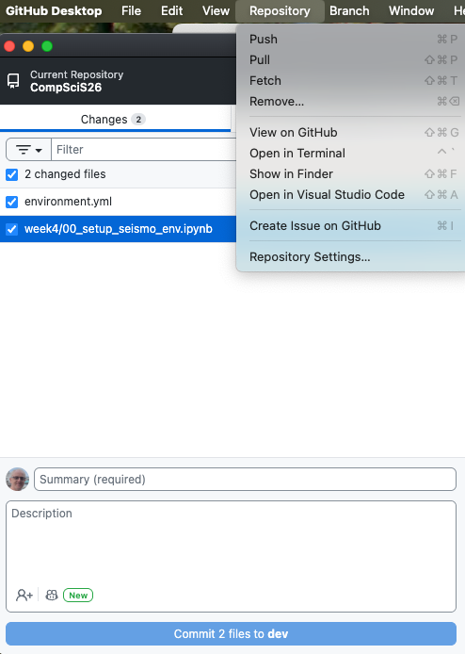
Open Visual Studio Code from GitHub Desktop
Top menu -> Repository -> Open in Visual Studio Code

Slide 21
Open the Folder “mess2024”
Open “00_Python_Crash_Course.ipynb”
Click “Run All”
Click “Python Environments”
Select “compsci (Python 3.11.14)”
You can also select the Python environment through the “View”=>”Command Pallette…” top menu items.
Later we will use the same approach to work through the 9 ObsPy notebooks.

