Slide 1
Seismic Instrumentation as a Computational System
From analog drums to nodal arrays and DAS
  Instrumentation choices drive computation
  Foundation for ADCs, sampling, and digitizers
Notes:
Introduce the idea that seismic networks are end-to-end computational systems. This lecture explains why instruments look the way they do and how they force computational choices.

Slide 2
Why Instrumentation = Computation
Sensors, telemetry, digitizers, storage, processing are inseparable
  Each instrumentation advance forces computational change
Notes:
Students often separate instruments and software conceptually. Emphasize that they co-evolve.
Slide 2 — Why Instrumentation = Computation
On slide:
Seismic networks are end-to-end computational systems
Sensors → telemetry → digitizers → storage → processing
Each instrumentation advance forces a computational change
Speaker notes:
We often talk about “instruments” and “software” separately. In reality, they evolve together. You can’t understand digitizers or ADCs without understanding why earlier instruments failed.
Seismic Instrumentation as a Computational System
From Analog Drums to DAS, Nodal Arrays, and Citizen Seismology
Course: Computational Seismology
Week: Instrumentation, Digitizers, and Data QC
Speaker notes:
This lecture is about why seismic instruments look the way they do, and how instrumentation choices force computational choices. This is not a sensor catalog — it’s a systems view.

Slide 3
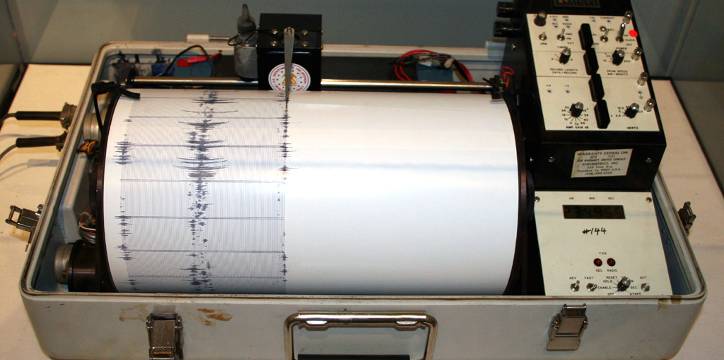
Analog Seismology (Pre-Digital Era)
Short-period electromagnetic seismometers
  Analog telemetry
  Paper drum helicorders
  Human interpretation
Notes:
Explain that these systems were continuous but only on paper. The instrument itself limited bandwidth and dynamic range. The instrument itself did the filtering and clipping. There was no digital storage, no automation, and no replay.

Slide 4
Constraints of Analog Systems
Limited dynamic range
  Mechanical saturation
  No automation or replay
  Manual phase picking
Notes:
Highlight why waveform analysis and automation were impossible with analog systems. On slide:
Limited dynamic range
Mechanical saturation
No automated detection
Manual phase picking
Speaker notes:
When students ask “why didn’t they just do X?”, the answer is usually: the instrument physically couldn’t do it.

Slide 5
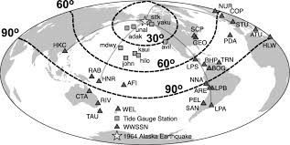
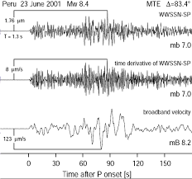
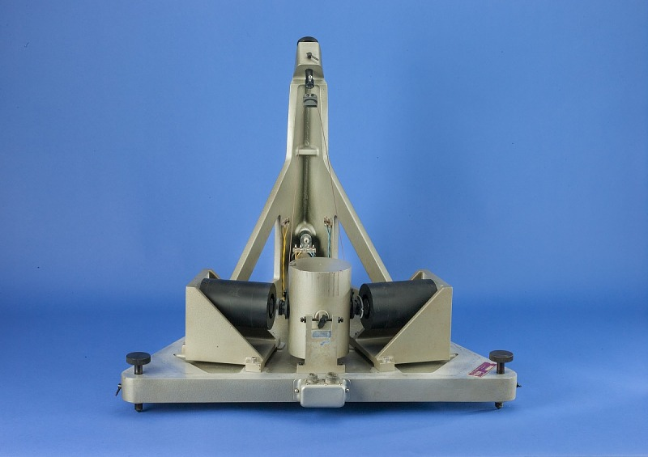
WWSSN: Global Standardization (1960s)
World-Wide Standardized Seismograph Network
Identical instruments worldwide
  Cold War nuclear-test monitoring
  Birth of global catalogs
  Evidence for plate tectonics
Notes:
Stress that standardized instruments made global computation meaningful.

Slide 6
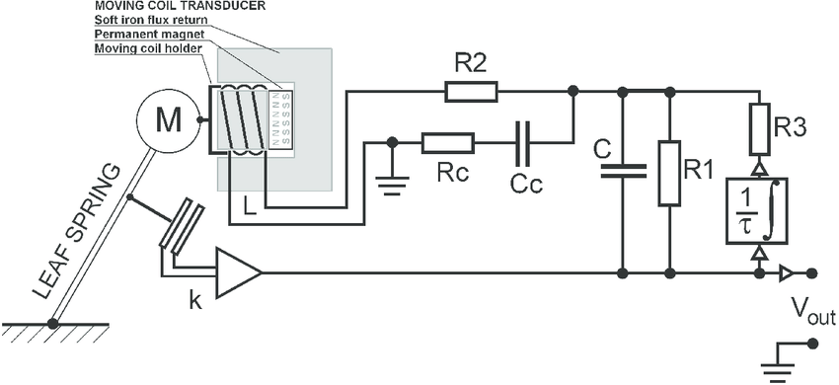
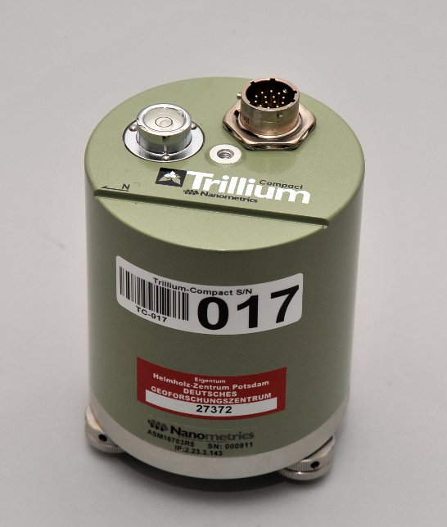
Broadband Seismometers (Late 1980s)
Force-balance feedback sensors
  Wide frequency band
  Huge dynamic range
  Analog telemetry inadequate
Notes:
Broadband sensors broke analog telemetry and forced digitization. Force-balance feedback sensors
Huge dynamic range
Wide frequency band
No longer compatible with analog telemetry
Broadband sensors broke analog systems. The sensors became better than the telemetry. This forces digitization.

Slide 7
Digitization Becomes Mandatory
Analog links clip broadband signals
  Digitization moves closer to the sensor
  ADCs become central design elements
Notes:
This is the conceptual bridge to digitizers and ADC theory. Analog links clip broadband signals
Digitization moves closer to sensor
ADCs become critical design elements
Speaker notes:
This is the point where digitizers stop being optional accessories and become central to the system.

Slide 8
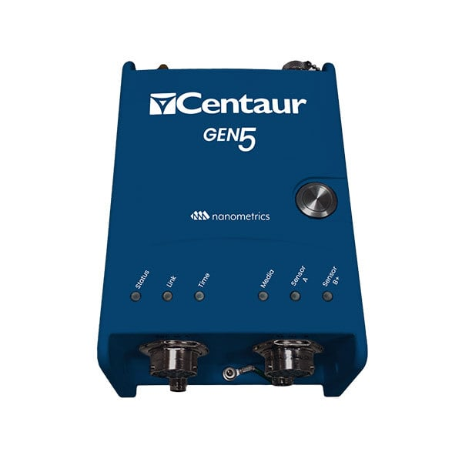

Digitizers Become Computers (2000s)
Embedded CPUs
  GPS timing
  Ethernet / IP networking
  Remote configuration
Notes:
Modern digitizers are networked computers, not passive devices. On slide:
Embedded CPUs
GPS timing
Ethernet / IP networking
Remote configuration
Speaker notes:
Modern digitizers are small computers. They run operating systems, buffer data, and talk IP — just like servers.

Slide 9
What Digitizers Force Us to Care About
Sampling rate
  Bit depth and quantization
  Dynamic range
  Telemetry bandwidth
  Buffering and latency
Notes:
Everything on this slide motivates the lab and ADC theory. Sampling rate
Bit depth & quantization
Dynamic range
Telemetry bandwidth
Buffering & latency
Speaker notes:
This slide is the bridge to the lab. Everything here comes directly from digitizer physics and data flow.

Slide 10
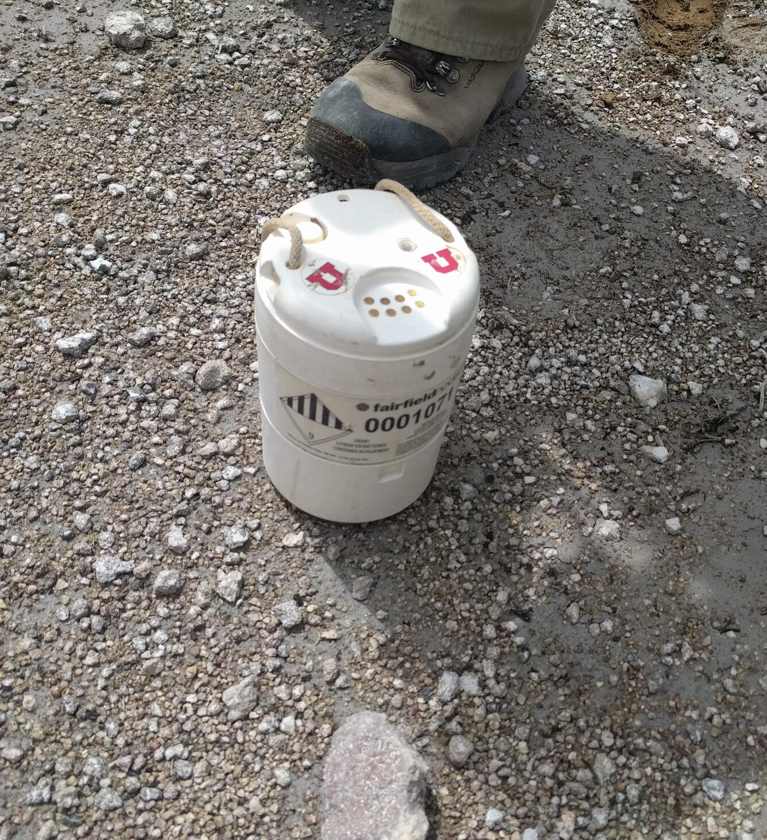
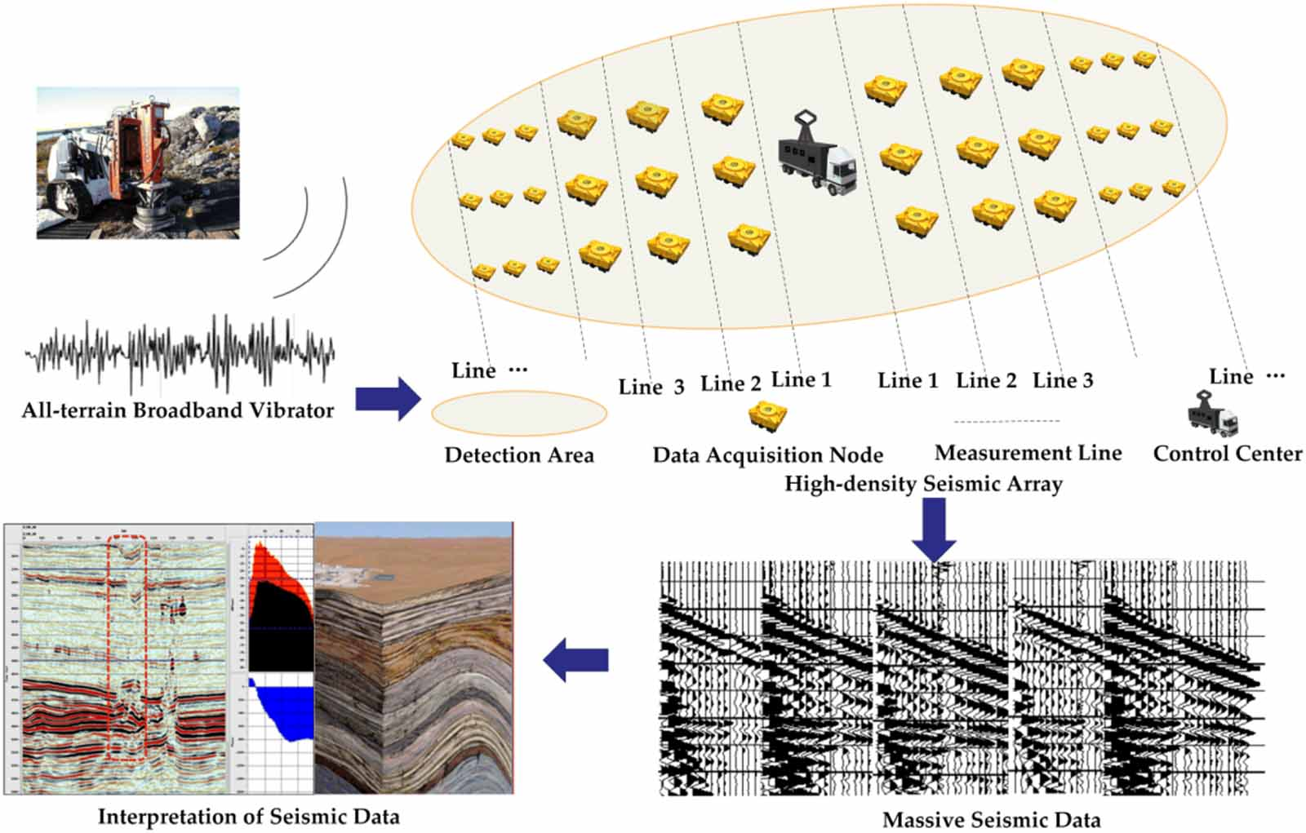
Large-N Instrumentation: Nodal Arrays
Hundreds to tens of thousands of sensors
  Battery powered
  Massive data volumes
  Automation required
Notes:
Large-N arrays eliminate manual inspection and require automated workflows. Hundreds to tens of thousands of sensors
Battery powered
No real-time telemetry
Massive post-processing
. Speaker notes:
Once N gets large, humans are out of the loop. Automation is no longer optional — it’s survival.

Slide 11
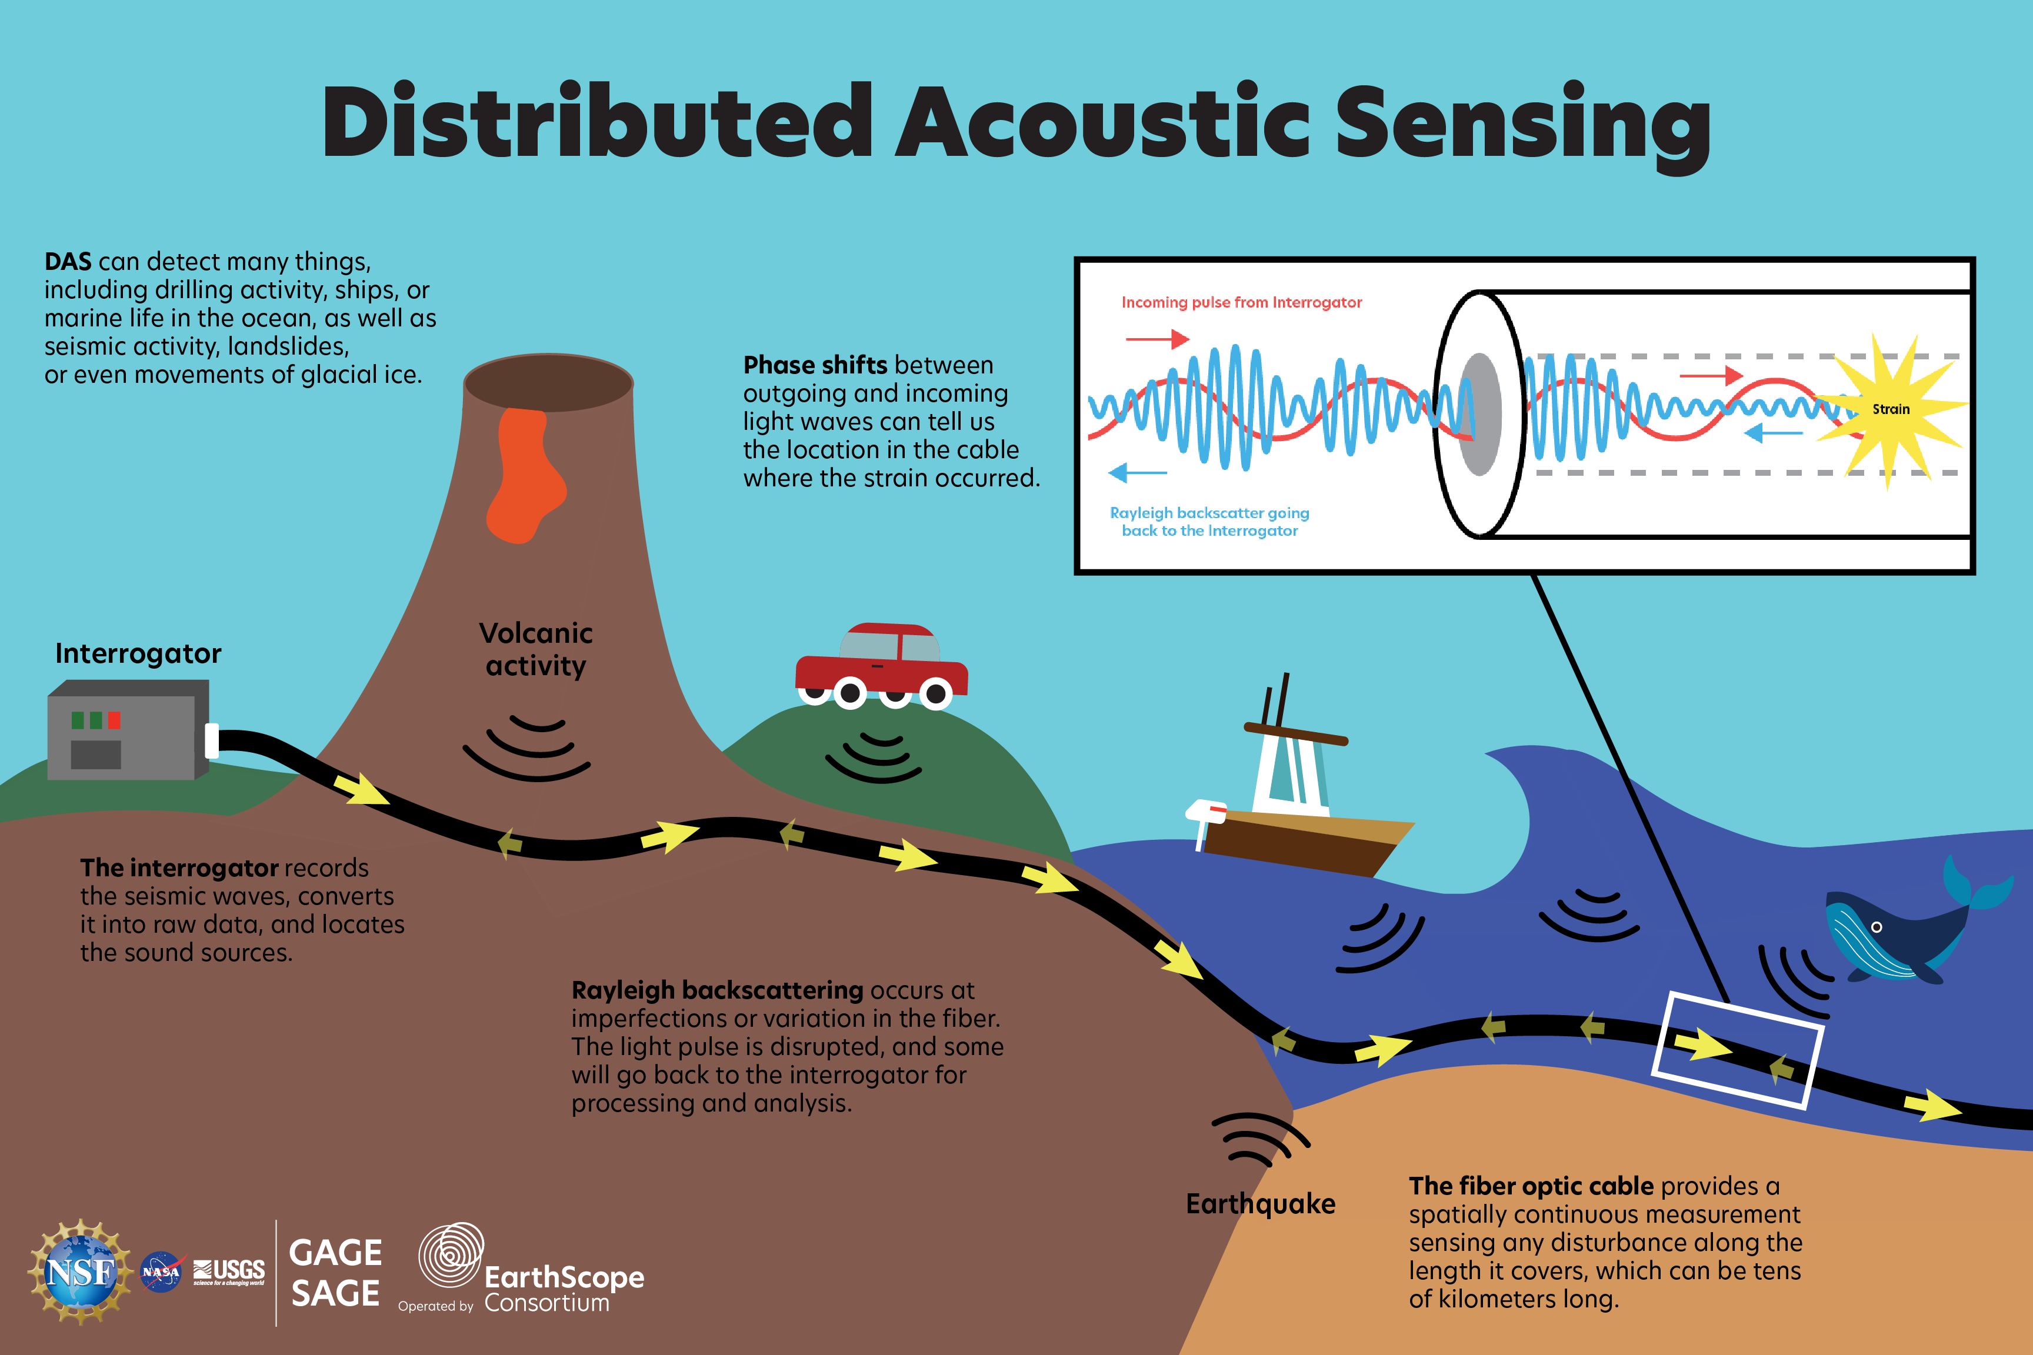
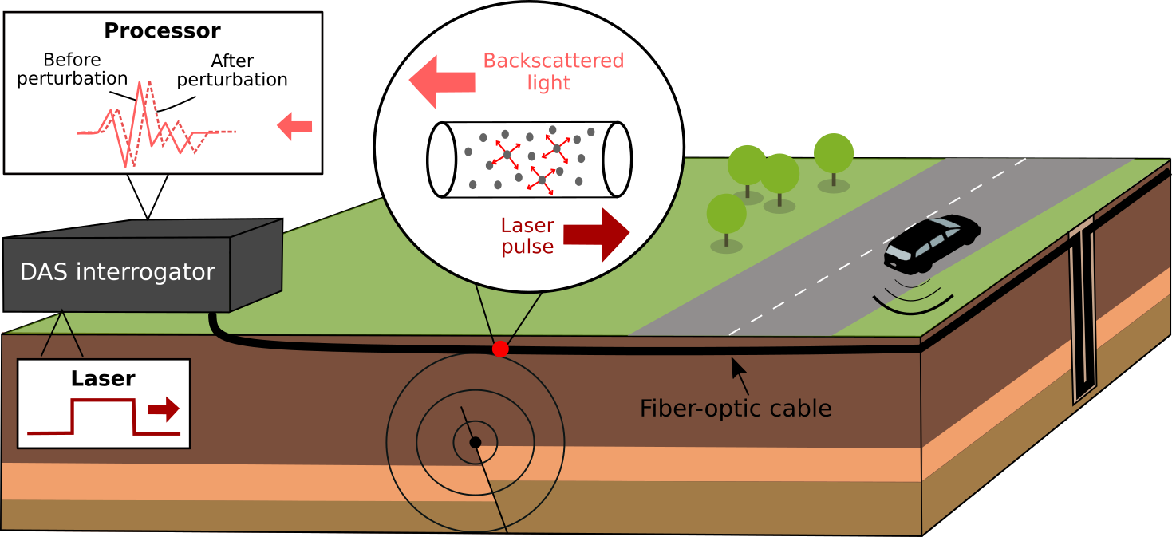
Distributed Acoustic Sensing (DAS)
Fiber-optic cables as sensors
  Meter-scale spacing
  Extremely high data rates
  GPU-scale processing
Notes:
DAS flips the problem: spatial sampling is easy, computation is hard. Fiber-optic cables as sensors
Meter-scale spacing
Enormous data rates
GPU-scale processing
DAS flips the problem: spatial sampling becomes trivial, computation becomes the bottleneck.

Slide 12
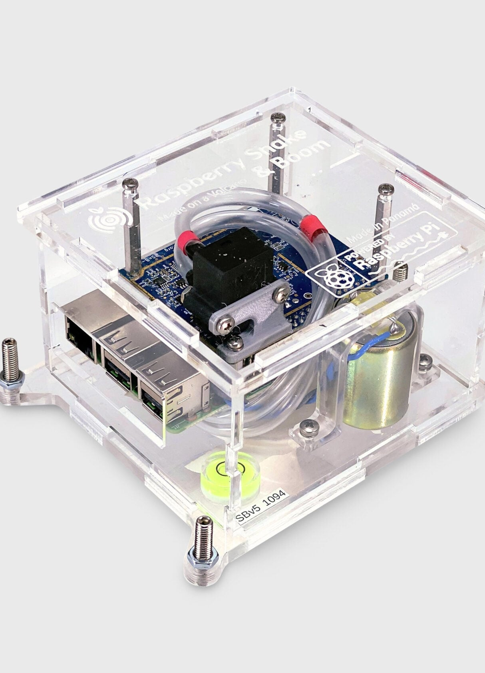
Citizen & Educational Seismology
Low-cost digital instruments
  Cloud-connected by default
  Dense informal networks
  Public engagement
Notes:
Citizen seismology assumes cloud infrastructure from day one.
Low-cost digital instruments
Cloud-connected by default
Dense informal networks
Public engagement
These systems assume Internet, cloud storage, and automation from day one — very different design philosophy.

Slide 13
Instrumentation Drives Computation
Analog drums → human interpretation
  Broadband sensors → digitization
  Networked digitizers → real-time processing
  Nodal & DAS → automation and GPUs
Notes:
Tie instrumentation history back to computing history from Notebook 1. On slide (table or bullets):
Analog drums → human interpretation
Broadband sensors → digitization
Networked digitizers → real-time processing
Nodal & DAS → automation & GPUs
Speaker notes:
Every major computational shift we discussed in Notebook 1 has an instrumentation driver behind it.

Slide 14
Why This Matters for the Lab
Digitizers sit between physics and computation
  ADC settings determine what is measurable
  Sampling and quantization are scientific choices
Notes:
Make clear that digitizer configuration affects science outcomes. On slide:
Digitizers are the boundary between physics & computation
ADCs determine what is measurable
Sampling & quantization are instrument design decisions
Speaker notes:
When you configure a digitizer, you are making scientific choices — not just IT choices.

Slide 15
Looking Ahead
Next: ADCs, sampling, quantization
  Installing and servicing a station
  Key question: What problem did this instrument solve—and what new one did it create?
Notes:
Close by setting up the lab and reinforcing the systems-thinking mindset. On slide:
Next: ADCs, sampling, quantization
Then: installing & servicing a station
Question to hold onto:
What problem did this instrument solve — and what new problem did it create?
Speaker notes:
That question will guide everything we do this week.

