Slide 1
Review of last lecture
We discussed:
Convolution: how to convolve two discrete time series by hand, and using MATLAB
the Z-Transform is a complex polynomial with coefficients that come from the corresponding discrete time series
Multiplication of Z-Transforms is the equivalent to convolution of discrete time series
Division of Z-Transforms is equivalent to deconvolution of discrete time series
A system can be represented by its impulse response function, h[n] – a time series – or equivalently by its transfer function, expressed as the ratio of the Z-Transforms
H(z) = B(z)/A(z)
The roots of B(z) are called the zeros of the transfer function
The roots of A(z) are called the poles of the transfer function
the Z-Transform is the discrete version of the (continuous) Laplace Transform
the Discrete Fourier Transform (DFT) is discrete version of the Fourier Transform.
The DFT is also a special case of the Z-Transform, evaluated around the unit circle.
The frequency response of the system is the DFT when the input is an impulse. It uniquely describes a system in an equivalent way as does the impulse response in the time domain and the transfer function in the z-domain
We also looked at pzgui – a MATLAB graphical user interface that allows us to move poles and zeros and see how this changes the frequency response

Slide 2
Previous lecture (3 weeks ago!)
Last time we examined one the two main techniques of signal processing: convolution. Convolution is the basis of filtering. The other main technique in DSP is Fourier analysis. Both are based on the strategy presented:
  decompose signals into simple additive components
  process the components in some useful manner
  synthesize the components into a final result.

Slide 3
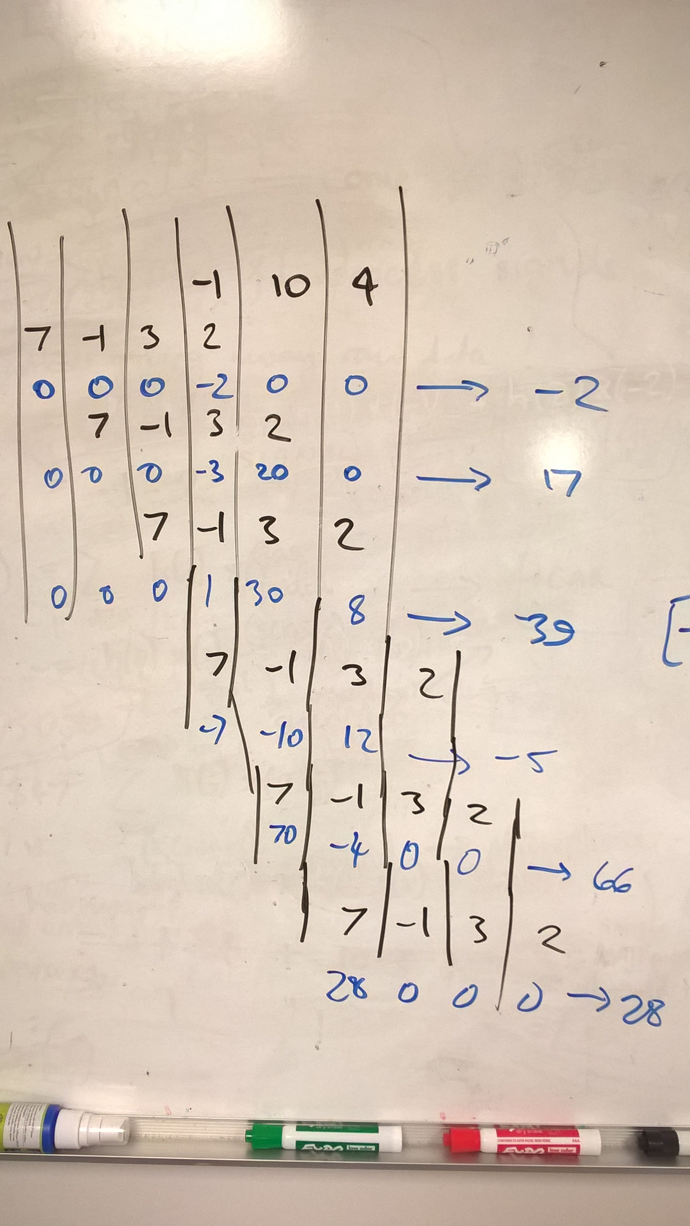
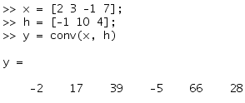
Convolution by hand
h[n]
x[-n]
x[n] = [2 3 -1 7]
x[-n] = [7 -1 3 2] (n=[-3 -2 -1 0])
h[n] = [-1 10 4]
y[n] = [-2 17 39 -5 66 28]
y[n]
In MATLAB:

Slide 4



z-Transform: time-shifting
Take a signal:
  A[n] = [a₀ a₁ a₂ … a_{N-1}]
The z-transform is the polynomial:
Multiplying by z is the same as time-shifting by 1 sample:
because this is now the signal:
    [0, a₀ a₁ a₂ … a_{N-1}]
  In general, multiplying by z^{k} delays a signal by k-samples.
  (z is just a symbol that represents a complex number, so a z-transform just means “complex transform”)
⁺¹

Slide 5





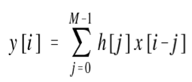
Multiplying two z-transforms
This is just the z-transform of the time sequence c[n] where:
Which is identical to the convolution formula:
Multiplying the z-transforms (polynomials) of two signals is the same as convolving them.

Slide 6

Transfer function: poles and zeros
Since a z-transform is a polynomial, it has roots. In general a polynomial of order N has N complex roots, and can be factored into:
So we can also write the ratio of two z-transforms as:
This means that r(z) will become 0 when z is any of z₀, z₁, …, z_{N-1}
and that r(z) will become ∞ when z is any of p₀, p₁, …, p_{M-1}
The complex numbers z₀, z₁, …, z_{N-1} are the “zeros” of the function, r(z)
The complex numbers p₀, p₁, …, p_{M-1} are the “poles” of the function, r(z)
r(z) is called the discrete transfer function. It is the z-plane analog to the impulse response (which is defined for the time domain).

Slide 7
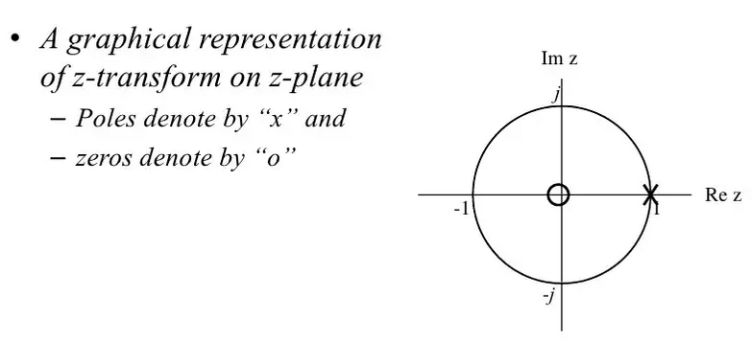
Pole-Zero Plot
The unit circle
|z|=1
or
z = e^{-jω}
where ω ranges from 0 to 2π

Slide 8
Where is this going: filters
Any filter can be described by:
poles and zeroes (s-domain/z-domain)
impulse response (time domain)
frequency response function (Fourier/frequency domain)
For continuous-time signals we use the Laplace transform / s-domain.
For discrete-time signals we use the z-transform / z-domain.

Slide 9
So many transforms!
The z-transform (i.e. discrete complex transform) is the discrete version of the Laplace Transform.
The Discrete-Time Fourier Transform (DTFT) is the special case of the z-transform evaluated along the unit circle, z=e^{-iw}, i.e. a set of complex sinusoids.
The Discrete Fourier Transform (DFT) is a sampled version of the DTFT.
The Fast Fourier Transform (FFT) is an algorithm used to compute the DFT. This is what we use to do Fourier decomposition (decompose a complex signal into a discrete sum of different complex exponentials).
These, and their relation to Fourier Series (continuous periodic signals) and Fourier (Integral) Transform (continuous non-periodic signals), will be covered in detail later.

Slide 10
Previous lab/homework (3 weeks ago!)
Synthesizing square wave and saw tooth signals.
Note that MATLAB has functions for these!

Slide 11
This lecture
The DFT (and inverse DFT)
  Definition
  DFT pairs
  Properties
Filtering
  How we go from recurrence/difference equation to transfer function representation and back
  Compare the conv and filter functions in MATLAB
  Simple low pass and high pass filters
  Bandpass filters
  Butterworth filters
  Moving Average (MA)/smoothing filters
  Median filters

Slide 12
DFT in MATLAB

Slide 13
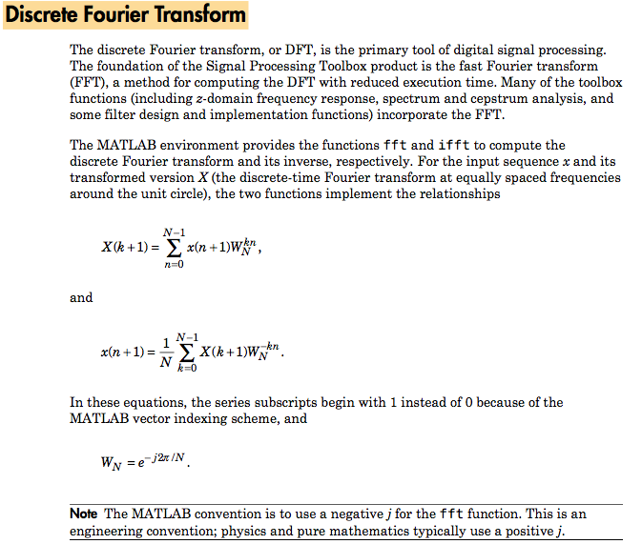

Slide 14
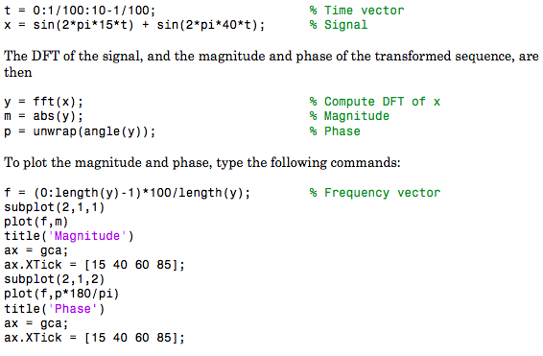
Example use of MATLAB fft

Slide 15
Inverse FFT recovers original signal
The inverse discrete Fourier transform function ifft also accepts an input sequence and, optionally, the number of desired points for the transform. Try the example below; the original sequence x and the reconstructed sequence are identical (within rounding error).
^{t = 0:1/255:1;}
^{x = sin(2*pi*120*t);}
^{y = real(ifft(fft(x)));}

Slide 16

Filters and Transfer Functions in MATLAB
In general, the z-transform Y(z) of a discrete-time filter's output y(n) is related to the z-transform X(z) of the input by
Confusingly while Smith defines z-transform in positive powers of z, MATLAB and every other book I see uses negative powers.
where H(z) is the filter's transfer function. Here, the constants b(i) and a(i) are the filter coefficients and the order of the filter is the maximum of n and m.
MATLAB filter functions store the coefficients in two vectors, one for the numerator (B) and one for the denominator (A).
Note: The filter coefficients start with subscript 1, rather than 0. This reflects the standard indexing scheme used for MATLAB vectors. In most books (and in programming languages like Python and C) you will see indexing that starts at subscript 0.

Slide 17
Filter Coefficients and Filter Names
Many standard names for filters reflect the number of a and b coefficients present:
When n = 0 (that is, b is a scalar), the filter is an Infinite Impulse Response (IIR), all-pole, recursive, or autoregressive (AR) filter.
When m = 0 (that is, a is a scalar), the filter is a Finite Impulse Response (FIR), all-zero, nonrecursive, or moving-average (MA) filter.
If both n and m are greater than zero, the filter is an IIR, pole-zero, recursive, or autoregressive moving-average (ARMA) filter.
The acronyms AR, MA, and ARMA are usually applied to filters associated with filtered stochastic (random) processes.

Slide 18

Filtering with the filter function
From the Z-transform relation…
…it is simple to work back to a difference equation. Assume that a(1) = 1. Move the denominator to the left side and take the inverse Z-transform:
In terms of current and past inputs, and past outputs, y(k) is
This is the standard time-domain representation of a digital filter, computed starting with y(1) and assuming a causal system with zero initial conditions.

Slide 19
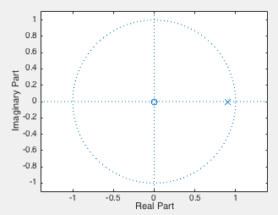
y = filter(B, A, x)
A filter in this form is easy to implement with the filter function. For example, a simple single-pole filter (lowpass) is
B = 1; % Numerator
A = [1 -0.9]; % Denominator
where the vectors B and A represent the coefficients of a filter in transfer function form, that is:
Y(z) = H(z)X(z) where:
This has a pole at z=0.9. Plot it in MATLAB using:
>> zplane(B, A)
The corresponding difference equation is:
y[n] – 0.9y[n-1] = x[n]

Slide 20


roots
zplane finds poles and zeros using the roots function
for
e.g. find the roots of A(z)
use this to find roots of any polynomial function.

Slide 21
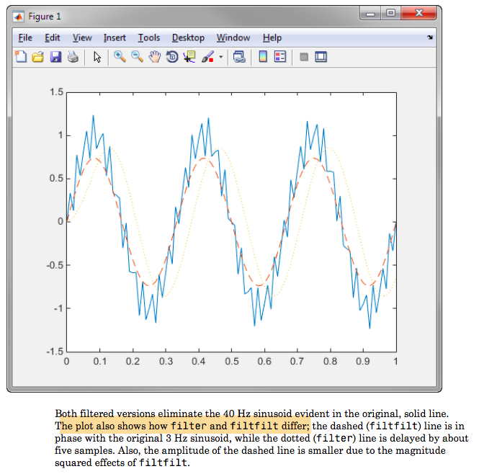
filtfilt – two-way filtering
filter delays a signal, because it passes data in one-direction only
filtfilt corrects this by filtering in one direction, reversing the result, and then filtering again, which corrects the delay, but can lead to spurious acausal effects

Slide 22
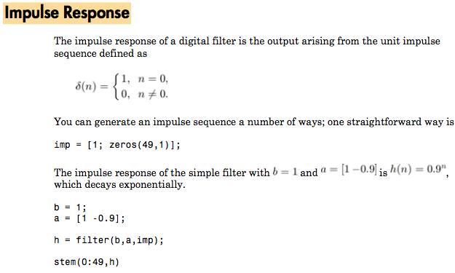

Slide 23
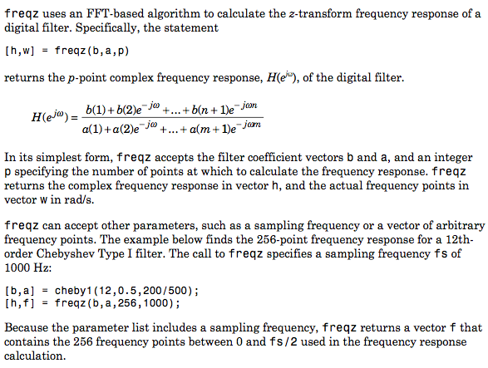

Slide 24
Why does frequency axis go to 1 in MATLAB?
^{The Signal Processing} Toolbox uses the convention that unit frequency is the Nyquist frequency, defined as half the sampling frequency. The cutoff frequency parameter for all basic filter design functions is normalized by the Nyquist frequency. For a system with a 1000 Hz sampling frequency, for example, 300 Hz is 300/500 = 0.6. To convert normalized frequency to angular frequency around the unit circle, multiply by π. To convert normalized frequency back to hertz, multiply by half the sample frequency.

Slide 25
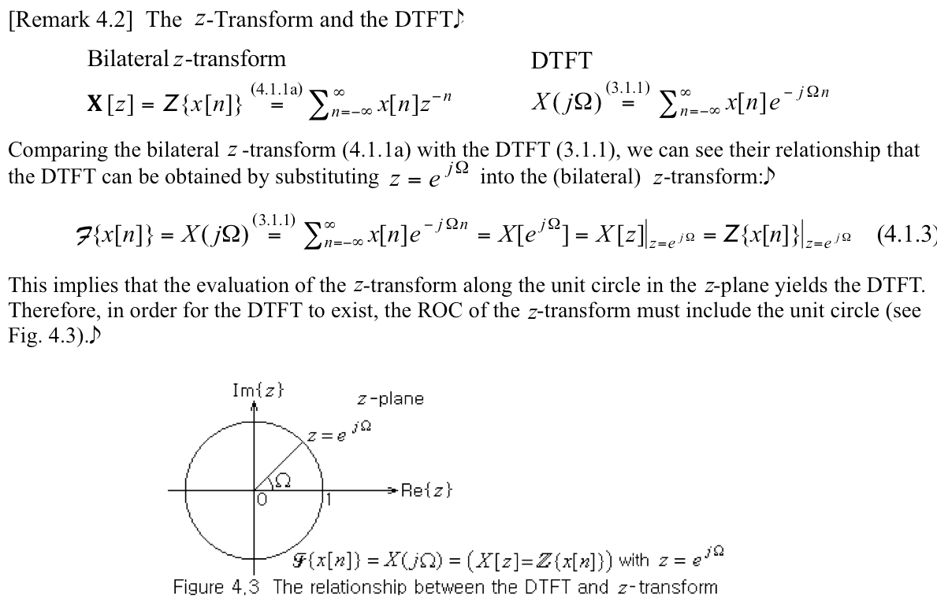

Slide 26
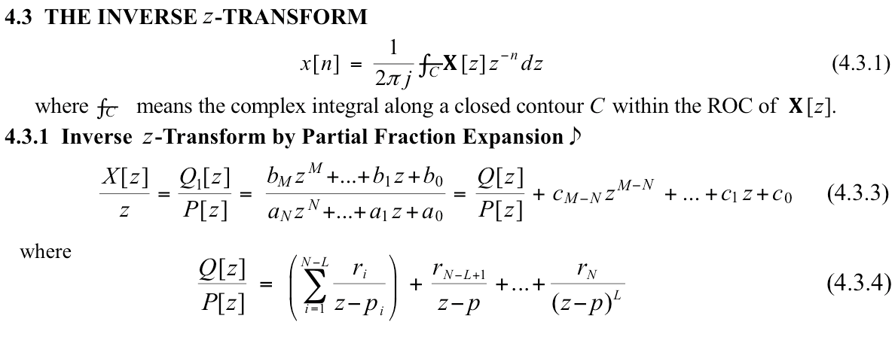

Slide 27
