Slide 1
Some applications of DSP in Seismic Monitoring
Digitizer – anti-alias filter, ADC
Radio (voltage controlled oscillator, amplitude or frequency modulation)
Multiplexing
Demultiplexing (Discriminating)
Demodulator
Amplitude-based alarms, e.g. event & tremor alarms
RSAM
Event detection
Event location (delay and stack on grid)
Magnitude determination
Swarm alarms
Amplitude-based location
Analyst review

Slide 2
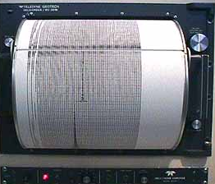
You are a Seismologist at Caltech back in early 1980s, running an earthquake monitoring network. Until now you’ve been reliant of helical drum recorders.
Computers are just beginning to get useful. For the first time, you begin to digitize seismic data, rather than just rely on paper records. But the data volumes are so huge, about 100 MB per day and all you have is a 1 MB hard drive. So you have to cut the data down and only save the most important parts for detailed analysis.
So you decide just to try to detect the earthquake events, and throw away everything else.

Slide 3
Simplest method: Amplitude-duration trigger
The signal has to exceed an amplitude threshold, thresh_a, for at least time, thresh_t (misses spikes)
Pros:
Great for detecting large earthquakes (strong motion), high amplitude tremor etc.
Cons:
Will completely miss all signals smaller than thresh_a.
Poor event discrimation (lots of false triggers)
Cannot adapt to changing signal levels
Better method: STA/LTA trigger
The STA/LTA has to exceed an amplitude threshold, thresh_a, for at least time, thresh_t (misses spikes)
Pros:
Will always work where there is a good signal:noise ratio (weak motion)
Doesn’t need retuning as signal levels change
Few false triggers
Cons:
Completely breaks down in presence of high amplitude noise (no events recorded during high amplitude tremor, dome collapse etc.)

Slide 4
Event detection & location – 2 steps
Detection
Traditionally, an earthquake is detected at one station at a time, using an energy detector such as a short-term average (STA)/long-term average (LTA). STA/LTA computes the ratio of the STA energy in a short time window to the LTA energy in a longer time window, as these windows slide through the continuous data. A detection is declared when the STA/LTA ratio exceeds certain thresholds.
Association (of detections from different stations into events)
An association algorithm then determines whether detections at multiple stations across the network are consistent with a seismic source. If a seismic event is detected at a minimum of four stations, it is included in an earthquake catalog, which is a database of the location, origin time, and magnitude of known earthquakes.

Slide 5
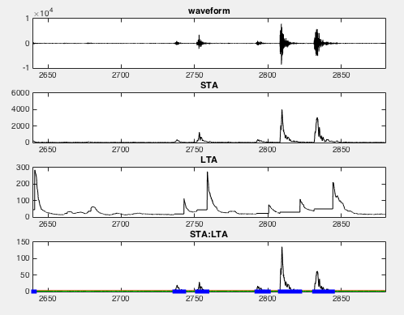
Detecting events

Slide 6
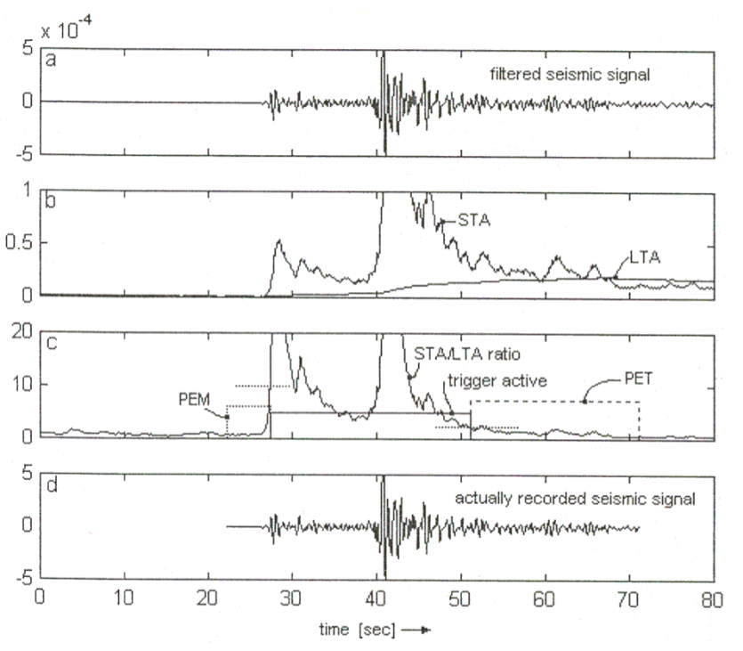
Detecting P & S phase arrivals

Slide 7
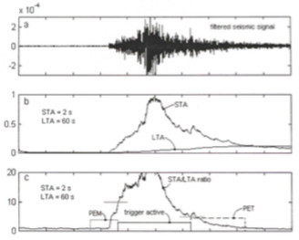

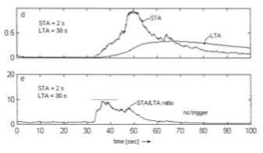
STA window
longer than a few periods of the signal you want to detect (too short = false triggers, e.g. spikes)
Shorter than length of signal (VTs, rockfalls?)
LTA window
Longer than a few periods of the noise
Longer than an event
Shorter than time between events (not good for swarms)
Much shorter than the overall seismogram
Short moving average filter to capture “signal”
Longer moving average filter to capture “noise”

Slide 8
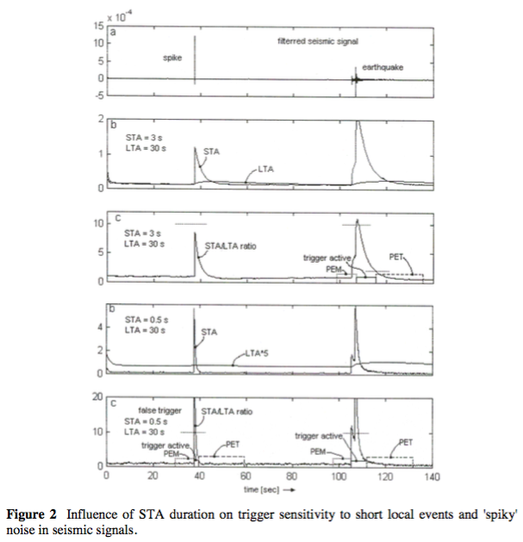

Slide 9
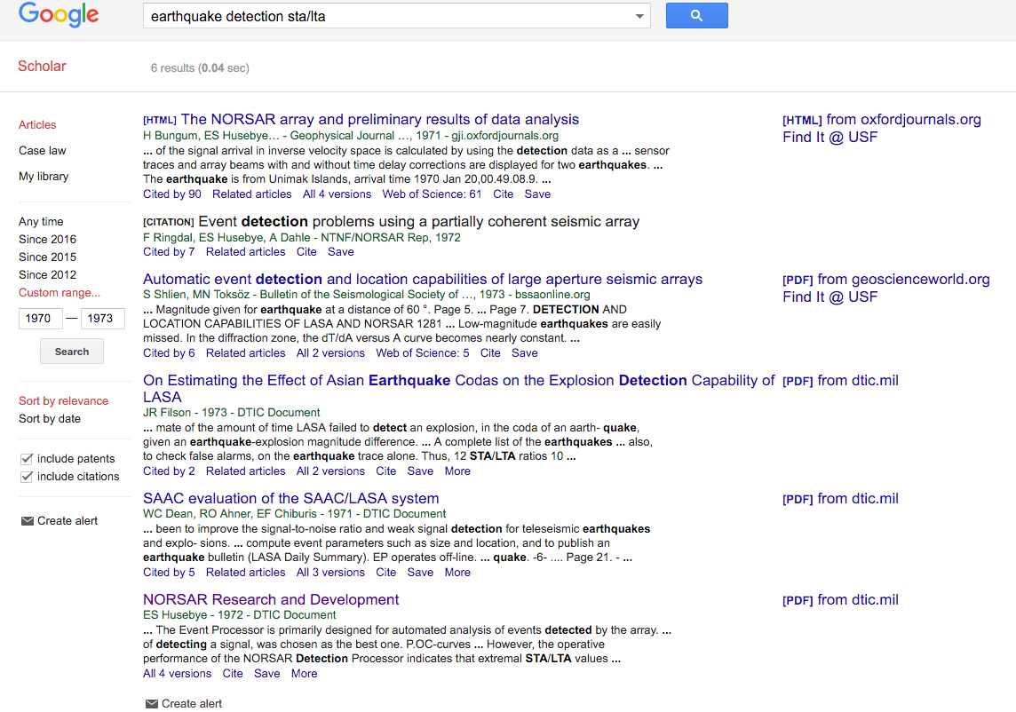
STA/LTA
6 results on Google Scholar until 1973

Slide 10
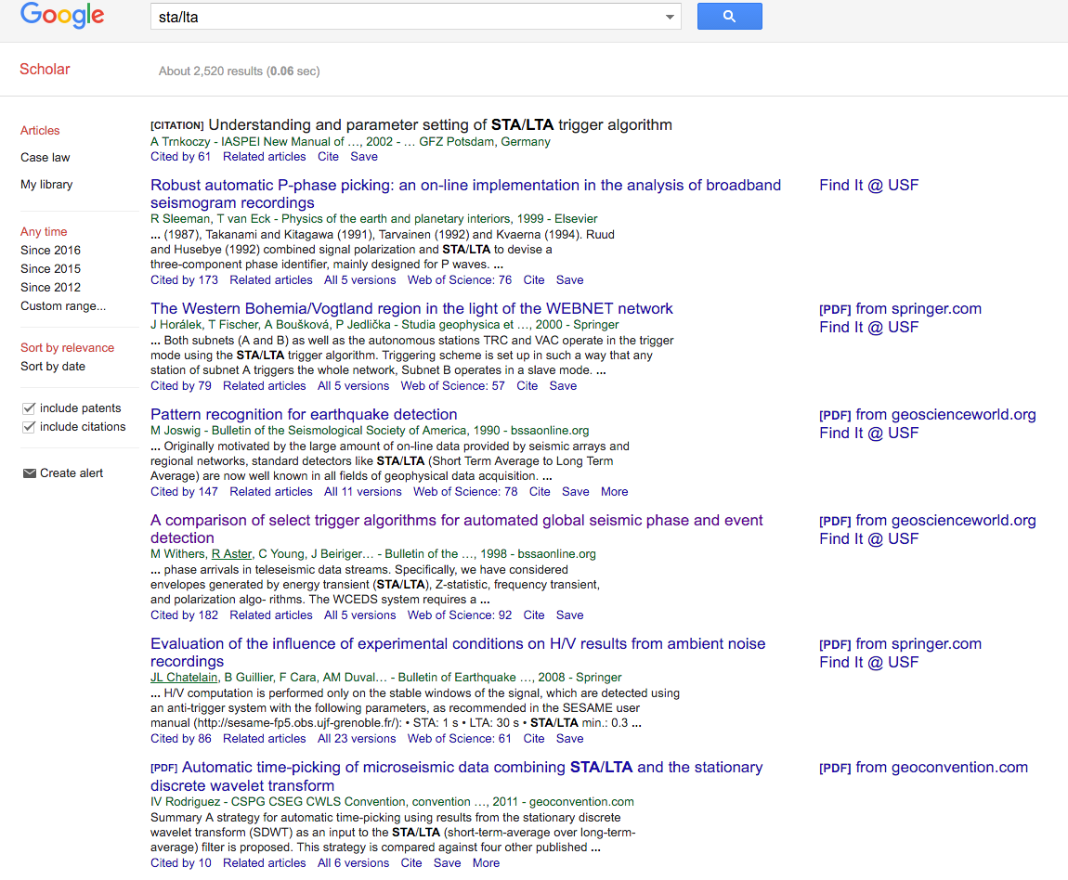
STA/LTA
2500 now

Slide 11
Pros:
STA/LTA successfully identifies earthquakes with impulsive, high signal-to-noise ratio (snr) P-wave and S-wave arrivals.
High ability to detect a wide variety of earthquakes without prior knowledge of the event waveform or source information.
Fast
Cons
STA/LTA fails to detect earthquakes, or may produce false detections, in more challenging situations such as:
  low snr
  waveforms with emergent arrivals
  overlapping events
  cultural noise
  sparse station spacing;
thus, STA/LTA has low detection sensitivity. Therefore, earthquake catalogs are incomplete for lower-magnitude events.

Slide 12
Other methods
We can overcome the limitations of STA/LTA by using the full waveform!
Waveform cross-correlation (also called “matched filtering” and “template matching”)
Seismic sources that repeat in time, over the course of weeks, months, or even years, have highly similar waveforms when recorded at the same station. Waveform cross-correlation exploits the resulting waveform similarity to perform as a highly sensitive earthquake detector (provided you know what you are looking for!). Computationally inefficient.
(2) Waveform auto-correlation
Correlate whole waveform against itself. Computationally expensive.
But computer power per dollar doubles every 2 years (1000 times in 20 years).
1970s: STA/LTA cutting edge
1990s: (when Steve was my age) Waveform correlation cutting edge, STA/LTA routine.
2010s: Waveform auto-correlation cutting edge, waveform correlation routine.
2030s: (when you are my age!) Waveform auto-correlation routine.
“Today’s research techniques become tomorrow’s routine monitoring tools” – some Brit.

Slide 13
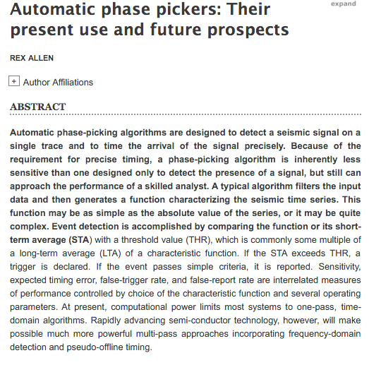
Rex Allan pickers – trying to get P and S wave arrival times from STA/LTA

Slide 14
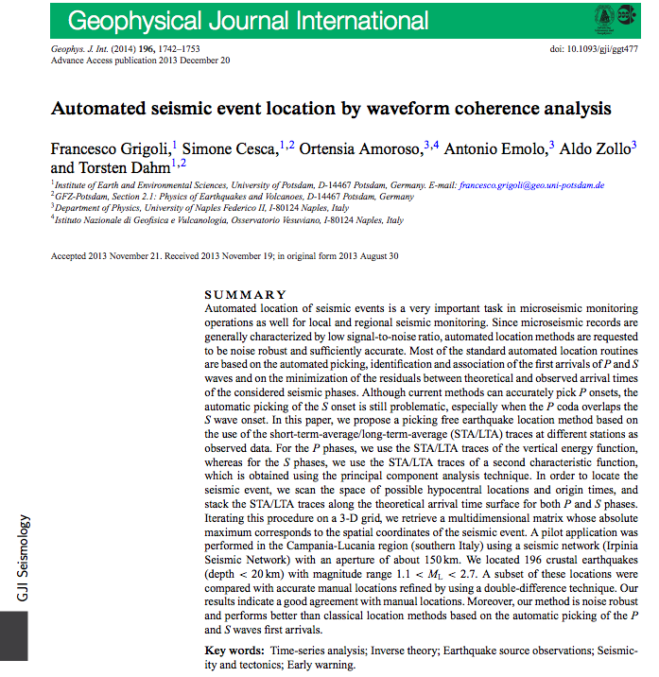
Locating events by time delaying & stacking STA/LTA on a grid

Slide 15
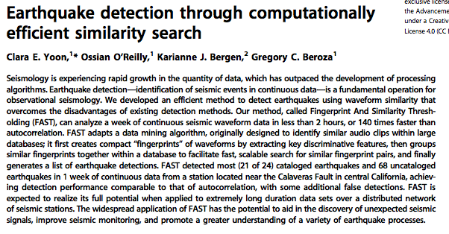
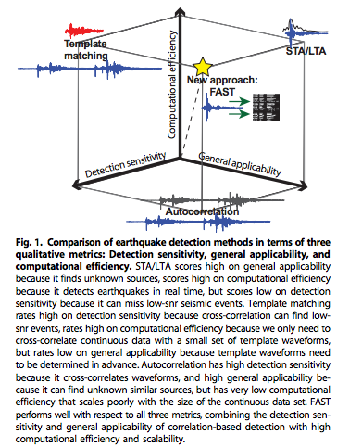
An attempt to combine:
STA/LTA
Waveform correlation (template matching)
Autocorrelation (whole waveform with itself)
All DSP techniques!

Slide 16
STA/LTA in software packages
Real-time systems (all C programming language = fast):
Earthworm: http://love.isti.com/trac/ew/wiki/carlstatrig
Antelope: orbdetect
SeisComP3: https://www.seiscomp3.org/wiki/doc/applications/scautopick
Post-processing:
Antelope: dbdetect
ObsPy (Python): https://docs.obspy.org/tutorial/code_snippets/trigger_tutorial.html
GISMO (Matlab):
IRISSeismic (R): http://search.r-project.org/library/IRISSeismic/html/STALTA.html

Slide 17
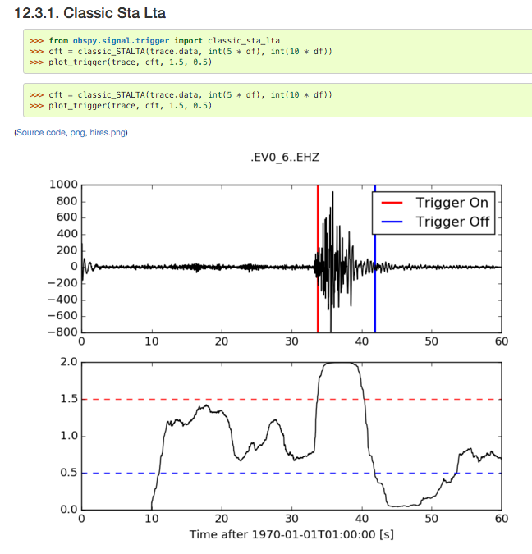
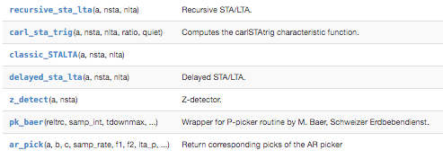
ObsPy
https://docs.obspy.org/tutorial/code_snippets/trigger_tutorial.html

Slide 18
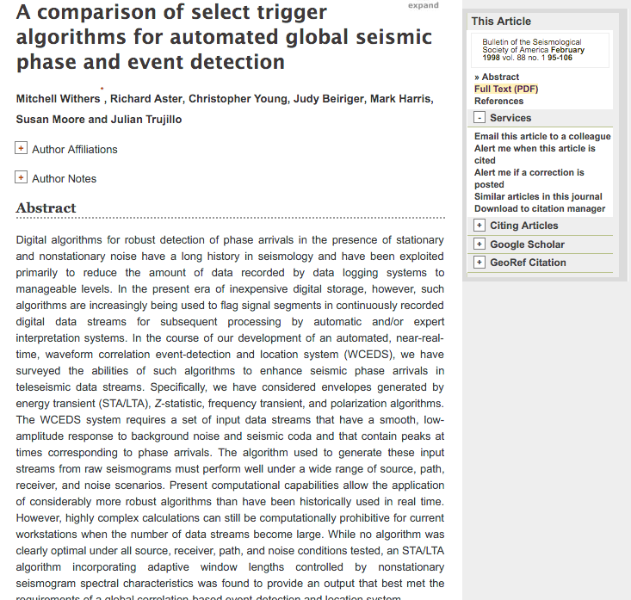
Information about different methods

Slide 19
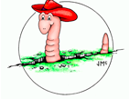
Earthworm carlstatrig
Very hard to play archived data into Earthworm, so how do you tune parameters?

Slide 20
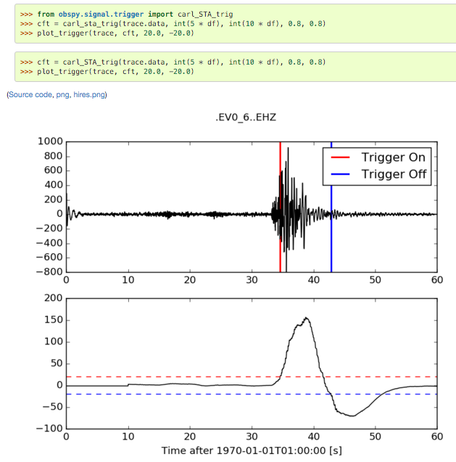
ObsPy implements carl_sta_trig

Slide 21
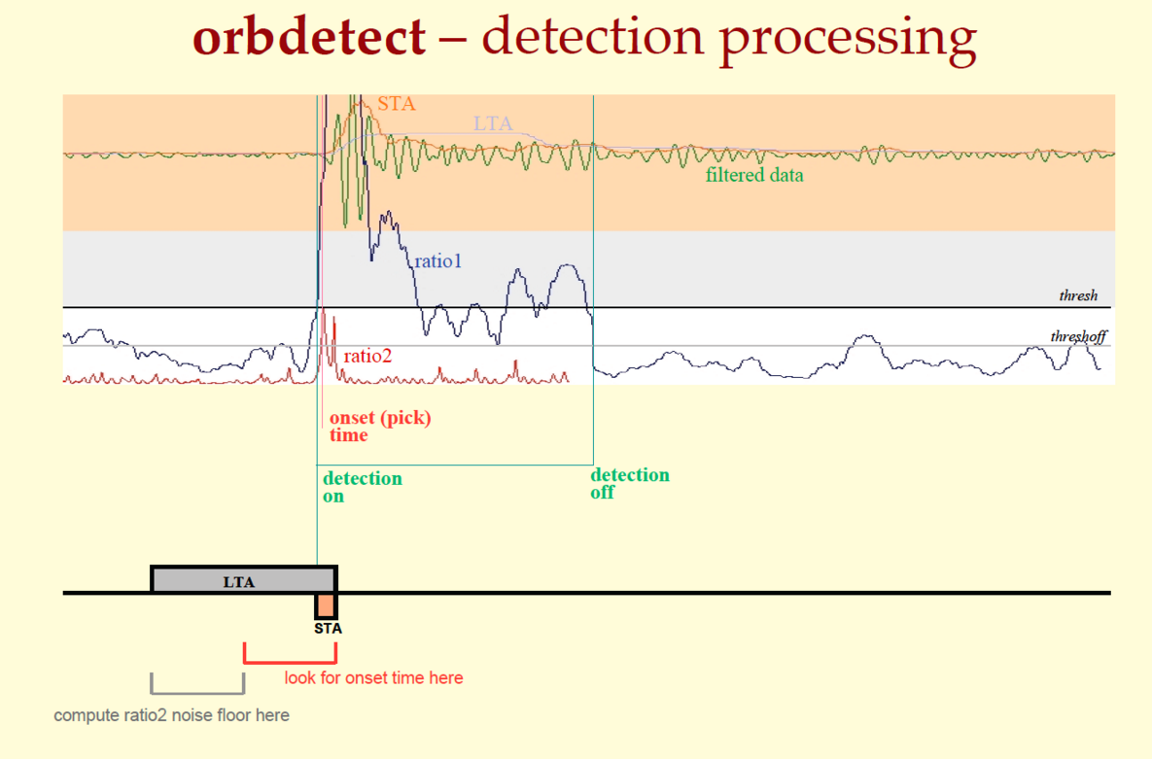
Antelope
https://usflearn.instructure.com/courses/1164049/modules/items/9471939
orbdetect/dbdetect are black boxes --> cannot see or simulate code.
Have to just run it many times and compare results.

Slide 22
ObsPy tutorial

Slide 23
GISMO tutorial

Slide 27
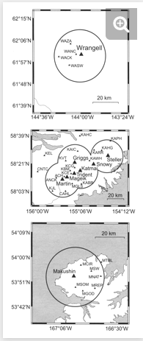

Slide 28
Simplest method: Amplitude-duration algorithm
The signal has to exceed an amplitude threshold, thresh_a, for at least time, thresh_t.
Exercise:
  Code this in MATLAB* now by filling in this template:
  Use this data file:
  Choose suitable thresh_a and thresh_t parameters to capture the two largest events only.
  Email me your answer.
What are the pros of this method?
What are the cons?
* If this were really 1981 you’d be coding in Fortran77 if you were lucky, maybe assembly language.

