Slide 1
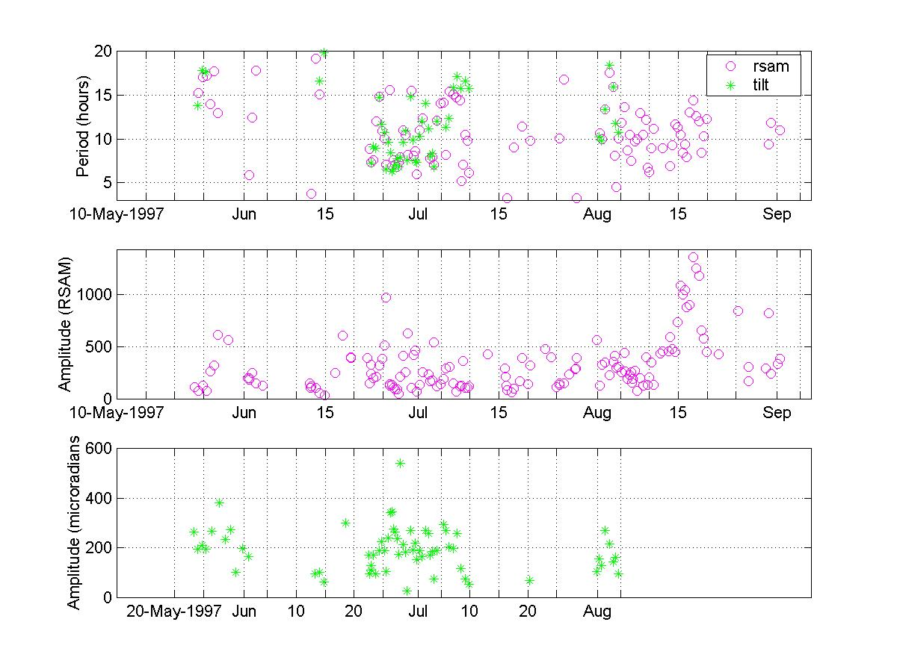
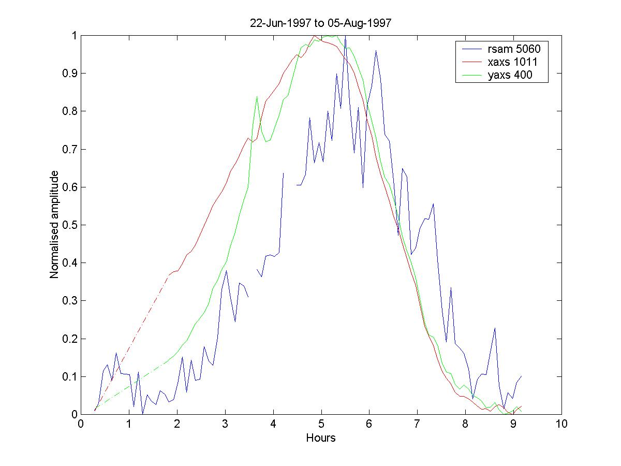
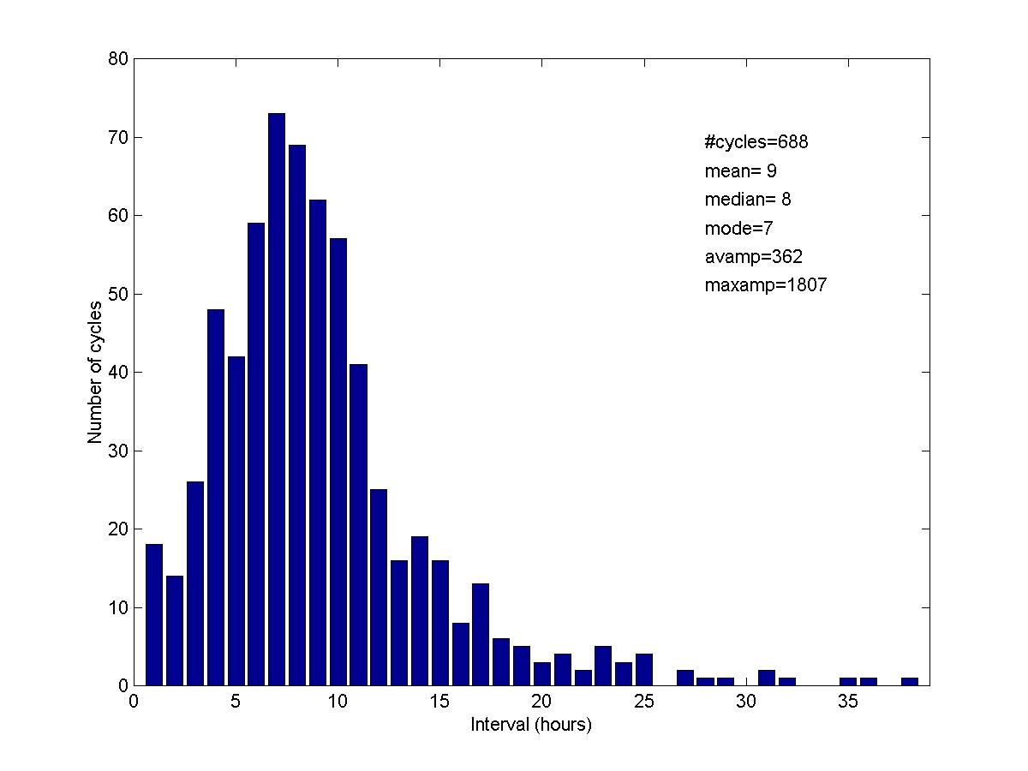
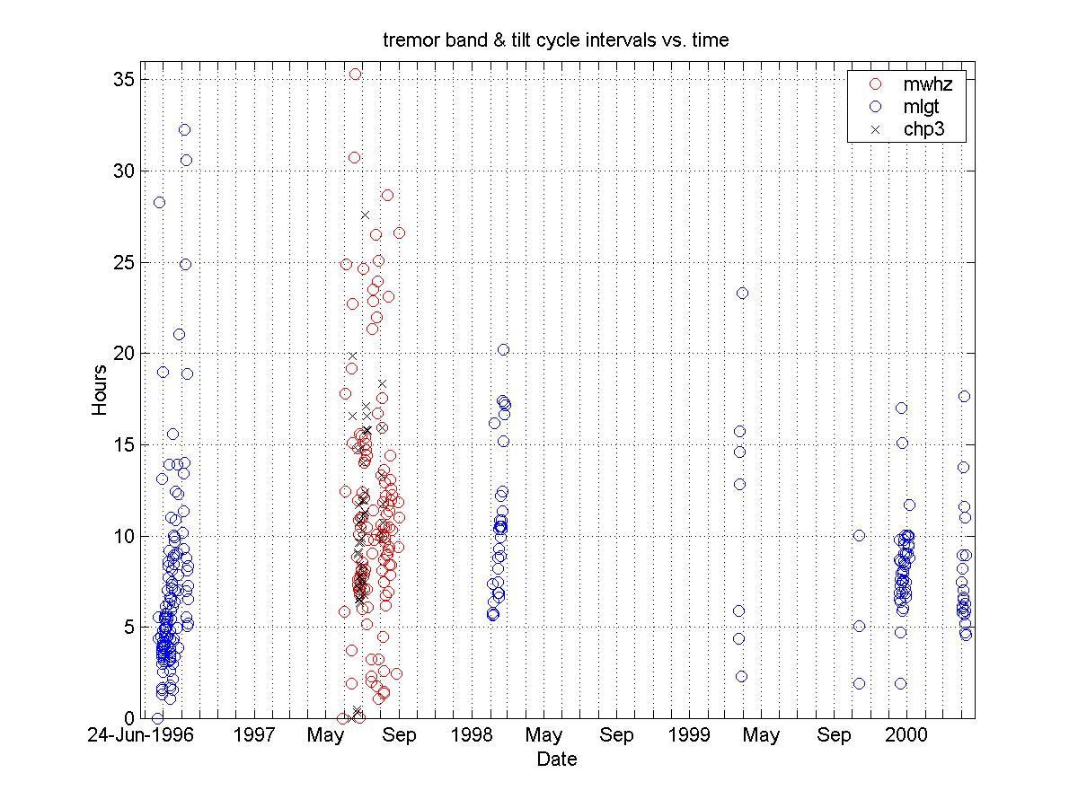

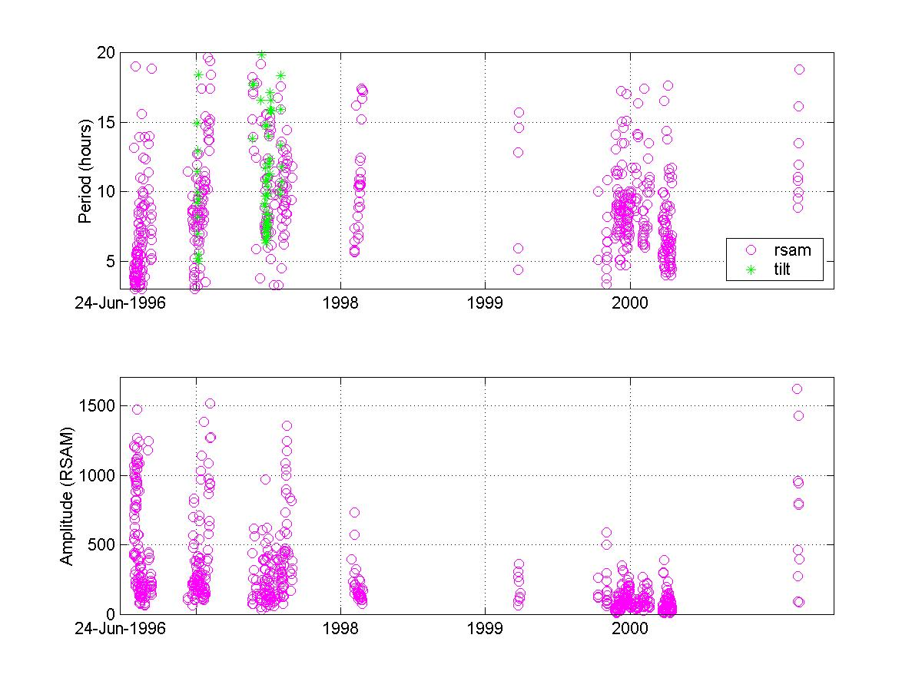
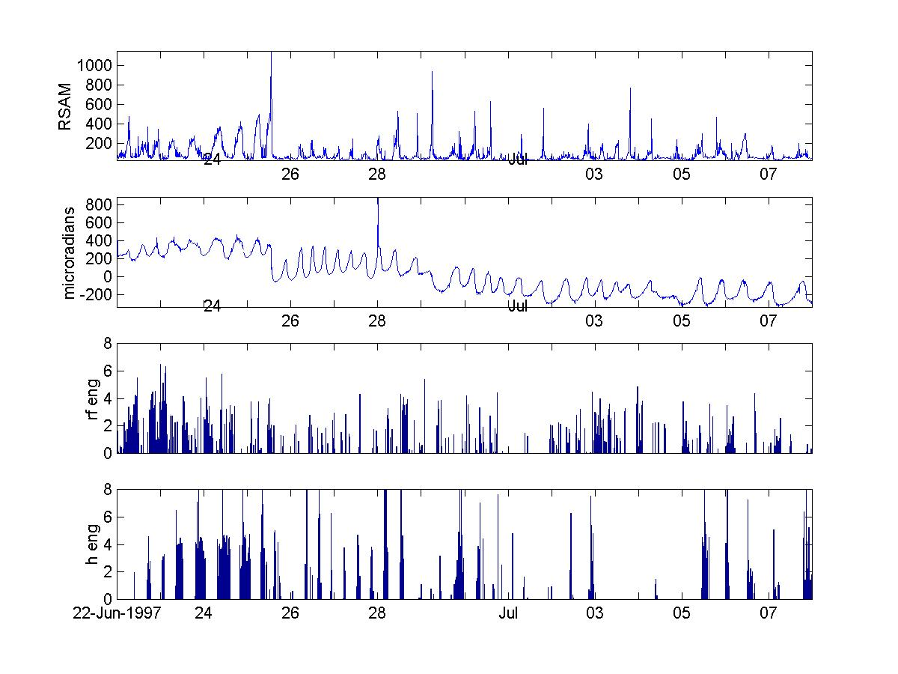
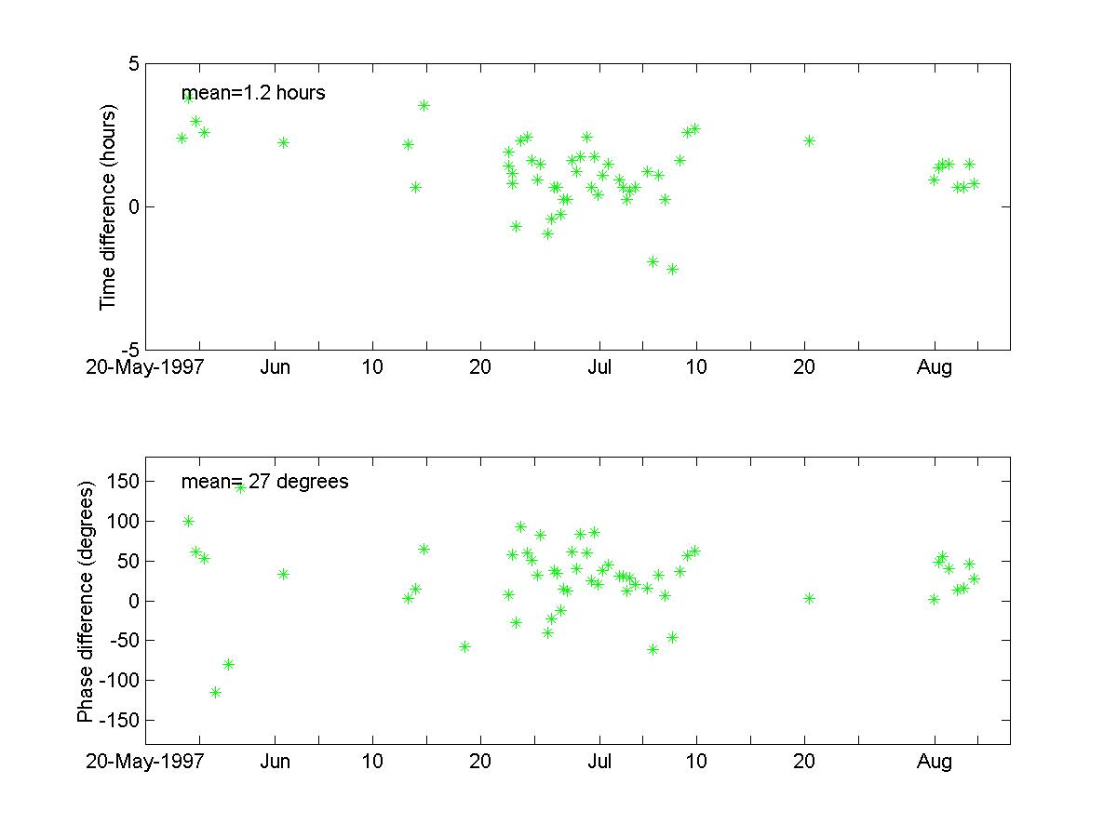
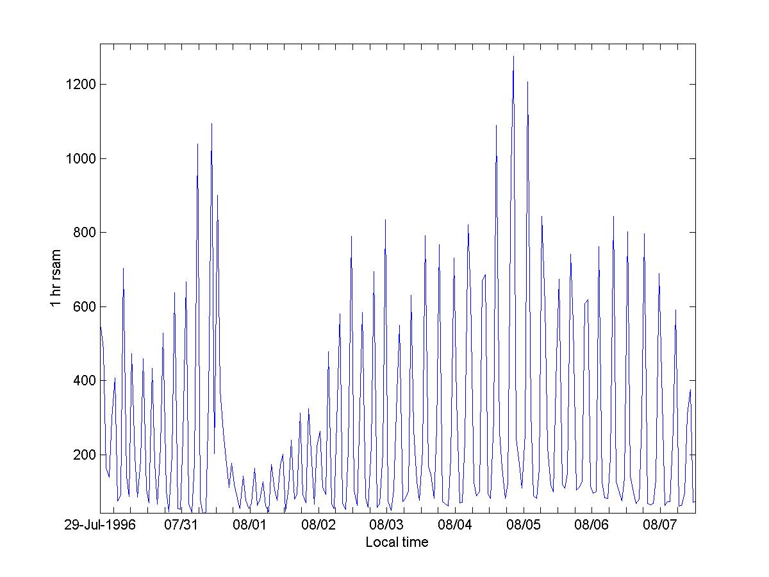
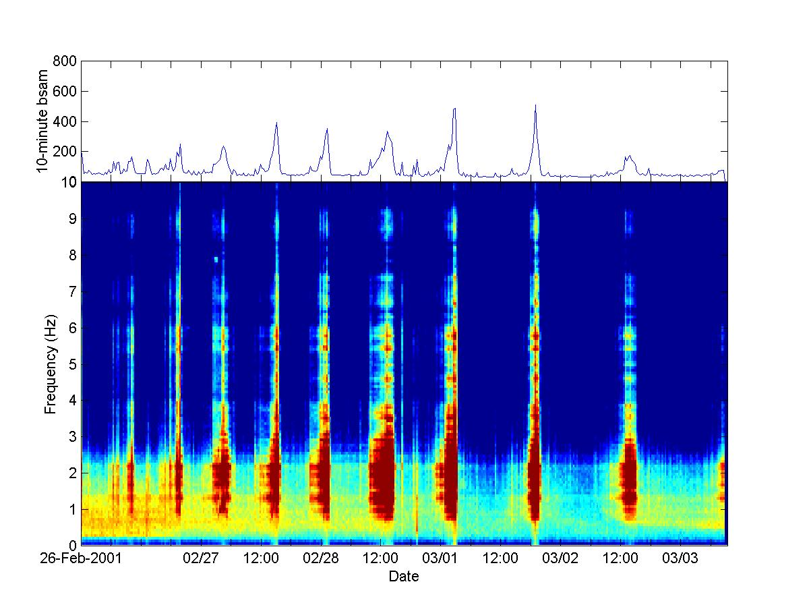
Cyclic tremor at the Soufriere Hills Volcano, Montserrat, 1996-2001
Glenn Thompson¹ and Tanya Powell²
¹Montserrat Volcano Observatory & ²University of Leeds, UK
Introduction
An important feature of the seismicity associated with the 1995-2001 eruption of the Soufriere Hills Volcano has been the occurrence of episodes of cyclic tremor. On the helicorders these tremor cycles appear as alternate bands of strong and weak seismicity, from which the term “banded tremor” arises [Fig. 1]. Banded tremor was first identified at the Soufriere Hills Volcano on 29 July 1996, in the RSAM data [Fig. 2]. This was quickly recognised as signal associated with pressure cycles in the volcanic system, but strong evidence did not come until mid-1997 when tilt cycles were also recorded, and allowed the phase relation between tilt and tremor to be examined. Further breakthroughs came in late-1999 when COSPEC measurements shed light on the relation between tremor cycles and degassing. To date 10 episodes of cyclic tremor have been recorded, lasting from a few days to a few months, and consisting of tremor cycles with periods ranging from 3-24 hours [Table 1]. Here we present a comprehensive re-analysis of the RSAM and tilt data on which previous works have drawn, and discuss work in progress to
Start date | End date | Number of cycles | Mean interval (hours) | Mean cycle amplitude (RSAM) | Maximum cycle amplitude (RSAM) | Stations showing tilt cycles
28-Jul-1996 | 13-Sep-1996 | 137 | 6 | 573 | 1701
12-Dec-1996 | 8-Feb-1997 | 100 | 10 | 501 | 1637 | CHPK
23-May-1997 | 2-Sep-1997 | 144 | 11 | 386 | 1412 | CHP3
? Nov-1997 | ? Dec-1997 | RSAM data not available
4-Feb-1998 | 25-Feb-1998 | 34 | 11 | 284 | 861
25-Mar-1999 | 29-Mar-1999 | 3 | 10 | 372 | 429
12-Oct-1999 | 13-Oct-1999 | 4 | 4 | 204 | 314
1-Nov-1999 | 20-Feb-2000 | 160 | 9 | 177 | 626
22-Mar-2000 | 16-Apr-2000 | 84 | 7 | 152 | 434
25-Feb-2001 | 04-Mar-2001 | 11 | 12 | 833 | 1807
ALL |  | 688 | 9 | 362 | 1807
Table 1: Statistics of cyclic tremor episodes.
Stacked (normalised) tilt and tremor cycle from 22 Jun – 5 August 1997. The tremor cycle has a phase of +30⁰ with respect to the tilt cycle.
Figure 1: Banded tremor as it appears on a helicorder. This example is from 26 Feb 2001 – 1 Mar 2001, station MRYT.
Relationship between tremor cycles, tilt cycles, rockfall energy and hybrid earthquake energy. Further analysis of the occurrence times of different event
Figure 2: RSAM data show tremor cycles very clearly. A problem with RSAM data is that they do not distinguish between hybrids/tremor and other types of activity such as rockfalls, regional earthquakes etc.
Spectrogram showing the cyclic tremor episode that occurred between 26 Feb and 3 Mar 2001.

