Slide 1
Seismic monitoring systems at MVO (after Y2K)
Art tipped me off Jun-Dec 1999
Then Y2K hit!
And volcano erupting again!
Fewer staff than ever before
Arrived 10 January 2000

Slide 2
Analog seismic network
July 1995
Designed for volcano-monitoring 3rd world
Simple PC based system
Good real-time tools
Just not Y2K compliant
DOS/3.1 became harder to network

Slide 3
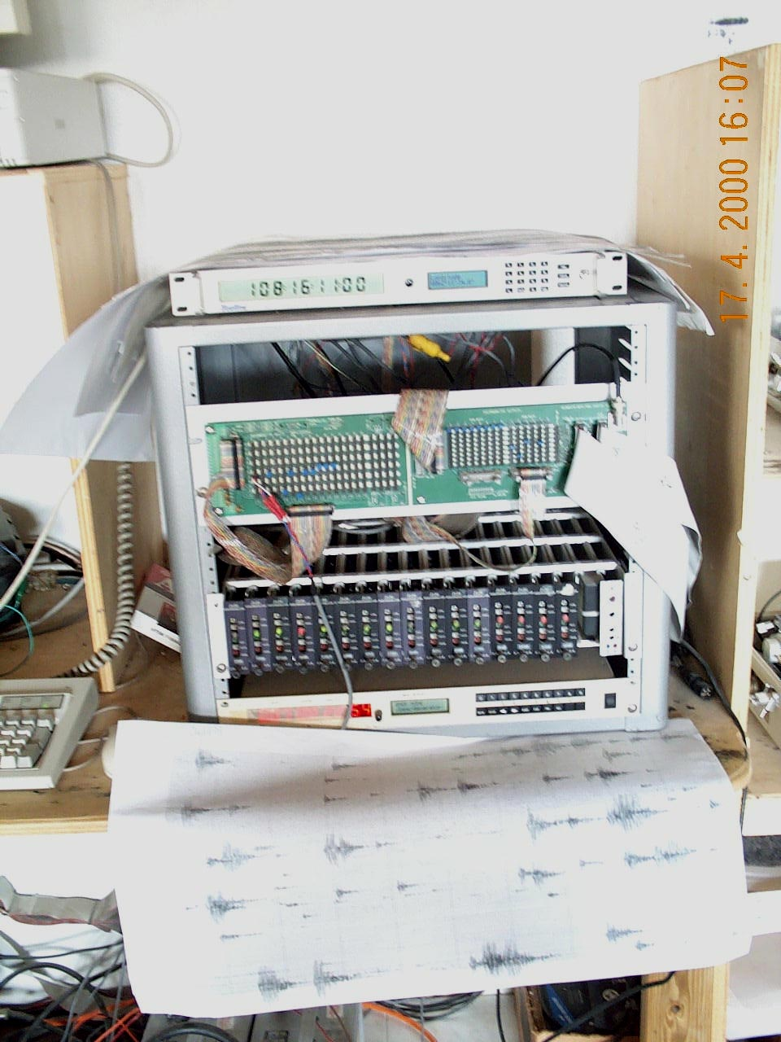
ASN Discriminators
Fed helicorders, PCSEIS, RSAM and TILT
2 helicorders dead
No spare parts

Slide 4
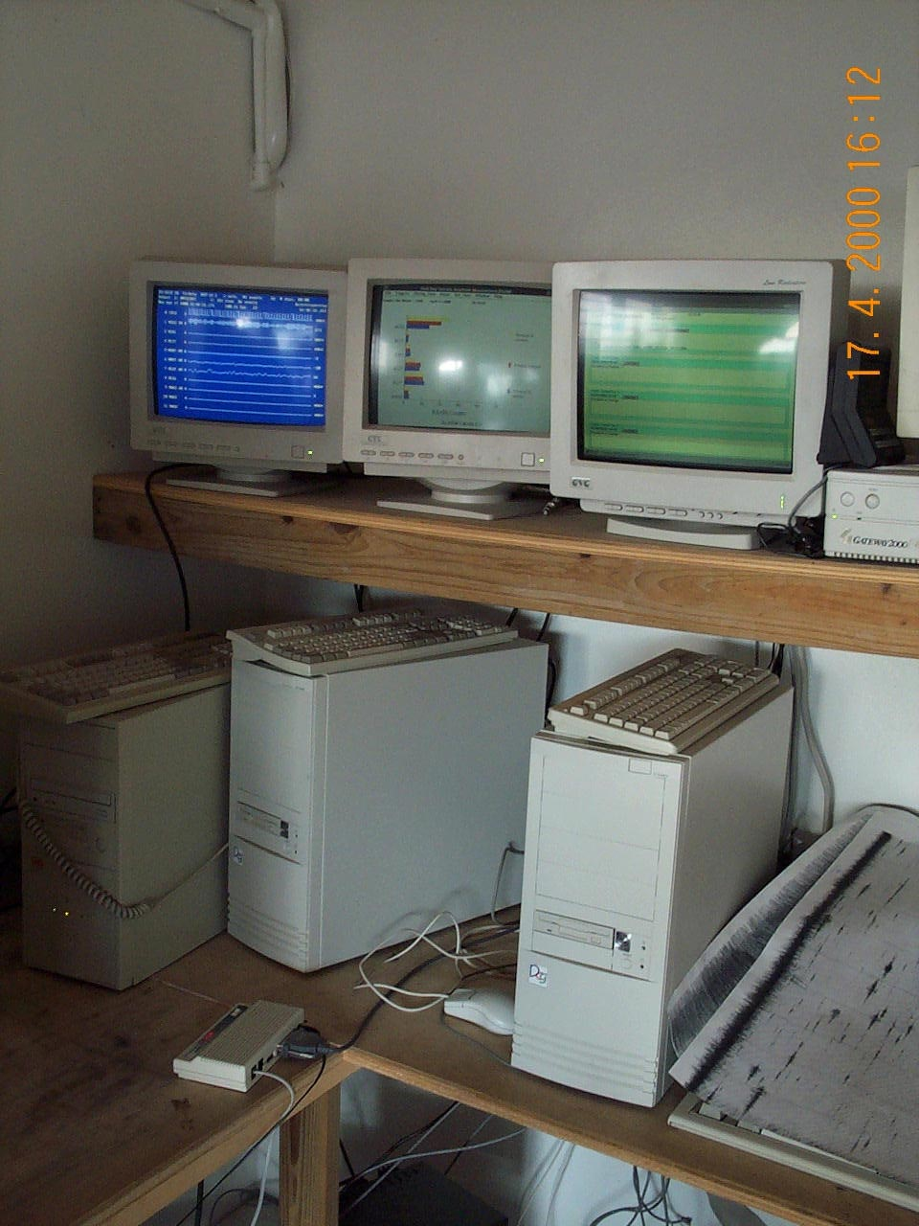
SPN Data Acquisition
No networking
PCSEIS DOS6 only, old PC
Floppy transfer, Drive filled up, data loss
RSAM computer froze frequently
Alarm algorithm wouldn’t call phones
TILT computer completely failed Y2K
No spare cards for PC-SEIS or RSAM

Slide 5
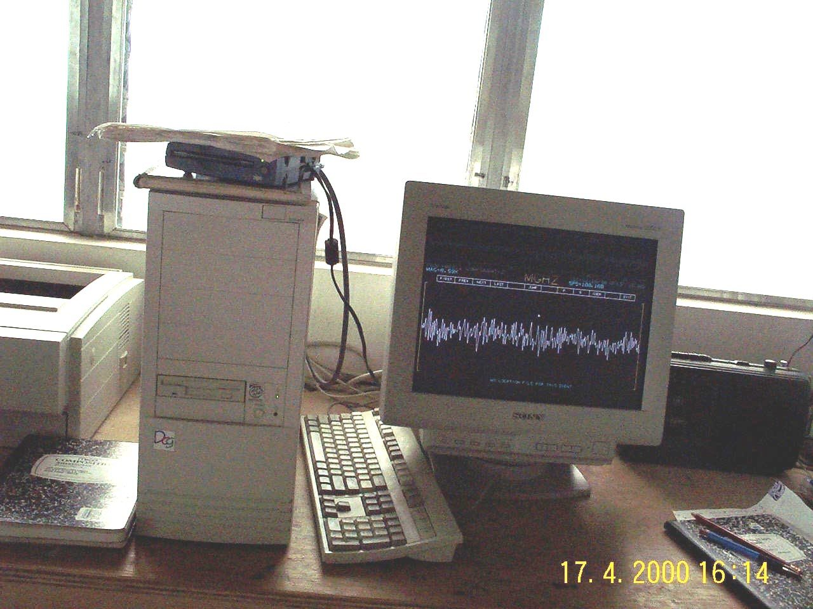
SPN data analysis
DOS/Win3
No network (floppy disk)
BOB useless
- No way to integrate data
No computer record of events (book)
Just counts and hypocentres
disorganised archival (to Zip,Tracker, CD

Slide 6
Digital seismic network
October 1996
Not designed for volcano-seismic monitoring
Off-line system for low-level earthquake monitoring (UK)
No real-time functionality (research community loved it)
Specialist OS/hardware not supportable on Montserrat

Slide 7
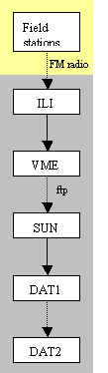
DSN data flow

Slide 8
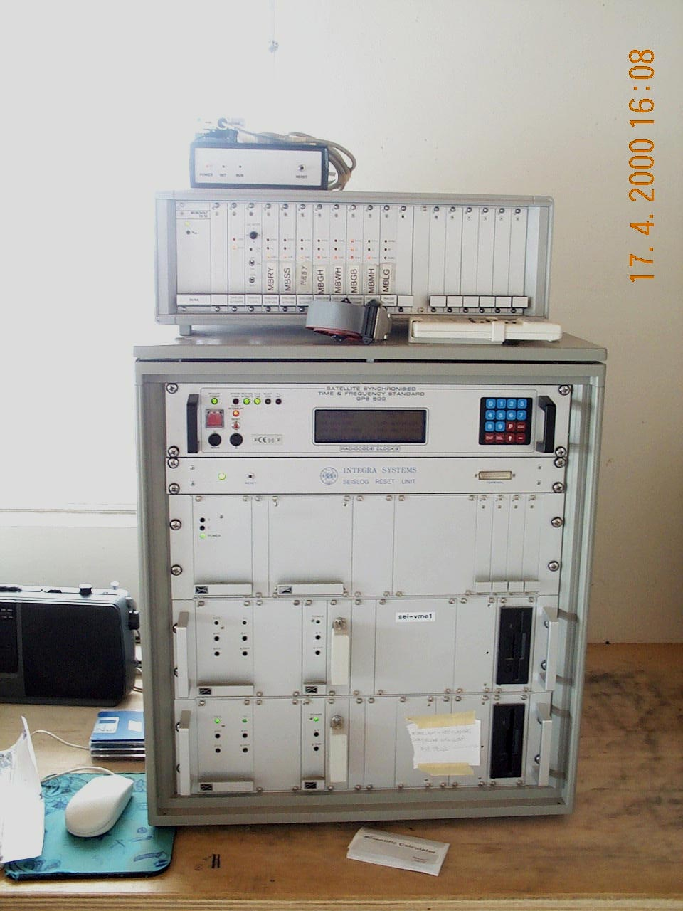
DSN data acquisition
Not Y2K compliant
Crashed up to 25 times a day
No terminal display
Specialist hardware and OS
No real time capability

Slide 9
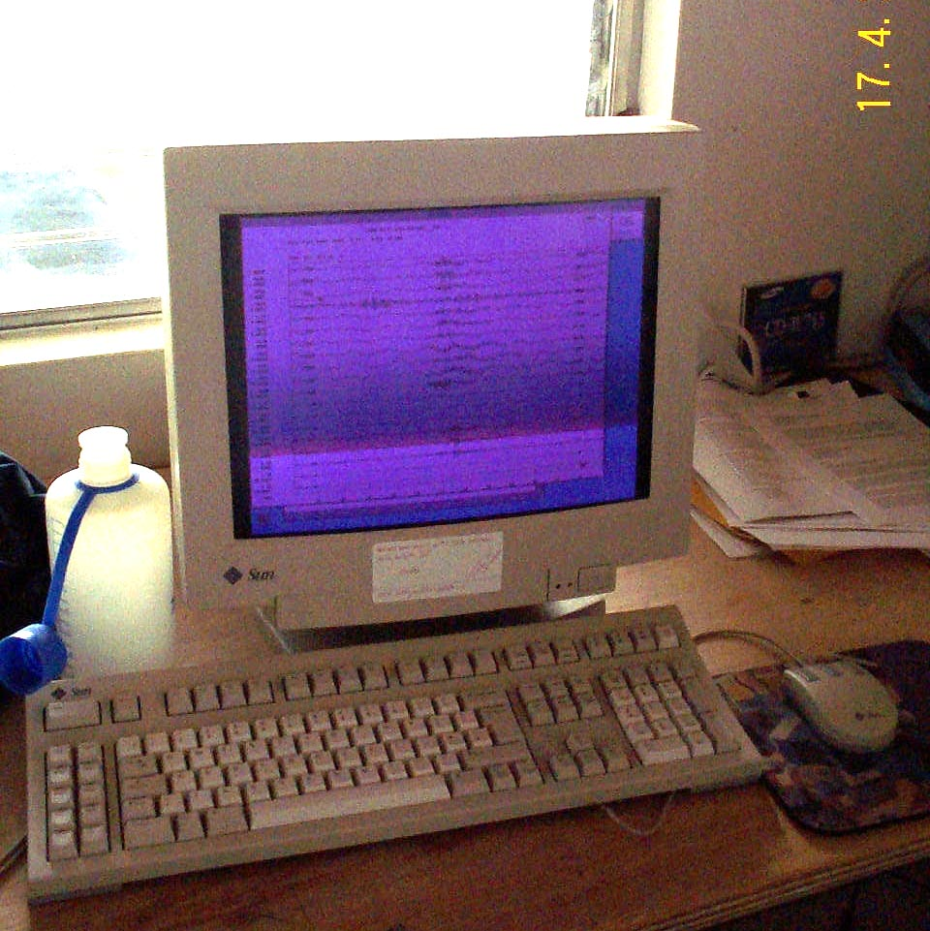
DSN Data Analysis
SEISAN (good, but slow, 200 events = 1 day)
Monitor unrepairable
Just 2 GB hard drive space
Just classifying & counting events
No SAMBA networking (or printing)
Can’t locate events

Slide 10
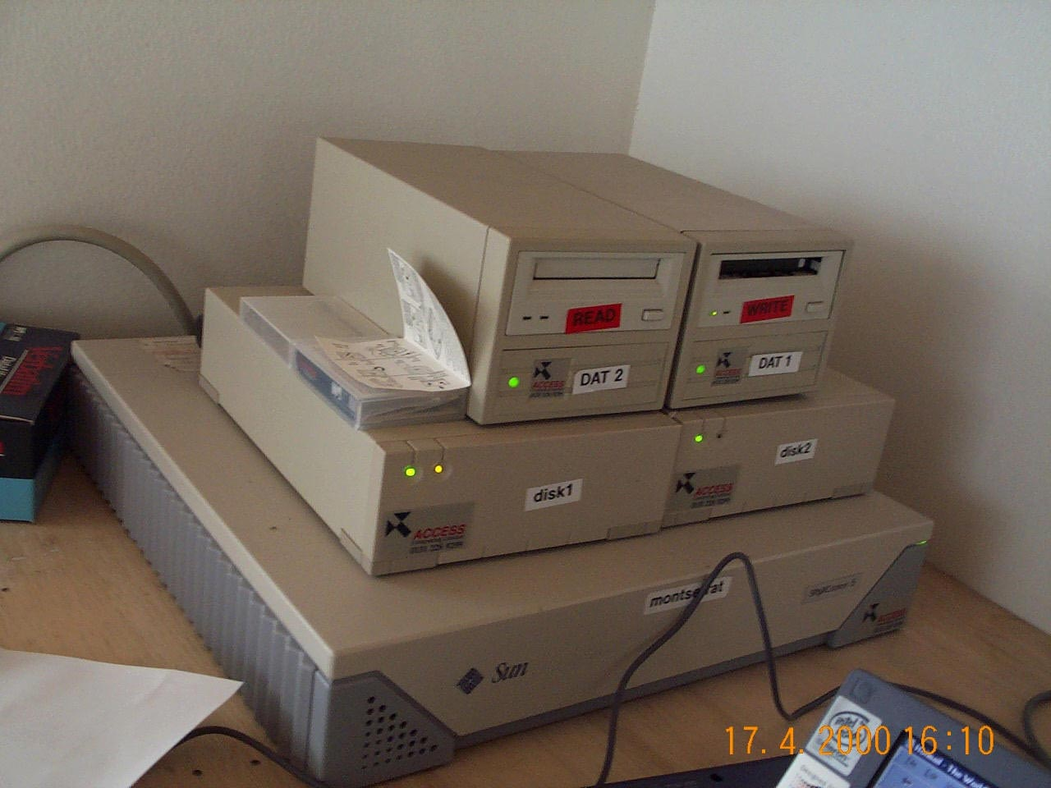
DSN Data Archival
Poor algorithm
No check if tape present
No forward to end of tape
No verify
No verify if tape was DDS (Art bought music DAT – no data)
Ailing hardware
50% data loss

Slide 11
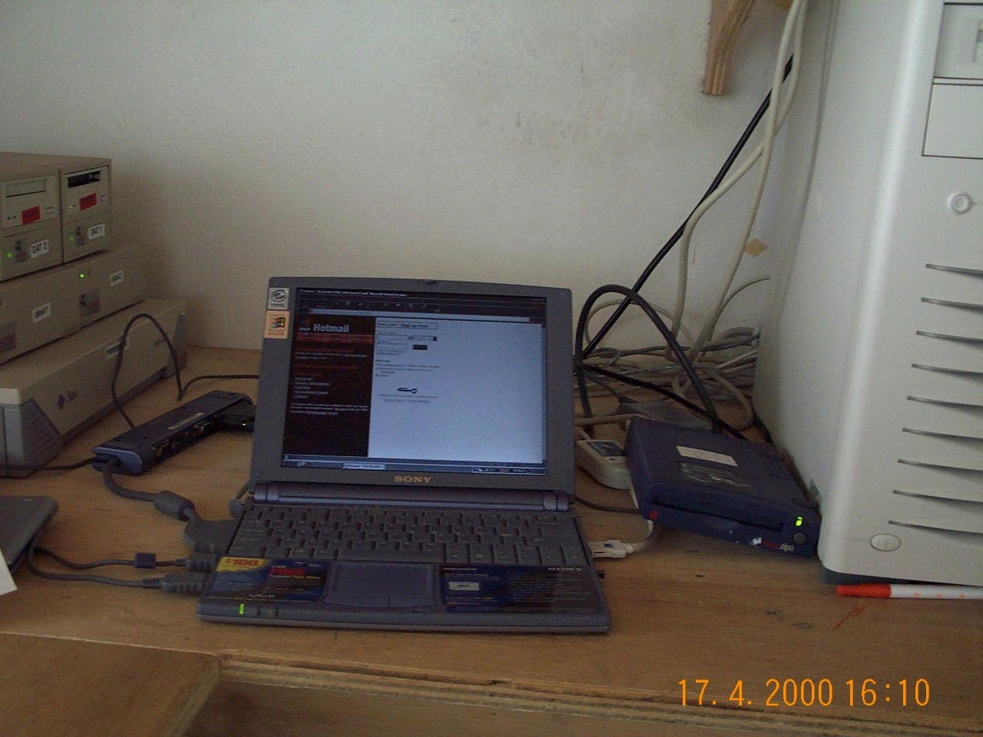
Better data analysis
Personal laptop (no funding, Art’s experience)
Personal zip drive
Matlab licence (from UAF)
Tools to produce spectrograms, counts, energy, Dr, hypocentre plots, plot RSAM and TILT data
Tools to automate reports

Slide 12
Computer network
OS9 / Solaris (DSN, 1996)
Windows NT
SPINE
Business
VME
ftp
GAS
Sun
Photo
Printer
DOS / Win3.1
(ASN, 1995)
PCSEIS
Director
RSAM
Brains
Laptop
TILT
GPS

Slide 13
Capabilities
Helicorders & RSAM (no nighttime monitoring!)
Event classification, few locatable (slow, two separate systems)
Daily counts (but remember 50% data loss)

Slide 14
Integrated monitoring & research?
Other monitoring (the “Bubble”):
COSPEC (Excel = laborious)
GPS
Photogrammetry
Previously:
BOB
Weekly meetings (present & discuss data / observations)
Problems:
Sitting on data (stealing)
BGS pigeon holing (seismologists just need to watch drums)
Physical separation (“seismologists don’t need to leave Ops Room”)
No online databases (no storage capacity)
DFID instructions (no pay for research)
No Matlab (GMT only)

Slide 15
Other problems
Seismology seen as a solved problem
Scientists without monitoring experience / focused on research rather than monitoring (lack of infrastructural development, seeing the big picture)
BGS very hierarchical (managers can’t be wrong)
Management perception of Montserrat being a luxury Caribbean vacation
Saving budget = promotion
No familiarity with monitoring earthquakes / volcanoes
BGS internal politics (Seismology vs. International)
BGS / GoM / DFID politics (dealing with staff)
Intimidating senior technician, undermining the monitoring (taking live computers!), threatening and abusing staff, empire building / undermining authority, doing nothing

Slide 16
…and
Dome had begun erupting again November 1999
Getting quite big by January 2000
Funding cuts following March 1998, staff downsized, reliance on alarm systems rather than 24 hour staffing
RACE AGAINST TIME TO PUT IN PLACE ROBUST, 24hr, SEISMIC ACQUISITION & ALARM SYSTEMS

