Slide 1

1. ALARM SYSTEMS
RSAM alarms
MVO volcano alarms
MVO diagnostic alarms

Slide 2
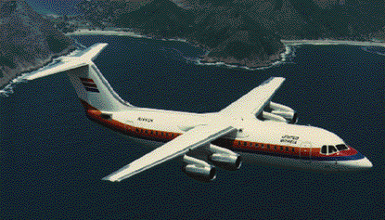
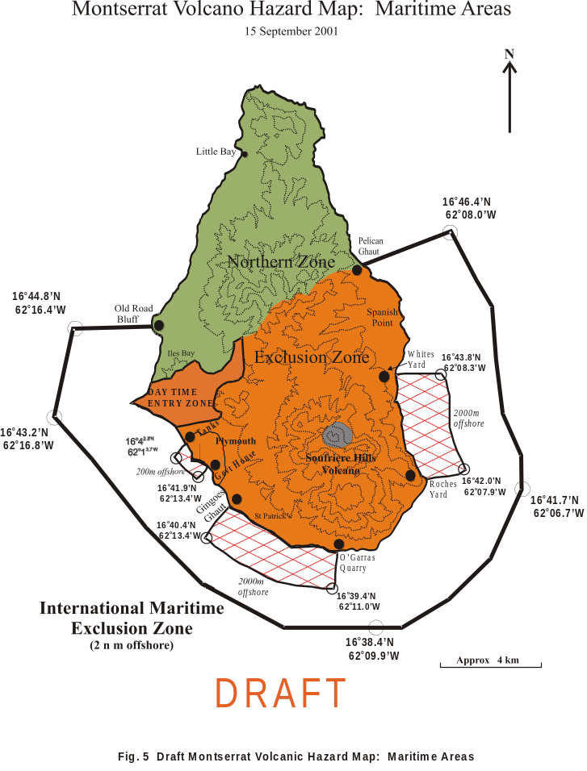
Motivations - Hazards
Population
Aviation
Gallunggung, Indonesia
Pinatubo, Phillipines
Sakurijima, Japan
Pacaya, Guatemala
Galeras, Columbia
Hudson & Lascar, Chile
Augustine, Redoubt & Spurr, Alaska
Nyamuragira, Zaire
Kluchychevskoi & Sheveluch, Russia
Manam, Papua New Guinea
http://www.geo.mtu.edu/department/classes/ge404/gcmayber/

Slide 3
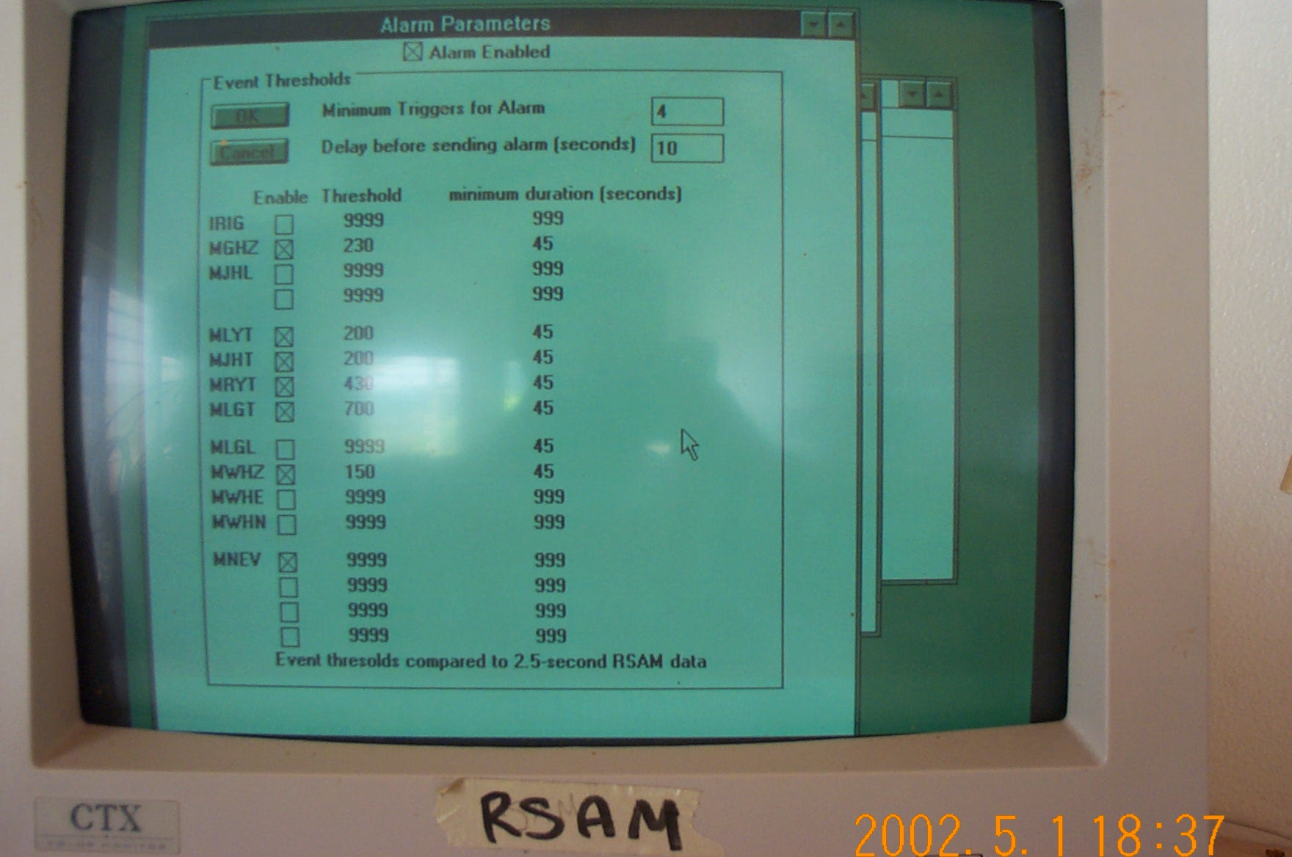
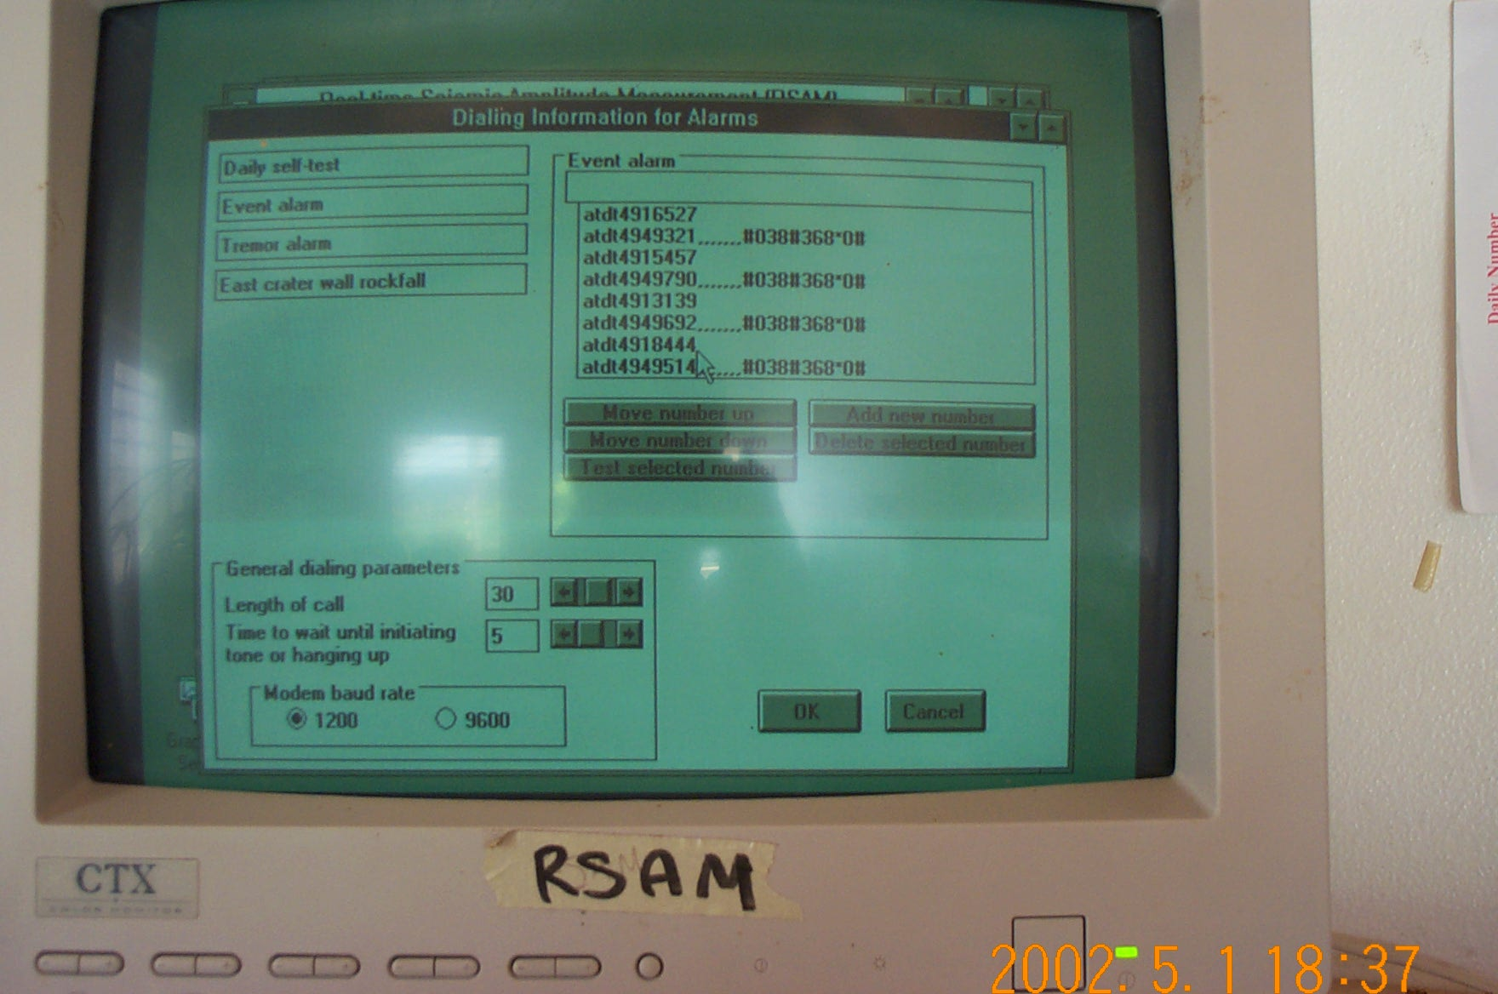
RSAM alarm
settings
Call down list
Alarm triggering
parameters
Only really reliable at calling pagers
Modem gets hung frequently
Fixed threshold

Slide 4
MVO Volcano Alarms
Motivation:
RSAM alarm system unreliable
First task to replicate RSAM system
Advantages:
Operates on digital and analog seismic network data
Rapid sending to pagers by C&W web server
Modem sending to telephones
Email sending to cell phones
Email Alarm Notifications (particularly in the Ops Room). Linked to digital camera images.
QNX
EarthWorm
1 minute rbuffers
1 minute rbuffers
Alarm triggering algorithm
Communication modules
alerts
DUTY SCIENTIST

Slide 5
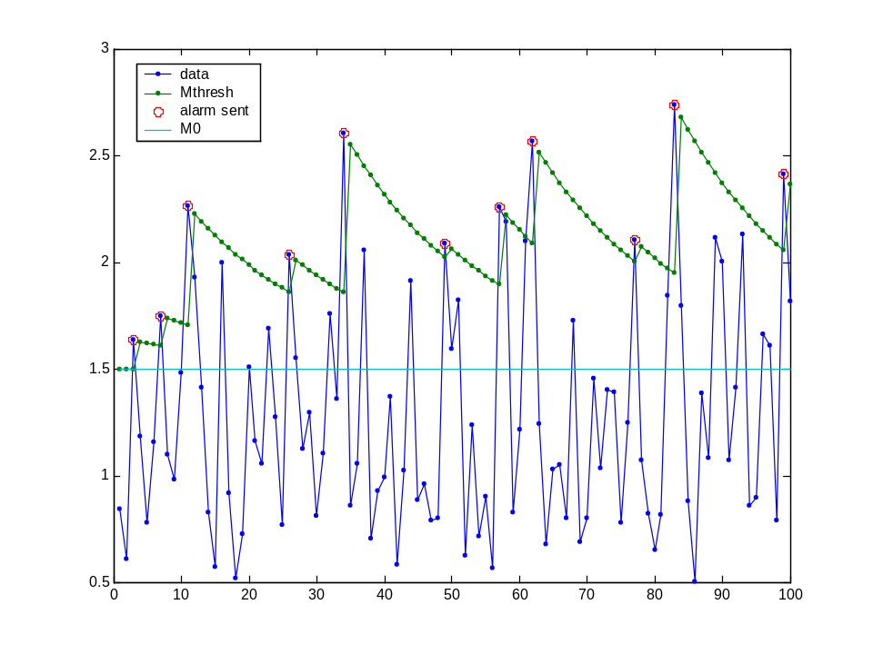
NEW MVO ALARM TRIGGERING ALGORITHM
Previous alarm triggering algorithms are all threshold-duration based
Problem is lots of alarms can be generated in rapid succession
Time-out period can be used, but not desirable if seismicity increasing
Plan is to use an “exponentially falling” alarm threshold instead. Threshold depends on recent seismicity and reflects “interest”. Alarm less sensitive immediately after an alarm, and gradually regains sensitivity.
Will use network magnitude – insensitive to changes in the network.
where
M_{thresh} = magnitude at which alarm will be sent (computed by algorithm)
M₀ = lowest magnitude at which to send an alarm (set by user)
M_{alarm} = magnitude at which last alarm was sent (save & load this)
dt = time since last alarm was sent (computed by algorithm)
t₀ = recovery timescale (set by user)
Seismicity (sampled every X minutes) varying around a level below M0 with M0=1.5, t0=20X, X=1. Eleven alarms sent (28 with threshold-duration alarm).

Slide 6
DIAGNOSTIC ALARMS
Motivated by VME – need to know when acquisition systems crash
Use same communications modules as MVO Volcano Alarms (pagers, cellphones, email, telephones)
Sent to Seismologist’s pager and by email to Seismologist, Software Engineer and Ops Room
Diagnostic alarm messages include:
“SA24 unreachable”
“Alarm system is dead”
“No EW rbuffers”
“No EW events”
“No QNX events”
“Autobackup not working”
“Drives full –lockfiles in place”

Slide 7

Email Alarm Notification System
Its important that the Ops Room staff know about and can respond to any volcano alarms and diagnostic alarms sent by the Linux computer. There is now an email notification service, which will play an obvious sound every time a message arrives. To ensure this works, please ensure:
1. EarthWorm2 (Analyst) is running, and logged on as user “seisan”.
2. “Outlook” is running.
3. Speakers at the back of the Ops Room are turned to a high volume.
Alarm sound

Slide 8
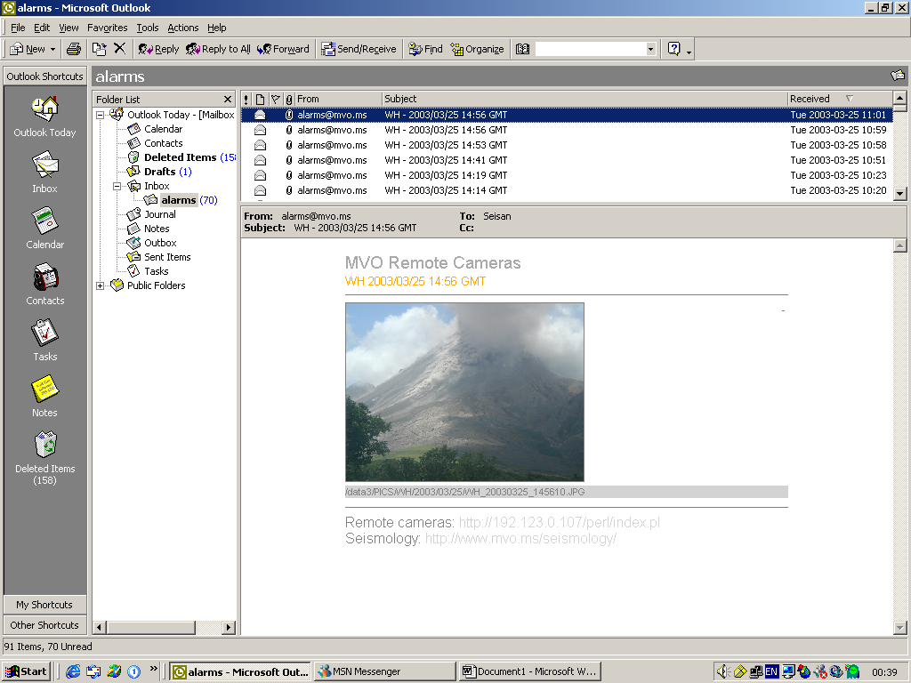

Slide 9
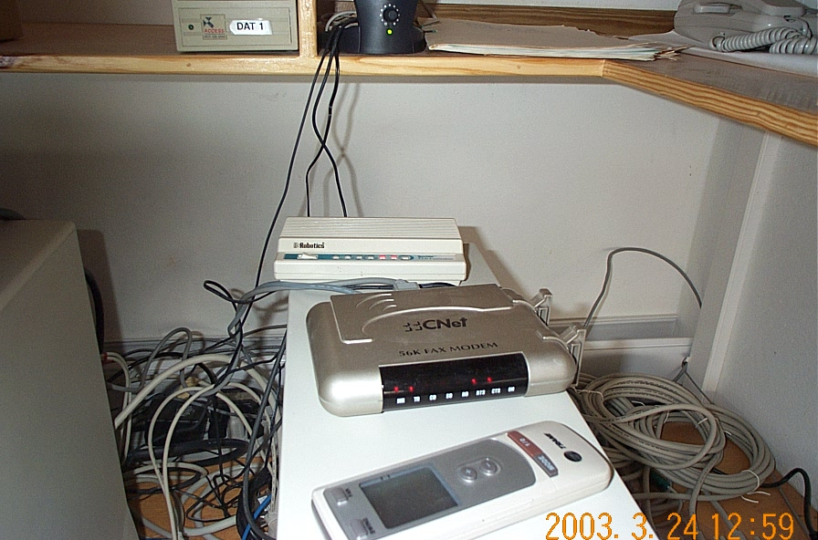
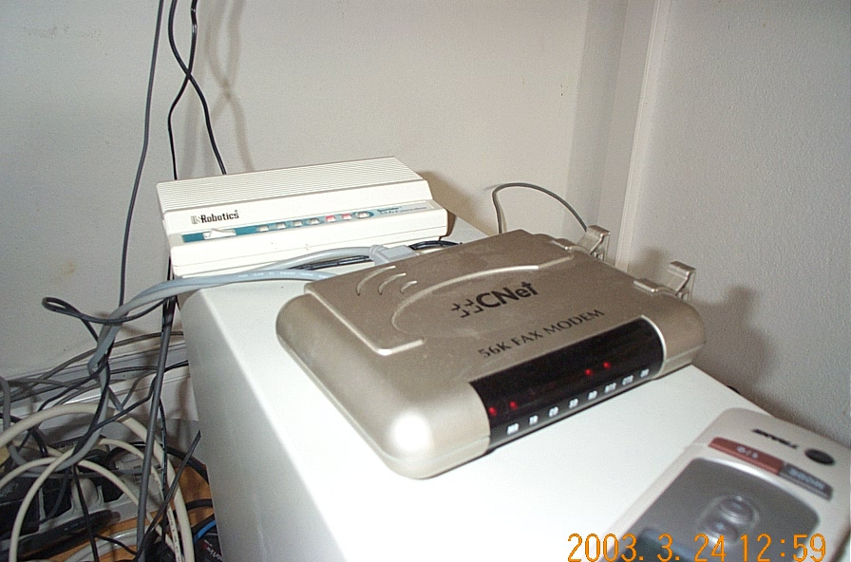
Alarm modems
RSAM
2 lights
SEISAN
4 lights

Slide 10
4. REMOTE MONITORING WEBPAGE
Motivations
Volcanic data
Diagnostic data

Slide 11
MOTIVATIONS
ALARM RESPONSE
- Quicker response to alarms
- Less tiring
EASY ACCESS TO SEISMIC DATA FOR ALL STAFF
ENCOURAGE INTEGRATED MONITORING & SCIENTIFIC DISCUSSION

Slide 12
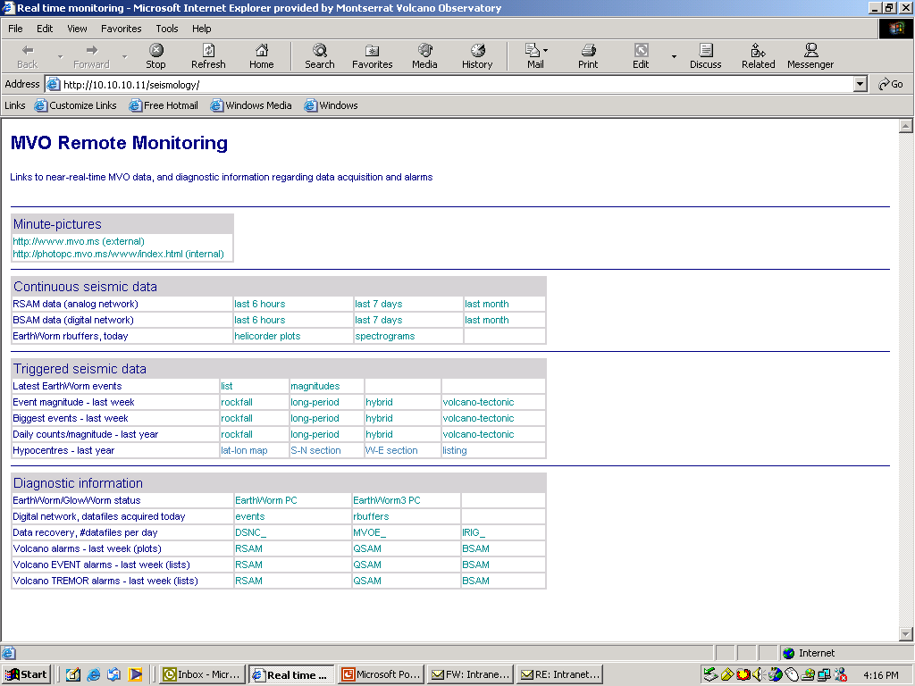

Slide 13
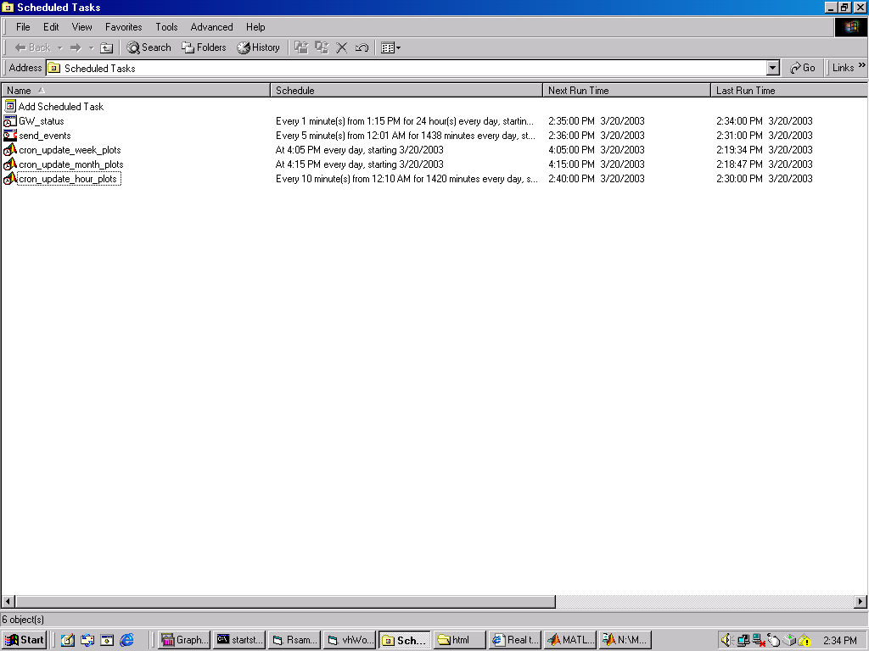
Scheduled Tasks on EarthWorm3

Slide 14
Remote Monitoring Webpage
VOLCANIC DATA

Slide 15
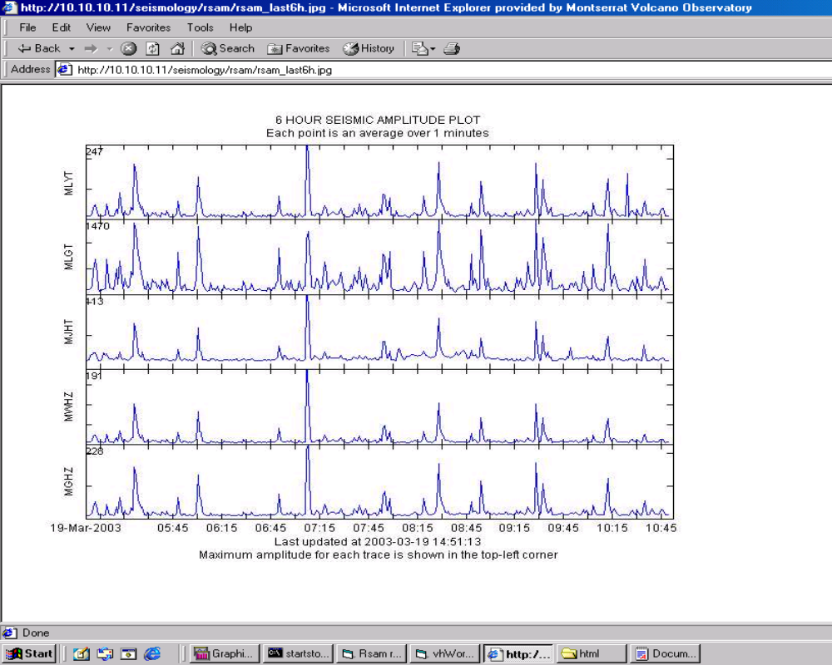

Slide 16
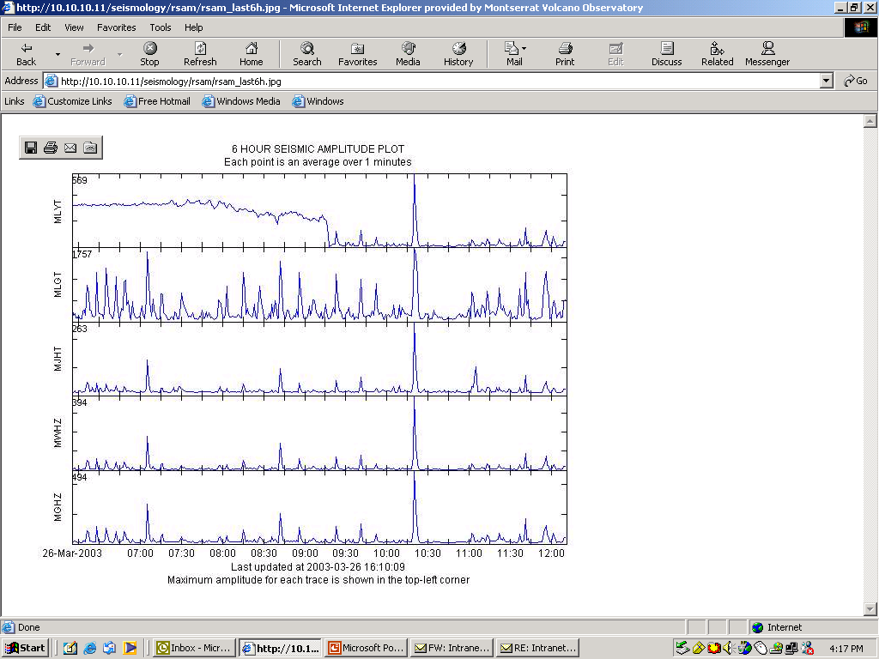

Slide 17
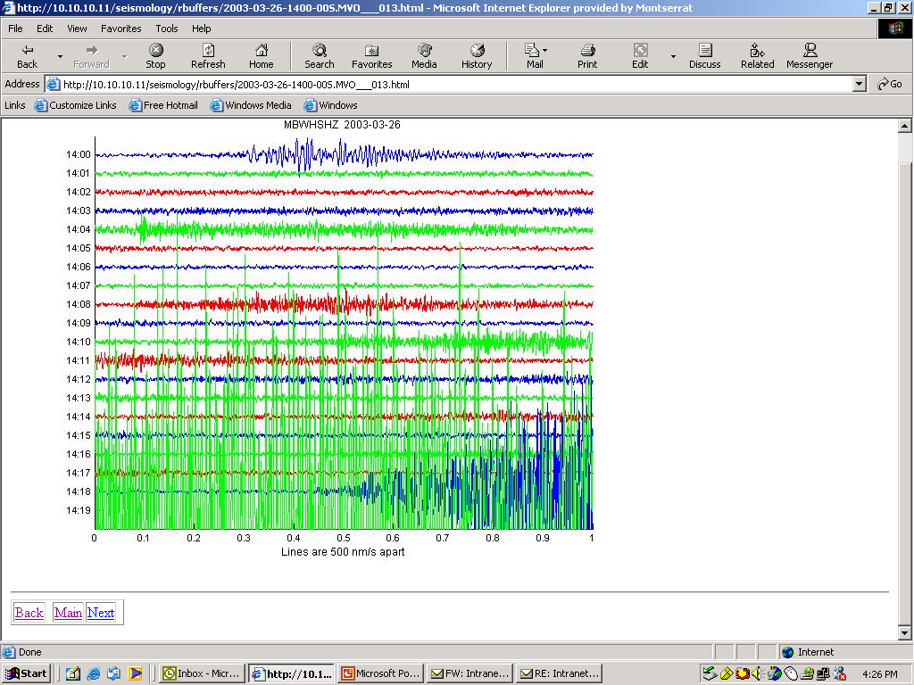

Slide 18
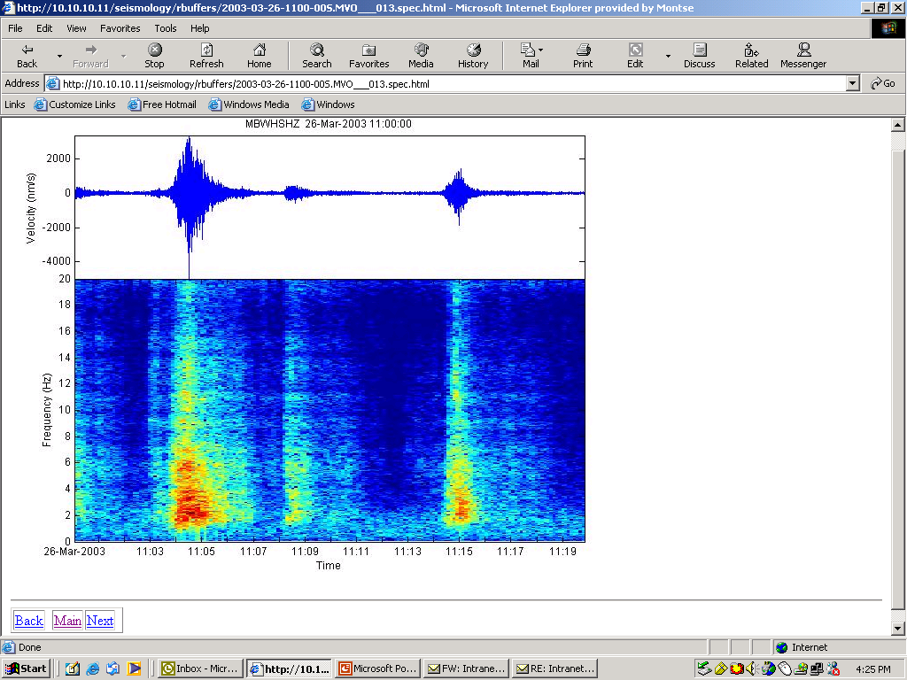

Slide 19
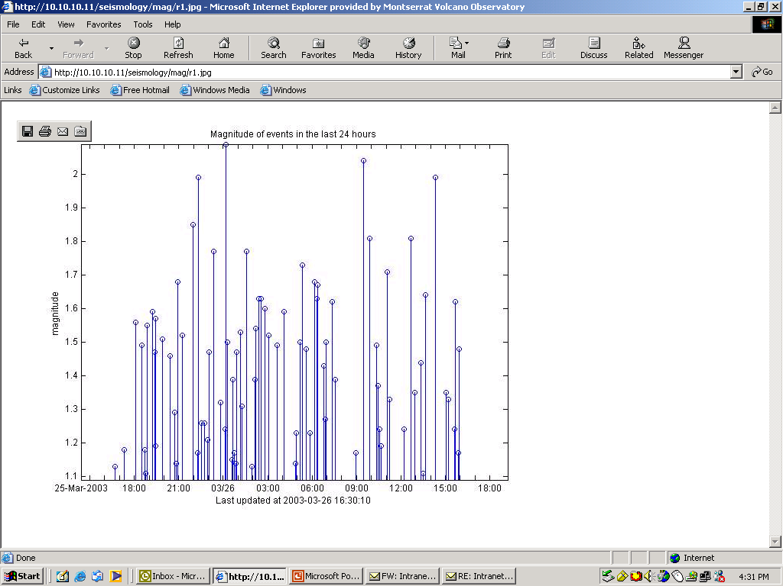

Slide 20
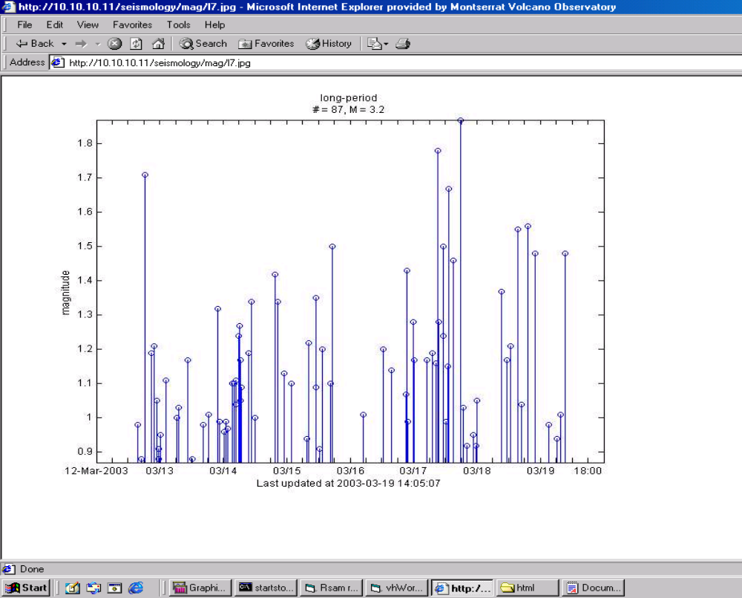

Slide 21
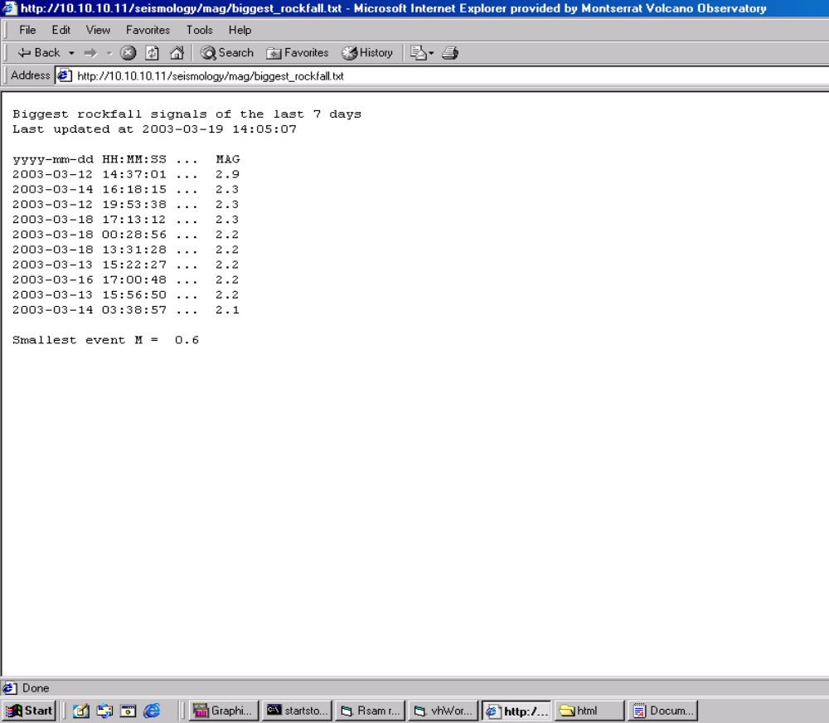

Slide 22
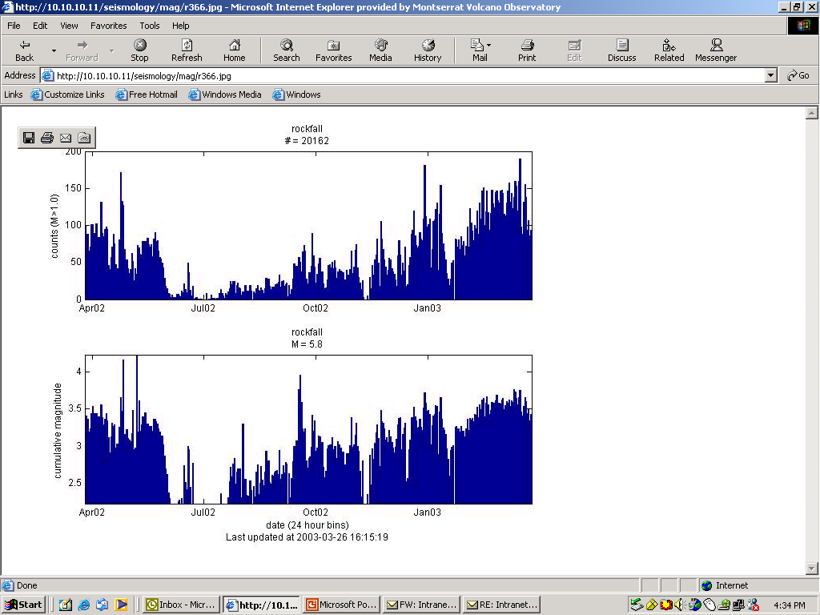

Slide 23
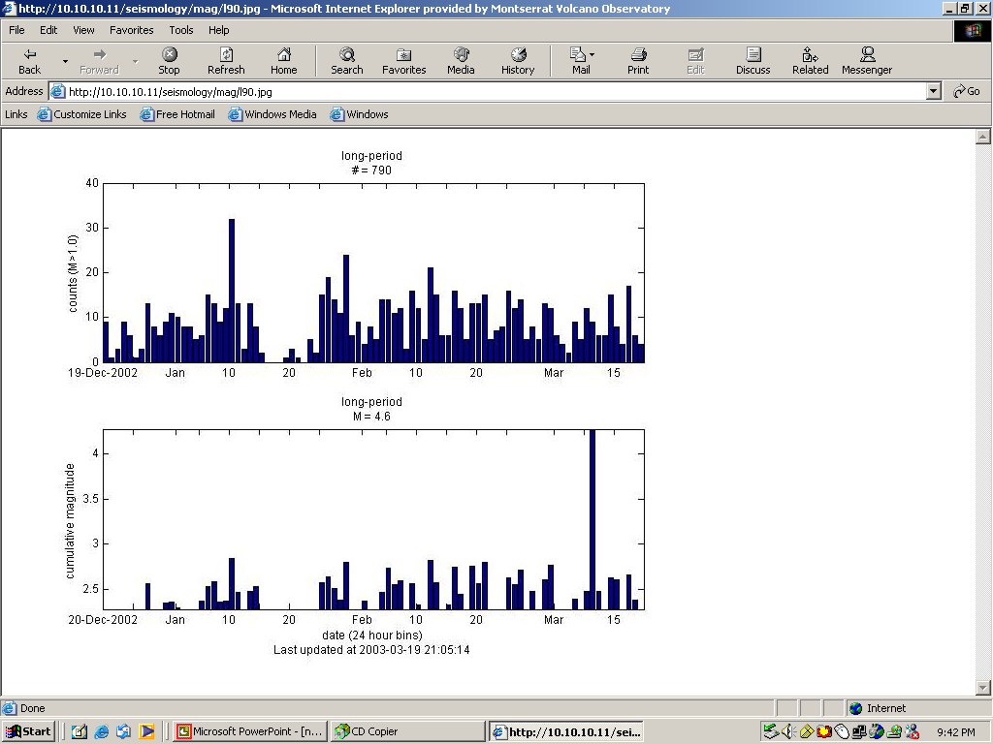

Slide 24
Remote Monitoring Webpage
DIAGNOSTIC DATA

Slide 25
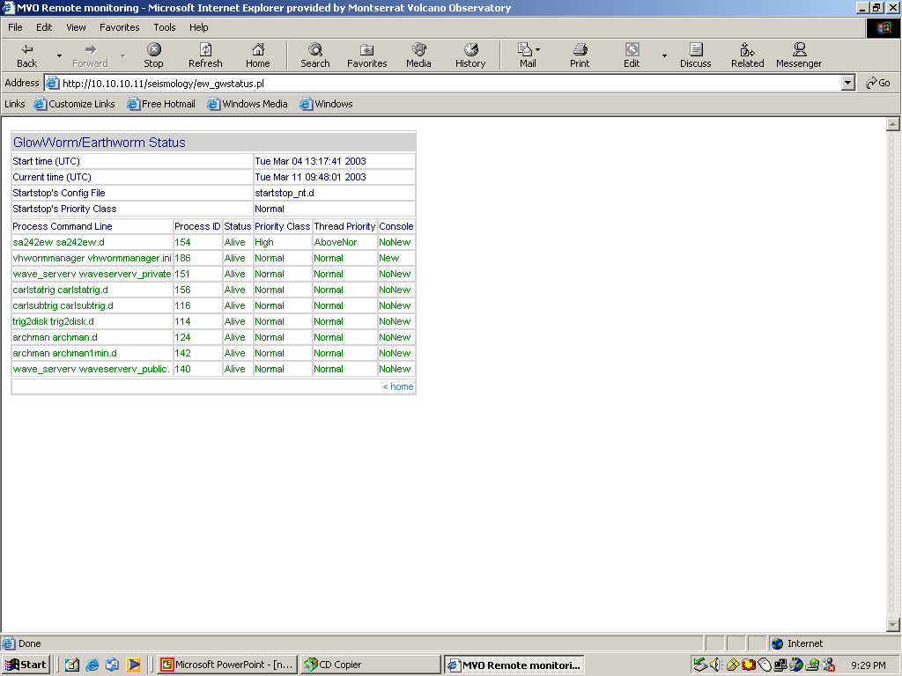

Slide 26
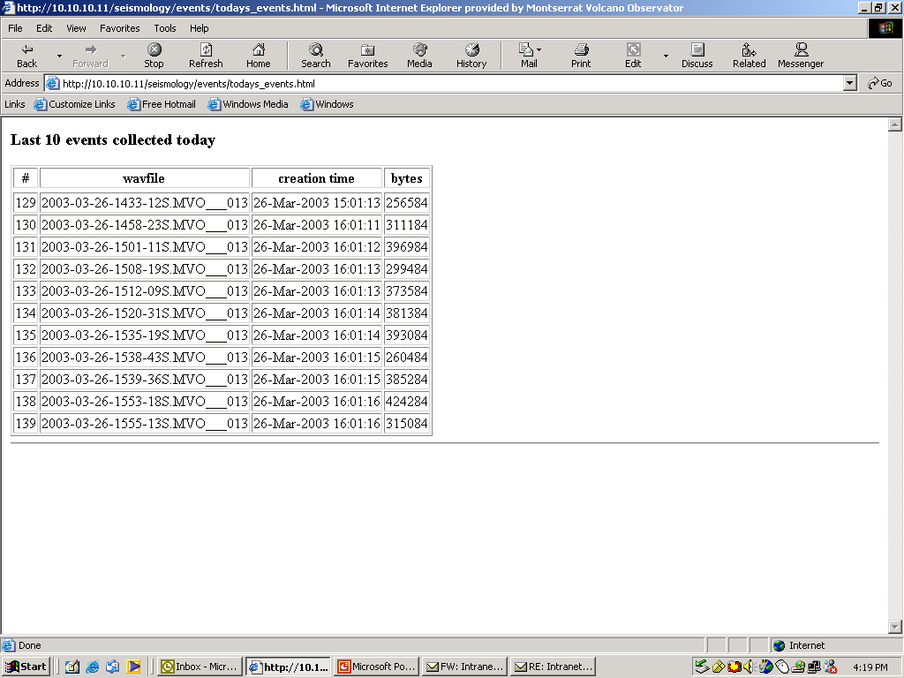

Slide 27
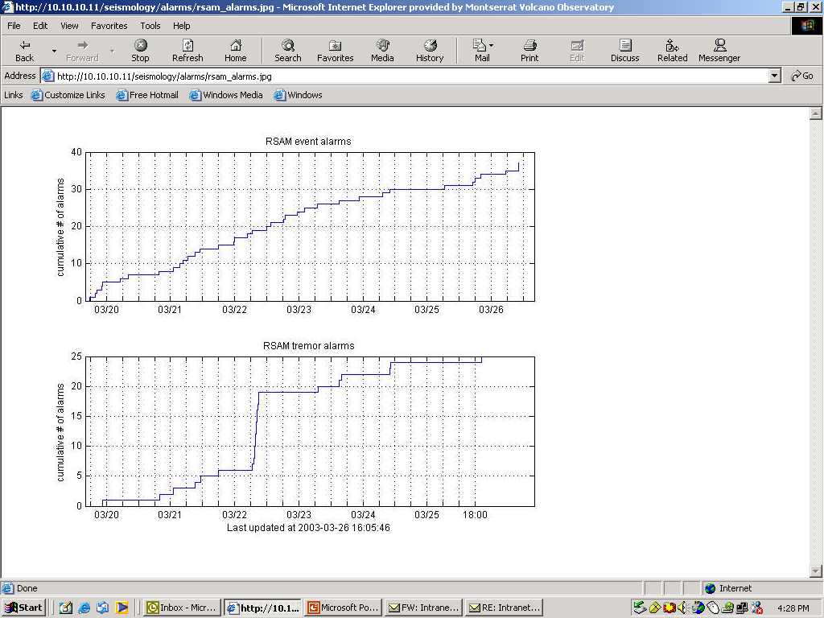

Slide 28
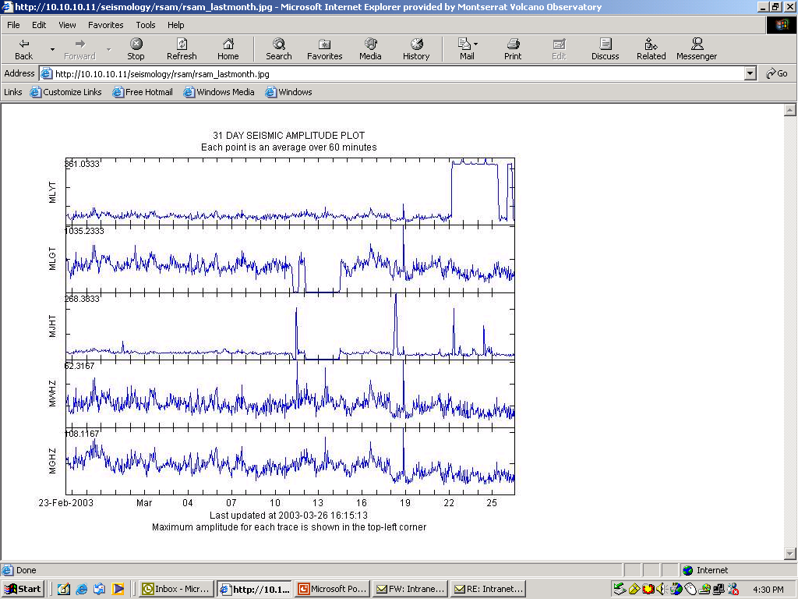

Slide 29
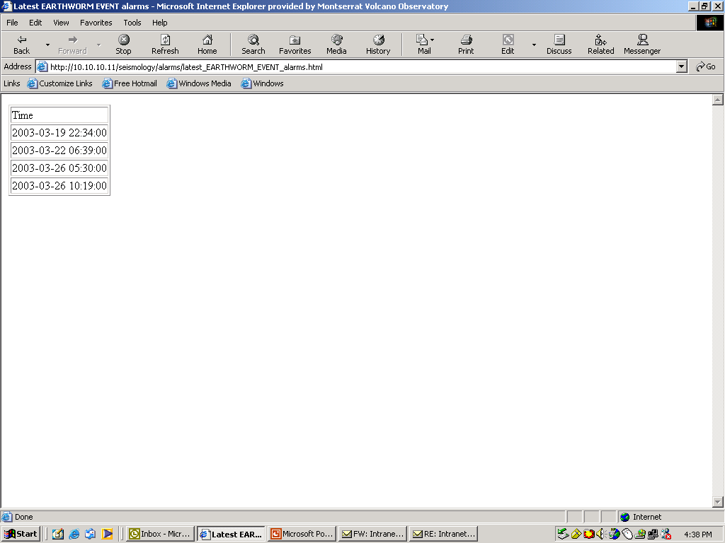

Slide 30
