Slide 1

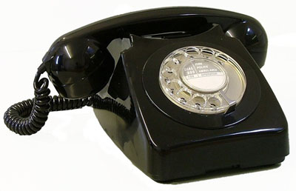
Real-Time
Event Catalog
Swarm Tracking
System
IceWeb
swarm alarm
tremor alarm
Alarm
Database
Generic
Alarm
Management
system
text/voice message
voice message

Slide 2
continuous
waveform
data
orbdetect
STA/LTA single station detector
orbassoc
orb
Associate detections into events & arrivals. Compute origins.
orb2dbt
Write detection, origin, arrival and magnitude information to database tables.
orbmag
Compute magnitudes.
Real-time
Event
Database

Slide 3
# Timewindow of data to check (minutes)
TIMEWINDOW 60
# Reminders will be sent about an
# ongoing swarm (minutes)
REMINDER_TIME 1440
# new alarm threshold
new_swarm &Arr{
mean_rate 16
median_rate 32
# mean_ml 1.0
# cum_ml 1.2
}
# significant change threshold
significant_change &Arr{
mean_rate_pcchange 50
median_rate_pcchange 50
# mean_ml_change 0.176
# cum_ml_change 0.176
}
Real-Time
Event
Database
Subset catalog for volcano and current timewindow
dbDetectSwarm
Read new_swarm and significant_change thresholds
Read information about
previous swarm alarm
(start, escalation, end?)
Parameter file for
dbDetectSwarm
Write information about
current swarm alarm
Alarm
database

Slide 4
stations &Arr{
DFR &Arr{
chan EHZ
threshold 0.3
}
NCT &Arr{
chan EHZ
threshold 0.3
}
RDE &Arr{
chan EHZ
threshold 2.0
}
REF &Arr{
chan EHZ
threshold 0.5
}
RDN &Arr{
chan EHZ
threshold 0.3
}
RDT &Arr{
chan EHZ
threshold 0.0
}
}
timewindow 60 # minutes
escalationRatio 3
triggers4alarm 4
continuous
waveform
data
Alaska
Master
Stations
Database
(AEIC)
computeDerivedData
D_{RS} data
Instrument
response
functions
& station
coordinates
detectTremor
Compare
against
thresholds
Read station and escalationRatio thresholds
Alarm
Database
IceWeb parameter file for Redoubt volcano

Slide 5
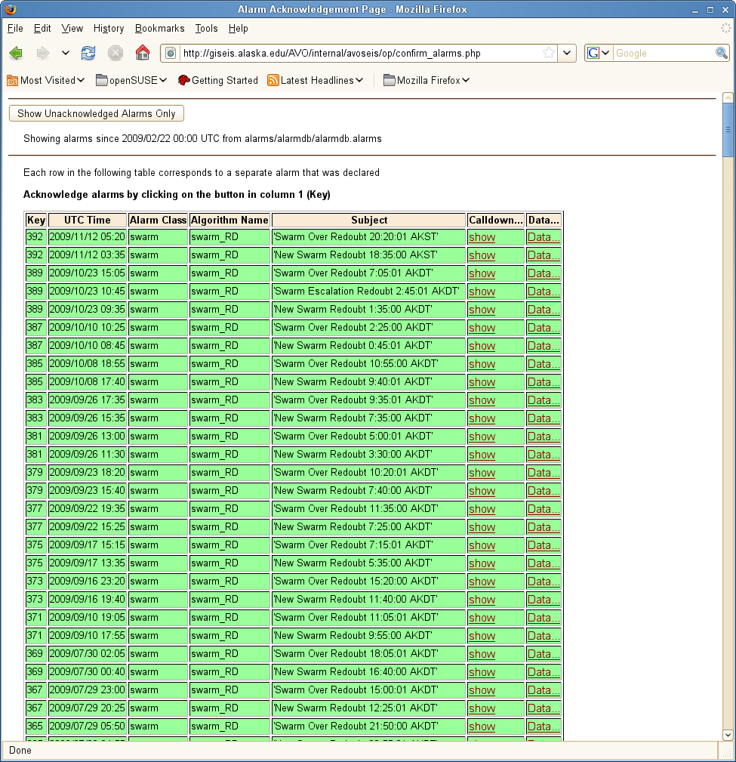
Alarm
Database
iceweb_tremor_Redoubt &Arr{
alarmclass tremor
recipients &Arr{
gthompson@alaska.edu
}
}
swarm_RD &Arr{
alarmclass swarm
recipients &Arr{
# Duty Seismologist – delay 0 s
9071234567@mms.att.net
# Voice Message – delay 300 s
seis_alarms@email2phone.net 300
# Scientist-In-Charge – delay 600 s
9071357913@msg.acsalaska.com 600
# Co-ordinating scientist – delay 750 s
9071470369@mms.att.net 750
# Duty Scientist – delay 900 s
9071593715@msg.acsalaska.com 900
}
}
New alarm?
Acknowledge
alarm
dbAlarmDispatch
Compare
against
thresholds
Call next recipient (if alarm not acknowledged yet)
email
email2Phone
text message
Parameter file for dbAlarmDispatch
Confirm
Alarms
Web page
recipient
responds
voice message

