Slide 1
Bully Button
Presenter: Guanyu Tian, Vikram Hegde

Slide 2

Problem: school bullying

Slide 3
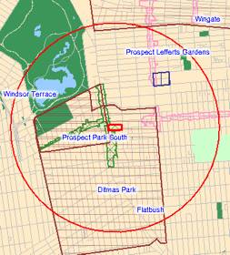
Solution: BullyButton
Assumption:
Every student has a smartphone: Android, iPhone, windows phone
High/middle school covered by Raspberry Pi 3
It consists of
A web server and MySQL database
Raspberry Pi 3
Programming languages:
HTML and PHP

Slide 4
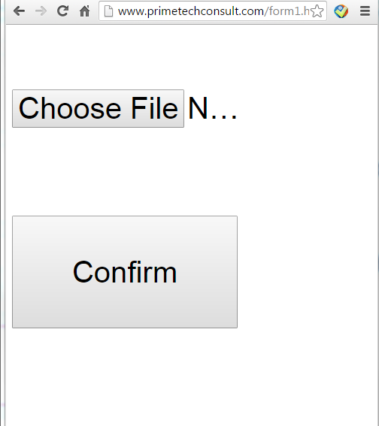
Bully Button
A user’s phone will discover the
nearest Raspberry Pi and then the user
will click it.
2. The phone will open its browser
and load the web page
3. User clicks the confirm button. Done!

Slide 5
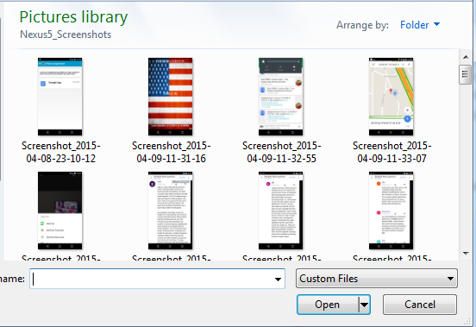
Upload Picture

Slide 6
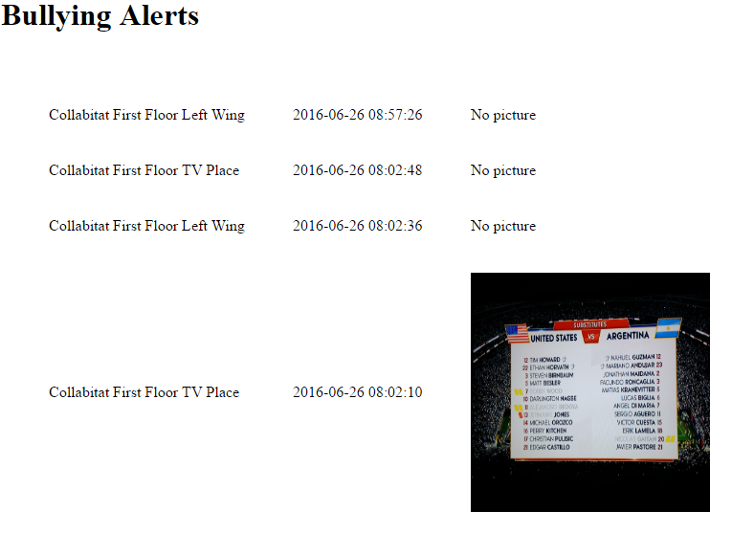
Security Guard Monitoring
The web page will refresh
automatically every 10 seconds.
Location, Time, Picture

Slide 7

Business Value
Cost for each school setup:
Each Raspberry Pi 3 costs $30
Its range is about 300 feet
1,000 Pi * $30 = $30,000
Monthly Income
1,800 students * $5 per month = $9, 000

Slide 8

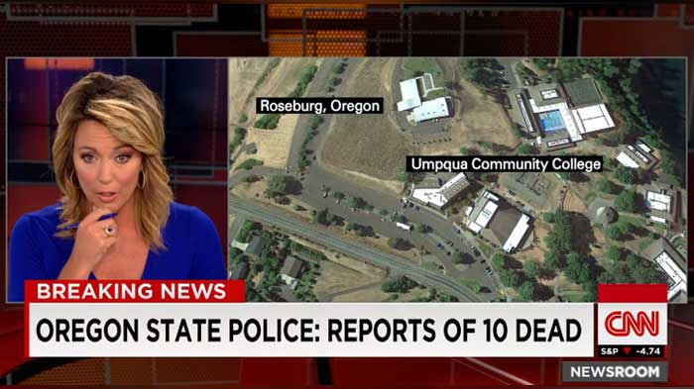
More than just Bully button
A student is locked in a restroom
A student is left in a school bus
A shooter on campus
It is limitless

Slide 9
Conclusion
Bully Button is a solution to mitigate or stop school bullying and make students feel safe
Live demo

