Slide 1

FISHY WATCH
When technology meets fish farmer needs in the digital world

Slide 2
Presented By “ARCHISQUAD”
Gaurav Tiwari
Praveen Kumar Mishra
Vartika Arora
Vartika Gupta

Slide 3
INDEX
Consumer Expectations
Fishy Watch Architecture Design
System Design
Gearing up to towards their smack stack in place
Fishy Watch Use Cases
Source: gettyimages.com

Slide 4
INDEX
Consumer Expectations
Fishy Watch Architecture Diagram
System Design
Gearing up to towards their smack stack in place
Fishy Watch Use Cases
Source: gettyimages.com

Slide 5
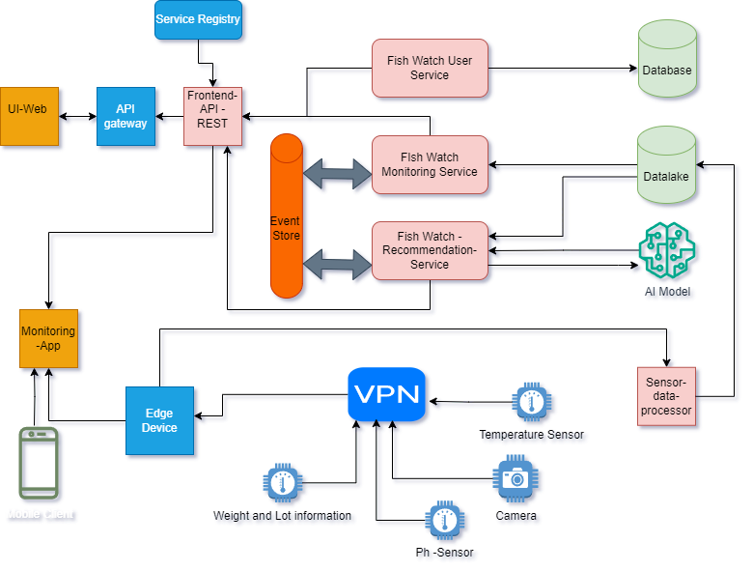
FISHY WATCH ARCHITECTURE DESIGN
Notes:
Speaker Notes:
As consumers continue to evolve, becoming more sophisticated and complex, so too are companies focusing on understanding what customers need and want. While clear answers are yet to surface, it’s apparent that there are business principles that are vital to the survival of consumer-based companies in the near future:
The rise of the ‘destination store’
Consumers demand a seamless, personalized experience that meets their needs. That means no matter the channel, consumers want to be able to browse and buy what they want, how they want, and when they want.
Consistent and personalized service includes flexible, efficient returns—across channels
- Convenience, flexibility and speed will be key as companies strive to provide consumers with a myriad of pickup and delivery options

Slide 6
INDEX
Consumer Expectations
Fishy Watch Architecture Diagram
System Design
Gearing up to towards their smack stack in place
Fishy Watch Use Cases
Source: gettyimages.com

Slide 7
GEARING UP TO TOWARDS GETTING THEIR SMACK STACK IN PLACE
Other Consumer Engagement Channels
In bound Order Capture Channels
Search Engines
Other Apps
e-mail & SMS
e comm
Marketplaces
App
Social Commerce
Fish Watch Model
pH sensor | Weight & Lot Information | Edge Computing | Camera
Monitoring Engine
Call Center System
Historic Data Records
Sensors (IoT) Processing System
Alerts Engine
Web Application
Data Lake
Edge Devices
VPN
AI Recommendation Engine
Mobile App
Consumer Data Platform
CRM
Illustrative
Social
Mobile
Analytics
Cloud
Consumer Facing Tech

Slide 8
FISHY WATCH USE CASE - 1
Title: Edge Device with Private network
Status: Accepted
Context: Unavailability of cellular networks at farm locations.
Decision: With edge device, all the sensors connected with private network through which user can get real time(live data) information despite of unavailability of cellular network.
Consequences: Cost of edge devices.

Slide 9
FISHY WATCH USE CASE - 2
Title: Data lake
Status: Accepted
Context: To store all sensors and monitoring data which will be further used by AI model.
Decision: To create data lake repository to store different sensor data.
Consequences: Technical challenges to setup data lake rather than using RDBMS.

Slide 10
FISHY WATCH USE CASE - 3
Title: AI Model
Status: Accepted
Context: Provide recommendation to farmers for health monitoring & optimal harvesting.
Decision: Collect data from data lake and AI model will provide recommendation to farmers.
Consequences: Cost of model setup.

Slide 11


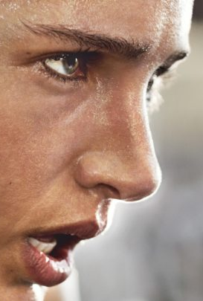
Thank You
“No one person knows all the information in the world. To find the right answers, you must ask the right questions” - Unknown
Source: gettyimages.com

Slide 12
END OF PRESENTATION

